Slide 1
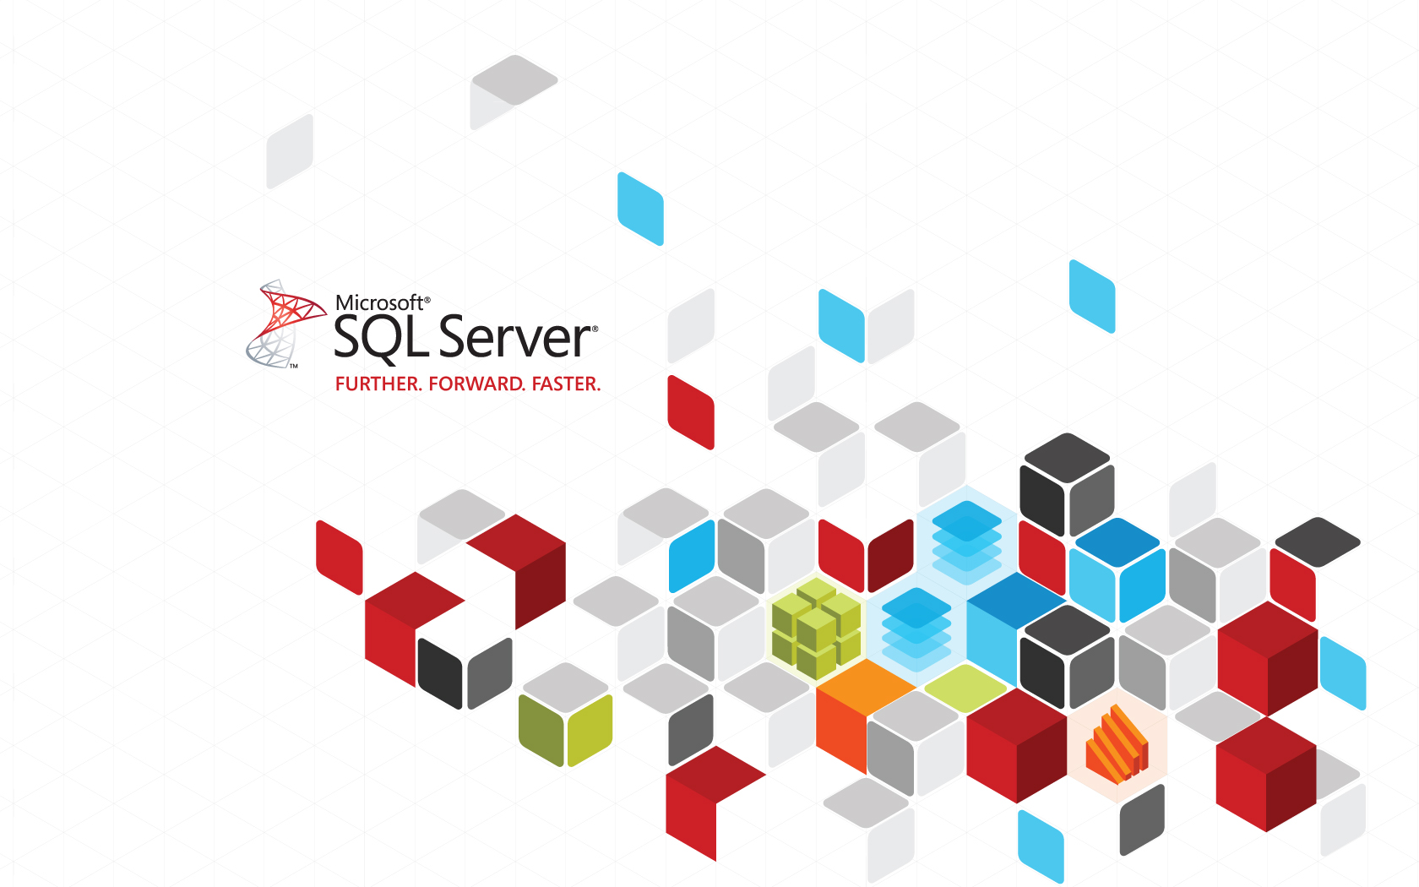

Slide 2
SQL Server
Microsoft SQL Server is a relational database management system (RDBMS) developed by Microsoft.
SQL Server 2012 comprises a set of programming extensions to enhance the Structured Query Language (SQL), a standard interactive and programming language for getting information from and updating to a database.
It is a software product with the primary function of storing and retrieving data as requested by other software applications which may run either on the same computer or on another computer across a network (including the Internet).

Slide 3
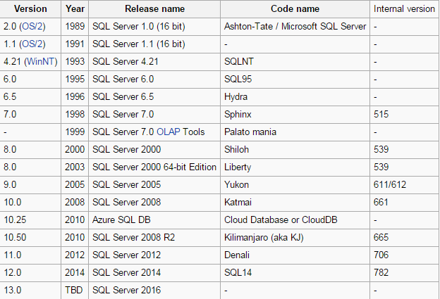
SQL Server 2014 is Microsoft’s latest cloud-ready information platform
SQL Server release history

Slide 4
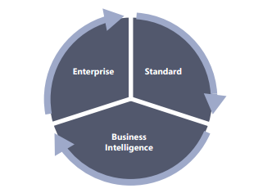
SQL Server 2012 Editions
SQL Server 2012 is obtainable in three main editions

Slide 5
Enterprise Edition
The Enterprise edition of SQL Server 2012 is the uppermost SKU; it is meant to meet the highest demands of large-scale datacenters and data warehouse solutions
Standard Edition
The Standard edition is a data-management platform tailored toward departmental databases and limited business-intelligence applications that are typically appropriate for medium-class solutions, smaller organizations, or departmental solutions.
Business Intelligence Edition
The Business Intelligence edition offers organizations the full suite of powerful BI capabilities such as scalable reporting and analytics, Power View, and PowerPivot

Slide 6
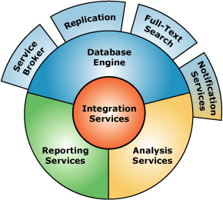
SQL Server Components

Slide 7
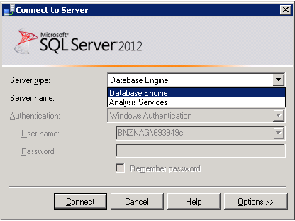
SQL Server Components(Contd.)
Database engine:
Provides support to store, query, process, and secure data on the database server.
Allows you to create and manage database objects, such as tables.
Provides the following background services:
Service broker
Replication
Full-text search
Notification services

Slide 8
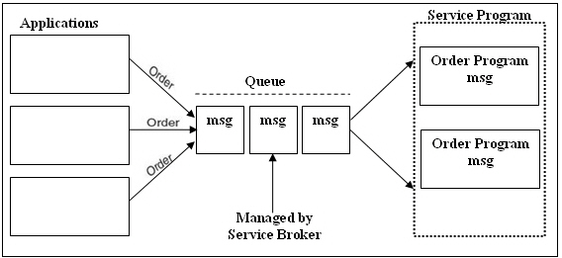
SQL Server Components(Contd.)
Service Broker:
Provides support for asynchronous communication between clients and the database server.
Enables reliable query processing.
The following figure shows an example of order processing system

Slide 9
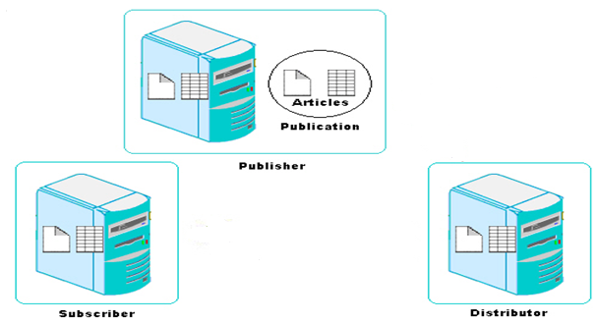
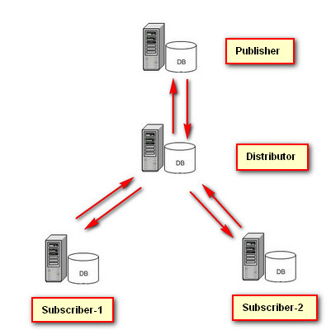
SQL Server Components(Contd.)
Replication:
Allows you to copy and distribute data and database objects from one database server to another.
The following figure shows an example of order processing system.

Slide 10
SQL Server Components(Contd.)
Full-text search
Allows you to implement fast and intelligent search in large databases.
Notification services
Allow you to generate and send notification messages to the users or administrators about any event.
Allow developers to build notification applications that send timely, personalized information updates, helping to enhance customer relationships.

Slide 11

SQL Server Components(Contd.)
Integration services:
These services allow you to gather and integrate the varied data in a consistent format in a common database called the data warehouse.
A data warehouse is similar to a physical warehouse that stores raw material or products for further distribution.
The SQL Server Integration Services (SSIS) Import and Export Wizard helps you to complete the process of selecting the data source, the destination, and the objects that will be transferred to create a data warehouse.

Slide 12
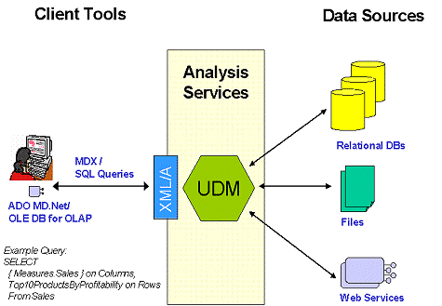
SQL Server Components(Contd.)
Analysis services:
These services help in data analysis in a BI application.
Microsoft SQL Server Analysis Services (SSAS)
Provides Online Analytical Processing (OLAP) for BI applications.

Slide 13
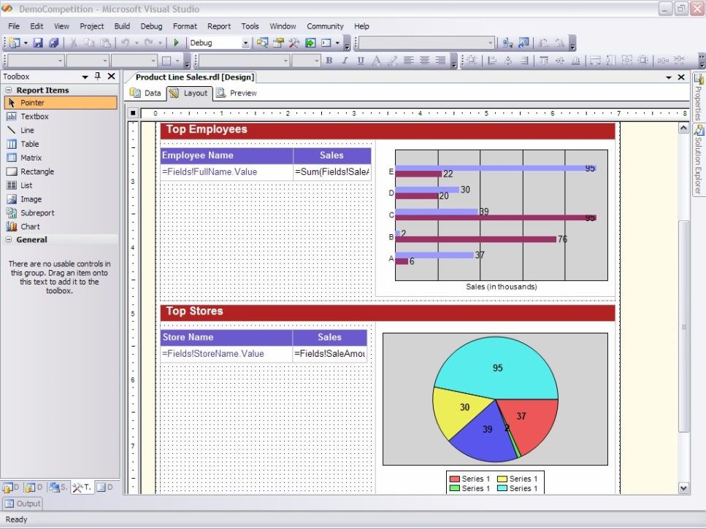
SQL Server Components(Contd.)
Reporting services:
These services provide support to generate complete reports on data in the database engine or in the data warehouse.
These services provide secure and restricted access to these reports.
Microsoft SQL Server Reporting Services (SSRS)
Helps in creating Web-based reports that is based on the content stored in a variety of data sources.

Slide 14
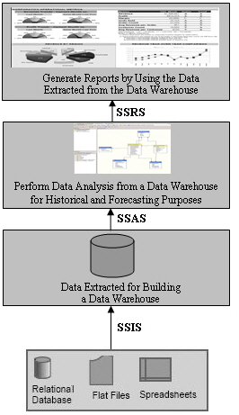
SQL Server Components(Contd.)
The following figure shows the usage of the various SQL Server core components in a BI application.

Slide 15
SQL Server Integration with the .NET Framework
Microsoft SQL Server is integrated with the .NET Framework.

Slide 16
SQL Server Integration with the .NET Framework (Contd.)
The following figure shows the integration of SQL Server with the .NET Framework.
.NET Framework
Database Engine
Service Broker
Replication
Full-Text Search
Notification Services
Integration Services
Analysis Services
Reporting Services

Slide 17
SQL Server Integration with the .NET Framework (Contd.)
The .NET Framework:
Is an environment used to build, deploy, and run business applications.
Has its own collection of services and classes.
Consists of the following components:
Development tools and languages
Base class library
Common Language Runtime (CLR)

Slide 18
SQL Server Integration with the .NET Framework (Contd.)
Development tools and languages:
Are used to create the interface for the Windows forms, Web forms, and console applications.
Base class library:
Provides classes that can be used in the code to accomplish a range of common programming tasks, such as:
String management
Data collection
Database connectivity
File access

Slide 19
SQL Server Integration with the .NET Framework (Contd.)
CLR:
Provides an environment for the application to run.
Provides the following features:
Automatic memory management
Standard type system
Language interoperability
Platform independence
Security management

Slide 20
Features of SQL Server
SQL Server provides the following features:
Built-in support for Extensible Markup Language (XML) data
CLR integration
Scalability
Service-oriented architecture
Support for Web services
High level of security
High availability
Support for data migration and analysis
Intellisense
Policy-based management
Resource governor

Slide 21
Foundations of T-SQL
T-SQL is the main language used to manage and manipulate data in Microsoft’s main relational database management system (RDBMS), SQL Server—whether on premises or in the cloud (Microsoft Windows Azure SQL Database).
SQL Server also supports other languages, like Microsoft Visual C# and Microsoft Visual Basic, but T-SQL is usually the preferred language for data management and manipulation.

Slide 22
Identifying SQL Server Tools
Before you start working on SQL Server, it is important to identify the various tools and their features provided by SQL Server.

Slide 23
SQL Server Management Studio
It is a software application first launched with the Microsoft SQL Server 2005 that is used for configuring, managing, and administering all components within Microsoft SQL Server. The tool includes both script editors and graphical tools which work with objects and features of the server

Slide 24
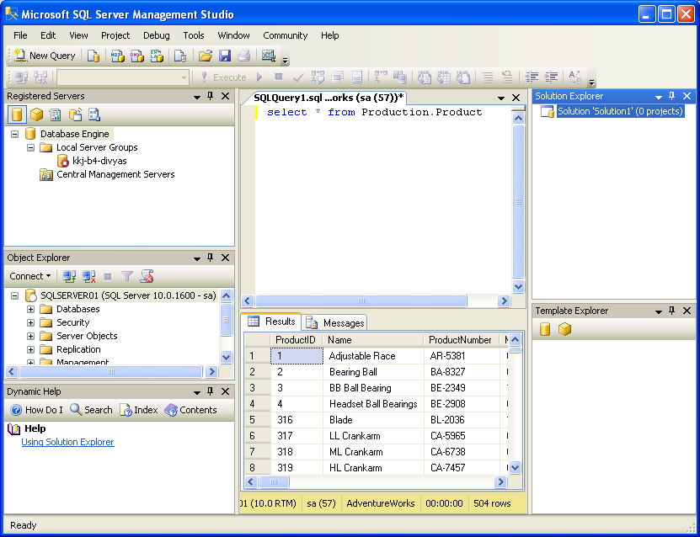
SQL Server Management Studio (Contd.)
Registered Servers
Solution Explorer
Query Editor
Object Explorer
Template Explorer
Dynamic Help
Let us see how to open SQL Server Management Studio.

Slide 25
SQL Server Business Intelligence Development Studio
Is a tool that provides an environment to develop business intelligence solutions.
Contains templates, tools, and wizards to work with objects that you can use to create business intelligence solutions.
Helps build the following types of solutions:
Data integration
Data analysis
Data reporting

Slide 26
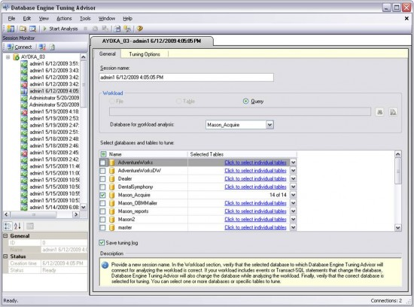
Database Engine Tuning Advisor
Helps database administrators to analyze and tune the performance of the server.
Provides recommendations to add, remove, or modify database objects, such as indexes or indexed views to improve performance.

Slide 27
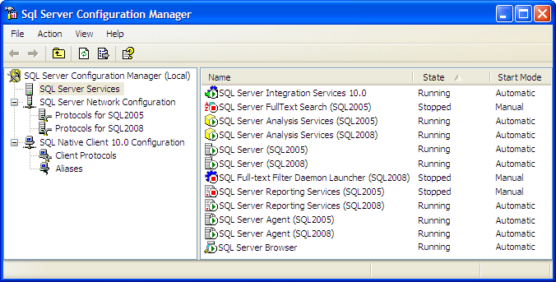
SQL Server Configuration Manager
Helps the database administrators to manage the services associated with SQL Server.
Allows you to manage the network connectivity configuration from the SQL Server client computers.
Allows you to specify the protocols through which the client computers can connect to the server.

Slide 28
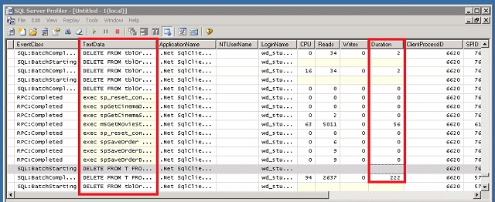
SQL Server Profiler
Helps in monitoring the events, such as login connections, execution of DML statements, stored procedures, batches, and security permission checks that are generated within an instance of a database engine.
Provides an in depth view of the query submission, access of the database against the queries, and return of results after processing of queries.

Slide 29
Summary
A database server is used to store and manage the database in a business application.
SQL Server consists of the four core components: database engine, integration services, analysis services, and reporting services.
The database engine provides support to store, query, process, and secure data on a database server.
Integration services allow you to gather and integrate this varied data in a consistent format in a common database called the data warehouse.
Analysis services assist in determining past trends and formulating future business decisions.

Slide 30
Summary(Contd.)
Reporting services provide support to generate comprehensive reports on the data stored in the database engine or the data warehouse.
Microsoft SQL Server is integrated with the .NET Framework.
The .NET Framework is an environment used to build, deploy, and run business applications.
The .NET Framework consists of three components: development tools and languages, base class library, and CLR.
SQL Server provides the following tools to improve the efficiency of the database developers and manage the server:
SQL Server Management Studio
SQL Server Business Intelligence Development Studio
Database Engine Tuning Advisor
SQL Server Configuration Manager
SQL Server Profiler

