Slide 1
Topics
Managing Tables

Slide 2
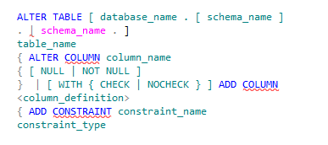

Modifying a Table
You need to modify tables when there is a requirement to add or remove columns and constraints.
You can use the ALTER TABLE statement to modify a table.
Syntax
Example
Adds a column named ApprovedBy to
the EmployeeLeave table that can store string values.
Notes:
Example:
Adding a column in the existing table EmployeeLeave
ALTER TABLE HumanResources.EmployeeLeave
ADD ClaimDetails DSCRP NOT NULL
CONSTRAINT chkDefClaim DEFAULT 'No Claim‘

Slide 3


Modifying a Table(Contd.)
You can drop a constraint by using the ALTER TABLE statement.
Syntax
Example
Drops the chkDefLeave constraint from the EmployeeLeave table.
Notes:
Example:
Adding a column in the existing table EmployeeLeave
ALTER TABLE HumanResources.EmployeeLeave
ADD ClaimDetails DSCRP NOT NULL
CONSTRAINT chkDefClaim DEFAULT 'No Claim‘

Slide 4

Renaming a Table
You can rename a table by using the sp_rename stored procedure.
Syntax
Example
Renames the EmployeeLeave table.

Slide 5

Dropping a Table
You can delete a table by using the DROP TABLE statement.
Syntax
Example
Deletes the EmployeeVacation table.

Slide 6
Demo: Managing Tables
Problem Statement:
The management of AdventureWorks, Inc. has decided to provide travel and medical reimbursements to the employees. They want to store the details of these reimbursements in the database. For this, you need to create a database table, EmployeeReimbursements. The following table shows the structure of the EmployeeReimbursements table.
Columns | Data Type and Size | Constraints
RimID | Int | Primary key
EmployeeID | Int | Foreign key references the EmployeeID of the Employee Table, NOT NULL
Amount | money | Amount>0
RimType | varchar(20) | RimType should be Medical, Cash, or Local
Pending_with | varchar(30) | NOT NULL
How will you create the table ?

Slide 7
Summary
In this session, you learned that:
The ALTER TABLE statement is used to modify a table.
The DROP TABLE statement is used to delete a table.

