Slide 1
Topics
Modifying Table Content

Slide 2
Modify Data
Inserting Data
T-SQL supports a number of different methods that you can use to insert data into your tables
Those include statements like
INSERT VALUES :
Insert single and multiple rows into a table
INSERT SELECT :
Insert the result of a query into a table
INSERT EXEC :
Insert the result of a stored procedure or a dynamic batch into a
table
SELECT INTO :
Use a query result to create and populate a table

Slide 3
Modify Data(Contd.)
While inserting rows into a table, you need to consider the following guidelines:
The number of data values must be the same as the number of attributes in the table or column list.
The order of inserting the information must be the same as the order in which attributes are listed for insertion.
The values clause need not contain the column with the IDENTITY property.
The data types of the information must match the data types of the columns of the table.

Slide 4
Modify Data(Contd.)
INSERT VALUES
With the INSERT VALUES statement, you can insert one or more rows into a target table based on value expressions
Example
Specifying the target column names after the table name is optional but considered a best practice

Slide 5

Modify Data(Contd.)
INSERT SELECT
The INSERT SELECT statement inserts the result set returned by a query into the specified target table.
As with INSERT VALUES, the INSERT SELECT statement supports optionally specifying the target column names
you can omit columns that get their values automatically
from an IDENTITY property, default constraint, or when allowing NULLs.
Example

Slide 6

Modify Data(Contd.)
INSERT EXEC
With the INSERT EXEC statement, you can insert the result set (or sets) returned by a dynamic batch or a stored procedure into the specified target table
INSERT EXEC supports specifying an optional target column list,
and allows omitting columns that accept their values automatically.
Example

Slide 7

Modify Data(Contd.)
SELECT INTO
The SELECT INTO statement involves a query (the SELECT part) and a target table (the INTO part).
The statement creates the target table based on the definition of the source and inserts the result rows from the query into that table
Example
Remember that SELECT INTO does not copy constraints from the source table

Slide 8
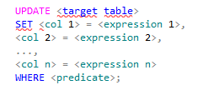
Modify Data(Contd.)
Updating Data
T-SQL supports the UPDATE statement to enable you to update existing data in your tables
Syntax
You specify the target table name in the UPDATE clause
If you want to filter a subset of rows, you indicate a WHERE clause with a predicate.
Only rows for which the predicate evaluates to true are updated

Slide 9

Modify Data(Contd.)
Example
UPDATE Based on Join
Standard SQL doesn’t support using joins in UPDATE statements, but T-SQL does
The idea is that you might want to update rows in a table, and refer to related rows in other tables for filtering and assignment purposes.

Slide 10
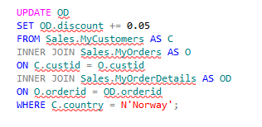
Modify Data(Contd.)
Example
You need to consider the following guidelines while updating data:
An update can be done on only one table at a time.
If an update violates integrity constraints, then the entire update is rolled back.

Slide 11
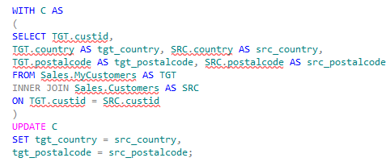
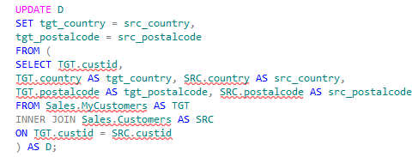
Modify Data(Contd.)
UPDATE and Table Expressions
With T-SQL, you can modify data through table expressions like CTEs and derived tables
This capability can be useful, for example, when you want to be able to see which rows are going to be modified and with what data before you actually apply the update.
Example
Example
Update through CTE
Update through Derived Tables

Slide 12


Modify Data(Contd.)
Deleting Data
T-SQL supports two statements that you can use to delete rows from a table: DELETE and TRUNCATE
DELETE Statement
It deletes rows from a table. You can optionally specify a predicate to restrict the rows to be deleted
Syntax
Example
If you don’t specify a predicate, all rows from the target table are deleted

Slide 13
Modify Data(Contd.)
TRUNCATE Statement
The TRUNCATE statement deletes all rows from the target table. Unlike the DELETE statement, it doesn’t have an optional filter, so it’s all or nothing
Example
When you need to delete all rows from a table, it is usually preferred to use TRUNCATE because it is significantly faster than DELETE

Slide 14
Modify Data(Contd.)
Delete vs Truncate
DELETE | TRUNCATE
The DELETE statement writes significantly more to the transaction log compared to the TRUNCATE statement. For DELETE, SQL Server records in the log the actual data that was deleted. | For TRUNCATE, SQL Server records information only about which pages were deallocated. As a result, the TRUNCATE statement tends to be substantially faster
The DELETE statement doesn’t attempt to reset an identity property if one is associated with a column in the target table | The TRUNCATE statement does.
The DELETE statement is supported if there’s a foreign key pointing to the table in question as long as there are no related rows in the referencing table | TRUNCATE is not allowed if a foreign key is pointing to the table—even if there are no related rows in the referencing table, and even if the foreign key is disabled.
The DELETE statement is allowed against a table involved in an indexed view | A TRUNCATE statement is disallowed in such a case.
The DELETE statement requires DELETE permissions on the target table. | The TRUNCATE statement requires ALTER permissions on the target table.

Slide 15
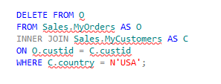
Modify Data(Contd.)
DELETE Based on a Join
delete rows from one table based on information that you evaluate in related rows in other tables.
Example
The FROM clause defining the JOIN table operator is logically evaluated first. The join
matches orders with their respective customers. Then the WHERE clause filters only the rows where the customer’s country is the USA.

Slide 16
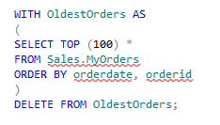
Modify Data(Contd.)
DELETE Using Table Expressions
T-SQL supports deleting rows by using table expressions
suppose you want to delete the 100 oldest orders (based on orderdate,
orderid ordering). The DELETE statement supports using the TOP option directly, but it
doesn’t support an ORDER BY clause.
You can achieve the same using table expressions as follows
Example

Slide 17
Other Data Modification Aspects
Additional aspects of data modification such as
SEQUENCE object
IDENTITY column
MERGE statement,
OUTPUT option.
The IDENTITY column property and the sequence object are both features that you can use to generate a sequence of numbers automatically
The IDENTITY property is a very old feature in the product and has a number of limitations and restrictions
The sequence object was introduced in SQL Server 2012 and overcomes many of the limitations of IDENTITY

Slide 18
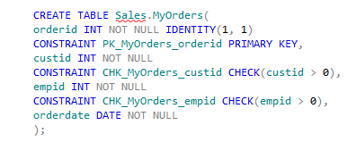
Other Data Modification Aspects(Contd.)
IDENTITY Column Property
IDENTITY is a property of a column in a table.
The property automatically assigns a value to the column upon insertion.
Can define it for columns with any numeric type that has a scale of 0.
Can optionally specify a seed and an increment.(defaults are 1 and 1).
Only one column in a table can have an IDENTITY property.
Example
When you insert rows into the table, don’t specify a value for the IDENTITY column because it gets its values automatically

Slide 19

Other Data Modification Aspects(Contd.)
T-SQL provides a number of functions that you can use to query the last identity value generated
SCOPE_IDENTITY Function :
It returns the last identity value generated in your session in the current scope.
@@IDENTITY Function :
It returns the last identity value generated in your session regardless of scope.
IDENT_CURRENT Function :
It accepts a table as input and returns the last identity value generated in the input table
regardless of session.
Example

Slide 20


Other Data Modification Aspects(Contd.)
Sequence Object
Unlike the IDENTITY column property, a sequence is an independent object in the database.
It’s not tied to a particular column in a particular table.
Like IDENTITY, all numeric types with a scale of 0 are supported.
Example
Syntax
The following are some of the properties and their default values:
INCREMENT BY : Increment value( default is 1.)
MINVALUE : The minimum value to support(default is minimum value in the type)
MAXVALUE : The maximum value to support(default is maximun value in the type)
CYC LE | NO CYC LE : Defines whether to allow the sequence to cycle or not.(Default is NO CYCLE)
START WITH : The sequence start value(Default is MINVALUE for an ascending sequence
MAXVALUE for a descending one)

Slide 21
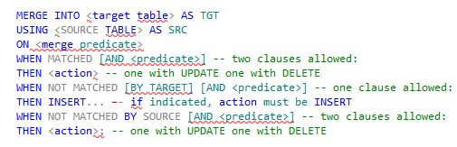
Other Data Modification Aspects(Contd.)
Merging Data
With the MERGE statement, you can merge data from a source table into a target table.
The statement has many practical uses in both online transaction processing (OLTP) scenarios and in data warehousing ones.
Syntax
MERGE INTO <target table> : This clause defines the target table for the operation.
USING <source table> : This clause defines the source table for the operation

Slide 22
Other Data Modification Aspects(Contd.)
ON <merge predicate> : Defines whether a source row is or isn’t matched by a target row.
WHEN MATCHE D [AND <predicate>] THEN <action>: This clause defines an
action to take when a source row is matched by a target row
WHEN NOT MATCHE D [BY TAR GET ] [AN D <predicate>] THEN <action>: This
clause defines what action to take when a source row is not matched by a target row.
WHEN NOT MATCHE D BY SOURCE [AN D <predicate>] THEN <action> : This
clause defines an action to take when a target row exists, but it is not matched by a
source row.

Slide 23


Other Data Modification Aspects(Contd.)
For example, you take the backup of the Education table in the Education_Backup table by using the following statement:
After taking the back up, the Education table is modified by using the following statements:
Example
Example

Slide 24
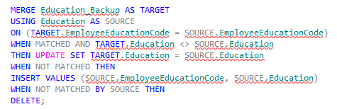
Other Data Modification Aspects(Contd.)
You can use the following MERGE statement to reflect the changes in the Education_Backup table:
Example

Slide 25
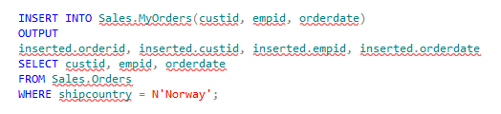
Other Data Modification Aspects(Contd.)
OUTPUT Option
T-SQL supports an OUTPUT clause for modification statements, which you can use to return information from modified rows.
You can use the output for purposes like auditing or
archiving.
Is used along with the INSERTED or DELETED statement to return the data of the affected rows.
INSERT with OUTPUT
The OUTPUT clause can be used in an INSERT statement to return information from the inserted rows.
Example

Slide 26

Other Data Modification Aspects(Contd.)
DELETE with OUTPUT
You can use the OUTPUT clause to return information from deleted rows in a DELETE statement.
You need to prefix the columns that you refer to with the keyword deleted.
Example
If you need to persist the output rows in a table—for example, for archiving
purposes—you can add an INTO clause with the target table name

Slide 27
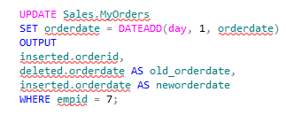
Other Data Modification Aspects(Contd.)
UPDATE with OUTPUT
You can use the OUTPUT clause to return information from modified rows in an UPDATE statement.
With updated rows, you have access to both the old and the new images of the
modified rows.
Example

Slide 28
Summary
In this session, you learned that
Modify data by using INSERT, UPDATE, and DELETE statements.
Additional aspects of data modification such as
SEQUENCE object
IDENTITY column
MERGE statement,
OUTPUT option.
Merging Data

