Slide 1
Topics
Indexes

Slide 2
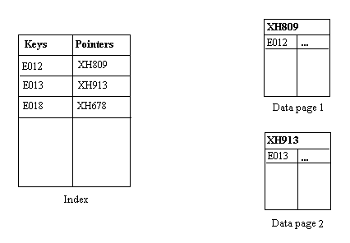
Indexes
An index is an on-disk structure associated with a table or view that speeds retrieval of rows from the table or view.
An index contains keys built from one or more columns in the table or view.
These keys are stored in a structure (B-tree) that enables SQL Server to find the row or rows associated with the key values quickly and efficiently.

Slide 3
Types of indexes available in SQL Server
Index type | Description
Clustered | A clustered index sorts and stores the data rows of the table or view in order based on the clustered index key. The clustered index is implemented as a B-tree index structure that supports fast retrieval of the rows, based on their clustered index key values.
Nonclustered | A nonclustered index can be defined on a table or view with a clustered index or on a heap. Each index row in the nonclustered index contains the nonclustered key value and a row locator. This locator points to the data row in the clustered index or heap having the key value. The rows in the index are stored in the order of the index key values, but the data rows are not guaranteed to be in any particular order unless a clustered index is created on the table.
Unique | A unique index ensures that the index key contains no duplicate values and therefore every row in the table or view is in some way unique. Uniqueness can be a property of both clustered and nonclustered indexes.
Columnstore | An xVelocity memory optimized columnstore index based on vertical partitioning of the data by columns, stored as large objects (LOB).
Index with included columns | A nonclustered index that is extended to include nonkey columns in addition to the key columns.

Slide 4
Types of indexes available in SQL Server(Contd.)
Index type | Description
Index on computed columns | An index on a column that is derived from the value of one or more other columns, or certain deterministic inputs.
Filtered | An optimized nonclustered index, especially suited to cover queries that select from a well-defined subset of data. It uses a filter predicate to index a portion of rows in the table. A well-designed filtered index can improve query performance, reduce index maintenance costs, and reduce index storage costs compared with full-table indexes.
Spatial | A spatial index provides the ability to perform certain operations more efficiently on spatial objects (spatial data) in a column of the geometry data type.
XML | A shredded, and persisted, representation of the XML binary large objects (BLOBs) in the xml data type column.
Full-text | A special type of token-based functional index that is built and maintained by the Microsoft Full-Text Engine for SQL Server It provides efficient support for sophisticated word searches in character string data.

Slide 5
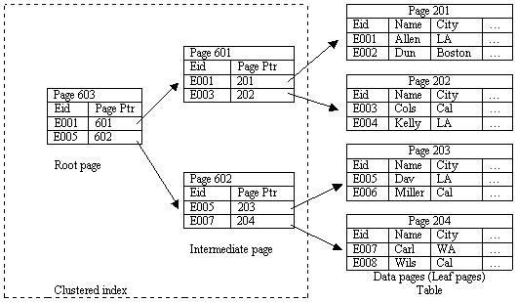
Indexes(Contd.)
Clustered Index :
Clustered indexes sort and store the data rows in the table or view based on their key values.
These are the columns included in the index definition.
There can be only one clustered index per table, because the data rows themselves can be sorted in only one order.
When a table has a clustered index, the table is called a clustered table

Slide 6
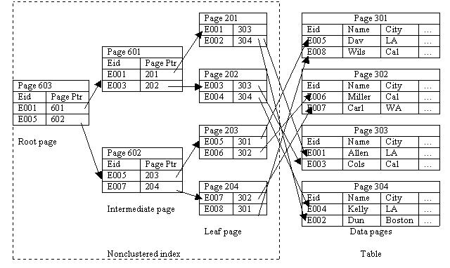
Indexes(Contd.)
Nonclustered Index :
A nonclustered index contains the nonclustered index key values and each key value entry has a pointer to the data row that contains the key value.
The physical order of the rows is not the same as the index order.

Slide 7
Creating Indexes
Index:
Is created on the most frequently queried column in tables or views.
Based on two or more columns is called a composite index.
Can be created by using the CREATE INDEX statement

Slide 8
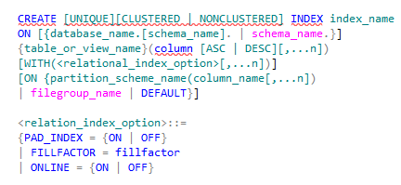
Creating Indexes (Contd.)
Syntax

Slide 9


Creating Indexes (Contd.)
You can create a clustered index on the EmployeeID attribute of the Employee table by using the following statement:
The following statement creates a nonclustered index on the ManagerID attribute of the Employee table:
Example
Example

Slide 10
Creating Indexes (Contd.)
Consider the following guidelines while creating indexes on a table:
Create clustered indexes on columns that have unique or not null values.
Do not create an index that is not used frequently. You require time and resources to maintain indexes.
Create a clustered index before creating a nonclustered index. A clustered index changes the order of rows. A nonclustered index would need to be rebuilt if it is built before a clustered index.
Create nonclustered indexes on all columns that are frequently used in predicates and join conditions in queries.

Slide 11
Just a minute
Which type of index implements physical sorting of data?
Solution:
Clustered index

Slide 12

Create Indexes with Included Columns
This topic describes how to add included (or nonkey) columns to extend the functionality of nonclustered indexes
By including nonkey columns, you can create nonclustered indexes that cover more queries.
An index with nonkey columns can significantly improve query performance when all columns in the query are included in the index either as key or nonkey columns
When an index contains all the columns referenced by a query it is typically referred to as covering the query
Example

Slide 13
Create Indexes with Included Columns
Limitations and Restrictions
Nonkey columns can only be defined on nonclustered indexes.
All data types except text, ntext, and image can be used as nonkey columns.
Computed columns that are deterministic and either precise or imprecise can be nonkey columns. For more information, see Indexes on Computed Columns.
Computed columns derived from image, ntext, and text data types can be nonkey columns as long as the computed column data type is allowed as a nonkey index column.
Nonkey columns cannot be dropped from a table unless that table’s index is dropped first.

Slide 14
Filtered Indexes
A filtered index is an optimized nonclustered index especially suited to cover queries that select from a well-defined subset of data.
It uses a filter predicate to index a portion of rows in the table.
A well-designed filtered index can improve query performance as well as reduce index maintenance and storage costs compared with full-table indexes.
Can be created based on a condition specified by the WHERE clause.
Filtered indexes can provide the following advantages over full-table indexes:
Improved query performance and plan quality
Reduced index maintenance costs
Reduced index storage costs
You cannot create a filtered index on a view

Slide 15


Filtered Indexes(Contd.)
Example
Example
Creates a filtered index for those records in the Employee table, where the value in the Title column is Tool Manager.

Slide 16
Columnstore Index
Columnstore index is a new type of index introduced in SQL Server 2012.
It is a column-based non-clustered index geared toward increasing query performance for workloads that involve large amounts of data, typically found in data warehouse fact tables.
It stores data column-wise instead of row-wise, as indexes currently do.
For example, consider an Employee table containing employee data, as shown below
FirstName | LastName | HireDate | Gender
Adam | Jorgensen | 5/9/2008 | Male
Sherri | McDonald | 7/1/2009 | Female
Brian | McDonald | 09/15/2009 | Male
Jose | Chinchilla | 1/10/2010 | Male
Tim | Murphy | 7/1/2009 | Male
Tim | Moolic | 6/1/2008 | Male

Slide 17
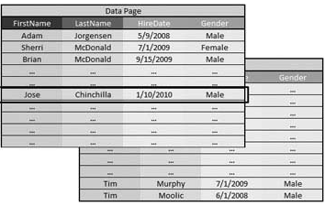
Columnstore Index (Contd.)
In a row-based index, the data in the Employee table is stored in one or more data pages, as shown below.

Slide 18
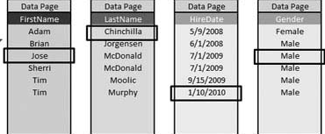
Columnstore Index (Contd.)
In a column-based index, the data in the Employee table is stored in separate pages for each of the columns, as shown

Slide 19

Columnstore Index (Contd.)
Performance advantages in columnstore indexes are possible by leveraging the VertiPaq compression technology, which enables large amounts of data to be compressed in-memory.
This in-memory compressed store reduces the number of disk reads and increases buffer cache hit ratios because only the smaller column-based data pages that need to satisfy a query are moved into memory.
For wide tables, such as those commonly found in data warehouses, columnstore indexes come in handy as you essentially reduce the amount and size of data needed to be accessed for any given query.
Example

Slide 20
Columnstore Index (Contd.)
A columnstore index
Cannot have more than 1024 columns.
Cannot be clustered. Only nonclustered columnstore indexes are available.
Cannot be a unique index.
Cannot be created on a view or indexed view.
Cannot act as a primary key or a foreign key.
Cannot be changed using the ALTER INDEX statement. Drop and re-create the columnstore index instead.
Cannot be created with the INCLUDE keyword
Cannot include the ASC or DESC keywords for sorting the index.
Does not use or keep statistics in the manner of a traditional index.
Cannot contain a column with a FILESTREAM attribute

Slide 21
Managing Indexes
The common index maintenance tasks include:
Disabling indexes
Enabling indexes
Renaming indexes
Dropping indexes
Optimizing indexes

Slide 22

Managing Indexes (Contd.)
Disabling indexes:
When an index is disabled, the user is not able to access the index.
If a clustered index is disabled, then the table data is not accessible to the user.
Example
Disables a clustered index, IX_EmployeeID, on the Employee table.

Slide 23

Managing Indexes (Contd.)
Enabling indexes:
Can be achieved by one of the following methods:
Using the ALTER INDEX statement with the REBUILD clause
Using the CREATE INDEX statement with the DROP_EXISTING clause
Example
Rebuilds the clustered index on the Employee table.

Slide 24

Managing Indexes (Contd.)
Renaming indexes:
Can be done with the help of the sp_rename system stored procedure.
Example
Renames the IX_JobCandidate_EmployeeID index to IX_EmployeeID.

Slide 25

Managing Indexes (Contd.)
Dropping indexes:
Can be done using the DROP INDEX statement.
Example
Drops the IX_EmployeeID index on the Employee table.

Slide 26
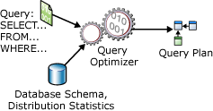
Query Optimization and Execution Plan

Slide 27
Query Execution
How a query executes?
You type a query in SSMS, hit F5 and get the results.
…well, its more complicated than that…

Slide 28
Query Execution (Contd..)
Every query goes through a number of steps:
Parsing
Algebraization
Optimization
Execution

Slide 29
DMVs
What can be done using the DMVs and functions?
Dynamic management views and functions return server state information that can be used to monitor the health of a server instance, diagnose problems, and tune performance.
It helps the developers and DBAs to identify the performance.
All the DMVs exits in SYS schema and their names start with DM_.
So when you need to query a DMV, you should prefix the view name with SYS
As an example, if you need to see the total physical memory of the SQL Server machine; then execute the below TSQL command:
select * from sys.dm_os_sys_memory

Slide 30
DMVs (Contd..)
Some of the other DMVs and Functions:
sys.dm_exec_requests
Status
wait_type
sys.dm_exec_query_memory_grants
granted_memory_kb
used_memory_kb
max_used_memory_kb
sys.dm_io_virtual_file_stats (DBID,FIELDID)
num_of_reads
num_of_bytes_read
num_of_writes
num_of_bytes_written

Slide 31
Execution Plan
What is an Execution Plan?
An execution plan, simply put the result of the query optimizer's attempt to calculate the most efficient way to implement the request represented by the T-SQL query you submitted.
Execution plans can tell you how a query will be executed, or how a query was executed. They are, therefore, the DBAs and Developers primary means of troubleshooting a poorly performing query.
Why a given query is performing thousands of scans, putting your I/O through the roof, you can use the execution plan to identify the exact piece of SQL code that is causing the problem.

Slide 32
Execution Plan (Contd..)
Different execution plan formats
Graphical Plans
These are quick and easy to read but the detailed data for the plan is masked.
Both Estimated and Actual execution plans can be viewed in graphical format.
Text Plans
These are a bit harder to read, but more information is immediately available.
There are three text plan formats:
SHOWPLAN_ALL
A reasonably complete set of data showing the Estimated execution plan for the query
SHOWPLAN_TEXT
provides a very limited set of data for use with tools like osql.exe.
STATISTICS PROFILE
similar to SHOWPLAN_ALL except it represents the data for the Actual execution plan

Slide 33
Execution Plan (Contd..)
XML Plans
XML plans present the most complete set of data available on a plan, all on display in the structured XML format.
There are two varieties of XML plan:
SHOWPLAN_XML
The plan generated by the optimizer prior to execution.
STATISTICS_XML
The XML format of the Actual execution plan.

Slide 34
Summary
In this session, you learned that:
Types of indexes available in sqlserver
Clustered indexes should be built on an attribute whose values are unique and do not change often. Data is physically sorted in a clustered index.
In a nonclustered index, the physical order of rows is not the same as that of the index order.
A nonclustered index is the default index that is created with the CREATE INDEX command.
Query Optimization and Execution Plan
Query Execution
DMV
Execution plan

