Slide 1
Objectives
In this session, you will learn to:
Implement batches

Slide 2
Implementing Batches
Sometimes, you need to execute more than one SQL statement to perform a task.
In such a case, you can send all the SQL statements together to SQL Server to be executed as a unit.
This helps in reducing the network traffic.

Slide 3
Implementing Batches(Contd.)
How can we send multiple SQL statements for execution?

Slide 4
Implementing Batches(Contd.)
You can use batches to send multiple SQL statements for execution.

Slide 5
Creating Batches
Batch:
Is a group of SQL statements submitted together to SQL Server for execution.
Compiles the statements as a single executable unit called an execution plan.
Uses GO command at the end to send the SQL statements to the instance of SQL Server.
Statement 1
Statement 2
Statement 3
Statement 4
GO
Database

Slide 6

Creating Batches (Contd.)
Batch:
Is a group of SQL statements submitted together to SQL Server for execution.
Compiles the statements as a single executable unit called an execution plan.
Uses GO command at the end to send the SQL statements to the instance of SQL Server.
Statement 1
Statement 2
Statement 3
Statement 4
Database
Notes:
6

Slide 7


Creating Batches (Contd.)
Using variables:
Batch uses variables to store values during execution.
A variable must be declared by using the DECLARE statement.
A variable name is always preceded by the ‘@’ symbol.
Syntax
Example

Slide 8
Creating Batches (Contd.)
Displaying user-defined messages:
A batch uses the PRINT statement to display user-defined messages and values of variables.
For example:
PRINT @Rate
You can also use comment entries in batches in the following ways:
Multiple line comment entries enclosed within /* and */
Single line comment entry starting with -- (double hyphens)

Slide 9
Creating Batches (Contd.)
Guidelines to create batches:
While creating batches, you need to consider the following restrictions:
You cannot bind rules and defaults to columns and use them in the same batch.
You cannot define and use the CHECK constraint in the same batch.
You cannot drop objects and recreate them in the same batch.
You cannot alter a table by adding a column and then refer to the new columns in the batch created earlier.

Slide 10
Just a minute
Which of the following statements can be used within a batch?
CREATE FUNCTION
CREATE RULE
DECLARE
Solution:
DECLARE

Slide 11
Let us understand the programming constructs in batches.
Using Constructs
Notes:
In this slide, you need to define constructs to the students. As students have already read the constructs in previous modules, you need not to put much stress on the explanation of these.

Slide 12
Using Constructs (Contd.)
Programming constructs allow batches to perform the conditional execution of statements.
A batch uses the following constructs to control the flow of statements:
IF…ELSE statement
CASE statement
WHILE statement
Notes:
In this slide, you need to define constructs to the students. As students have already read the constructs in previous modules, you need not to put much stress on the explanation of these.

Slide 13
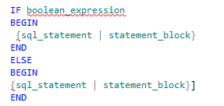
Using Constructs (Contd.)
The IF…ELSE statement:
Is used to perform a particular action based on the result of the boolean expression.
Syntax

Slide 14
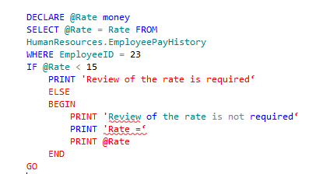
Using Constructs (Contd.)
Example
Compares the value of the @Rate variable with the value 15 by using the < (less than) comparison operator.

Slide 15

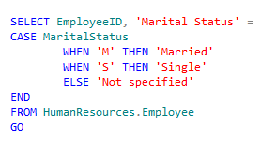
Using Constructs (Contd.)
The CASE statement:
Is used to evaluate a list of conditions and returns one of the possible results.
Syntax
Example
Displays the marital status as ‘Married’ or ‘Single’.

Slide 16

Using Constructs (Contd.)
The WHILE statement:
Is used to execute repeatedly as long as the given condition holds true.
Is used to break or continue the loop by using the BREAK and CONTINUE statements.
Syntax

Slide 17
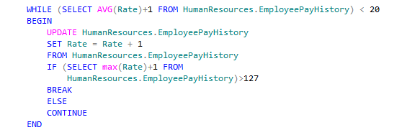
Using Constructs (Contd.)
Example
Increases the hourly salary of all the employees until the average hourly salary reaches near $20.
Checks if the average hourly salary rate of all the employees is less than $20.
Ensures that the maximum hourly salary should not exceed $127.

Slide 18
Summary
In this session, you learned that:
A batch is a set of SQL statements submitted together to the server for execution.
You can use a variable to store a temporary value.
You can use the PRINT statement to display a user-defined message or the content of a variable on the screen.
You can use the comment entries in batches to write a description of the code.
You can use the IF…ELSE statement for conditional execution of SQL statements.
The CASE statement evaluates a list of conditions and returns one of the various possible results.
You can use the WHILE statement in a batch to allow a set of T SQL statements to execute repeatedly as long as the given condition holds true.

Slide 19
Summary(Contd.)
The BREAK statement causes an exit from the WHILE loop.
The CONTINUE statement causes the WHILE loop to restart, skipping any statements after the CONTINUE statement within the loop.

