Slide 1
Functions
Function is a database object in Sql Server.
It is a set of Sql statements that accepts only input parameters, perform actions and return the result.
Function can return only single value or a table.
Can’t use function to Insert, Update, Delete records in the database table(s).
Types of Function
System Defined Function
Scalar Function : Scalar functions operates on a single value and returns
a single value.
ex - Rand(),Round(),Upper(),Convert(),abs() etc..
Aggregate Function : Aggregate functions operates on a collection of values
and returns a single value.
ex- Max(),Min(),Avg(),Count()

Slide 2
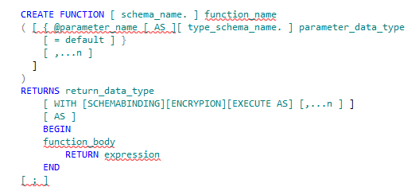
Functions(Contd.)
User Defined Function :
These functions are created by user in system database or in user defined database.
A UDF can be created by using the CREATE FUNCTION statement.
Syntax

Slide 3
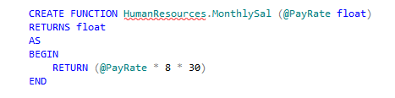

Functions(Contd.)
Scalar Function :
User defined scalar function also returns single value as a result of actions perform by function. We can return any datatype value from function.
Example
Execute the function by using the following statements:
Example

Slide 4
Functions(Contd.)
Creating table-valued functions:
A table-valued function returns a table as an output in the form of table data type.
The table data type is a special data type used to store a set of rows.
Table-valued functions are of the following types:
Inline table-valued function :
Multistatement table-valued function :

Slide 5
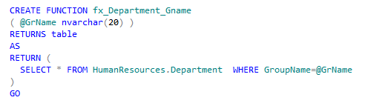

Functions(Contd.)
Inline table-valued function:
Returns a variable of a table data type from the result set of a single SELECT statement.
Does not contain a function body within the BEGIN and END statements.
Example
You can use the following query to execute the fx_Department_GName function with a specified argument:
Example
output

Slide 6
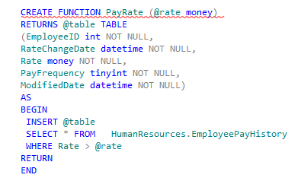

Functions(Contd.)
Multi-Statement Table-Valued Function
Uses multiple statements to build the table.
Contains a function body using a BEGIN...END block that holds multiple T-SQL statements.
Returns a temporary table that is created based on the function specification.
Example
You can execute the PayRate function by using the following query:
Example

Slide 7
Just a minute
Which type of function returns a single value?
Solution:
Scalar functions

Slide 8

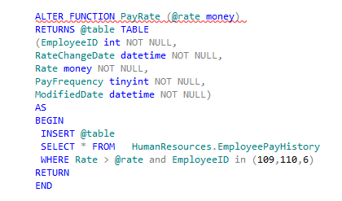
Functions(Contd.)
To modify a user-defined function
You can modify the UDF using ALTER Function
Syntax
Example

Slide 9

Functions(Contd.)
Delete User-defined Functions
You can use DROP statement to delete UDF
Example

Slide 10
Summary
In this session, you learned that:
A UDF is a database object that contains a set of T-SQL statements.
UDFs can return either a single scalar value or a result set.
UDFs are of two types, scalar functions and table-valued functions.
A scalar function accepts a single value and returns a single value.
A table-valued function returns a table as an output, which can be derived as part of a SELECT statement.

