Slide 1
Implementing Stored Procedures
What is a stored procedure?

Slide 2
Implementing Stored Procedures(Contd.)
A stored procedure is a precompiled object stored in the database.

Slide 3
Implementing Stored Procedures(Contd.)
Let us discuss how to create a stored procedure.

Slide 4
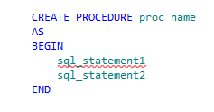

Implementing Stored Procedures(Contd.)
Stored procedures are created using the CREATE PROCEDURE statement.
Syntax
Stored procedures are executed using the EXECUTE PROCEDURE statement.
Syntax

Slide 5

Implementing Stored Procedures(Contd.)
The following statement creates a stored procedure to view the department names from the Department table:
You can execute the stored procedure, prcDept, as shown in the following statement:
Example
Example

Slide 6
Implementing Stored Procedures(Contd.)
You can also modify or drop a stored procedure.

Slide 7


Implementing Stored Procedures(Contd.)
Altering a stored procedure :
A stored procedure is modified using the ALTER PROCEDURE statement.
Syntax
Example

Slide 8
Implementing Stored Procedures(Contd.)
Dropping a stored procedure:
A stored procedure is deleted using the DROP PROCEDURE statement.
Syntax
Example

Slide 9
Just a minute
Which statement will you use to modify a stored procedure?
Solution:
ALTER PROCEDURE

Slide 10
Just a minute
Which system-defined table stores the names of all the stored procedures?
Solution:
Sysobjects

Slide 11
Creating Parameterized Stored Procedures
You can create a procedure with parameters.

Slide 12
Creating Parameterized Stored Procedures (Contd.)
Parameters:
Are used to pass values to the stored procedure during run time.
Are defined as input parameters.

Slide 13
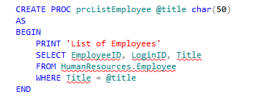
Creating Parameterized Stored Procedures (Contd.)
You can create a parameterized stored procedure by using the following statement:
You can execute the prcListEmployee stored procedure by using the following statement:
Example
Example

Slide 14

Creating Parameterized Stored Procedures (Contd.)
Apart from scalar variables, you can pass a table-valued parameter to a stored procedure.
The table-valued parameter:
Enables you to send multiple rows of data to the stored procedure without creating a temporary table or many parameters.
Must be declared with the READONLY option while creating a stored procedure.
Example
Creates a table type named NType.

Slide 15
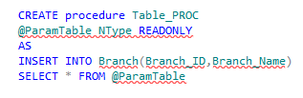

Creating Parameterized Stored Procedures (Contd.)
You can create a stored procedure that takes a parameter of table type by using the following statement:
You can execute the Table_Proc stored procedure by using the following statements:
Example
Example

Slide 16

Creating Parameterized Stored Procedures (Contd.)
When the preceding statements are executed, two rows are inserted in the Branch table, as shown in the following figure

Slide 17
Returning Values from Stored Procedures
You can also return values from a stored procedure.

Slide 18
Returning Values from Stored Procedures (Contd.)
You can return values from the stored procedure:
By using the RETURN statement.
By using the OUTPUT parameter.

Slide 19
Returning Values from Stored Procedures (Contd.)
The RETURN statement allows the stored procedure to return only an integer value to the calling application.
Syntax

Slide 20
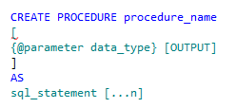
Returning Values from Stored Procedures (Contd.)
The OUTPUT keyword allows you to create a stored procedure with output parameters.
Syntax

Slide 21
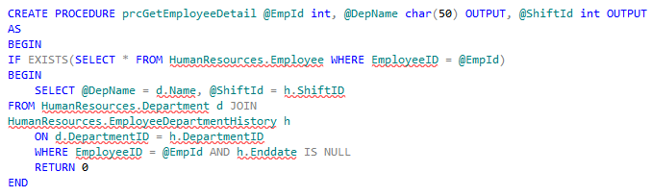
Returning Values from Stored Procedures (Contd.)
Example

Slide 22
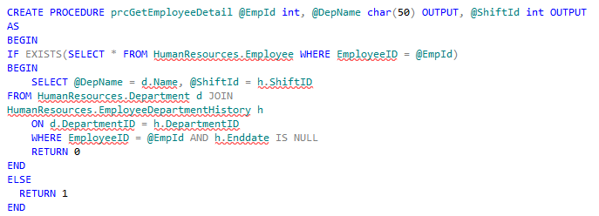
Returning Values from Stored Procedures (Contd.)
Example
Accepts the employee ID as an input parameter and returns the department name and shift ID as the output parameters.

Slide 23
Calling a Procedure from Another Procedure
You can also call a procedure from another procedure
.

Slide 24
Calling a Procedure from Another Procedure (Contd.)
The procedure that calls or executes another procedure is known as the calling procedure.
The procedure that is called or executed by the calling procedure is known as the called procedure.
Procedure A
Procedure B
Calling Procedure
Called Procedure
Called Procedure
Calling
Notes:
24

Slide 25
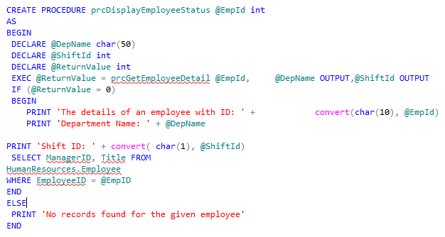
Calling a Procedure from Another Procedure (Contd.)
Example
Calls the prcGetEmployeeDetail procedure.
Notes:
25

Slide 26

Calling a Procedure from Another Procedure (Contd.)
To execute the prcDisplayEmployeeStatus procedure, you need to execute the following statement:
Example
Notes:
26

Slide 27
Demo: Creating Stored Procedures
Problem Statement:
You are a database developer of AdventureWorks, Inc. The Human Resource department needs to revise the payment details of the employees. You need to create a procedure that obtains the percentage value by which you need to increase the pay rate. In addition, you need to ensure that the pay is revised for only those employees whose pay rate was not revised in the last six months.

Slide 28
Summary
In this session, you learned that:
A stored procedure is a collection of various T-SQL statements that are stored under one name and are executed as a single unit.
A stored procedure can be created by using the CREATE PROCEDURE statement.
A stored procedure allows you to declare parameters, variables, and use T-SQL statements and programming logic.
A stored procedure provides better performance, security, accuracy, and reduces network congestion.
A stored procedure accepts data through input parameters.
A stored procedure returns data through output parameters or return statements.
A stored procedure is executed by using the EXECUTE statement.
A stored procedure can be altered by using the ALTER PROCEDURE statement

