Slide 1
Implementing Error Handling
Let us understand how to handle the errors and exceptions in batches.

Slide 2
Implementing Error Handling(Contd.)
The errors that occur at run time are known as exceptions.
Exceptions can be handled in the following ways:
By using the TRY…CATCH construct
SQL Server 2012 uses both RAISERROR and the THROW command to generate errors.

Slide 3
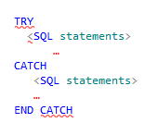
Implementing Error Handling(Contd.)
Using TRY…CATCH:
TRY block encloses a group of T-SQL statements. If any error occurs in the statements of TRY block, control passes to the CATCH block.
CATCH block encloses another group of statements, which gets executed when an error occurs in the TRY block.
Syntax

Slide 4
Implementing Error Handling(Contd.)
You can use the following set of functions within the CATCH block to report on errors:
ERROR_NUMBER :
Returns the error number
SQL Server error messages are numbered from 1 through 49999.
Custom error messages are numbered 50001 and higher.
ERROR_MESSAGE :
Returns the error message
ERROR_SEVERITY :
Returns the severity of the error
SQL Server defines 26 severity levels numbered from 0 through 25.
ERROR_LINE :
Returns the line number of the batch where the error occurred
ERROR_PROCEDURE :
The function, trigger, or procedure name that was executing
when the error occurred
ERROR_STATE :
The state of the error
This is an integer with a maximum value of 127, used by Microsoft for internal
purposes.

Slide 5
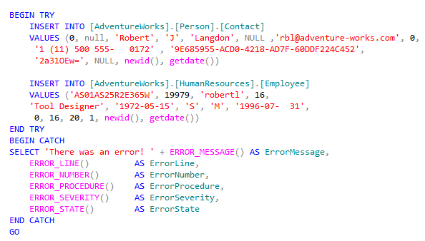
Implementing Error Handling(Contd.)
Example

Slide 6
Implementing Error Handling(Contd.)
RAISERROR:
Is used to return messages back to the called applications.
Uses the same message format as a system error or warning message generated by the SQL Server Database Engine.
Can also return user-defined error messages.
Syntax

Slide 7
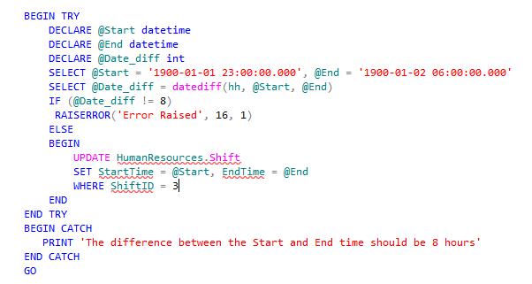
Implementing Error Handling(Contd.)
Example

Slide 8

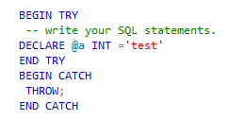
Implementing Error Handling(Contd.)
THROW
The new THROW keyword introduced in SQL server 2012 is an improvement over the existing RAISERROR()statement
With the THROW statement, you don’t have to specify any parameters and the results are more accurate. You simply include the statement as is in the CATCH block.
Syntax
Example

Slide 9
Implementing Error Handling(Contd.)
THROW vs. RAISERROR in TRY/CATCH
In the TRY block, you can use either RAISERROR or THROW (with parameters) to generate an
error condition and transfer control to the CATCH block
A RAISERROR in the TRY block must have a severity level from 11 to 19 to transfer control to the CATCH block.
You can use a RAISERROR in the CATCH block to report the original error back to the client,
or to raise an additional error that you want to report
You can use a THROW statement with parameters, like RAISERROR, to re-raise the error
in the CATCH block
You must take care that the THROW with or without parameters is the last statement you
want executed in the CATCH block, because it terminates the batch and does not execute
any remaining commands in the CATCH block.

Slide 10
Just a minute
Which system function returns the text of the error message when used in the CATCH block?
Solution:
ERROR_MESSAGE()

Slide 11
Just a minute
How can you return a user-defined error message in a batch?
Solution:
Using the RAISERROR statement

Slide 12
Summary
The TRY/CATCH block provides each batch of T-SQL code with a CATCH block in which to handle errors.
SQL Server 2012 uses both RAISERROR and the THROW command to generate errors.
You can query the @@ERROR system function to determine whether an error has occurred and what the error number is.
The THROW command can be used to re-throw errors.
There is a complete set of error functions to capture information about errors.

