Slide 1
Topics
DataTypes used in Sql Server
Retrieve the Data by using Various operators
Filtering with various Predicates
Customizing the Data

Slide 2
Retrieving Data
To retrieve data, you first need to understand the various data types used in SQL Server.

Slide 3
Data Types:
In SQL Server, each column, local variable, expression, and parameter has a related data type
A data type is an attribute that specifies the type of data that the object can hold: integer data, character data, monetary data, date and time data, binary strings, and so on.
Data Types Categories
Exact Numeric
Approximate Numeric
Date and Time
Character Strings
Unicode Character Strings
Binary Strings
Other DataTypes

Slide 4
Data Types(Contd.)
Exact Numeric Data Types:
bigint
bit
decimal
int
money
numeric
smallint
smallmoney
Tinyint
Approximate Numeric :
float
real

Slide 5
Data Types(Contd.)
Date and Time:
date
datetime2
datetime
datetimeoffset
smalldatetime
time
Character Strings
char
varchar
text

Slide 6
Data Types(Contd.)
Unicode Character Strings :
nchar
nvarchar
ntext
Binary Strings :
binary
varbinary
image
Other Data Types :
cursor
hierarchyid
sql_variant
table
timestamp
uniqueidentifier
xml
Spatial Types

Slide 7
Retrieving Specific Attributes
The SELECT statement is used for accessing and retrieving data from a database.
Syntax

Slide 8

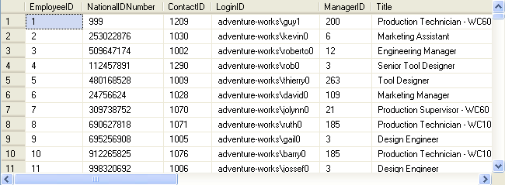
Retrieving Specific Attributes (Contd.)
To display all the details of employees, you can use the following query:
Example
Output

Slide 9
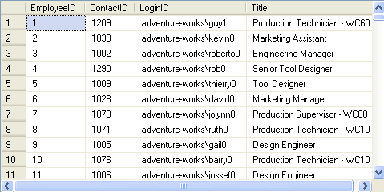
Retrieving Specific Attributes (Contd.)
To view specific details, you can specify the column names in the SELECT statement, as shown in the following query:
Example

Slide 10

Customizing the display:
Consider the following example that displays the Department ID and Department Names from the Department table of the AdventureWorks database.
The report should contain column headings different from those given in the table, as shown in the following figure.
Example
Example
Example

Slide 11
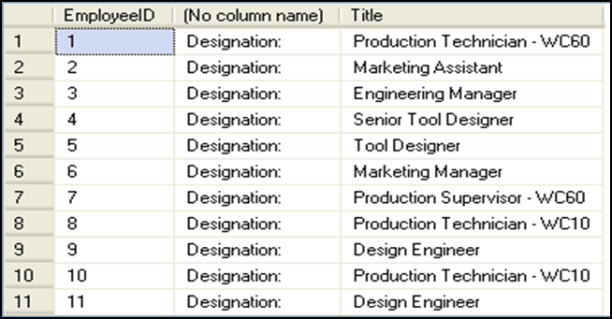
Retrieving Specific Attributes (Contd.)
Literals are string values that are enclosed in single quotes and added to the SELECT statement.
The following SQL query retrieves the employee ID and their titles from the Employee table along with a literal ‘Designation’:
Example

Slide 12

Retrieving Specific Attributes (Contd.)
Concatenating the text values in the output:
The concatenation operator is used to concatenate string expressions and is represented by the + sign.
To concatenate two strings, you can use the following query:
Example

Slide 13
Retrieving Specific Attributes (Contd.)
Calculating column values:
Arithmetic operators are used to perform mathematical operations, such as addition, subtraction, division, and multiplication, on numeric columns or on numeric constants.
SQL Server supports the following arithmetic operations:
+ (for addition)
- (for subtraction)
/ (for division)
* (for multiplication)
% (for modulo)

Slide 14


Retrieving Specific Attributes (Contd.)
The following SQL query retrieves the per day rate of the employees from the EmployeePayHistory table:
Example

Slide 15

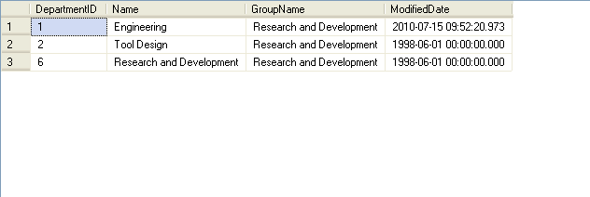
Filtering Data with Predicates
T-SQL supports three query clauses that enable you to filter data based on predicates . Those are the ON, WHERE, and HAVING clauses
The following SQL query retrieves the department details from the Department table, where the group name is Research and Development:
Example

Slide 16

Filtering Data with Predicates(Contd.)
Comparison operators:
Test for similarity between two expressions.
Allow row retrieval from a table based on the condition specified in the WHERE clause.
Cannot be used on text, ntext, or image data type expressions.
Syntax

Slide 17

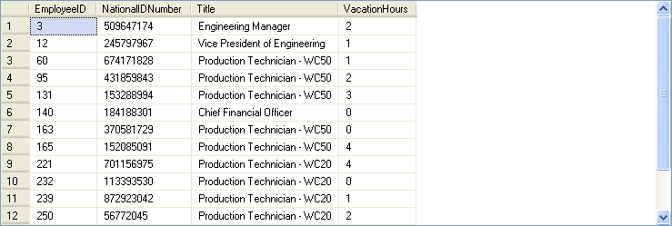
Filtering Data with Predicates(Contd.)
The following SQL query retrieves records from the Employee table where the vacation hour is less than 5:
Example

Slide 18
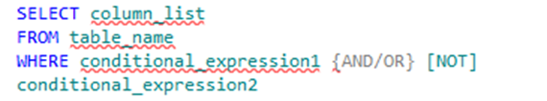
Filtering Data with Predicates(Contd.)
Logical operators:
Are used in the SELECT statement to retrieve records based on one or more conditions.
Are of the following types:
OR
AND
NOT
Syntax

Slide 19


Filtering Data with Predicates(Contd.)
Example

Slide 20

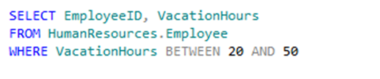
Filtering Data with Predicates(Contd.)
Range operator:
Retrieves data based on a range.
Are of the following types:
BETWEEN
NOT BETWEEN
Syntax
Example

Slide 21
Just a minute
Which of the following options are logical operators?
1. BETWEEN and NOT BETWEEN
2. AND, OR, and NOT
3. + and %
4. > and <
Answer:
2. AND, OR, and NOT

Slide 22

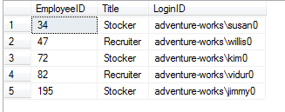
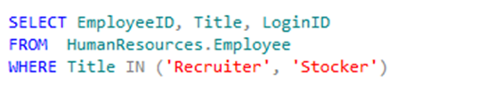
Filtering Data with Predicates(Contd.)
IN keyword:
Selects values that match any one of the values in a list.
NOT IN keyword:
Restricts the selection of values that match any one of the values in a list.
Syntax
Example

Slide 23


Filtering Data with Predicates(Contd.)
The LIKE keyword: is used to search a string by using the following wildcard characters:
%
_
[]
[^]
Matches the given character string with the specified pattern.
Example

Slide 24
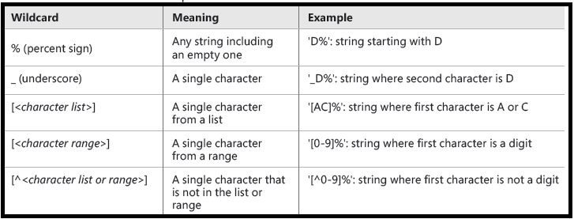
Wildcards used in LIKE patterns

Slide 25

Filtering Data with Predicates(Contd.)
NULL values:
Can be retrieved by using the IS NULL keyword with the SELECT statement.
Example

Slide 26
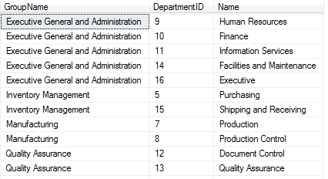

Sorting Data
ORDER BY clause:
Can be used with the SELECT statement to display records in a specific order.
Displays record in ascending or descending order.
Syntax
Example

Slide 27
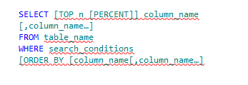

Filtering Data with Top and OFFSET-FETCH
Top
With the TOP option, you can filter a requested number or percent of rows from the query result based on indicated ordering.
Syntax
Example

Slide 28

Filtering Data with OFFSET-FETCH
OFFSET-FETCH
Use to filter data based on a specified number of rows and ordering.
It has skipping capability.
The OFFSET and FETCH clauses appear right after the ORDER BY clause
OFFSET clause indicating how many rows you want to skip (0 if you don’t want to skip any); you then optionally specify the FETCH clause indicating how many rows you want to filter.
The following query defines ordering based on order date descending, followed by order ID descending; it then skips 50 rows and fetches the next 25 rows.
Example

Slide 29


DISTINCT keyword:
Eliminates the duplicate rows from the result set.
Syntax
Example

Slide 30

Just a minute
Write a query to display all the records of the ProductModel table where the product name begins with HL.
Solution

Slide 31
Demo: Retrieving Data
Problem Statement:
You are a database developer of AdventureWorks, Inc. The AdventureWorks database is stored in the SQLSERVER01 database server. The details of the sales persons are stored in the SalesPerson table. The management wants to view the details of the top three sales persons who have earned bonus money between $ 4,000 and $ 6,000.
How will you generate this report?

Slide 32
Summary
In this session, you learned that:
Data can be retrieved from a database by using the SELECT statement.
Data that has to be retrieved based on a condition is specified by adding the WHERE clause.
Literals and user-defined headings are added to change the display.
The concatenation operator is used to concatenate a string expression.
Arithmetic operators are used to perform mathematical operations.
Comparison operators test the similarity between two expressions.
Logical operators are used in the SELECT statement to retrieve records based on one or matching conditions. The logical operators are AND, OR, and NOT.

Slide 33
Summary
Range operators retrieve data based on the range. There are of two types of range operators, BETWEEN and NOT BETWEEN.
The IN keyword allows the selection of values that match any one of the values in a list.
The NOT IN keyword restricts the selection of values that match any one of the values in a list.
The LIKE keyword is used to specify the pattern search.
The IS NULL keyword is used to retrieve missing values.
The ORDER BY clause is used to retrieve data in a specific order.
Filtering Data with OFFSET-FETCH

