Slide 1
Topics
Using built-in Functions
Different Types of functions- Scalar, Aggregate, Ranking
Different Types of Scalar Functions

Slide 2
Using Built-in Functions to Customize the Result Set
What is customization?

Slide 3
Using Built-in Functions to Customize the Result Set(Contd)
Customization includes changing the format of the string or date values or performing calculations on the numeric values in the result set
.

Slide 4
Built-in Functions (Transact-SQL)
SQL Server provides many built-in functions and also lets you create user-defined functions. The categories of built-in functions are listed on this page.
Types of Functions
Scalar Functions
Aggregate Functions
Ranking Functions
Rowset Functions

Slide 5
Scalar Functions:
String Functions
Mathematical Functions
System Functions
Date and Time Functions
Conversion Functions
Text and Image Functions
Security Functions
Metadata Functions

Slide 6

Using String Functions
String functions :
Are used to manipulate the string values in the result set.
Are used with the char and varchar data types.
Syntax

Slide 7
Using String Functions (Contd.)
The following table lists some of the string functions provided by SQL Server.
ASCII | LTRIM | SOUNDEX
CHAR | NCHAR | SPACE
CHARINDEX | PATINDEX | STR
CONCAT | QUOTENAME | STUFF
DIFFERENCE | REPLACE | SUBSTRING
FORMAT | REPLICATE | UNICODE
LEFT | REVERSE | UPPER
LEN | RIGHT
LOWER | RTRIM

Slide 8
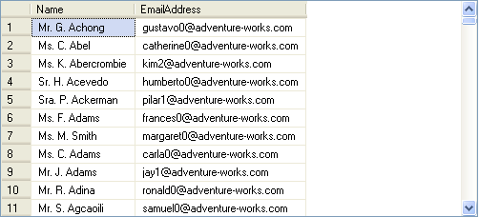
Using String Functions (Contd.)
Example

Slide 9
Date and Time Functions
T-SQL supports a number of date and time functions that allow you to manipulate your date and time data.
Function | Syntax | Return value | Return data type
DATENAME | DATENAME (datepart , date ) | Returns a character string that represents the specified datepartof the specified date. | nvarchar
DATEPART | DATEPART (datepart , date ) | Returns an integer that represents the specified date part of the specified date. | int
DAY | DAY ( date ) | Returns an integer that represents the day day part of the specified date. | int
MONTH | MONTH ( date ) | Returns an integer that represents the month part of a specified date. | int
YEAR | YEAR ( date ) | Returns an integer that represents the year part of a specified date. | int

Slide 10
Date and Time Functions(Contd..)
Function | Syntax | Return value
DATEFROMPARTS | DATEFROMPARTS (year, month, day ) | Returns a datevalue for the specified year, month, and day.
DATETIME2FROMPARTS | DATETIME2FROMPARTS ( year, month,day, hour, minute,seconds, fractions,precision ) | Returns adatetime2 value for the specified date and time and with the specified precision.
DATETIMEFROMPARTS | DATETIMEFROMPARTS ( year, month,day, hour, minute,seconds,milliseconds ) | Returns a datetimevalue for the specified date and time.
DATETIMEOFFSETFROMPARTS | DATETIMEOFFSETFROMPARTS ( year,month, day, hour,minute, seconds, fractions,hour_offset,minute_offset,precision ) | Returns adatetimeoffsetvalue for the specified date and time and with the specified offsets and precision.
SMALLDATETIMEFROMPARTS | SMALLDATETIMEFROMPARTS ( year,month, day, hour,minute ) | Returns asmalldatetimevalue for the specified date and time.
TIMEFROMPARTS | TIMEFROMPARTS (hour, minute,seconds, fractions,precision ) | Returns a timevalue for the specified time and with the specified precision.

Slide 11
Date and Time Functions(Contd..)
Function | Syntax | Return value | Return data type
DATEADD | DATEADD (datepart, number , date ) | Returns a newdatetime value by adding an interval to the specifieddatepart of the specified date. | The data type of the date argument
EOMONTH | EOMONTH (start_date [,month_to_add ] ) | Returns the last day of the month that contains the specified date, with an optional offset. | Return type is the type of start_date ordate.
DATEDIFF | DATEDIFF ( datepart, startdate , enddate) | Returns the number of date or timedatepartboundaries that are crossed between two specified dates. | int

Slide 12
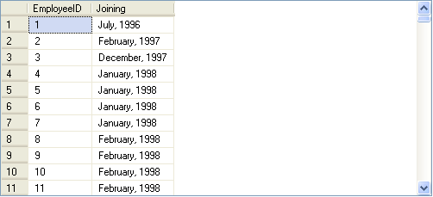
Date and Time Functions(Contd..)
The following SQL query uses datename() and datepart() functions to retrieve the month name and year from a given date:
Example

Slide 13
Mathematical Functions
The following scalar functions perform a calculation, usually based on input values that are provided as arguments, and return a numeric value:
ABS | DEGREES | RAND
ACOS | EXP | ROUND
ASIN | FLOOR | SIGN
ATAN | LOG | SIN
ATN2 | LOG10 | SQRT
CEILING | PI | SQUARE
COS | POWER | TAN
COT | RADIANS

Slide 14

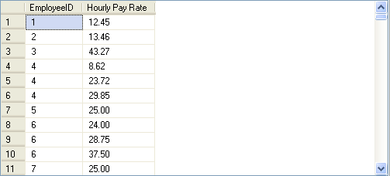
Mathematical Functions(Contd.)
The following SQL query retrieves the EmployeeID and Rate for a specified employee id from the EmployeePayHistory table:
Example

Slide 15
Just a minute
Identify the utility of the datepart() function
Solution:
The datepart() function is used to extract different parts of a date value.

Slide 16

Just a minute
The management of AdventureWorks wants to increase the shift time from 8 hours to 10 hours. Calculate the end time of the shifts based on their start time.
Solution

Slide 17
Ranking Functions
What are ranking functions?

Slide 18
Ranking Functions
Ranking functions return a ranking value for each row in a partition.
Depending on the function that is used, some rows might receive the same value as other rows.
Ranking functions are nondeterministic.
Transact-SQL provides the following ranking functions:
ROW_NUMBER()
RANK()
DENSE_RANK()
NTILE()

Slide 19

Ranking Functions(Contd.)
ROW_NUMBER() :
Returns the sequential number of a row within a partition of a result set, starting at 1 for the first row in each partition.
Syntax

Slide 20

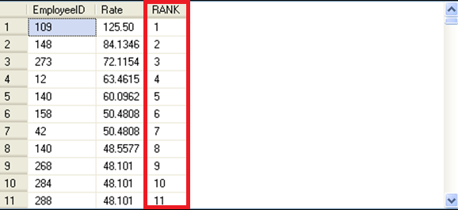
Ranking Functions(Contd.)
Example

Slide 21

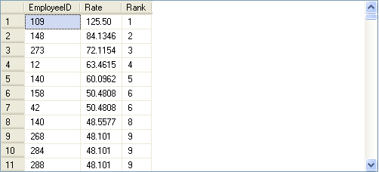
Ranking Functions(Contd.)
The rank() function:
Returns the rank of each row in a result set based on specified criteria.
Example
The salary rates for the employee IDs 158 and 42 are same.
But the rank for the employee ID 140 is 8, not 7.

Slide 22

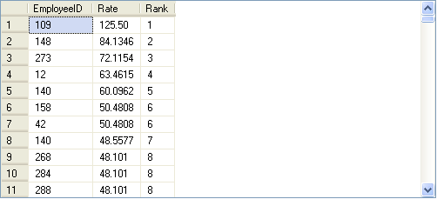
Ranking Functions(Contd.)
The dense_rank() function:
Is used where consecutive ranking values need to be given based on a specified criteria.
Example
The salary rates for the employee IDs 158 and 42 are same.
But the rank for the employee ID 140 is 7, not 8.

Slide 23

Ranking Functions(Contd.)
The ntile() function:
Is used to divide the result set into a specific number of groups.
Accepts a positive integer to distribute the rows into the number of groups.
Returns the number of group to which the row belongs for each row retrieved from the database.
Example

Slide 24
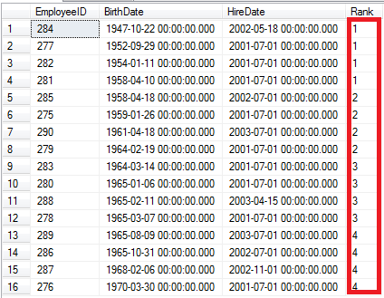
Ranking Functions(Contd.)
Divided into four groups with each group containing four rows and each row in a group is given the same ranking.

Slide 25
System Functions
The following system functions perform operations on and return information about values, objects, and settings in SQL Server.
$PARTITION | ERROR_SEVERITY
@@ERROR | ERROR_STATE
@@IDENTITY | FORMATMESSAGE
@@PACK_RECEIVED | GETANSINULL
@@ROWCOUNT | GET_FILESTREAM_TRANSACTION_CONTEXT
@@TRANCOUNT | HOST_ID
BINARY_CHECKSUM | HOST_NAME
CHECKSUM | ISNULL
CONNECTIONPROPERTY | ISNUMERIC
CONTEXT_INFO | MIN_ACTIVE_ROWVERSION
CURRENT_REQUEST_ID | NEWID
ERROR_LINE | NEWSEQUENTIALID
ERROR_MESSAGE | ROWCOUNT_BIG
ERROR_NUMBER | XACT_STATE, ERROR_PROCEDURE

Slide 26
Demo: Customizing the Result Set
Problem Statement:
The management at AdventureWorks, Inc. wants to view a report that displays the employee ID, designation, and age of the employees who are working as marketing managers or marketing specialists. The data should be displayed in uppercase.
The employee details are stored in the Employee table in the AdventureWorks database. How will you display the required data?

Slide 27
Summary
In this session, you learned that:
The mathematical functions are used to perform numerical operations.
The ranking functions are used to generate sequential numbers for each row or to give a rank based on specific criteria.
You can use the following functions to rank the records:
row_number()
rank()
dense_ rank()
ntile()
The system functions are used to query system tables.

