Slide 1
Topics
Summarizing and Grouping data by Aggregate Functions
Using Pivot

Slide 2
Summarizing and Grouping Data
How can I summarize and group data?

Slide 3
Summarizing and Grouping Data(Contd.)
SQL Server provides aggregate functions to generate summarized data.

Slide 4
Summarizing Data by Using Aggregate Functions
Aggregate functions:
Summarize the values for a column or a group of columns, and produce a single value.
Aggregate functions are:
Avg()
Count()
Min()
Max()
Sum()
Syntax

Slide 5
Summarizing Data by Using Aggregate Functions
Avg():
Returns the average of values in a numeric expression, either all or distinct.
Example
Count():
Returns the number of values in an expression, either all or distinct.
Example

Slide 6
Summarizing Data by Using Aggregate Functions
Min():
Returns the lowest value in the expression
Example
Max():
Returns the highest value in the expression.
Example

Slide 7
Summarizing Data by Using Aggregate Functions(Contd.)
Sum():
Returns the sum total of values in a numeric expression, either all or distinct.
Example

Slide 8

Grouping Data
A query becomes a grouped query when you use a group function, a GROUP BY clause, or both
Use group functions.
Group data by using a single grouping set
Group data by using multiple grouping sets.
HAVING clause : To filter entire groups
Group function :
A query that invokes a group function but doesn’t have an explicit GROUP BY clause arranges all rows in one group.
Example
The query defines
only one group, it returns only one row in the result set.

Slide 9

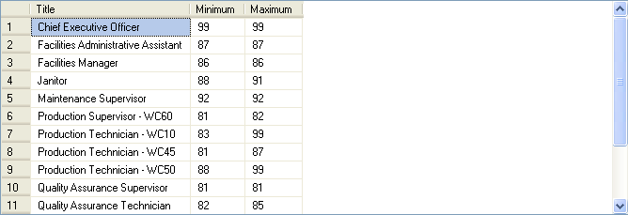
Grouping Data(Contd.)
Working with a Single Grouping Set :
Group the data in only one way.
The grouping set can be made of multiple elements.
Example
Displays the minimum and maximum values of vacation hours for the different types of titles.

Slide 10
Grouping Data(Contd.)
Working with Multiple Grouping Sets
you can use one query to group the data in more than one way
T-SQL supports three clauses that allow defined multiple grouping sets
1. GROUPING SETS
2. CUBE
3. ROLLUP

Slide 11
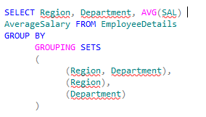
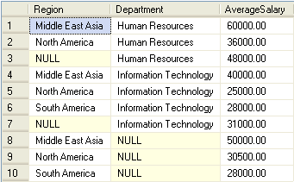
Grouping Data(Contd.)
GROUPING SETS :
Use the GROUPING SETS clause to list all grouping sets that you want to define in the query
Example
( Region, Department)
(Department)
(Region)

Slide 12
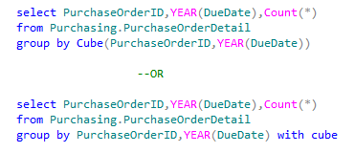
Grouping Data(Contd.)
CUBE :
The CUBE clause accepts a list of expressions as inputs and defines all possible grouping sets that can be generated from the inputs—including the empty grouping set
Example
The CUBE clause defines all four possible grouping sets from the two inputs:
1. ( PurchaseOrderID, YEAR(DueDate) )
2. (PurchaseOrderID)
3. ( YEAR(DueDatee) )
4. ( )

Slide 13
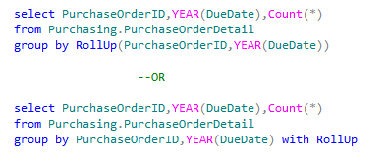
Grouping Data(Contd.)
ROLLUP
The ROLLUP clause is also an abbreviation of the GROUPING SETS clause.
you use it when there’s a hierarchy formed by the input elements.
it avoid computing unnecessary aggregates.
Example

Slide 14
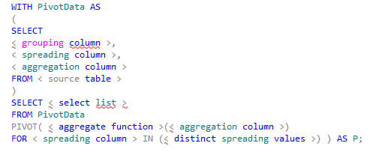
Pivoting Data
Pivoting :
Is a technique that groups and aggregates data, transitioning it
from a state of rows to a state of columns.
Unpivoting :
Is the inverse of pivoting
Pivoting Data :
In all pivot queries, you need to identify three elements:
What do you want to see on rows?
What do you want to see on columns?
What do you want to see in the intersection of each distinct row and column value?
Syntax

Slide 15
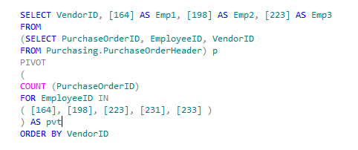
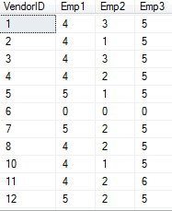
Pivoting Data(Contd.)
Example
Displays the number of purchase orders placed by certain employees, laid down with the vendors.

Slide 16
Just a minute
When grouping data, which of the following clauses helps eliminate the groups that do not match the specified condition?
NOT IN
HAVING
WHERE
COMPUTE
Solution:
2. HAVING

Slide 17
Just a minute
Match the column A with column B.
Column A | Column B
COMPUTE | Transforms a set of columns into values.
PIVOT | Removes leading blanks from the character expression.
Str | Generates summary rows by using aggregate functions in the query results.
Ltrim | Converts numeric data to character data.
Solution:
Column A | Column B
COMPUTE | Generates summary rows by using aggregate functions in the query results.
PIVOT | Transforms a set of columns into values.
Str | Converts numeric data to character data.
Ltrim | Removes leading blanks from the character expression.

Slide 18
Demo
Problem Statement:
You are a database developer at AdventureWorks, Inc. The management wants to view the average quantity ordered for each product group. The data should be displayed in the descending order of ProductID.
The sales details are stored in the SalesOrderHeader and SalesOrderDetails tables in the AdventureWorks database. How will you generate this report?

Slide 19
Summary
In this session, you learned that:
The system functions are used to query system tables
The aggregate functions, such as avg(), count(), min(), max(), and sum(), are used to retrieve summarized data.
The GROUP BY, GROUP BY ALL, and PIVOT clauses are used to group the result set.
The GROUPING SETS clause is used to combine the results generated by multiple GROUP BY clauses into a single result set.

