Slide 1
Topics
Introduction to Joins in Sql Server
Different types of Join operators available in Sql Server

Slide 2
Combining Sets
T-SQL provides a number of different ways to combine data from multiple tables
Using Joins
Using Subqueries
Using Table Expressions
Using APPLY Operator
Using Set Operators

Slide 3
Querying Data by Using Joins
What are Joins?

Slide 4
Querying Data by Using Joins(Contd.)
Joins are used to combine and retrieve data from multiple tables
Types of Joins
Cross Joins
Inner Joins
Outer Joins
Self Joins

Slide 5
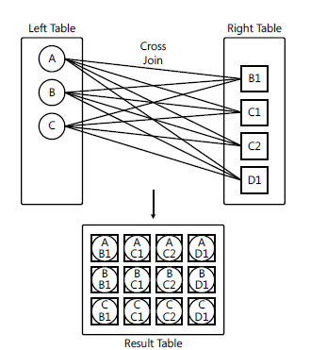

Querying Data by Using Joins(Contd.)
Cross Joins
A cross join is the simplest type of join.
Cross joins return a Cartesian product of the rows from both sides
Not most commonly used.
It performs Cartesian product of the two input tables.
Example

Slide 6
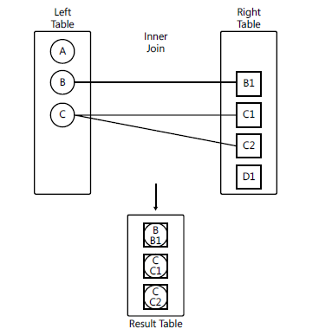
Querying Data by Using Joins(Contd.)
Inner Joins
Inner joins match rows based on a predicate and return only matches.
If join using a predicate with an equality operator is called as equijoin
Rows for which the predicate evaluates to false or unknown are
discarded.

Slide 7


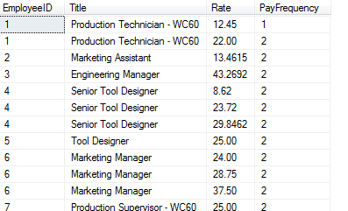
Querying Data by Using Joins(Contd.)
Inner Joins
Syntax
Example

Slide 8

Querying Data by Using Joins(Contd.)
Outer Joins
With outer joins, you can request to preserve all rows from one or both sides of the join, never mind if there are matching rows in the other side based on the ON predicate
Outer Joins is classified as following
Left Outer Join
Right Outer Join
Full Outer Join
Syntax

Slide 9
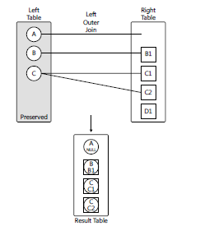
Querying Data by Using Joins(Contd.)
Left Outer Joins :
By using the keywords LEFT OUTER JOIN (or LEFT JOIN for short), you ask to preserve the left table.
The Join returns all the matching records in addition the join also returns rows from the left that had no matches in the right table with NULLs used as placeholders in the right side.

Slide 10
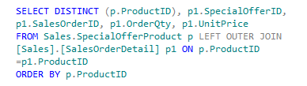
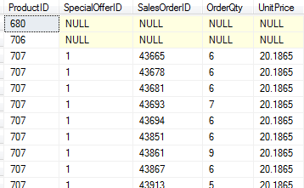
Querying Data by Using Joins(Contd.)
Example

Slide 11
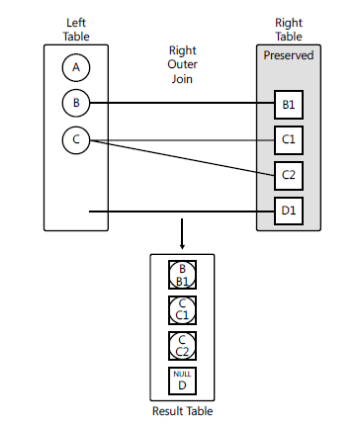
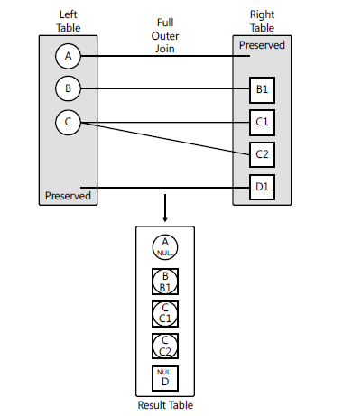
Querying Data by Using Joins(Contd.)
Right Outer Join
Full Outer Join

Slide 12
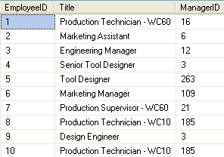
Querying Data by Using Joins(Contd.)
Self join:
A table is joined with itself.
One row in a table correlates with other rows in the same table.
A table name is used twice by giving two alias names in the query.
Consider the Employee table, as shown in the following figure.

Slide 13
Querying Data by Using Joins(Contd.)
To display the employee details along with their manager details, you can use a self join.

Slide 14
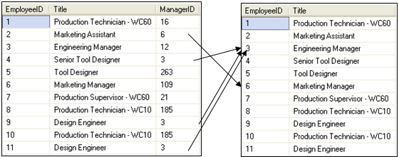
Querying Data by Using Joins(Contd.)
To perform self-join, you need to divide the physical tables into two logical tables, as shown in the following figure.
Employee (emp)
Employee (mgr)
Emp.ManagerID = mgr.EmployeeID

Slide 15

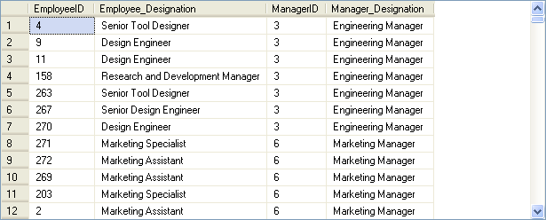
Querying Data by Using Joins(Contd.)
Example

Slide 16
Demo
Problem Statement:
The HR manager of AdventureWorks, Inc. requires a report containing the following details:
Employee ID
Employee name
Department name
Date of joining
Employee address
How will you generate this report?

Slide 17
Summary
In this session, you learned that:
Joins and subqueries are used to retrieve data from multiple tables.
An inner join combines records from multiple tables by using a comparison operator on a common column.
A left outer join returns all the rows from the left table and the matching rows from the right table.
A right outer join returns all the rows from the right table and the matching rows from the left table.
A full outer join returns all the matching and non-matching rows from both the tables on which the join is applied.
A cross join returns each row from the first table joined with each row from the second table.

Slide 18
Summary
In an equi join, only the equality operator is used to specify the join condition.
A self join correlates one row in a table with other rows in the same table.

