Slide 1
Topics
Introduction to subqueries
Different types of operators used with subqueries
Correlated subqueries
Using Apply Operators

Slide 2
Subqueries
A subquery is a query that is nested inside a SELECT, INSERT, UPDATE, or DELETE statement, or inside another subquery. A subquery can be used anywhere an expression is allowed
Self-Contained Subqueries :
Subqueries can be self-contained—namely, independent of the outer query
Correlated Subqueries :
Correlated subqueries are subqueries where the inner query has a reference to a column from the table in the outer query.
The result of the subquery can be
scalar
multi-valued
table-valued

Slide 3
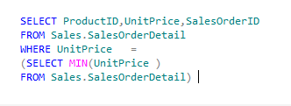

Subqueries(Contd.)
Self-Contained Subqueries :
Self-contained subqueries are subqueries that have no dependency on the outer query.
The following query uses a self-contained subquery to return the products sales details with the minimum unit price.
Example

Slide 4
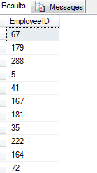

Subqueries(Contd.)
multi-valued subquery
You can specify different kinds of conditions on subqueries by using the following keywords:
IN
EXISTS
IN keyword:
Is used to retrieve rows in a subquery based on the match of values given in a list.
Example

Slide 5

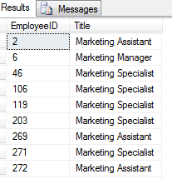
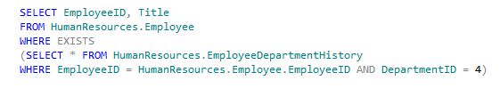
Subqueries(Contd.)
EXISTS keyword:
Is used to check the existence of the data and returns true or false.
Syntax
Example

Slide 6
Subqueries(Contd.)
Using Modified Comparison Operators
The ALL and ANY keywords can be used to modify the existing comparison operators.

Slide 7
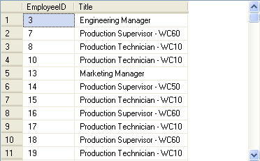

Using Modified Comparison Operators(Contd.)
The ALL keyword:
Returns a TRUE value if all the values that are retrieved by the subquery satisfy the comparison operator.
The ANY keyword:
Returns a TRUE value, if any value that is retrieved by the subquery satisfies the comparison operator.
Example

Slide 8
Using Modified Comparison Operators(Contd.)
The following table shows the operators that can be used with the ALL and ANY keywords.
Operator | Description
>ALL | Means greater than the maximum value in the list. The expression | column_name >ALL (10, 20, 30) means ‘greater than 30’
>ANY | Means greater than the minimum value in the list. The expression | column_name >ANY (10, 20, 30) means ‘greater than 10’
=ANY | Means any of the values in the list. It acts in the same way as the IN clause. The expression | column_name =ANY (10, 20, 30) means ‘equal to either 10 or 20 or 30’
<>ANY | Means not equal to any value in the list. The expression | column_name <>ANY (10, 20, 30) means ‘not equal to 10 or 20 or 30’
<>ALL | Means not equal to all the values in the list. It acts in the same way as the NOT IN clause. The expression | column_name <>ALL (10, 20, 30) means ‘not equal to 10 and 20 and 30’

Slide 9
Just a minute
What is the use of the EXISTS keyword in a subquery?
Solution:
The EXISTS keyword is used to check the existence of rows in the result set of an inner query according to the condition specified in the inner query.

Slide 10
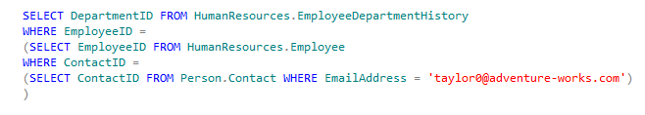

Nested Subqueries
Contain one or more subqueries.
Can be used when the condition of a query is dependent on the result of another query.
Example
The level 2 inner query returns the contact ID of an employee based on the e-mail address of the employee from the Person table.

Slide 11


Correlated subqueries
Correlated subqueries are subqueries where the inner query has a reference to a column from the table in the outer query
Example

Slide 12
Just a minute
Write a query to determine the employee ID and the department ID of all the employees whose manager ID is 6 from the AdventureWorks database.
Solution

Slide 13

APPLY Operator
The APPLY operator is a powerful operator that you can use to apply a table expression given to it as the right input to each row from a table expression given to it as the left input.
The two forms of the APPLY operator are
CROSS APPLY
OUTER APPLY
CROSS APPLY
Returns only those rows from the outer result set that matches with the inner result set.
Example

Slide 14

APPLY Operator(Contd.)
The OUTER APPLY operator:
Returns all rows from the outer result set even if the corresponding row is not found in the inner result set.
Contains NULL values when the inner result set does not return a matching value for each or either of the rows from the outer result set.
Example

Slide 15
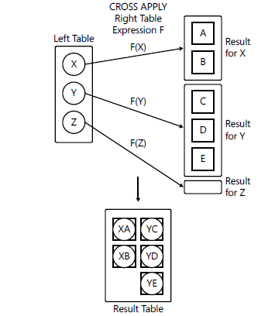
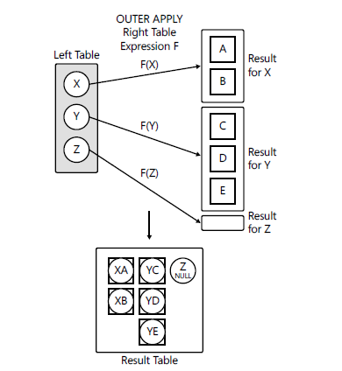
APPLY Operator(Contd.)

Slide 16
Summary
In this session, you learned that:
The IN clause in a subquery returns zero or more values.
The EXISTS clause in a subquery returns data in terms of a TRUE or FALSE value.
The ALL and ANY keywords are used in a subquery to modify the existing comparison operator.
Aggregate functions can also be used in subqueries to generate aggregated values from the inner query.
Subqueries that contain one or more queries are specified as nested subqueries.
A correlated subquery can be defined as a query that depends on the outer query for its evaluation.
SQL Server provides the APPLY operator that allows you to combine the result sets retrieved from table expressions.

Slide 17
Summary (Contd.)
There are two types of APPLY operators supported by SQL Server. These are:
CROSS APPLY
OUTER APPLY
The CROSS APPLY operator returns only those rows from the outer result set that match with the inner result set.
The OUTER APPLY operator returns all rows from the outer result set even if the corresponding row is not found in the inner result set.

