Slide 1
Topics
Introduction to Set Operations
Working with Union, Intersect, Except
Derived Tables
Working with CTE-Common Table Expression
Different types-nested and recursive

Slide 2

Using Set Operators
Set operators operate on two result sets of queries, comparing complete rows between the results
Depending on the result of the comparison and the set operator used, the operator determines whether to return the row or not.
T-SQL supports the following set operators
UNION
INTERSECT
EXCEPT
It also supports one multiset operator
UNION ALL.
The number of columns in the two queries needs to be the same, and corresponding
columns need to have compatible types.
Syntax

Slide 3

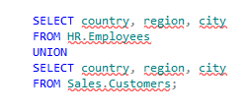
Using Set Operators(Contd.)
UNION
Unifies the results of the two input queries.
It has an implied DISTINCT property, meaning that it does not return duplicate rows.
Example
Returns locations that are employee locations or customer locations or both.

Slide 4


Using Set Operators(Contd.)
UNION ALL
The UNION ALL operator unifies the results of the two input queries.
It will not eliminate duplicate rows
Example

Slide 5
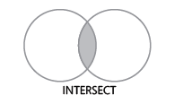
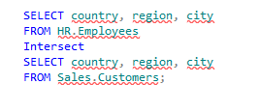
Using Set Operators(Contd.)
INTERSECT
It returns only distinct rows that are common to both sets.
If the common rows are not found, then NULL value is returned
Example
Return distinct locations that are both employee and customer locations

Slide 6
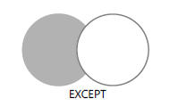

Using Set Operators(Contd.)
EXCEPT
The EXCEPT operator performs set difference
It returns distinct rows that appear in the first query but not the second.
Example
query returns locations that are employee
locations but not customer locations.

Slide 7

Using Set Operators(Contd.)
Set operators have precedence:
INTERSECT precedes UNION and EXCEPT, and
UNION and EXCEPT are considered equal
Consider the following set operators.
Example
First, the intersection between query 2 and query 3 takes place, and then a union between the result of the intersection and query 1
You can always force precedence by using parentheses.
Example

Slide 8
Table Expressions
Table expressions are named queries
You write an inner query that returns a relational result set, name it, and query it from an outer query
T-SQL supports four forms of table expressions :
Derived tables
Common table expressions (CTEs)
Views
Inline table-valued functions

Slide 9
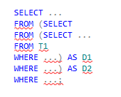
Table Expressions(Contd.)
Derived Tables
A derived table is probably the form of table expression that most closely resembles a subquery—only a subquery that returns an entire table result.
You define the derived table’s inner query in parentheses in the FROM clause of the outer query, and specify the name of the derived table after the parentheses.
The derived table is defined in the FROM clause of the outer query in parentheses, followed by the derived table name.
Example

Slide 10
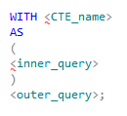
Table Expressions(Contd.)
Common table expressions (CTEs)
A common table expression (CTE) is a similar concept to a derived table in the sense that it’s a named table expression that is visible only to the statement that defines it.
Like a query against a derived table, a query against a CTE involves three main parts:
The name you assign to the query and its columns
The inner query
The outer query
Syntax

Slide 11
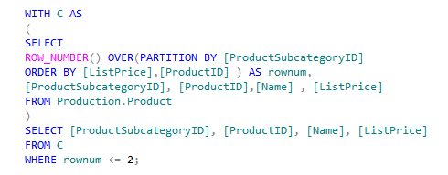
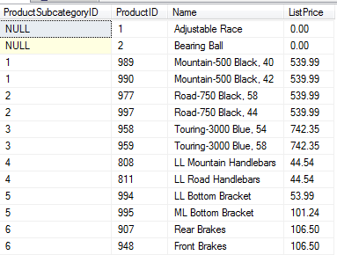
Table Expressions(Contd.)
Syntax
Returned for each product category the two products with the lowest unit prices.

Slide 12
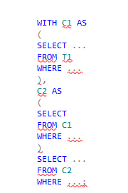
Table Expressions(Contd.)
If you need to define multiple CTEs, you simply separate them by commas.
Each can refer to the previously defined CTEs and the outer query can refer to all of them
If you want to refer to one CTE from another, you can use the following general form.
Syntax

Slide 13
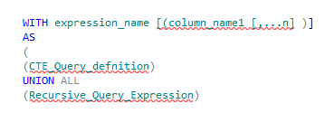
Table Expressions(Contd.)
Recursive CTE
A recursive CTE references a CTE multiple times in the same query.
In a recursive CTE, result sets of more than one query are combined to populate the CTE.
The body of the recursive query has two or more queries, usually separated by a UNION ALL operator
The recursive CTE consists of:
Anchor query
Recursive query
Syntax

Slide 14
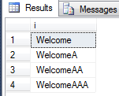
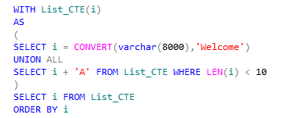
Table Expressions(Contd.)
The process of execution of a recursive CTE is:
The anchor query is executed first to create the first invocation or base result set (T0).
The recursive query is executed with Ti as an input and Ti+1 as an output. Here, i starts from 0.
Step 2 is repeated until an empty set is returned.
The final result set is displayed. This result set is a UNION ALL of T0 to Tn.
Example

Slide 15
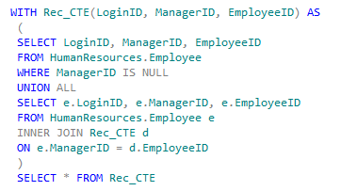

Table Expressions(Contd.)
The following code uses a recursive CTE to return the management chain leading all the way up to the CEO for a specified employee.
Example
The following steps describe the execution of the preceding statements:
The anchor query returns the top level employee where the ManagerID is null, as shown in the following figure.

Slide 16
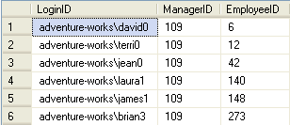
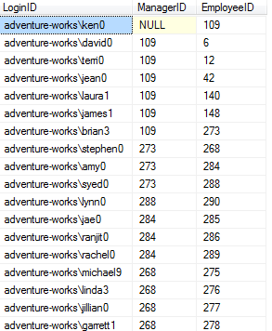
Table Expressions(Contd.)
This result is referenced by the recursive query to find the direct subordinates at the next level, 109. The following figure shows the direct subordinates at the next level.
Retrieval of direct subordinates at the next level occurs recursively, until an empty result set is returned by the JOIN operation.
Final result set of the preceding query is following

Slide 17
Demo
AdventureWorks, Inc is a leading manufacturing company. The company stores the details of sold products in the TransactionHistory table. The management of the company is reviewing the performance of its products in the market. Therefore, the management wants to know the number of units sold of each product. They also want to identify the product that sold the maximum units. How will you perform this task?

Slide 18
Summary
In this session, you learned that:
The UNION operator is used to combine the data of two or more queries into a single result set.
The EXCEPT operator compares two result sets and returns the data from the first result set that is not found in the second result set.
The INTERSECT operator returns the common rows after comparing two result sets. If the common rows are not found, then NULL value is returned.
A CTE is used to create a temporary named result set.
In a recursive CTE, result sets of more than one query are combined to populate the CTE.
A recursive CTE consists of the following members to produce the required result:
Anchor query
Recursive query

