Slide 1
Topics
Understanding System databases
Various database files and file groups
Derived Tables
Working with CTE-Common Table Expression
Different types-nested and recursive

Slide 2
Managing Databases
As a database developer, you might need to create databases to store information.
Notes:
2

Slide 3
Managing Databases(Contd)
Before creating a database, it is important to identify the system databases supported by SQL Server and their importance.
Notes:
3

Slide 4
Identifying System Databases in SQL Server
SQL Server contains the following system databases:
master
tempdb
model
msdb
Resource
ReportServer
ReportServerTempDB
Distribution
Notes:
4

Slide 5
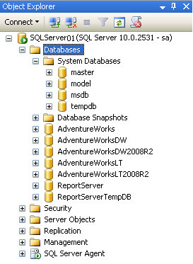
Identifying System Databases in SQL Server(Contd.)
You can view the system databases in the Object Explorer window of SQL Server Management Studio, as shown in the following figure.
Notes:
5

Slide 6
Identifying System Databases in SQL Server(Contd.)
The Object Explorer window does not display the Resource database.
Notes:
6

Slide 7
Identifying System Databases in SQL Server(Contd.)
The master database:
Consists of system tables that keep track of the server installation as a whole and all the other databases.
Contains critical data that controls the SQL Server operations.
Stores the initialization information of SQL Server.
The tempdb database:
Is a temporary database that holds all temporary tables and stored procedures.
Is automatically used by the server to resolve large or nested queries or to sort data before displaying results to the user.
Notes:
7

Slide 8
Identifying System Databases in SQL Server(Contd.)
The model database:
Acts as a template or a prototype for the new databases.
The msdb database:
Supports the SQL Server Agent tool.
Contains a few system-defined tables that are specific to the database.
The Resource database:
Is a read-only database that contains all the system objects, such as system-defined procedures and views.
Does not contain user data or user metadata.
Notes:
8

Slide 9
Identifying System Databases in SQL Server(Contd.)
The ReportServer database:
Stores the metadata and object related information used by reporting services.
Stores information about all the reports, linked reports, data source, report models, permissions, security settings, report execution schedules, and report execution log.
The ReportServerTempDB database:
Is also installed along with the installation of SQL Server Reporting Services.
Is used by ReportServer database to store session information, cached reports, and working tables used by reporting services.
Notes:
9

Slide 10
Identifying System Databases in SQL Server(Contd.)
The Distribution database:
Is created when the replication is configured on an instance of SQL Server.
Stores all the metadata information related to the configuration of replication.
Stores the historical data for all types of replication configured on an instance of SQL Server.
Notes:
10

Slide 11
Just a minute
What is the utility of the model database?
Solution:
The model database acts as a template or a prototype for the new databases

Slide 12
Identifying the Database Files
SQL Server maps a database over a set of operating-system files.
Each database is stored as a set of files on the hard disk of the computer.
These files include:
Primary data file
Has a .mdf extension, contains database objects
Secondary data file
Has a .ndf extension, used to store user defined database objects.
Transaction log file
Has a .ldf extension, Records all modifications that have occurred in the database and the transactions that caused those modifications.
Notes:
12

Slide 13
Identifying the Database Files(Contd.)
The database files are grouped together in filegroups for allocation and administration purposes.
Filegroup:
Is a collection of files.
Is of the following types:
Primary filegroup
User-defined filegroup
Contains the primary data file and any other files that are not put into any other filegroup.
Is a filegroup that is created by users.
Notes:
13

Slide 14
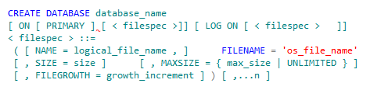
Creating a User-Defined Database
To create a user-defined database, you can use the CREATE DATABASE statement.
Syntax
The following SQL statement creates a database named Personnel to store the data related to all the employees:
Example
Creates a database named Personnel in the C:\Program Files\Microsoft SQL Server\MSSQL10.MSSQLSERVER\MSSQL\DATA folder.
Notes:
14

Slide 15
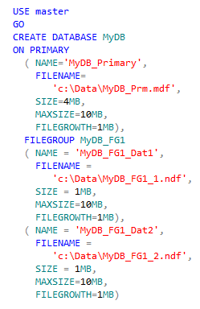
Creating a User-Defined Database(Contd.)
You can also use the following statements to create a database:
Example
Creates a database MyDB where the primary data file
is stored in the primary filegroup.
Creates two secondary data files that are stored in the user-defined filegroup named MyDB_FG1.
Notes:
15

Slide 16
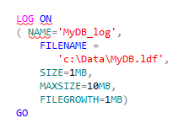
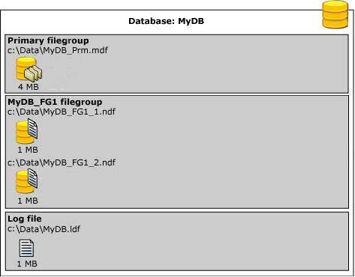
Creating a User-Defined Database(Contd.)
Creates a log file by the name MyDB.ldf.
The following figure represents the creation of primary, log, and secondary files of the MyDB database.
Notes:
16

Slide 17

Creating a User-Defined Database(Contd.)
You can change the default filegroup by using the following statement:
Example
Makes MyDB_FG1 as the default filegroup for the MyDB database.
Let us see how to create a database using the Object Explorer window.
Notes:
17

Slide 18
Creating a User-Defined Database(Contd.)
The FILESTREAM feature:
Enables you to store and manage unstructured data such as videos, graphic files, sound clips, Word documents, or Excel spreadsheets in a database. This unstructured data is called a Binary Large Object (BLOB).
Allows BLOBs to be stored directly in the Windows New Technology File System (NTFS).
The SQL Server database engine manages the link between the column declared with the FILESTREAM feature and the actual file located in the NTFS.

Slide 19
Creating a User-Defined Database(Contd.)
To use the FILESTREAM feature, a database needs to contain:
A FILESTREAM filegroup.
A table with a varbinary(max) column along with the FILESTREAM attribute.
For a database to contain the FILESTREAM filegroup, the FILESTREAM feature of the SQL Server instance, on which the database is created, must be enabled.
Once the FILESTREAM feature is enabled for an instance of SQL Server, you need to configure the FILESTREAM access level.

Slide 20
Creating a User-Defined Database(Contd.)
The FILESTREAM access level specifies the accessibility of the FILESTREAM data on an instance of SQL Server.
The following table describes the possible values of access levels and their accessibility.
Access Levels | Accessibility
0 | FILESTREAM data access is disabled. This is the default value.
1 | FILESTREAM data is enabled only for T-SQL access.
2 | FILESTREAM data is enabled only for T-SQL and local file system access.
3 | FILESTREAM data is enabled for T-SQL, local file system access, and remote file system access.

Slide 21

Creating a User-Defined Database(Contd.)
You can execute the following statement in the Query Editor window to configure the FILESTREAM data access:
Then, execute the following statement to apply the configuration changes:
Example
Example
Notes:
21

Slide 22
Just a minute
Which statement is used to create a database?
Solution:
The CREATE DATABASE statement

Slide 23


Renaming a User-Defined Database
The sp_renamedb stored procedure:
Is used to rename a database.
Syntax
Example
Renames the Personnel database to the Employee database.
Notes:
23

Slide 24


Dropping a User-Defined Database
The DROP DATABASE statement:
Is used to delete a database.
Syntax
Example
Deletes the Employee database.
Notes:
24

Slide 25
Managing Tables
A table is a database object used to store data.
Data in a table is organized in rows and columns..
Each row in a table represents a unique record and each column represents an attribute of the record.
Notes:
25

Slide 26
Managing Tables(Contd.)
As a database developer, you need to create and manage tables to store data.
Notes:
26

Slide 27
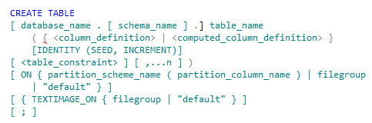
Creating a Table
The CREATE TABLE statement:
Is used to create a table.
Syntax
While creating tables, you need to consider the following guidelines:
The column names within a table must be unique, but the same column name can be used in different tables within a database.
The table name can be of maximum 128 characters.
Notes:
27

Slide 28
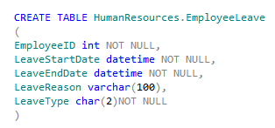
Creating a Table(Contd.)
You can use the following statement to create the EmployeeLeave table:
You can use the following statement to view the structure of HumanResources.EmployeeLeave table:
Example
Example
Notes:
28

Slide 29

Creating a Table(Contd.)
You can use the following statement to create an IDENTITY column in a table:
The EmpCode column of the Employee table is the IDENTITY column with the starting value (SEED) as 100 and the step value (INCREMENT) as 1.
Example
Notes:
29

Slide 30
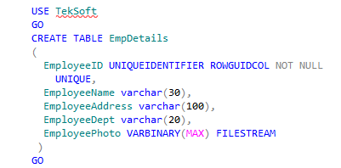
Creating a Table(Contd.)
You can use the following statements to create the EmpDetails table that stores the FILESTREAM data:
Example
Stored the data in the Windows file system.
Uniquely identifies the records in the table across the databases.
Notes:
30

Slide 31

Creating a Table(Contd.)
You can store the spatial data in a table by using the geometry and geography data types.
Example
Stores the latitude and longitude coordinates, which indicate the location of the country.
Let us see how to create a table by using SQL Server Management Studio.
Notes:
31

Slide 32
Summary
In this session, you learned that:
A database is a repository of information that contains data in an organized way.
The master database records all the server-specific configuration information, including authorized users, databases, system configuration settings, and remote servers.
The tempdb database is a temporary database that holds all the temporary tables and stored procedures.
The model database acts as a template or a prototype for new databases.
The msdb database supports the SQL Server Agent. SQL Server Agent includes features that schedule periodic activities of SQL Server.
The Resource database is a read-only database that contains all the system objects that are included with SQL Server.

Slide 33
Summary(Contd.)
The user-defined databases are created by the users to store data for client/server applications.
A database consists of the following types of files:
Primary data file
Secondary data file
Transaction log file
A database must consist of a primary data file and one transaction log file.
The CREATE DATABASE statement is used to create a database, which also includes determining the name of the database, the size of the database, and the files used to store data in the database.
The DROP DATABASE statement is used to delete a database.
Tables are used to store data.
The CREATE TABLE statement is used to create a table.

