Slide 1
Topics
Understanding Data Integrity in tables
Different types of Constraints

Slide 2
Implementing Data Integrity
Data integrity:
Is enforced to ensure that the data in a database is accurate, consistent, and reliable.
Is broadly classified into the following categories:
Entity integrity
Domain integrity
Referential integrity
User-defined integrity
Notes:
2

Slide 3
Implementing Data Integrity(Contd.)
When creating tables, SQL Server allows you to maintain integrity by:
Applying constraints.
Enabling and disabling constraints.
Applying rules.
Using user-defined types.
Notes:
3

Slide 4
Implementing Data Integrity(Contd.)
Constraints:
Define rules that must be followed to maintain consistency and correctness of the data.
Can be either created while creating a table or added later.
Check the existing data if added after the creation of the table.
Can be created by using either of the following statements:
CREATE TABLE statement
ALTER TABLE statement
Notes:
4

Slide 5
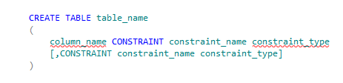
Implementing Data Integrity(Contd.)
Syntax
Constraints can be divided into the following types:
Primary key constraint
Unique constraint
Foreign key constraint
Check constraint
Default constraint
Notes:
5

Slide 6


Implementing Data Integrity(Contd.)
Primary key constraint:
Is defined on a column or a set of columns whose values uniquely identify all the rows in a table.
Ensures entity integrity.
Syntax
Example
Notes:
6

Slide 7


Implementing Data Integrity(Contd.)
Unique constraint:
Is used to enforce uniqueness on non-primary key columns.
Is similar to the primary key constraint except that it allows one NULL row.
Syntax
Example
Notes:
7

Slide 8
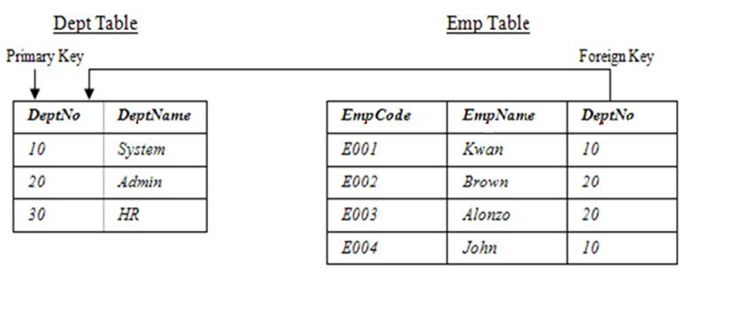
Implementing Data Integrity(Contd.)
Foreign key constraint:
Removes the inconsistency in two tables when the data in one table depends on the data in another table.
Always refers the primary key column of another table, as shown in the following figure.
Notes:
8

Slide 9


Implementing Data Integrity(Contd.)
Syntax
Example
Notes:
9

Slide 10
Implementing Data Integrity(Contd.)
The cascading referential integrity constraint:
Defines the action that SQL Server performs when an attempt is made to update or delete a row in a table with a key referenced by a foreign key in another table.
SQL Server supports the ON DELETE and ON UPDATE clauses to apply the cascading referential integrity constraint.
The ON DELETE and ON UPDATE clauses can be used with the following options:
ON DELETE | ON UPDATE NO ACTION
ON DELETE | ON UPDATE CASCADE
ON DELETE | ON UPDATE SET NULL
ON DELETE | ON UPDATE SET DEFAULT
Notes:
10

Slide 11

Implementing Data Integrity(Contd.)
Example
Ensures that any attempt to delete or update the EmployeeID in the Employee table will not be successful.
Notes:
11

Slide 12
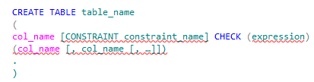
Implementing Data Integrity(Contd.)
Check constraint:
Enforces domain integrity by restricting the values to be inserted in a column.
Can be specified by using the following keywords:
IN
LIKE
BETWEEN
Syntax
Notes:
12

Slide 13
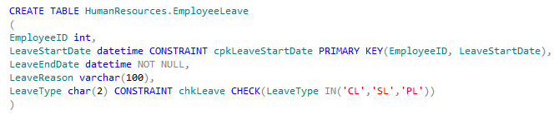
Implementing Data Integrity(Contd.)
IN:
Is used to ensure that the values entered are from a list of constant expressions.
Example
Notes:
13

Slide 14
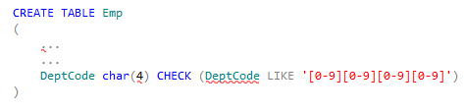
Implementing Data Integrity(Contd.)
LIKE:
Is used to ensure that the values entered in specific columns are of a certain pattern.
Example
Notes:
14

Slide 15
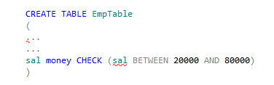
Implementing Data Integrity(Contd.)
BETWEEN:
Is used to specify a range of constant expressions by using the BETWEEN keyword.
Example
Notes:
15

Slide 16

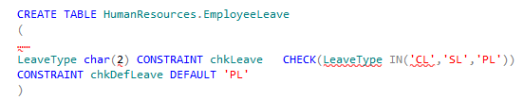
Implementing Data Integrity(Contd.)
Default constraint:
Can be used to assign a constant value to a column, and the user need not insert values for such a column.
Syntax
Example
Notes:
16

Slide 17
Just a Minute
Which keyword is used to specify a check constraint?
Solution:
A check constraint can be specified by using the LIKE, IN, and BETWEEN keywords

Slide 18


Implementing Data Integrity(Contd.)
You can disable the check constraint applied on the EmployeeLeave table by using the following statement:
Example
Disables the check constraint applied on the
EmployeeLeave table.
You can enable the check constraint applied on the EmployeeLeave table by using the following statement:
Example
Enables the check constraint applied on
the EmployeeLeave table.

Slide 19

Implementing Data Integrity(Contd.)
Rules:
Help in enforcing domain integrity for columns or user-defined data types.
Can be applied to the column or the user-defined data type before an INSERT or UPDATE statement is issued.
Are used to implement business-related restrictions or limitations.
Can be created by using the CREATE RULE statement.
Syntax

Slide 20
Implementing Data Integrity(Contd.)
The following table lists the statements to create a rule.
Example | Description
CREATE RULE dept_name_rule AS @deptname NOT IN (‘accounts’,’stores’) | Specifies that if the value of deptname is accounts or stores, then the value is to be rejected from being inserted into the column to which the rule is bound.
CREATE RULE min_price_rule AS @minprice >= $5000 | Allows a value of $5000 or more to be inserted in the column, to which the rule is bound.
CREATE RULE emp_code_rule AS @empcode LIKE '[F M][A Z][0-9] [0 9][0 9]' | Specifies that the value to be inserted in the column, to which the rule will be bound, must follow the pattern specified in the LIKE clause. The first character of the string can be any value between F to M; the second character can be any value ranging from A to Z; and from the third character onwards, the acceptable range is a numeric value from 0 to 9

Slide 21
Implementing Data Integrity(Contd.)
After you create the rule, you need to activate the rule by using a stored procedure, sp_bindrule.
Syntax
Example
Binds the rulType rule to the LeaveType column of the EmployeeLeave table.

Slide 22


Implementing Data Integrity(Contd.)
User-defined data types:
Are custom data types defined by the users with a custom name.
Are basically named objects with the following additional features:
Defined data type and length
Defined nullability
Predefined rules that may be bound to the user-defined data types
Predefined default value that may be bound to the user-defined data types
Can be created by using the CREATE TYPE statement.
Syntax
Example

Slide 23
Just a minute
You want to create a rule, rule1, which allows the user to enter any of the four values: Tea, Coffee, Soup, or Miranda in a column. Which statement should you execute?
Solution

Slide 24
Summary
In this session, you learned that:
Data integrity is enforced to keep the data in a database accurate, consistent, and reliable. It is broadly classified into the following categories:
Entity integrity: Ensures that each row can be uniquely identified by an attribute called the primary key.
Domain integrity: Ensures that only a valid range of values is allowed to be stored in a column.
Referential integrity: Ensures that the values of the foreign key match the value of the corresponding primary key.
User-defined integrity: Refers to a set of rules specified by a user, which do not belong to the entity, domain, and referential integrity categories.

Slide 25
Summary(Contd.)
Constraints define rules that must be followed to maintain consistency and correctness of data.
A primary key constraint is defined on a column or a set of columns whose values uniquely identify rows in a table.
The unique constraint is used to enforce uniqueness on non-primary key columns.
A foreign key constraint associates one or more columns (the foreign key) of a table with an identical set of columns (a primary key column in another table) on which a primary key constraint has been defined.
A check constraint enforces domain integrity by restricting the values to be inserted in a column. The IN, LIKE, and BETWEEN keywords are used to define the check constraint.
A default constraint can be used to assign a constant value to a column, and the user need not insert values for such a column.

Slide 26
Summary(Contd.)
A rule provides a mechanism for enforcing domain integrity for columns or user‑defined data types.
User-defined data types are custom data types defined by the users with a custom name.

