Slide 1
CSE 564 Visualization
Project Proposal | US Accidents

Slide 2
Background
With the rise of the automobile industry and the construction of roads, accidents on roads have increased exponentially over the past few years. Countless lives are lost due to road accidents every year. There are millions of dollars in damages to the individuals, insurance companies, and the reconstruction of roads.
Road accidents depend on various factors such as the speed of the car, wind direction, weather patterns.
With a plethora of information, as computer science students we would like to analyze various trends and insights into the causes of road accidents every year.

Slide 3
Problem
We would like to pair up with different organization to help them understand the major causes for road accidents and help them with the steps to reduce the road accidents.
Show the number of accidents in different states on a map
How has weather conditions affected the road accidents?
Identify the correlation between different attributes with the number of road accidents.
Identify the number of road accidents per state and per city
Where are the accident prone hotspots?

Slide 4
Approach
Map visualizations of accidents in U.S by state from 2016-2020
Parallel coordinate graph to show relation between various attributes wind speed, humidity and the severity of accident.
Number of accidents per state – Bar chart
MDS plot for identifying correlation between attributes.
State wise visualization using interactive elements.

Slide 5
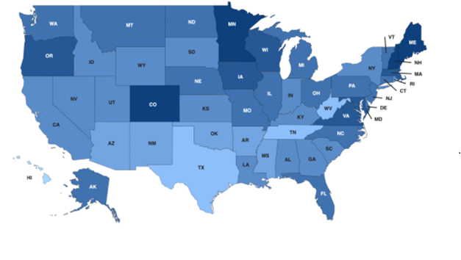
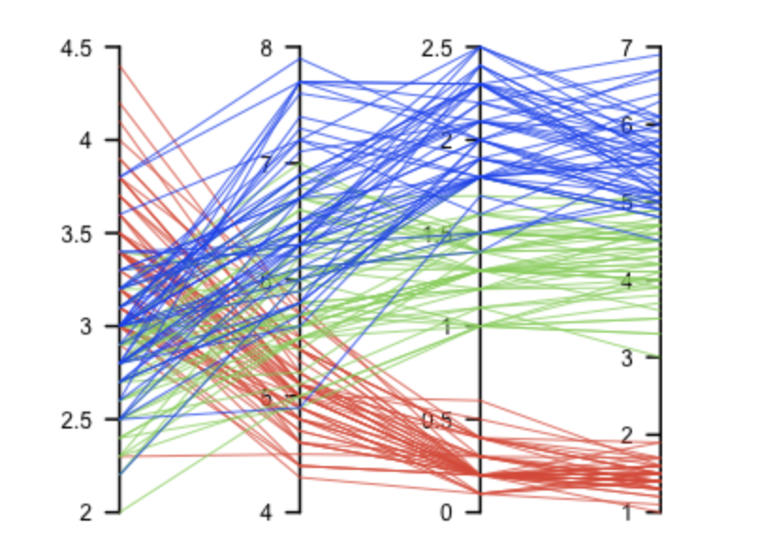
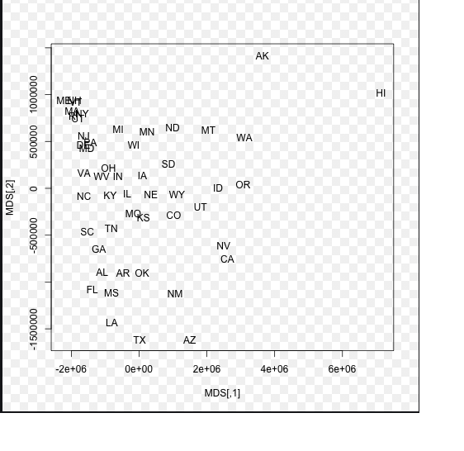
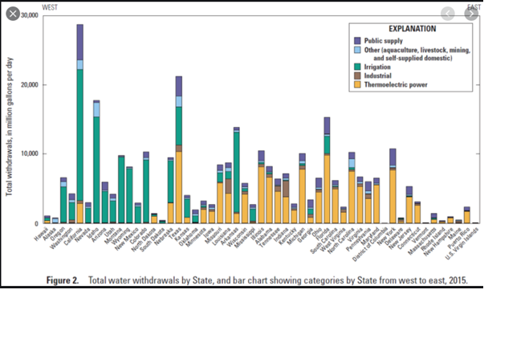

Slide 6
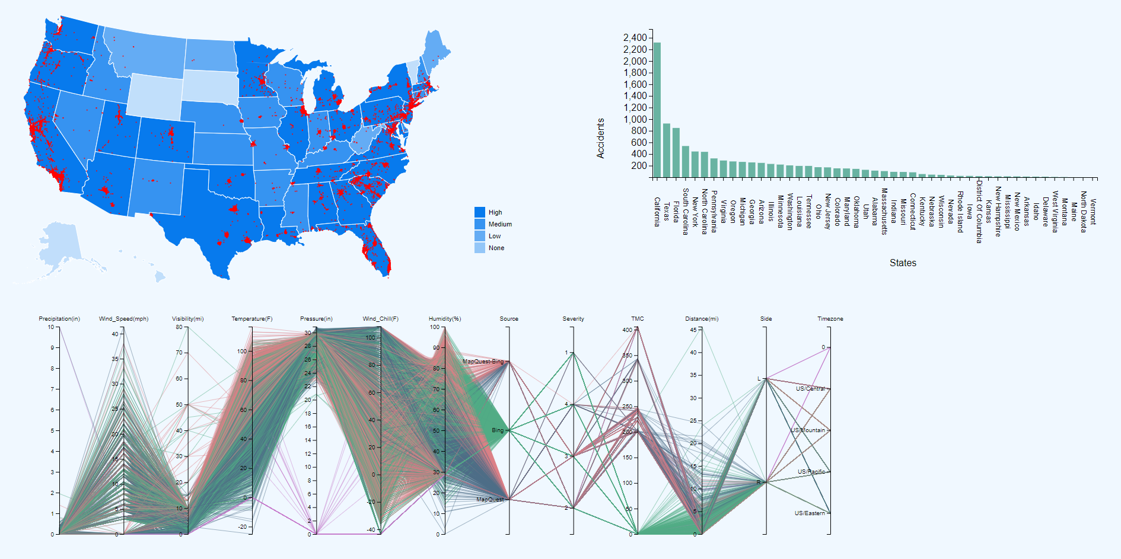

Slide 7
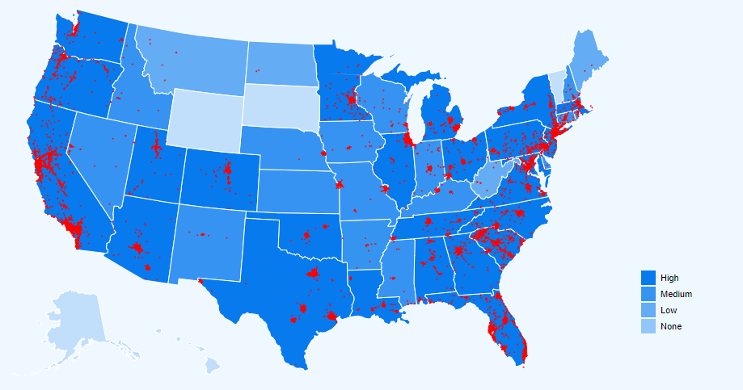
Map
The map shows the accident-prone areas based on the latitude ,longitude and city where it occurred. The background of each state specifies the number of accidents in a state.
We have plotted the latitude and longitude of the accident-prone areas on the map with red dots.

Slide 8
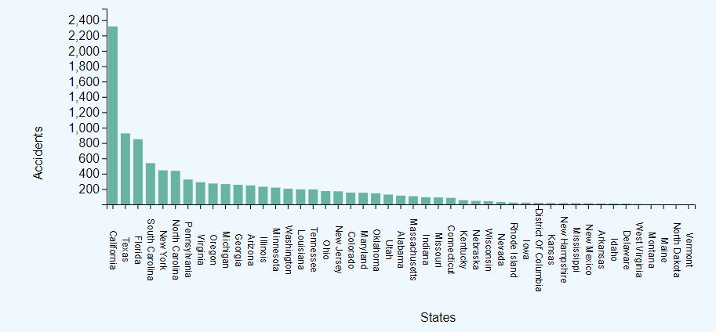
Bar Chart
Initially the bar chart shows the accidents in the state by the order of accidents.
We would like to implement an interaction when we click on the state. We change the bar chart to update the names of cities by number of accidents in place of number of states by the number of accidents.

Slide 9
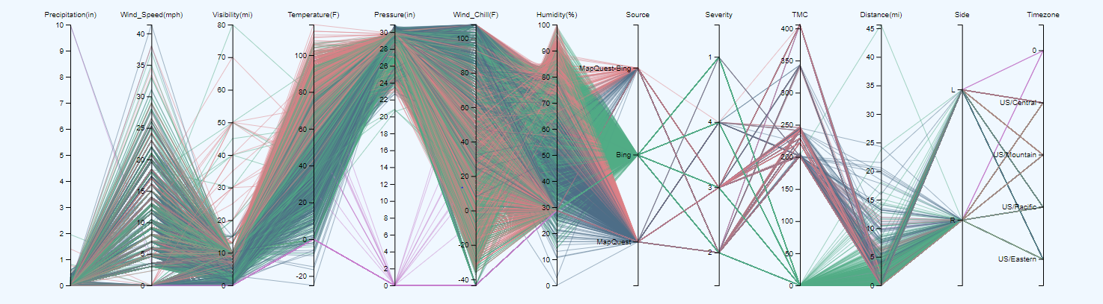
Parallel Coordinate Plot(PCP)
PCP Initially shows the number of datapoints of all the states in the US.
The PCP graph only shows the datapoints of the state in place of datapoints of all the states when a state is clicked on the map.

Slide 10
MDS(Multi Dimension Scaling)
We intend to visualize the variables of all the states.
When we click on the state we intend to plot the variables of the state.

Slide 11
Additional design techniques
We will implement brushing and zooming for the bar chart.

