Slide 1
PRESENTED BY :S.M.Srivignesh REGNO: 813821205050 DEPT: INFORMATION TECHNOLOGY COLLEGE: SARANATHAN COLLEGE OF ENGINEERING NM MAIL ID: rohithvignesh2@gmail.com
Generative AI : Poem Generator
3/21/2024 Annual Review

Slide 2
PROJECT TITLE:
Generative AI :
Poem Generator
3/21/2024 Annual Review

Slide 3


AGENDA:
Project Definition and Scope
Research and Background
Data Collection and Preprocessing
Model Training and Fine-Tuning
Development
Testing and Evaluation
Optimization and Refinement
3/21/2024 Annual Review

Slide 4

PROBLEM STATEMENT:
Text generation has been an intriguing field in natural language processing, with applications ranging from creative writing to automated content generation. However, generating coherent and aesthetically pleasing poetry remains a challenging task for artificial intelligence models. This project aims to develop a poetry generation system using the GPT-2 language model, capable of producing high-quality poems given starting and ending lines.
3/21/2024 Annual Review

Slide 5

PROJECT OVERVIEW:
This project aims to develop a poetry generation system using the GPT-2 language model. It involves fine-tuning the model on a poetry dataset and implementing a user-friendly interface for generating poems based on user-defined prompts. The methodology includes data collection, model training, and system design. Evaluation involves assessing the quality of generated poems. The project concludes with findings, implications, and potential future extensions
3/21/2024 Annual Review

Slide 6

WHO ARE THE END USERS?
Writers and Poets
Educators and Students
Creative Professionals
Literature Enthusiasts
Researchers and Developers
Artists and Musicians
3/21/2024 Annual Review

Slide 7

SOLUTION AND ITS VALUE PROPOSITION
Import Libraries: Import necessary libraries including torch and classes from the transfromers library.
Load Pre-trained Model and Tokenizer: Load the pre-trained GPT-2 model (gpt2-medium) and its corresponding tokenizer.
Set up Device: Determine and set the device to be used for computation (either GPU if available, otherwise CPU) and move the model to the selected device.
Define Poem Generation Function: Define the generate_poem() function, which takes starting and ending lines as input, generates a poem using the loaded GPT-2 model, and returns the generated poem.
Generate Poem Example: Provide an example usage of the generate_poem() function by specifying starting and ending lines, calling the function, and printing the generated poem.
3/21/2024 Annual Review

Slide 8

THE WOW IN YOUR SOLUTION:
The wow factor in the poetry generation system lies in its remarkable ability to produce high-quality poems based on user-defined prompts, showcasing the potential of advanced AI technology in creative endeavors. Its user-friendly interface, versatility in addressing various user needs, and innovative approach leveraging the GPT-2 language model contribute to its overall impressiveness and impact in the field of computational creativity.
3/21/2024 Annual Review
8

Slide 9
MODELLING:
Teams cam add wireframes
Input prompt
Generate poem
tokenization
Display poem
Decode ouput
Model inference
3/21/2024 Annual Review
9

Slide 10
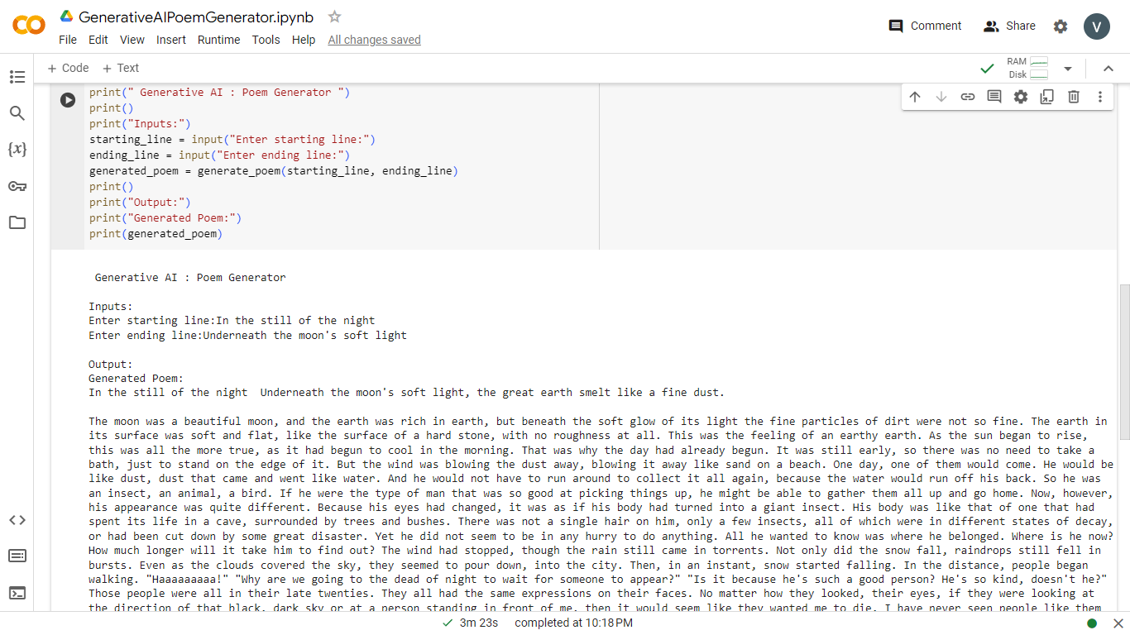
RESULTS:

Slide 11
RESULTS cont..
Ability of the poetry generation system to produce high-quality poems based on user-defined prompts showcases the potential of AI in augmenting human creativity and expression.
User-friendly interface enhances accessibility, democratizing the creative process and fostering broader appreciation for literature.
Valuable tool for language learning and education, providing authentic examples of poetry in the target language to aid language learners in improving language skills, vocabulary, and cultural understanding.
Exemplifies the fusion of art and technology, pushing the boundaries of creative expression and computational creativity.
Continues to inspire future endeavors and has a profound impact on poetry, language learning, and AI-driven creative applications
Demo Link
https://github.com/rohithvignesh25/TNSDC-Generative-AI.git
3/21/2024 Annual Review
11

