Slide 1
dPhone
Spring boot application
Team Members & contributions:-
Kaushik Appani - React – Frontend - Authentication
Datta Sai Jaideep - Spring Security and Frontend
Maruti Kameshwar - Java Spring boot - Backend
Rohith Vinta - Java Checkout FN – PostgreSQL - Docker

Slide 2
Problem Statement
DPhone Corporation is a telecommunications company that wants to create a web portal that allows users to buy new phones.
The portal should have functionalities such as user registration and login, referral creation, editing, and deletion, referral display, and rewarding users with 1000 bonus points for every referral that leads to a purchase.
Our solution involves designing a database and building an enterprise application using Java, Spring, Hibernate, ReactJS , Axios, Material UI, Router Dom, and PostgreSQL.
Four tables will be created: User, Referral, Customer, and Buying Details to store user details, referral details, customer details, and purchase details respectively.

Slide 3
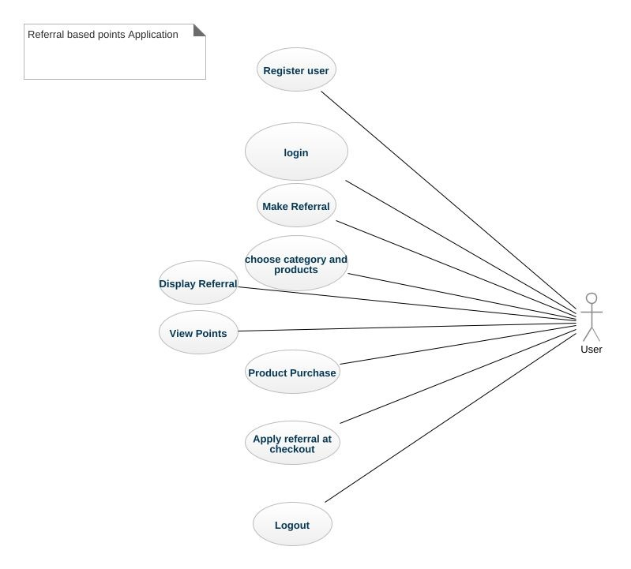
Use Case Diagram

Slide 4
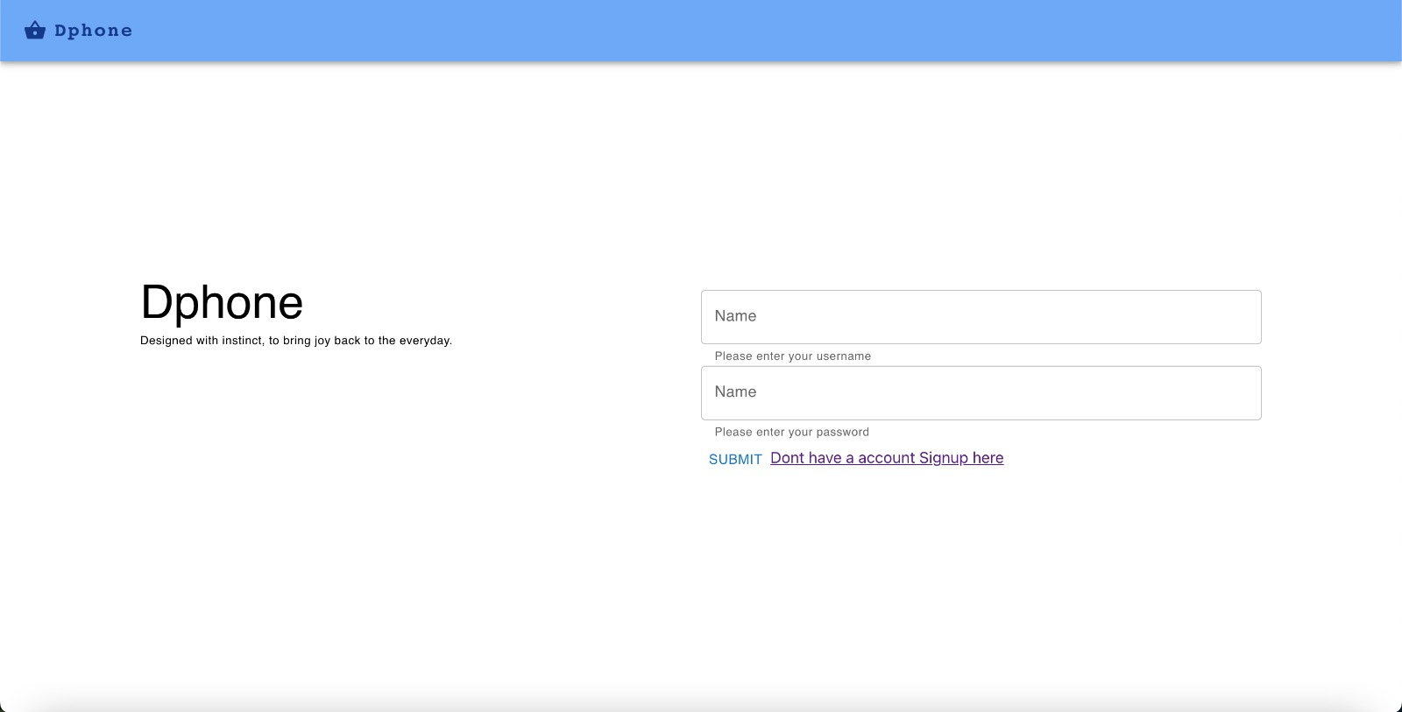
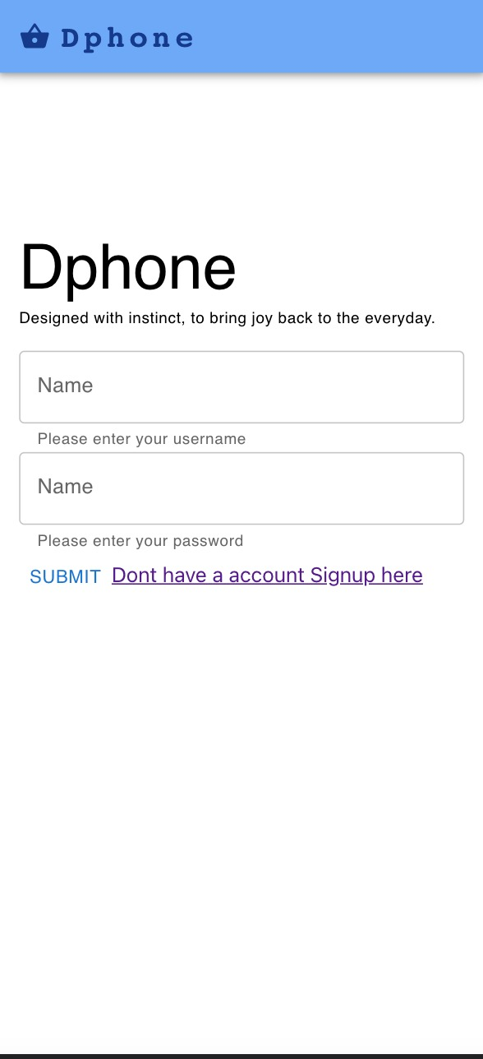
Login Page View

Slide 5
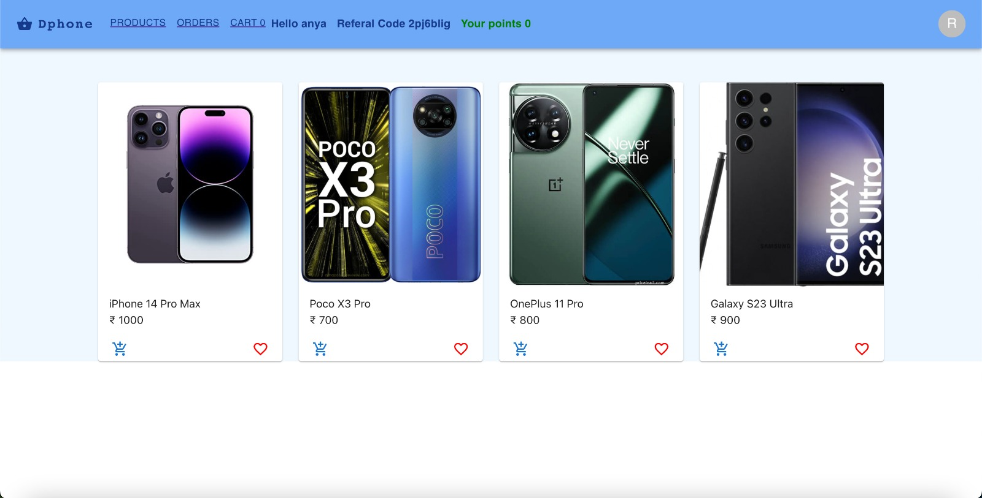
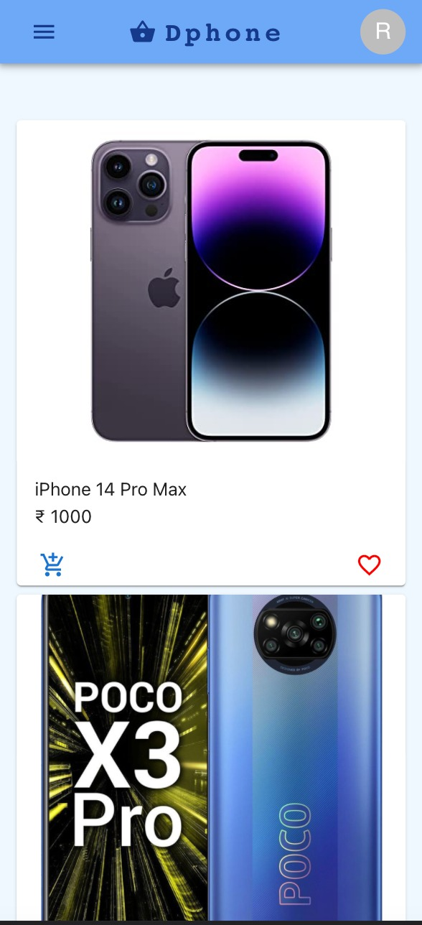
Products Page View

Slide 6
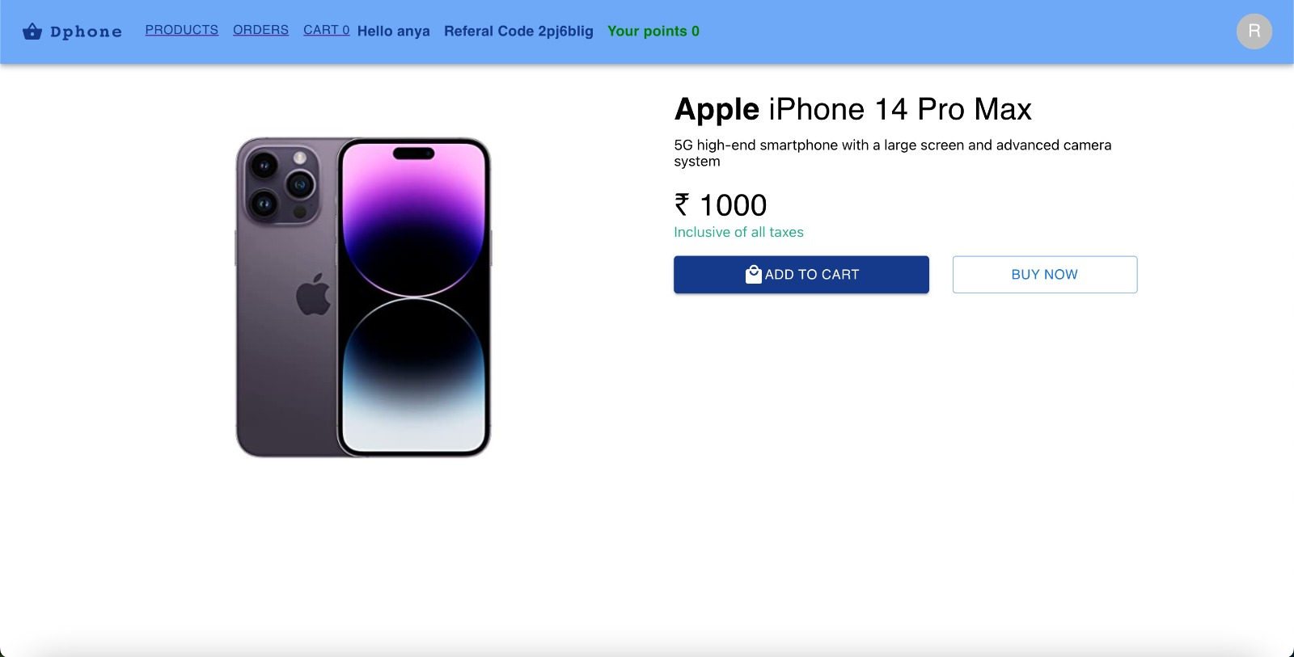
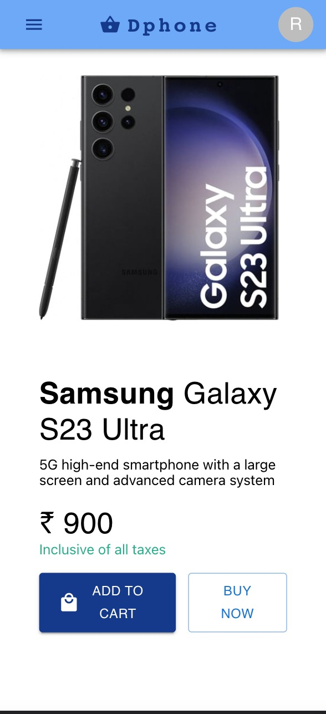
Details Page

Slide 7
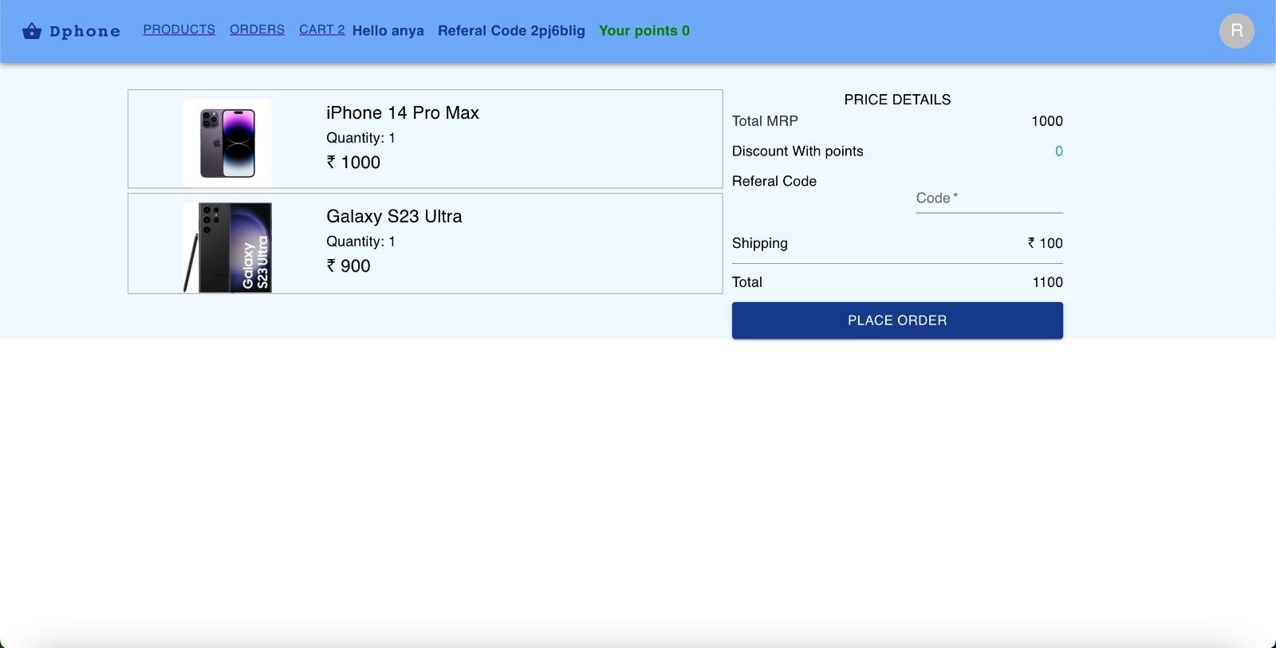
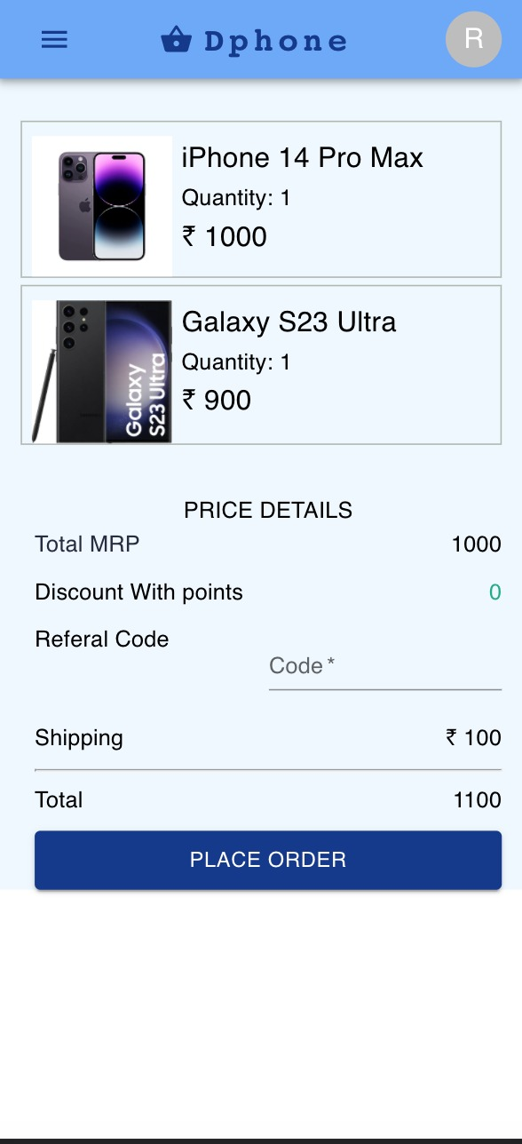
Checkout Page View

Slide 8
Future Scope
Referral code sharing through link via WhatsApp, Text Message, or Email.
A Secure Payment Gateway for product buying.
Introduce a rewards program: In addition to the referral program, you could introduce a rewards program.
Docker containerizing your Spring Boot application using Docker can simplify deployment and make it more portable across different environments.

