Slide 1
Explainable & LLM-Assisted CAN Bus Intrusion Detection
Detecting in-vehicle network attacks with generic behavioral features, SHAP explanations, and local LLM incident reporting
Internship Project Presentation

Slide 2
The Problem
• The CAN bus is the nervous system of modern vehicles — broadcast, multi-master, priority-arbitrated
• It has NO authentication or message-origin verification by design
• Any node with bus access can inject arbitrary frames: DoS, fuzzing, gear/RPM spoofing
• Goal: detect AND classify attacks, explain decisions, and generate actionable incident reports
• Constraint: software-only, laptop-scale, fully local (no cloud, no paid APIs, no hardware)

Slide 3
Dataset & Threat Model
• HCRL Car-Hacking dataset (real Hyundai Sonata, real injected attacks)
• 5 classes: Normal, DoS, Fuzzy, Gear-spoofing, RPM-spoofing — ~16.6M messages
  – Chosen over OTIDS / Survival-Analysis / ROAD for benchmark comparability
  – Per-message ground truth via a T (injected) / R (regular) flag
• Attacks occur as ~300 discrete ~3-5s bursts per file — verified from raw flags

Slide 4
Methodology — Pipeline
• Raw CSV → clean/label → 100ms/50ms sliding windows → 25 behavioral features
• Features are GENERIC (timing, entropy, payload stats, per-ID Hamming) — no vehicle-specific CAN IDs
• Any-attack-present window labeling (fixes majority-vote collapse of Gear/RPM)
• Baseline fit on normal-only traffic, persisted and reused (never refit online)
• XGBoost (multi:softprob) with balanced sample weighting, vs. RF & LightGBM

Slide 5
The Core Finding: Fixing Evaluation Leakage

Slide 6
Data Leakage — Found, Fixed, Measured
• Problem: 100ms windows with 50ms stride overlap 50% — a random split scatters near-duplicate windows across train/test
• Fix: group windows into 10s time blocks per file; assign whole blocks atomically to one split
• Verified: ZERO group overlap across splits; same-file contamination 98.8% → 0.96%
• Measured before/after on real data: random 0.9990 vs grouped 0.9990 — leakage did NOT inflate results here
  – Honest takeaway: the fix delivers methodological VALIDITY, not a changed number — reported as-is, not tuned

Slide 7
Results — Honest Held-Out Test Metrics
Macro-F1 0.9990 | Accuracy 0.9992 | Weighted-F1 0.9992 | 33,247 test windows
Class | Precision | Recall | F1 | Support
DoS | 0.9986 | 0.9998 | 0.9992 | 4249
Fuzzy | 0.9998 | 0.9985 | 0.9991 | 4673
Gear | 0.9995 | 0.9970 | 0.9983 | 4047
Normal | 0.9992 | 0.9999 | 0.9996 | 17153
RPM | 0.9990 | 0.9990 | 0.9990 | 3125

Slide 8
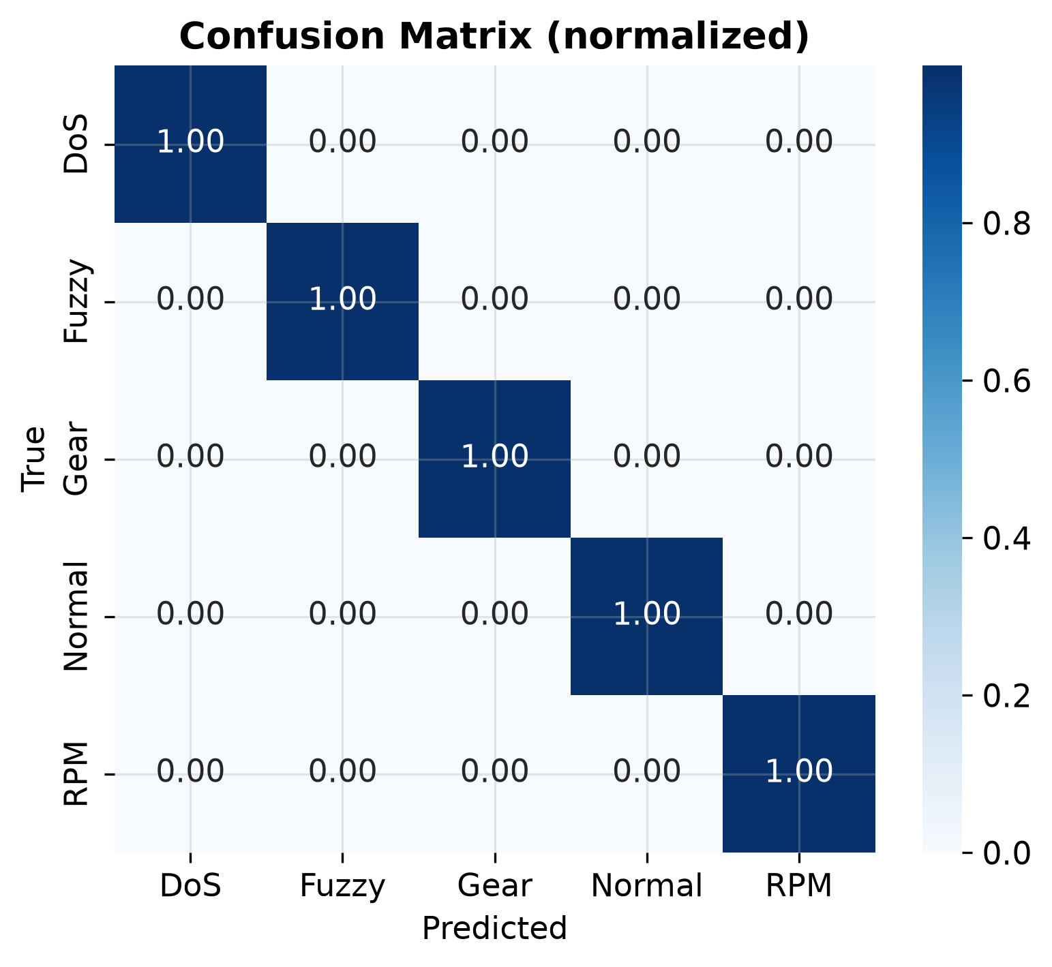
Confusion Matrix (Held-Out Test)
Normalized confusion matrix on the leakage-free test split.

Slide 9
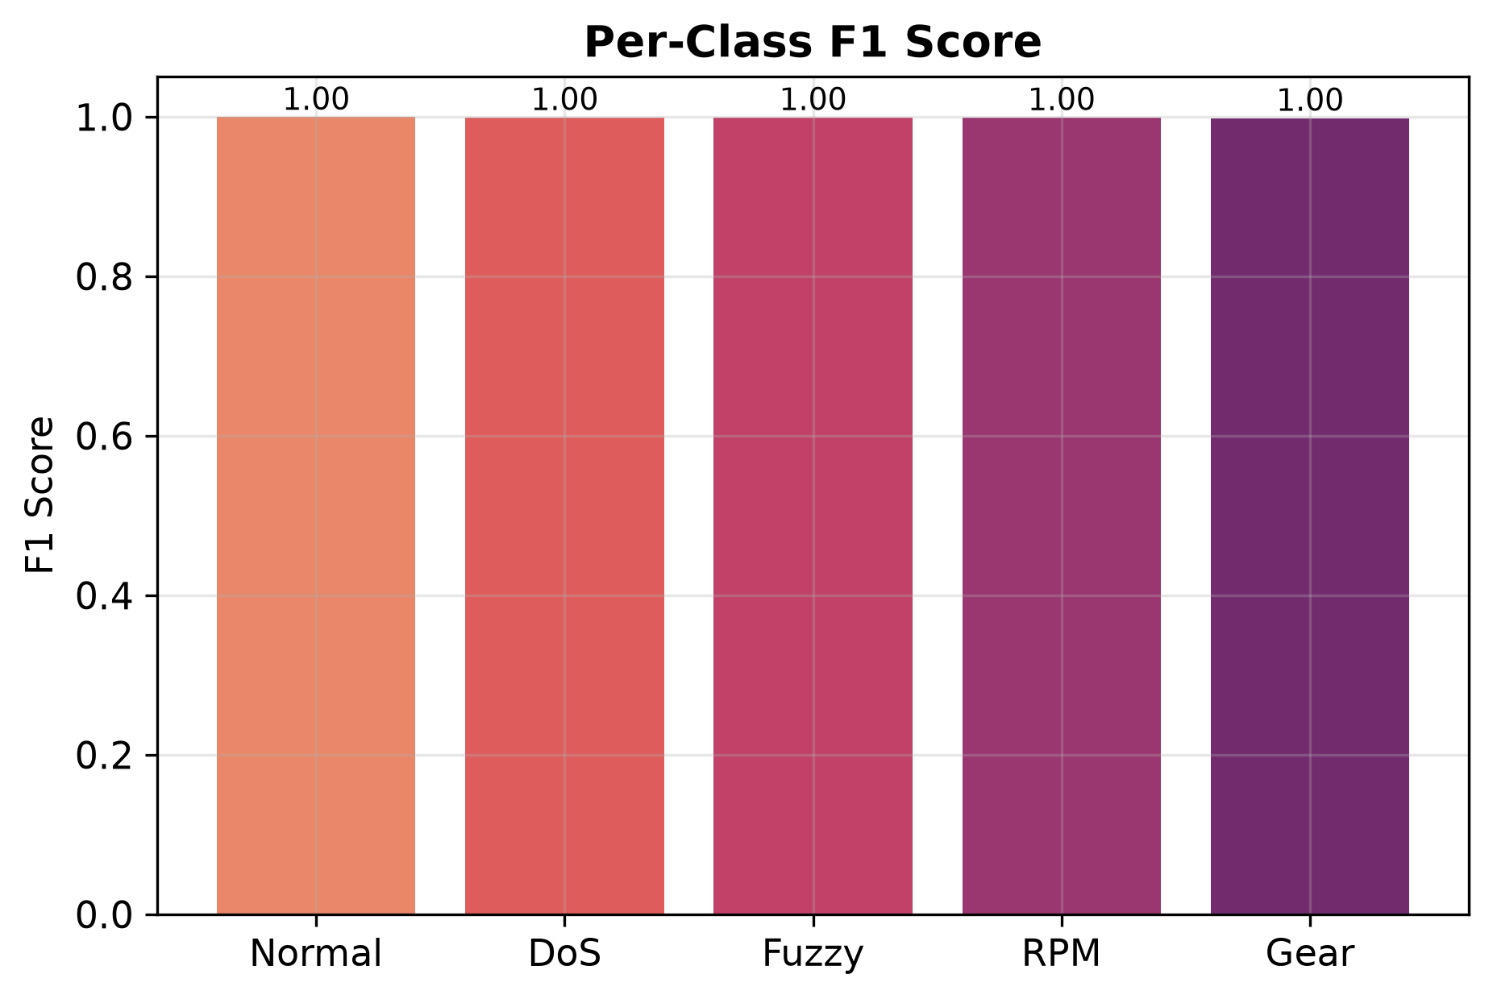
Per-Class F1
All five classes ≥0.998 F1, including historically-hard Gear & RPM.

Slide 10
Explainability, Reporting & Demo

Slide 11
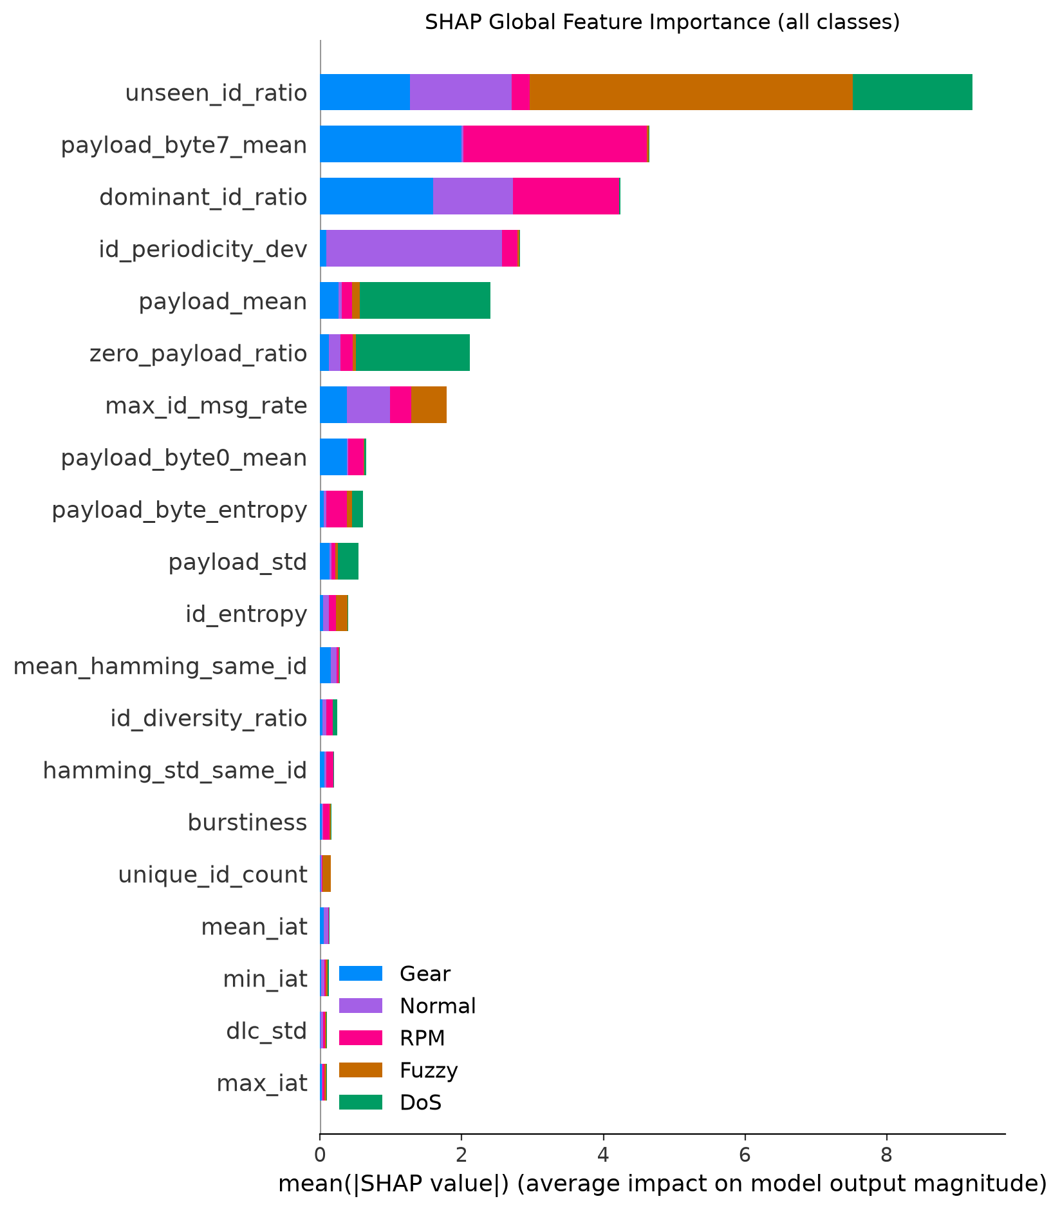
SHAP — Global Feature Importance
Which behavioral features drive each class — computed on the leakage-fixed model.

Slide 12
LLM Incident Reporting (Phase 8)
• Local Ollama + qwen3:4b — no cloud, no paid APIs
• Input: predicted class + confidence + SHAP top features (grounded, no fabrication)
• Output ≤200 words: Summary / Risk / Technical Analysis / Impact / Mitigation
• Required deterministic TEMPLATE fallback if Ollama is unavailable (verified working)
  – Risk language calibrated to model confidence — not uniformly alarmist

Slide 13
Real-Time Simulator & Dashboard (Phases 9-10)
• Stream simulator replays captures through the SAME feature-extraction path (no train/serve skew)
• Reuses the persisted baseline as-is — never refits on live, possibly-attacked traffic
• Streamlit dashboard: 11 sections (live feed, prediction, SHAP, AI report, attack timeline)
  – Dashboard imports backing modules — no ML logic in the UI layer

Slide 14
Contribution & Next Steps

Slide 15
Contribution — What We Claim (and Don't)
• CLAIM: a verified leakage-free evaluation methodology for overlapping-window CAN IDS
• CLAIM: an honest, reproducible full-dataset benchmark (macro-F1 0.9990) with explainability
• CLAIM: a complete local-only pipeline: detection → SHAP → LLM report → simulator → dashboard
• NOT claimed: cross-vehicle generalization (single-vehicle dataset)
• NOT claimed: real-hardware validation, or a novel model architecture
• Next: cross-dataset / cross-vehicle evaluation to test the generalization intention

