Slide 1
“Iris Recognition using HADOOP Image Processing Interface “
Presented By :
Mr. Jadhav Rohit (414)
Mr. Khopade Yogesh (426)
Mr. Suryawanshi Rushikesh (449)
Under the guidance of
Prof. Jagtap K. P.

Slide 2
Objective
Implement Iris Recognition System for large no. of users
Improve security by using probability based calculation of multiple images of single user
Handling large no. of images using Hadoop
Improving performance of image recognition using Hadoop Image Processing System.

Slide 3
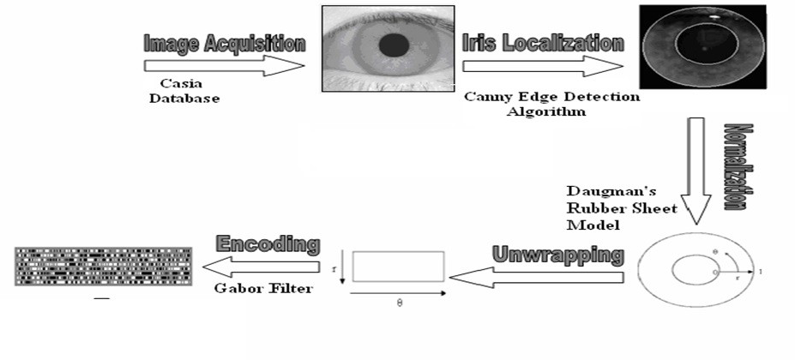
IRIS RECOGNITION PROCESS

Slide 4
WHAT IS HADOOP?
Job Tracker
Task Tracker
Name Node
Data Node
Secondary Name Node

Slide 5
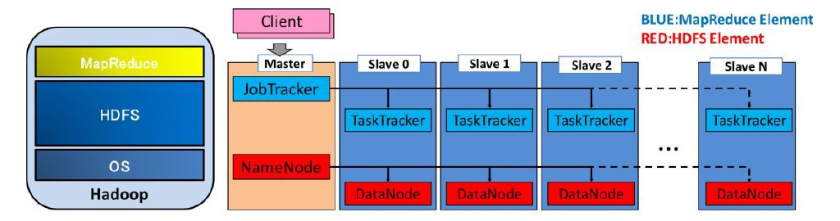
Structure with elements of MapReduce and HDFS

Slide 6
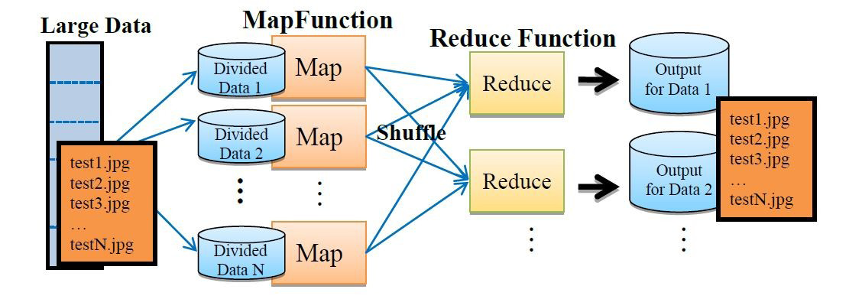
MAP REDUCE PROCESS

Slide 7
HIPI FEATURES
Provide an open, extendible library for image processing and computer vision applications in a MapReduce framework.
Store images efficiently for use in MapReduce applications.
Allow for simple filtering of a set of images.
Present users with an intuitive interface for image-based operations and hide the details of the MapReduce framework.
HIPI will set up applications so that they are highly parallelized and balanced so that users do not have to worry about such details.

Slide 8
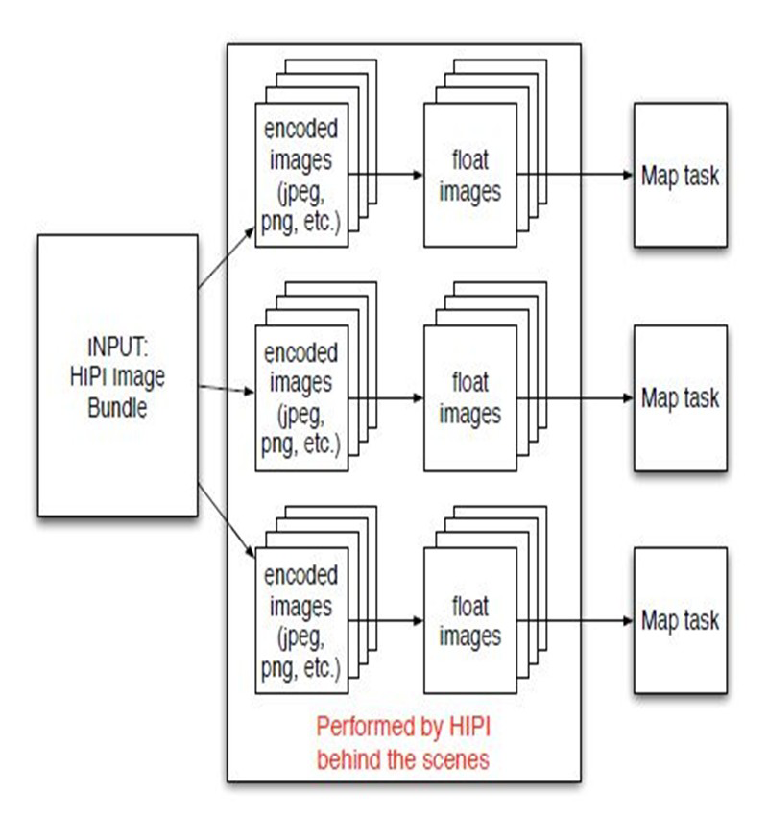
HIPI IMAGE BUNDLE

Slide 9
Work Done
Completed Project Design
Implemented Multithreaded java based Iris Recognition System
Performance Time Analysis
Created and Implemented hadoop Cluster
Executed image bundle Program on Hadoop

Slide 10
Expected Result
Sequential Processing of Iris.
Identification of Authorised User using HIPI.
Difference in time between Sequential and hadoop Based identification of Authorised user.

Slide 11
  Requirements
Software Requirements
1) Operating System : Ubuntu 12.04
2) Java 6
3) Hadoop 0.20.1
4) HIPI 1.0.1
Hardware Requirements
Ram : 512 MB
Hard Disk : 20 GB

Slide 12
Conclusion :
This project has described our library for image processing and vision applications on a MapReduce framework - Hadoop Image Processing Interface (HIPI). This library was carefully designed to hide the complex details of Hadoop’s powerful MapReduce framework and bring to the forefront what users care about most: images.

Slide 13
Thank You

