Slide 1
ECN-347 Tutorial

Slide 2
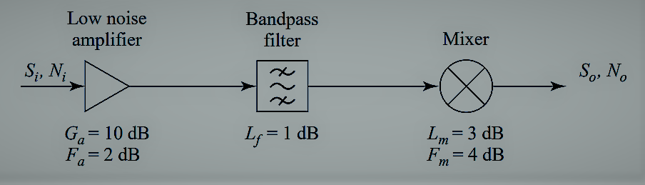
The block diagram of a wireless receiver front-end is shown in Figure, Compute the overall noise figure of this subsystem. If the input noise power from a feeding antenna is Ni = kT_{a}B, where T_{a} = 150 K, find the output noise power in dBm. If we require a minimum signal-to-noise ratio (SNR) of 20 dB at the output of the receiver, what is the minimum signal voltage that should be applied at the receiver input? Assume the system is at temperature T₀, with a characteristic impedance of 50 Ω, and an IF bandwidth of 10MHz.

Slide 3
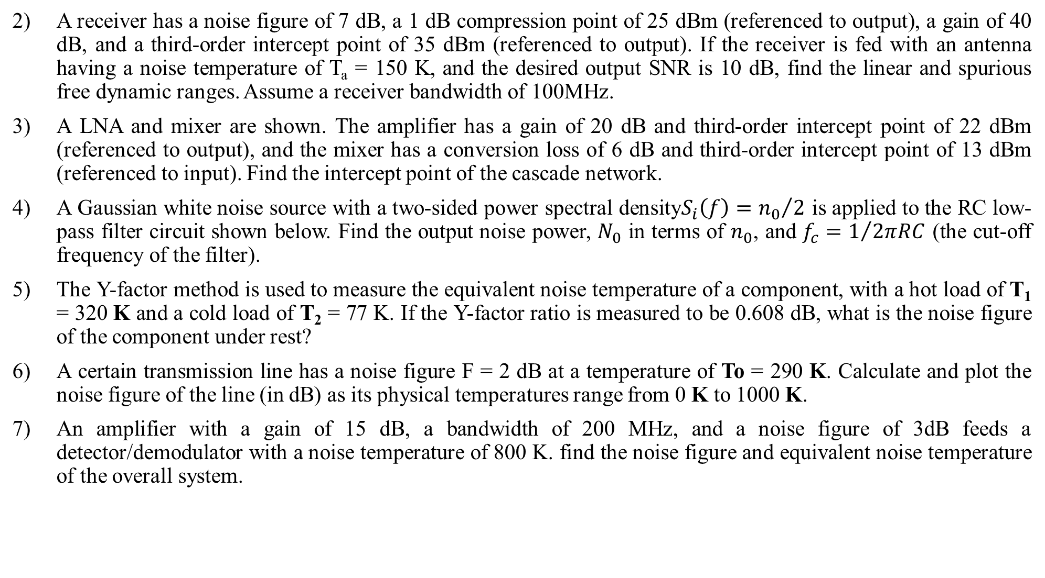
A receiver has a noise figure of 7 dB, a 1 dB compression point of 25 dBm (referenced to output), a gain of 40 dB, and a third-order intercept point of 35 dBm (referenced to output). If the receiver is fed with an antenna having a noise temperature of T_{a} = 150 K, and the desired output SNR is 10 dB, find the linear and spurious free dynamic ranges. Assume a receiver bandwidth of 100MHz.
A LNA and mixer are shown. The amplifier has a gain of 20 dB and third-order intercept point of 22 dBm (referenced to output), and the mixer has a conversion loss of 6 dB and third-order intercept point of 13 dBm (referenced to input). Find the intercept point of the cascade network.
A Gaussian white noise source with a two-sided power spectral density$S_{i}\left(f\right)={n_{0}}/2$ is applied to the RC low-pass filter circuit shown below. Find the output noise power, $N_{0}$ in terms of $n_{0}$, and $f_{c}=1/{2πRC}$ (the cut-off frequency of the filter).
The Y-factor method is used to measure the equivalent noise temperature of a component, with a hot load of T₁ = 320 K and a cold load of T₂ = 77 K. If the Y-factor ratio is measured to be 0.608 dB, what is the noise figure of the component under rest?
A certain transmission line has a noise figure F = 2 dB at a temperature of To = 290 K. Calculate and plot the noise figure of the line (in dB) as its physical temperatures range from 0 K to 1000 K.
An amplifier with a gain of 15 dB, a bandwidth of 200 MHz, and a noise figure of 3dB feeds a detector/demodulator with a noise temperature of 800 K. find the noise figure and equivalent noise temperature of the overall system.

Slide 4
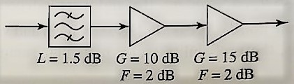
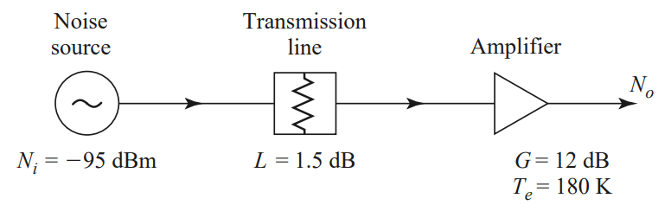
Consider the wireless local area network (WLAN) receiver front-end shown below, where the bandwidth of the band pass filter is 150 MHz centered at 2.4 GHz. If the system is at room temperature, find the noise figure of the overall system. What is the resulting signal-to-noise ratio at the output if the input signal power level is −85 dBm? Can the components be rearranged to give a better noise figure?
A digital PCS receiver front-end circuit is shown below. The operating frequency is 1805– 1880 MHz, and the physical temperature of the system is 300 K. A noise source with Ni = −95 dBm is applied to the receiver input. (a) What is the equivalent noise temperature of the source over the operating bandwidth? (b) What is the noise figure (in dB) of the amplifier? (c) What is the noise figure (in dB) of the cascaded transmission line and amplifier? (d) What is the total noise power output (in dBm) of the receiver over the operating bandwidth?

Slide 5









A receiver subsystem has a noise figure of 6 dB, a 1 dB compression point of 21 dBm (referenced to output), a gain of 30 dB, and a third-order intercept point of 33 dBm (referenced to output). If the subsystem is fed with a noise source with Ni = −105 dBm and the desired output SNR is 8 dB, find the linear and spurious free dynamic ranges of the subsystem. Assume a system bandwidth of 20 MHz.
In practice, the third-order intercept point is extrapolated from measured data taken at input power levels well below IP3. For the spectrum analyser display shown below, where ∆P is the difference in power between $P_{w_{1}}$ and $P_{{2w}_{1}−w_{2}}$show that the third order intercept point is given by $P_{3}=P_{w_{1}}+\frac{1}{2}∆P$.
$$P_{w_{1}}$$
$$∆P$$
$$P_{{2w}_{1}−w_{2}}$$
$$w$$
$${2w}_{1}−w_{2}$$
$$w_{1}$$
$$w_{2}$$
$${2w}_{2}−w_{1}$$

