Slide 1


UniForMe Empowering International Students Journey
Presented by : Gaurav Chauhan
Hetvi Mavani
Rohit Jire

Slide 2


Revisiting the Problem
International students face a complex, overwhelming process when choosing universities abroad.
Information is:
Scattered
Generic
Lacks Personalization
Fragmented Resources
Demand for Personalization

Slide 3
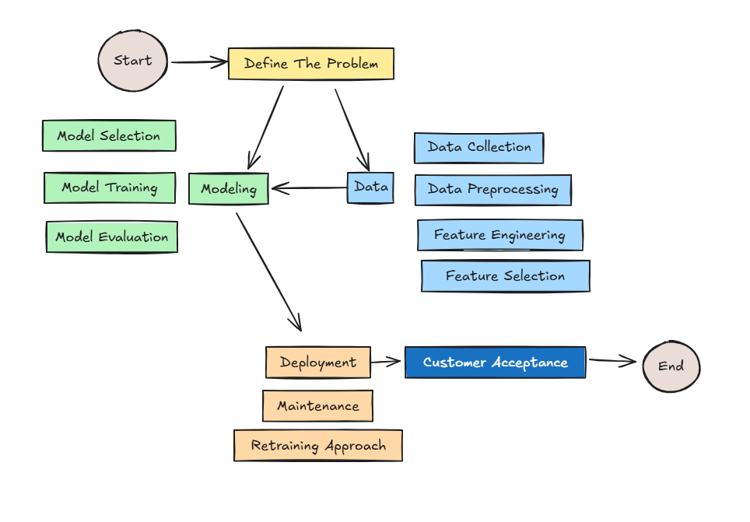
Project Lifecycle

Slide 4




Data Sources
University Data
Job Count by City
Travel Connections & Time
Nearby Cities & Distance
Internal API calls &
Web scrapping
Manual data fetched and Stored
Manually data fetched and Stored
Python Script

Slide 5

Data Preprocessing
Merge Multiple Dataset
Drop Columns
Remove Duplicates
Column Data Transform
Column Type Transform
d
Numerical To Categorial

Slide 6
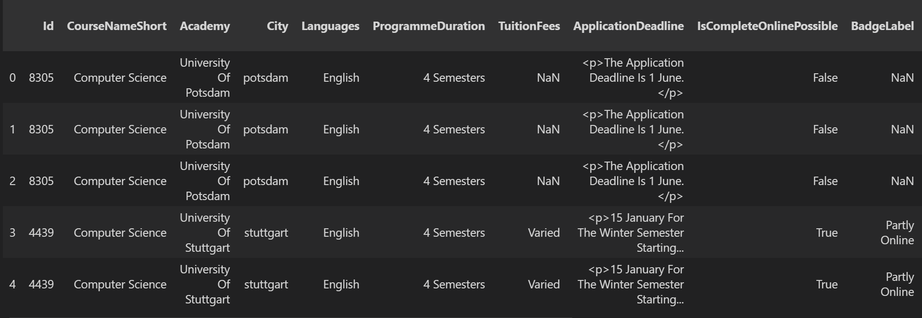
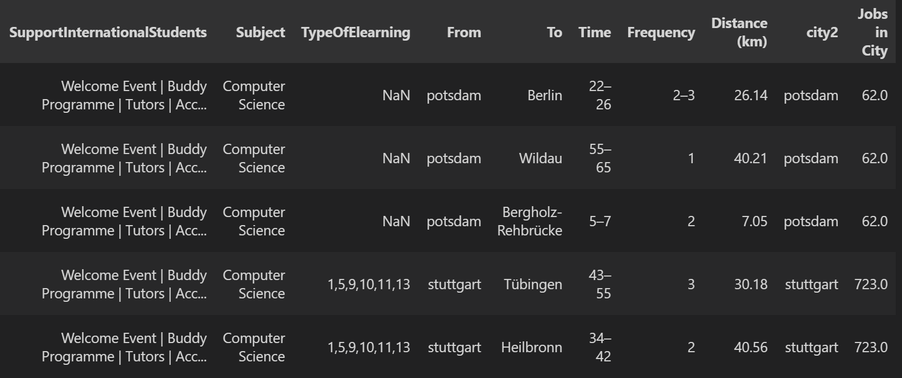

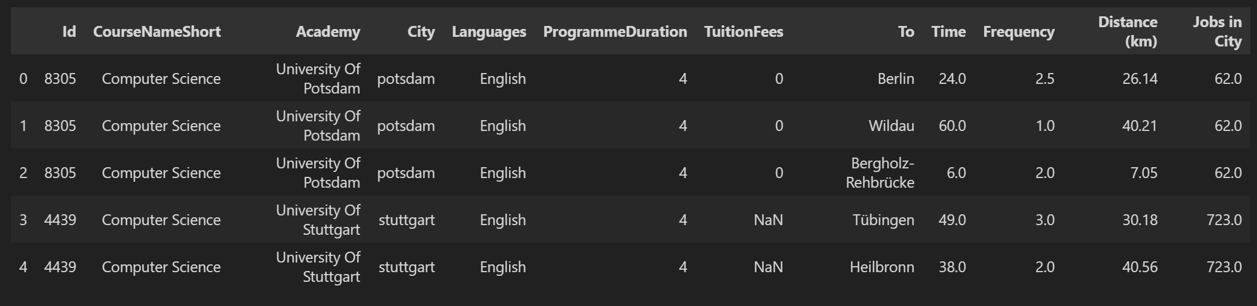

Slide 7
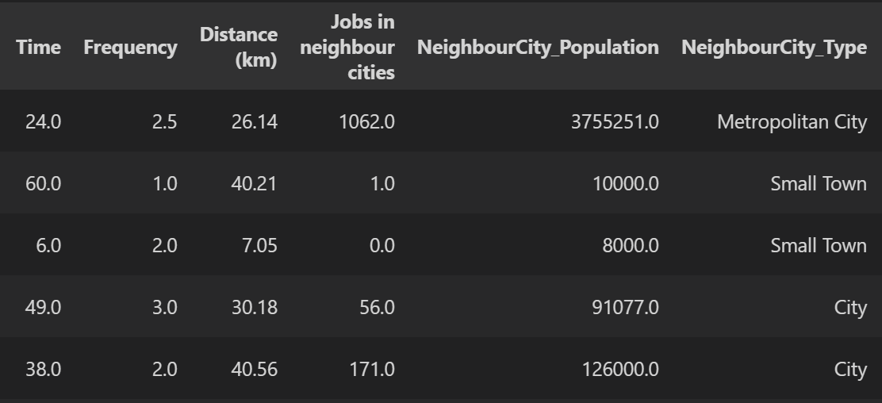
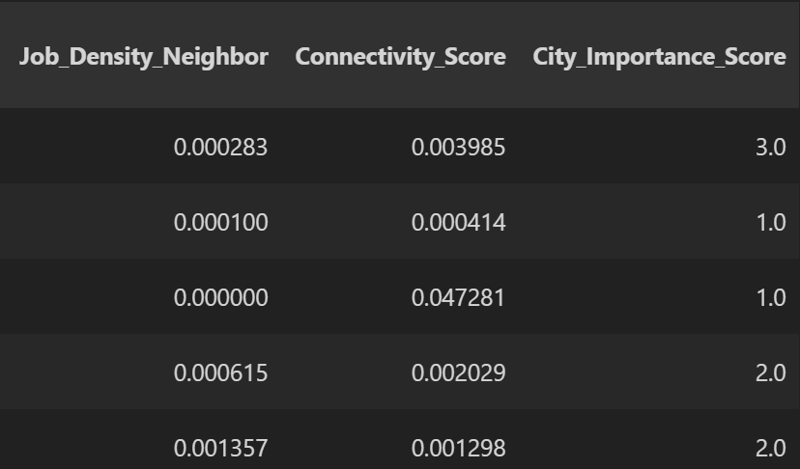
Feature Engineering

Slide 8
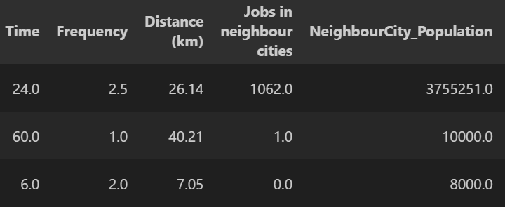
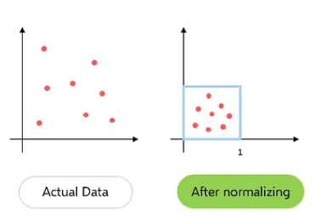
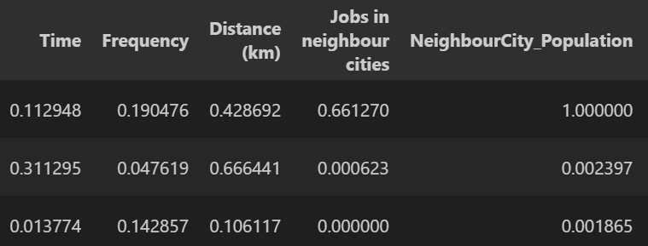
Normalization
In Normalization, scaled values from 0 to 1

Slide 9
Model Selection
By User Preference
Feature Weighting
By University & Course
Cosine Similarity
By User Description
Cosine Similarity

Slide 10
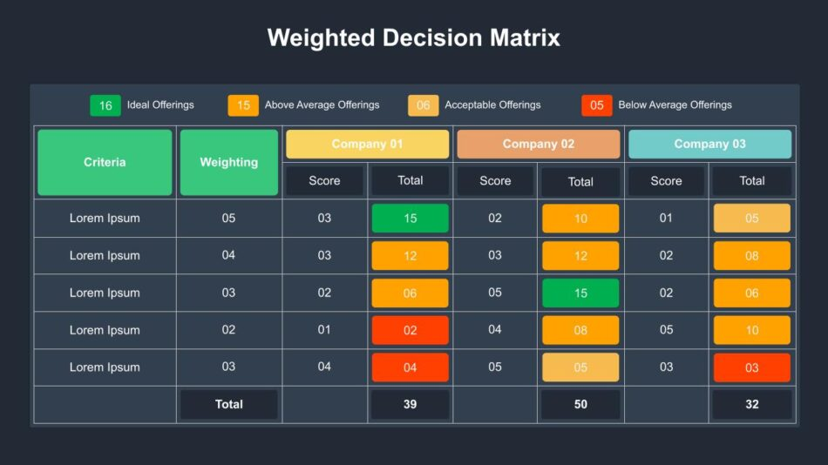
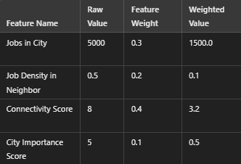
Feature Weighting
Implemented Feature Weighting

Slide 11
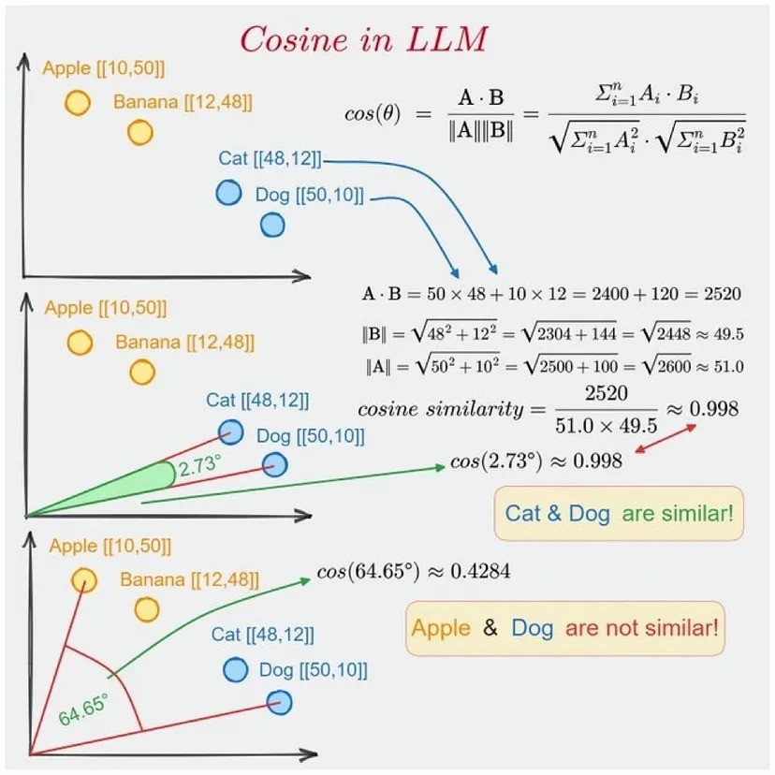
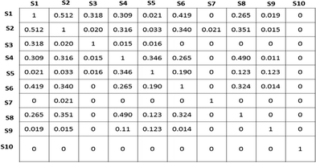
Cosine Similarity
The smaller the angle between the two vectors, the more similar they are to each other.

Slide 12
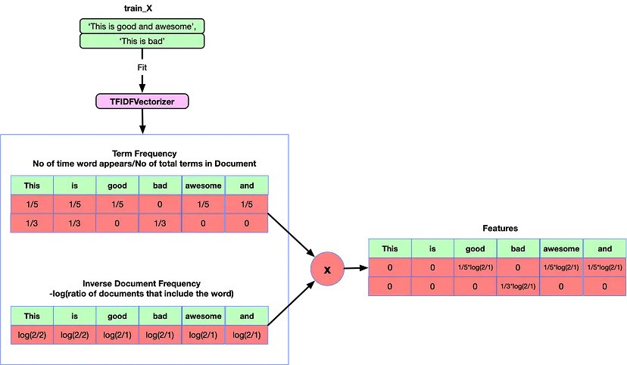
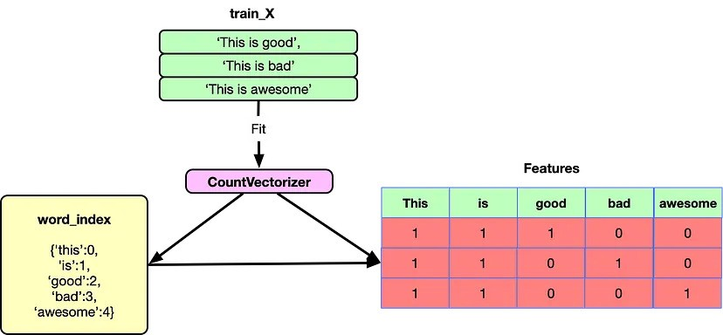

Count Vectorizer Vs TFIDF
Count Vectorizer
Term Frequency Inverse Document Frequency

Slide 13
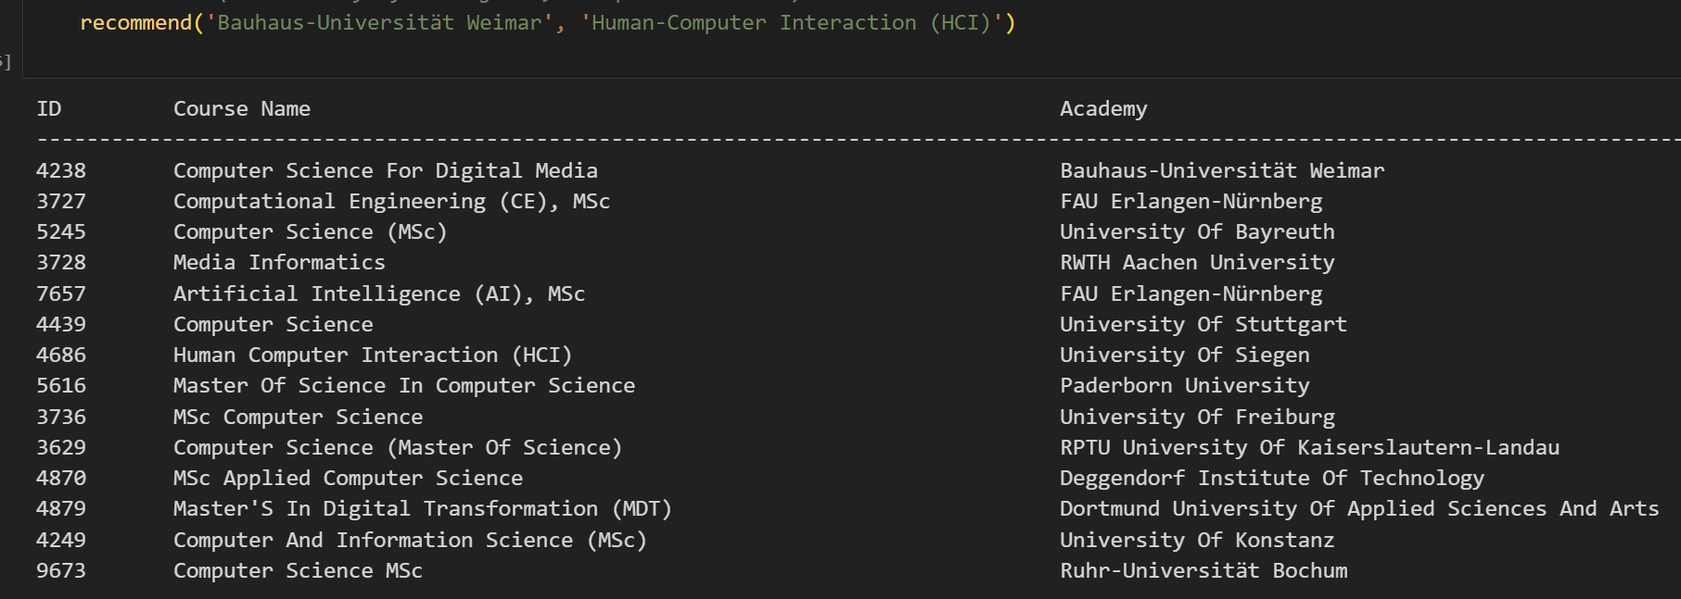
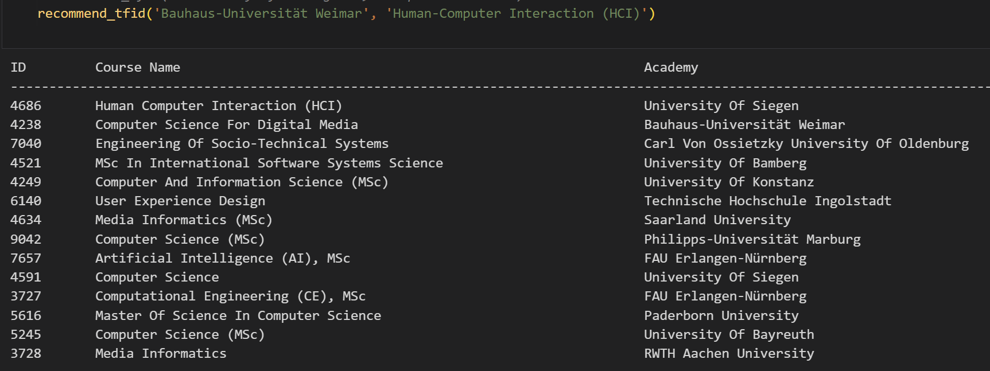
Evaluation
Count Vectorizer
TFIDF

Slide 14




Integration of Results
Operational Dataset
Binary Files
Frontend Integration

Slide 15
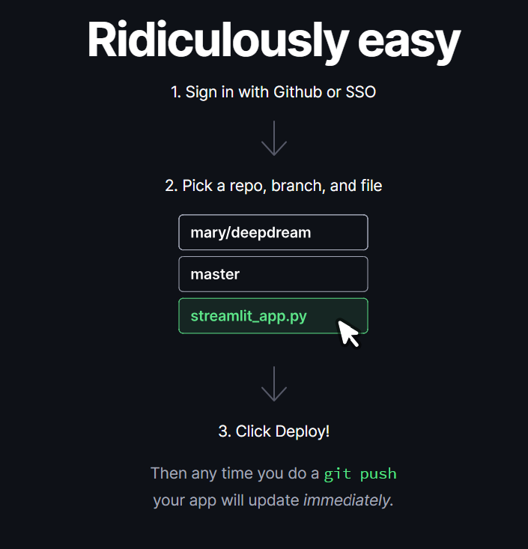
Deployment
Src: https://streamlit.io/cloud

Slide 16

Beta Testing
OR
https://uniforme.streamlit.app

Slide 17
THANK YOU ☺

