Slide 1
Chappie
A student services Chatbot

Slide 2
Outline
Problem Definition
Proposed Solution
Front-End Implementation
Back-End Implementation
Architecture

Slide 3
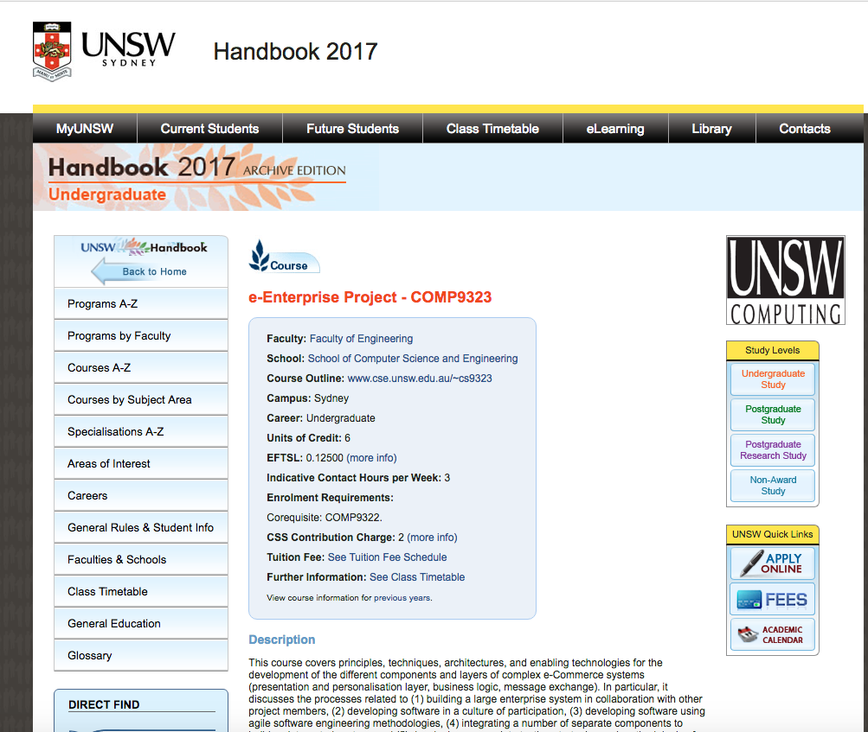
Problem Definition
First-year Student Experience
New system vs Old system(school)
Interactivity:
Navigation Difficulty in Handbook
Visually confusing
Flow of information
Outdated/Redundant Information:
Course difficulty information missing
Incomplete/conflicting information
Requirements & Specialization:
lacking information regarding course specializations
Interpretation of information e.g.. pre-requisites/eligibility
Notes:
First-year students experience:
1-student used to school system .
2- have no knowledge about unsw time table / handbook
Interactivity:
1-The UNSW Handbook pages are difficult to navigate ,
2-The information provided is not visual enough and often quite confusing.
3-The information in relation to a course spans across multiple pages.
outdated information :
1-The UNSW Handbook pages are difficult to navigate and often outdated
2-Missing information in relation to a course difficulty.
3-Missing the course outline information.
4-Might contain incomplete/conflicting information with the faculty.
Requirements & specializations :
1-Difficult to understand the details regarding specializations.
2-Number of courses available during the semester for enrollment is huge, difficult to know each course requirements and description.
3-UNSW timetable shows courses for undergraduate, postgraduate and research and some
4-The course prerequisites/eligibility information is difficult to interpret.

Slide 4
Proposed Solution
Live Action queries:
Student enquiry support
Live-action responses
Enhance Student Experience:
Enrollment experience Improvement
Centralized platform
Simplicity & Efficiency:
Interactive and Automated solution ie. Chatbot
Notes:
Live Action queries:
1-Provide an interface to support student inquiries in relation to course enrollments.
2-Provide live action query application that provides the necessary information regarding the courses running at the particular time of the academic calendar.
Enhance students experience :
1-Improve the enrollment experience of new students in UNSW.
2-Provide a centralized and personalized platform for students to get their course information.
Simplicity & efficiency :
1-Build a simplistic and easy to navigate software solution; where students can resolve their inquiries without having to learn any tedious functionalities of the website.
2-Make the platform interactive and efficient.

Slide 5
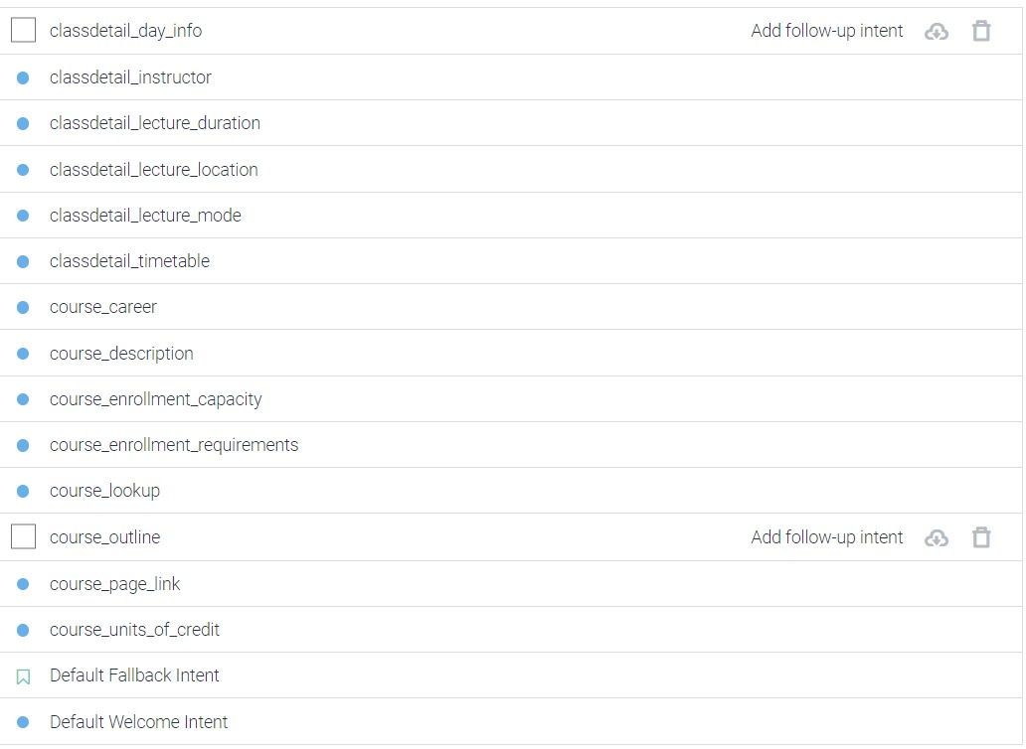
Front-end Implementation
Technology:
Chatbot server: Api.ai https://api.ai/
User Interface: Facebook Messenger
https://developers.facebook.com/docs/messenger-platform/send-messages/template/generic/
Intents:
Mapping of requests vs agent response
Use case categories

Slide 6
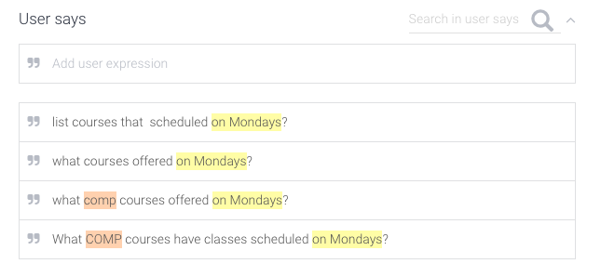
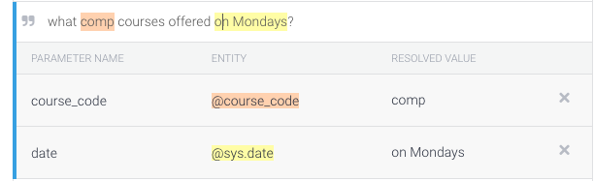
Front-end Implementation
Intents:
Entities:

Slide 7
Back-End Implementation
Technology:
Sails by Node.js
MongoDB
AWS
Purpose: Service that provides relevant information for the Agent
Data: Web crawler to extract information in JS

Slide 8




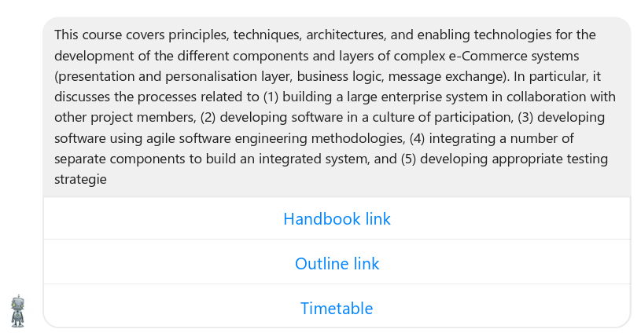
Architecture
DB Lookup
db.courses.find({“code”:”COMP9323”});
REST request
Intent – course_description
Entity – {course_code:”comp9323”}
Student query
What is comp9323 about?
FB Messenger Client
api.ai Server
node.js Server
Handbook database
Response sent to the student
REST response
{
"speech": "Description",
"source": "chappie_middleware",
"displayText": "Course Details",
"data": {
.........
}
Query Results
{
“code”:”COMP9323”,
“ course_title":"e-Enterprise Project“,
…
}

Slide 9
Demo

