Slide 1
Heart Disease Prediction Using Classification Algorithms
Team Members:
Apoorva Kyramkonda - 700742326
Varkuti Vijay Bhasker Reddy -700739778
Sanugommula Akshitha Reddy - 700742432
Pasula Sai Ragasri - 700742851

Slide 2
Introduction
In this pandemic situation, trying to help people recovering from any medical condition is the most important task for every human.
So, it’s our responsibility to use knowledge to help them. We decided to use different machine learning algorithms and see which will make the best prediction accuracy. By using this algorithm, we can help doctors warn the patient in advance to change their diets or increase medication.
As per our survey,
1.3 million died in 1990
2.8 million died in 2016
Assumption by Indian heart association: 23 million by 2030.

Slide 3
Role and Contribution in project
Apoorva worked on choosing the dataset and coding for Decision tree model and also helped in making documentation like report and PPT along with initial references for the project to move on.
Vijay worked on the XGBoost model and also helped in making documentation like report and PPT along with initial references for the project to move on.
Akshitha worked on the Random Forest model and also helped in making documentation like report and PPT along with initial references for the project to move on.
Ragasri worked SVM model and also helped in making documentation like report and PPT along with initial references for the project to move on.

Slide 4
Motivation
Heart conditions may become dangerous
Cardiovascular disease and stroke account for 12% to 15% of mortality.
Deadly attacks occur unexpected but might affect people who appear to be in good condition.
Might be trend or linkage between one person's personal behaviors as well as their likelihood of developing a pain and any cardiovascular problems.

Slide 5
Objective
Our Objective is to create a machine learning model that utilizes different algorithm, XGBoost ,Support Vector Classifier, Decision Tree Classifier, and Random Forest Classifiers.
To anticipate an individual's vulnerability to cardiovascular problems is to evaluate heart disease forecasting models utilizing larger range of input parameters.

Slide 6
Related Work
Latha and Jeeva et al., concentrates upon using it with a database of health data. Overall results of the study demonstrate how clustering algorithms, including bagging and boosting, were beneficial for enhancing overall reliability of classification algorithm also excel for estimating the risk of chronic diseases. Incorporating classification model significantly enhanced the procedure' efficiency, or the outcomes showed a significant improvement in model accuracy. Poor classifiers benefited from ensemble classification, which increased efficiency by approximately to 7%.
Ravindhar et al. employed 1 computational model but also four machine learning methods that correlate quality measures to the detection of heart problems. These researchers measured their programs' reliability, specificity, memory, overall F1 parameters through order to determine their ability to forecast cardiovascular events. This deep neural networking system identified cardiac illness with 98% efficiency.

Slide 7
Problem Statement
Design the Heart Attack Prediction and Detection System using machine learning techniques.

Slide 8
Algorithms Used
Decision Tree Classifier
Random Forest Algorithm
Support Vector Machine (Linear)
XGBoost

Slide 9
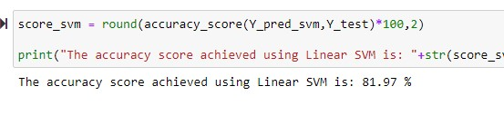
Support Vector Machine
Highest Score: 81.97% Kernel: Linear
used for both classification and regression challenges.
we plot each data item as a point in n-dimensional space (where n is number of features you have) with the value of each feature being the value of a particular coordinate.
perform classification by finding the hyper-plane that differentiate the two classes very well.

Slide 10
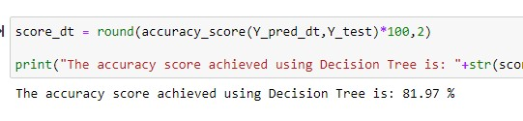
Decision Tree Classifier
Highest Score: 81.97%
most powerful and popular tool for classification and prediction.
is a flowchart like tree structure
each internal node denotes a test on an attribute, each branch represents an outcome of the test, and each leaf node (terminal node) holds a class label.
creates a decision tree based on which, it assigns the class values to each data point.
we can vary the maximum number of features to be considered while creating the model.

Slide 11

Random Forest Algorithm:
Highest Score: 95%
supervised learning algorithm which is used for both classification as well as regression.
it is mainly used for classification problems.
forest is made up of trees and more trees means more robust forest.
ensemble method which is better than a single decision tree because it reduces the over-fitting by averaging the result Random forest,
Each individual tree in the random forest spits out a class prediction and the class with the most votes becomes our model’s prediction.

Slide 12
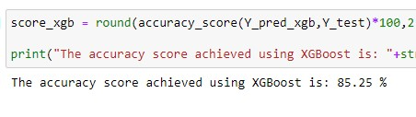
XGBoost
Uses bagging and boosting.
the framework is constructed by dividing on either particular trait.
it might be more resistant to certain other types of decision tree models.

Slide 13
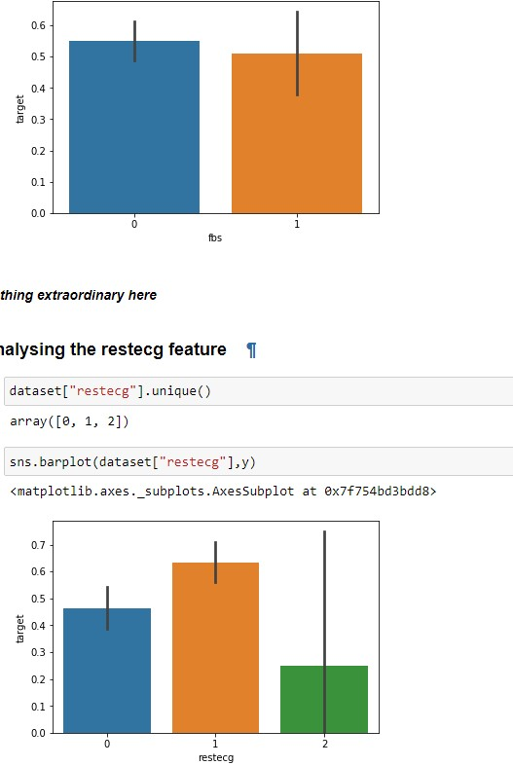
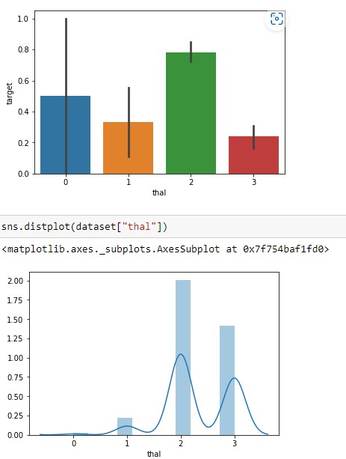
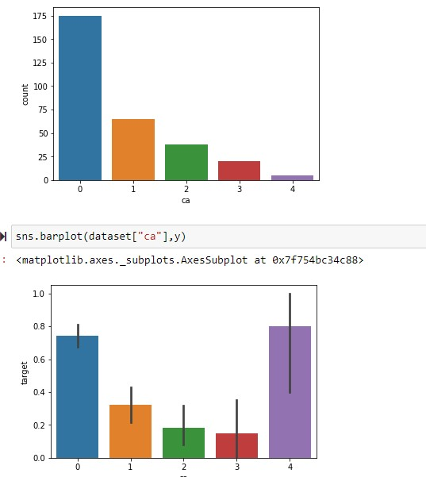
Preliminary Results

Slide 14
References
[1] C. Beyene, P. Kamat, “Survey on Prediction and Analysis the Occurrence of Heart Disease Using Data Mining Techniques”, https://www.researchgate.net/publication/323277772_Survey_on_prediction_and _analysis_the_occurrence_of_heart_dise ase_using_data_mining_techniques, 118(8):165-173 · January 2018.
[2] Muhammad Usama Riaz, SHAHID MEHMOOD AWAN, ABDUL GHAFFAR KHAN, “PREDICTION OF HEART DISEASE USING ARTIFICIAL NEURAL NETWORK”.
[3] Komal Kumar Napa, G.Sarika Sindhu, D.Krishna Prashanthi, A.Shaeen Sulthana, “Analysis and Prediction of Cardio Vascular Disease using Machine Learning Classifiers”, April 2020.
[4] Hossam Meshref, “Cardiovascular Disease Diagnosis: A Machine Learning Interpretation Approach,January 2019.
[5] A. Akella and S. Akella, “Machine learning algorithms for predicting coronary artery disease: efforts toward an open-source solution,” Future Science OA, vol. 7, no. 6, Article ID FSO698, 2021.

