Slide 1
Android Team:
Abhay Gupta
Gaurav Halbe
Mayank Chacko
Rohit Kandhal
Walk North Hills

Slide 2
Presentation Outline
Quick Recap
Our Approach
New Additions
Prototype
Future Work
Q&A

Slide 3
About the ‘Walk Campaign’
Initiated by Matt Tomasulo
Encourage people to walk
Integrates key features of initial physical campaign

Slide 4
Our Approach
Keep the app simple ( No weather, refresh etc. )
Dynamic Database
Category Selection
Showing walkable route between two places
Google Maps API integration

Slide 5
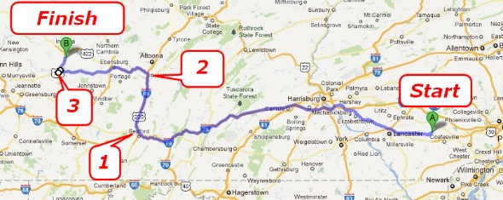
Google Direction Api

Slide 6
Google Distance Matrix api
Source
Destination 1
Destination 2
Destination 3
Destination 4
Destination 5
 | Destination 1 | Destination 2 | Destination 3 | Destination 4 | Destination 5
Source | 3 km/ 15 mins | 6 km/ 30 mins | 9 km/45 mins | 10km/50 mins | 1 km/ 5 mins

Slide 7
New Additions
Refresh destination list and time based on user location
Maintaining local copy of database
Sorted list based on proximity
Destination name and information on map
Splash screen
Highlight selected category

Slide 8
Future Work
Favorites
Cumulative walking minutes
Map/List option selection
Guide step by step

Slide 9
Prototype

Slide 10
Questions?

