Slide 1
Best Mumbai Eateries

Slide 2
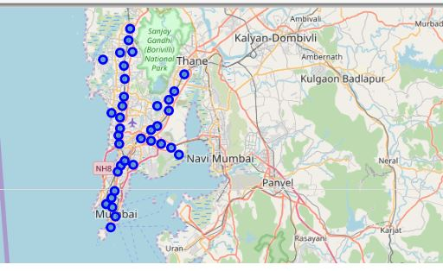
Mumbai neighbourhoods plotted with locatity
Plotted using Folium

Slide 3
Mumbai has a population of 19.98 million people
Unusually high amount eateries which need to be slotted and produce the very best of them
Mumbai has one of the best food in world
Data used about eateries is stripped from Foursquare and their likes count serve as criteria for sorting eateries.

Slide 4
The Following 37 localities where searched on Foursquare
Andheri Antop Hill Bandra Bhandup Bhayandar Borivali
Byculla Chembur Colaba Dadar Dahisar Fort Ghatkopar
Girgaon Goregaon Govandi Jogeshwari Juhu Kalbadevi
Kamathipura Kandivali east Kandivali west Kanjurmarg
Khar Kurla Malad Mankhurd Matunga Mulund Parel Powai
Santacruz Trombay Vidyavihar Vikhroli Vile Parle Virar

Slide 5
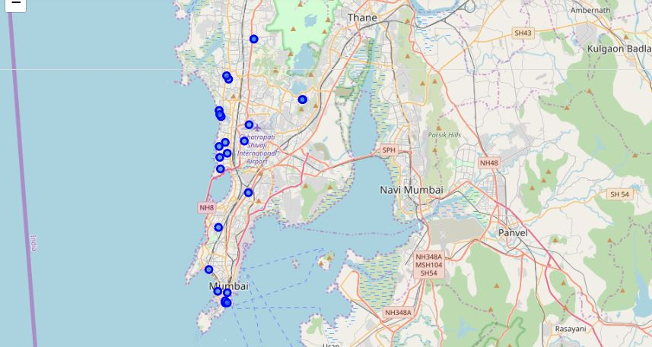
All the neighbourhood with excellent Eateries

Slide 6
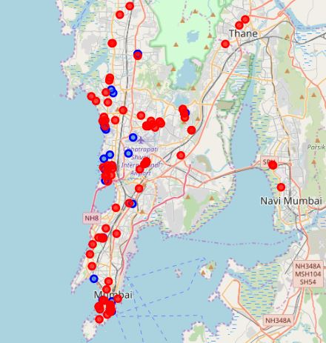
Eateries with Excellent and very good eateries

Slide 7
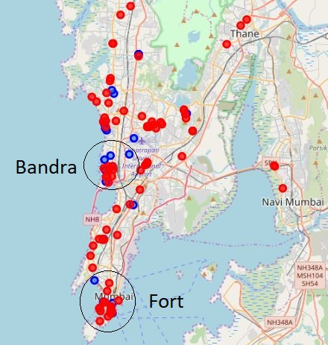
Two Clusters of best eateries as shown

Slide 8
Thank you

