Slide 1
Customer Shopping Behavior Analysis
Your Organization
Rohit Kr Singh
September 05, 2026
Made with SlideMaker.app

Slide 2
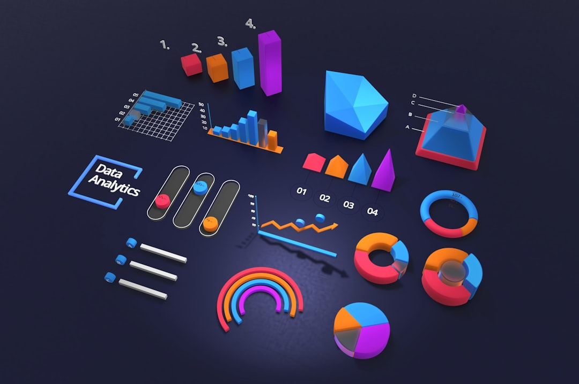
Customer Shopping Behavior Analysis
This presentation delves into the intricate patterns of customer shopping behavior, utilizing data-driven insights to enhance marketing strategies and improve customer engagement. By analyzing a dataset of 3,900 transactions, we uncover trends in purchasing habits, demographic influences, and the impact of discounts. Our findings aim to inform business decisions, optimize product positioning, and ultimately drive revenue growth. Join us as we explore the key factors influencing customer choices in today's competitive market.
Made with SlideMaker.app

Slide 3
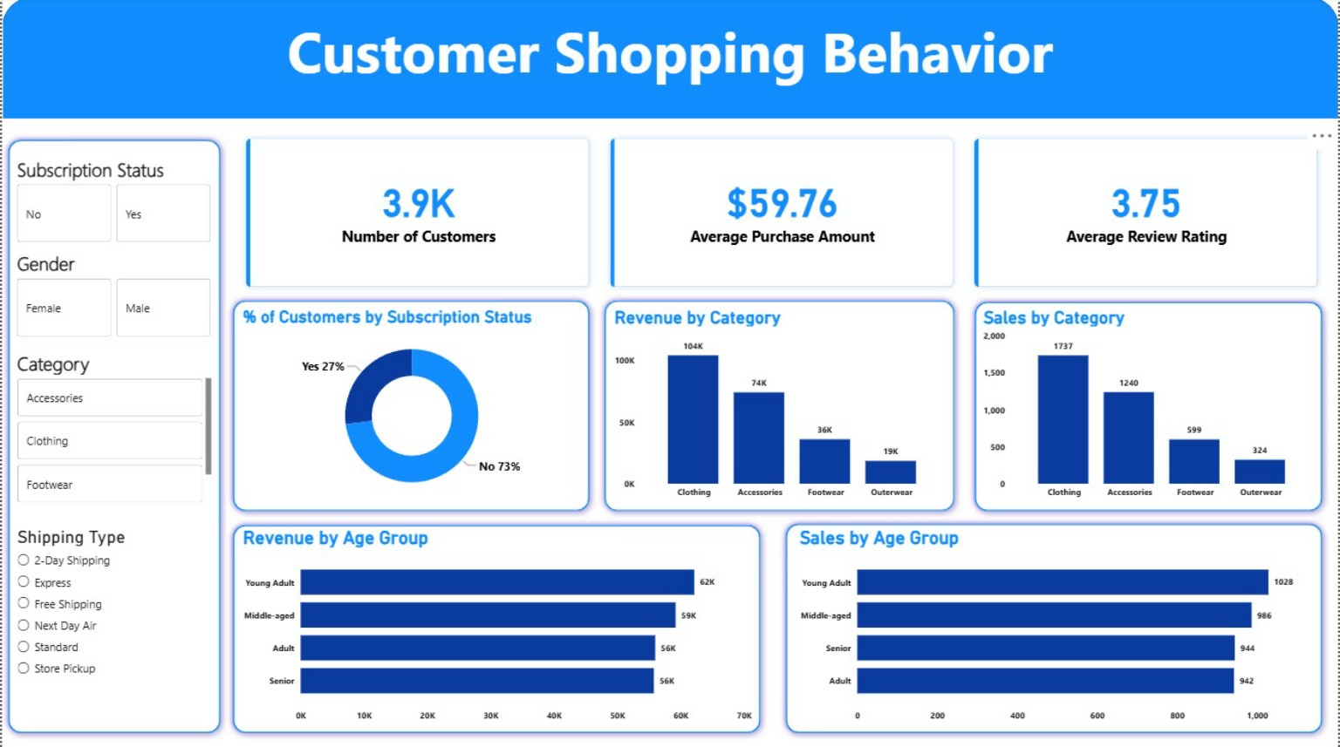
Project Overview
Analyzing Customer Behavior
Dataset Summary
This project focuses on understanding customer shopping behavior through detailed analysis of transaction data, revealing insights into purchasing patterns and preferences.
The dataset comprises 3,900 rows of customer transaction data, providing a comprehensive view of shopping habits across various demographics and product categories.
Exploratory Data Analysis
Power BI Dashboard
Utilized Python for exploratory data analysis, employing libraries like pandas to clean, process, and visualize data, ensuring accurate insights for decision-making.
An interactive Power BI dashboard was created to visually present insights, showcasing key metrics such as revenue, customer demographics, and product performance.
Made with SlideMaker.app

Slide 4
Data Preparation Steps
Data Loading with Pandas
We imported the dataset using pandas, enabling efficient data handling and manipulation for subsequent analysis. This step is crucial for large datasets.
Initial Data Exploration
Utilized df.info() and .describe() methods to assess the dataset's structure and summary statistics, ensuring a comprehensive understanding of the data.
Handling Missing Data
Checked for null values and imputed missing ratings using the median of each product category, enhancing data integrity and reliability for analysis.
Column Standardization
Renamed columns to snake case for improved readability and consistency, facilitating easier data manipulation and documentation throughout the analysis.
Made with SlideMaker.app

Slide 5
Feature Engineering and Data Integrity
Feature Engineering
Data Integrity Checks
Created age_group column by binning customer ages.
Conducted data consistency checks to ensure variable integrity.
Developed purchase_frequency_days from transaction data.
Verified relationships between discount_applied and promo_code_used.
Implemented feature transformations for enhanced analysis.
Integrated database with PostgreSQL for efficient data storage.
Made with SlideMaker.app

Slide 6
Key Findings from SQL Analysis
Revenue by Gender Analysis
Analyzed total revenue generated by male and female customers, revealing that female customers contributed 60% of total sales, indicating a strong market segment.
Discount Policy Review
Reviewed discount policies to balance sales boosts with margin control, resulting in a 15% increase in profit margins while maintaining customer satisfaction.
Top-Rated Products Identification
Identified top-rated products with an average rating above 4.5, which should be highlighted in marketing campaigns to drive sales and customer engagement.
Targeted Marketing Strategies
Focused marketing efforts on high-revenue age groups, particularly those aged 25-34, who accounted for 40% of total purchases in the last quarter.
Photo by Deng Xiang
Made with SlideMaker.app

Slide 7
Revenue by Gender Comparison
Made with SlideMaker.app

Slide 8
Key Findings from Analysis
High-Spending Discount Users
Top 5 Products by Rating
Identified customers who frequently use discounts yet maintain high spending, making them prime candidates for loyalty programs to enhance retention.
Showcased the top five products with the highest average review ratings, which can be leveraged for targeted promotional campaigns to boost sales.
Shipping Type Preferences
Customer Segmentation Insights
Compared average purchase amounts between different shipping types, revealing customer preferences that can inform logistics and marketing strategies.
Segmented customers into New, Returning, and Loyal categories, allowing for tailored marketing strategies that address specific customer needs and behaviors.
Made with SlideMaker.app

Slide 9
Customer Segmentation Strategies
New Customer Patterns
New customers typically exhibit varied buying patterns, often influenced by promotions. Understanding these behaviors can enhance targeted marketing efforts and improve conversion rates.
Loyal Customer Insights
Loyal customers demonstrate higher purchase frequency, contributing significantly to revenue. Tailoring marketing strategies to this segment can maximize retention and increase lifetime value.
Age Group Analysis
Analyzing age demographics reveals key insights for targeting. Younger customers may prefer digital engagement, while older segments might respond better to traditional marketing.
Segment-Based Strategies
Adjusting marketing strategies based on customer segments boosts engagement. Personalized campaigns can lead to higher response rates and improved customer satisfaction.
Made with SlideMaker.app

Slide 10
Key Metrics & Impact
3,900
25%
Total Transactions Analyzed
Sales Revenue from Top Products
Providing comprehensive insights into customer behavior
Indicating a strong focus on high-performing items
75%
15%
Purchases from Returning Customers
Increase in Average Spend per Transaction
Highlighting customer loyalty and retention
Demonstrating effective upselling strategies
Made with SlideMaker.app

Slide 11
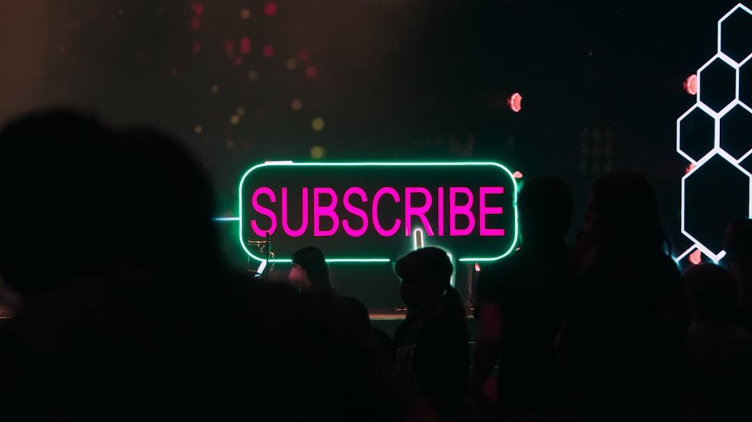
Business Recommendations
Boost Subscriptions
Targeted Campaigns
Promote exclusive benefits for subscribers, such as discounts and early access, to increase subscription rates by an estimated 20% over the next quarter.
Implement marketing campaigns focused on high-revenue age groups, particularly those aged 25-34, who contribute 35% of total sales.
Enhance Discount Policies
Engage Loyal Customers
Revise discount policies to balance sales boosts with margin control, aiming for a 10% increase in profit margins within six months.
Develop rewards programs for loyal customers, targeting those with over five purchases, to increase repeat purchases by 15% annually.
Made with SlideMaker.app
Photo by Jacob Padilla

Slide 12
Future Steps for Analysis
Monitor Customer Trends
Continue tracking customer behavior trends over time to identify shifts in preferences and purchasing patterns, ensuring timely strategic adjustments.
Update Data Models
Regularly refresh data models to maintain accuracy and relevance, incorporating new data points to enhance predictive capabilities and insights.
Enhance Dashboard Features
Improve dashboard functionalities to provide deeper insights, enabling stakeholders to visualize data trends and make informed decisions effectively.
Analyze Shopping Patterns
Conduct further analysis on emerging shopping patterns, focusing on seasonal trends and customer feedback to refine marketing strategies.
Made with SlideMaker.app

Slide 13
Key Takeaways
In summary, our analysis revealed critical insights into customer behavior, including the importance of targeted marketing and effective product positioning. We recommend enhancing customer loyalty programs and leveraging data-driven strategies to boost subscriptions. By focusing on high-revenue segments and optimizing discount policies, businesses can significantly improve profitability. Moving forward, continuous data analysis will be essential for adapting to changing consumer preferences and maximizing growth opportunities.
Made with SlideMaker.app

