Slide 1
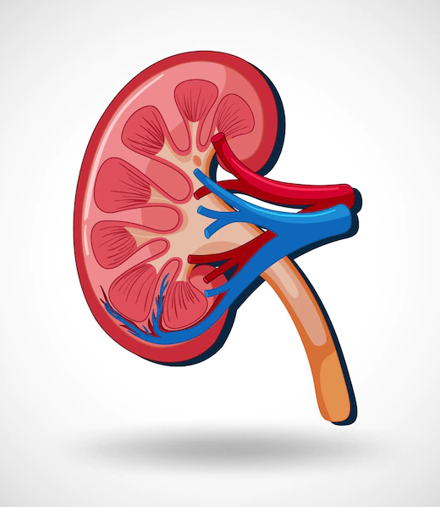
Chronic Kidney Disease Prediction
Presenter : Team – Bit by Bit
Rohit Tiwari (2100520109002)
Shivam Pandey (2000520100061)
Samarth Gautam (2000520100050)

Slide 2
Agenda
Introduction
Objective
Data Set
Development Stage
Future Scope & Conclusion
Chronic Kidney Disease Prediction

Slide 3
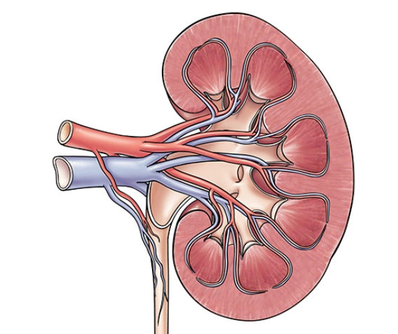
Introduction
Chronic kidney disease (CKD) means your kidneys are damaged and can’t filter blood the way they should. The disease is called “chronic” because the damage to your kidneys happens slowly over a long period of time. This damage can cause wastes to build up in your body. CKD can also cause other health problems.

Slide 4
Problem Statement
To develop an algorithm for providing prediction and reduce Kidney related disease using Machine Learning Algorithms.
Input –
Age. Blood Pressure, Albumin, Sugar, Red Blood Cell, Pus Cell, Pus Cell Clumps, Bacteria, Blood Glucose Random, Blood Urea, Serum Creatinine, Potassium, White Blood Cell Count, Hypertension, Diabetes Mellitus, Coronary Artery Disease, Pedal Edema, Anemia
Output –
Person gets immediate result based on their inputs along with accuracy,, so it helps to reduce danger.
Objective
To effectively predict if the person suffers from chronic kidney disease.

Slide 5
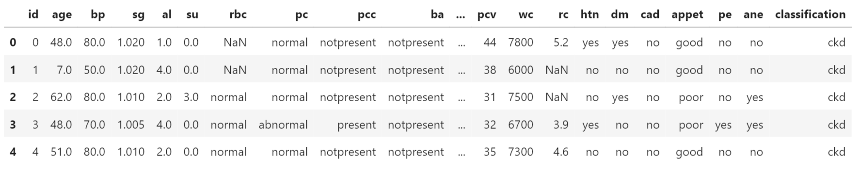
Quick View Of Data Set

Slide 6
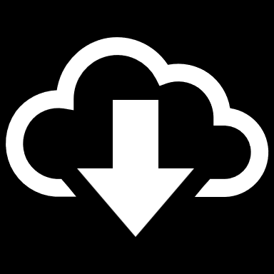
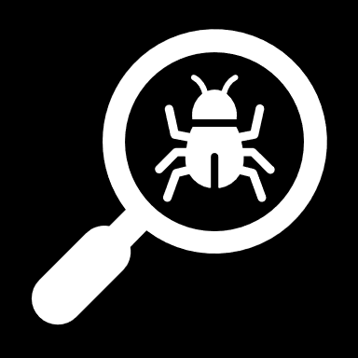
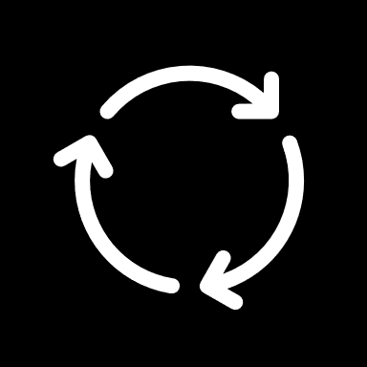
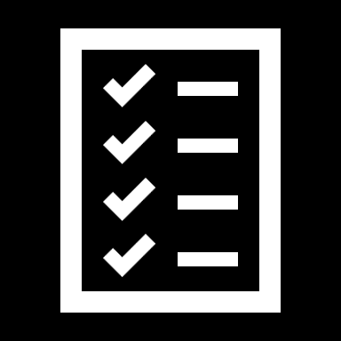
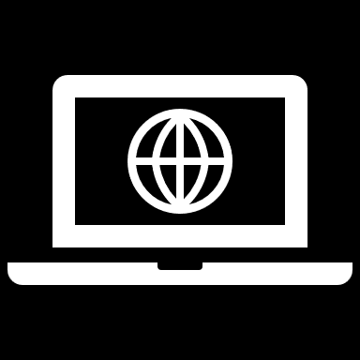
Project Stages
The Project consists of following stages -
Importing Libraries & Dataset
In this section we will load a few libraries and We will also be loading our dataset.
In this section we will analyze and We will also carry out preprocessing.
Model Implementation
In this section we will import Random Forest model from Sklearn.
Exploring & Pre-processing the Dataset
Model Testing
In this section we will test out prediction with testing data.
Deploying on Web
In this section we will deploy our model on Web using Flask and Pickle.

Slide 7
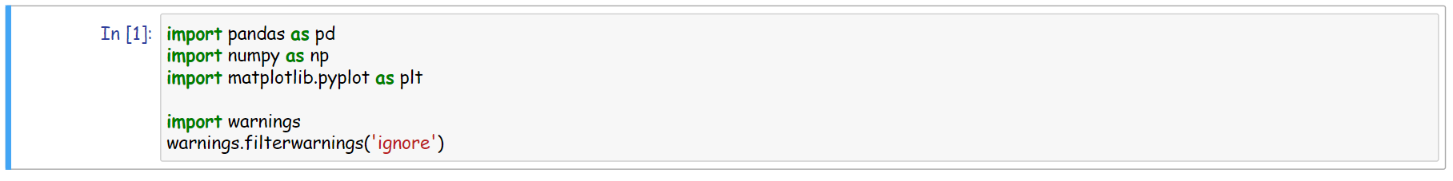
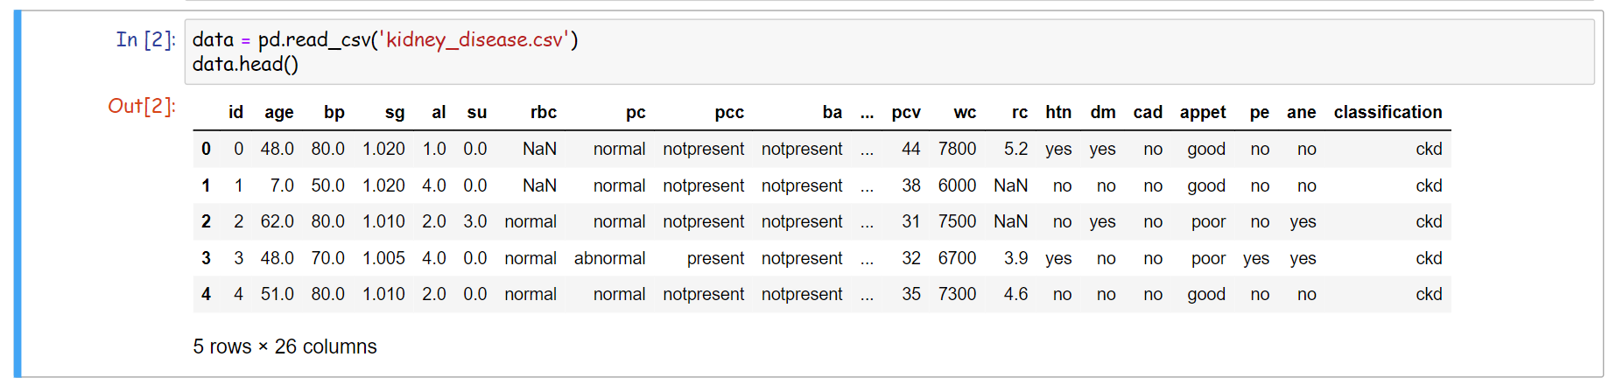
Importing Libraries and Dataset

Slide 8
Exploring and Pre-processing Data
Data Exploring
Create a pandas Data Frame for creating a copy of dataset on which we will carry out further processing.
head() and tail() to see fist and last five rows of the created data frame.
describe() to get even further insights on the created data frame.
df.info to know data type various features present in the dataset.
Creating Heatmap using seaborn to find correlation between features and labels
Data Pre-processing
Imputation of null values.
Handling typo errors in categorical and numerical columns.
Converting categorical columns to numerical columns.
Dropping features having negative correlation with labels.
Train test split

Slide 9
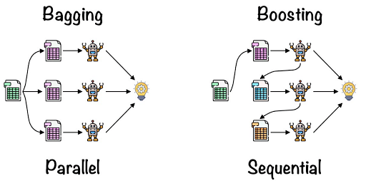
Random Forest Algorithm
It is Supervised Learning based on Ensemble learning
Ensemble Learning uses two methods
Bagging: Creating a different training subset from sample training data with replacement is called Bagging. The final output is based on majority voting
Boosting: Combing weak learners into strong learners by creating sequential models such that the final model has the highest accuracy is called Boosting. Example: ADA BOOST, XG BOOST.

Slide 10
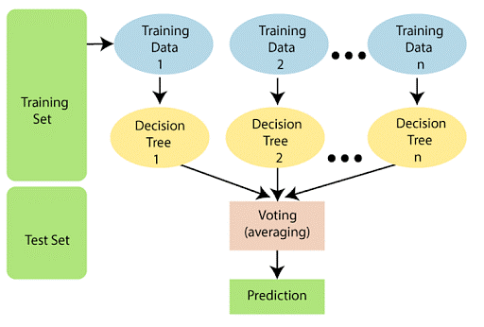
Random Forest Algorithm
Steps of Algorithm
Step 1: Select random samples from a given data or training set.
Step 2: This algorithm will construct a decision tree for every training data.
Step 3: Voting will take place by averaging( mean of resulting data of each tree) the decision tree.
Step 4: Finally, select the most voted prediction result as the final prediction result.

Slide 11
Essential feature of Random Forest
Immune to the curse of dimensionality: Since a tree is a conceptual idea, it requires no features to be considered. Hence, the feature space is reduced.
Miscellany: Each tree has a unique attribute, variety and features concerning other trees. Not all trees are the same.
Parallelization: We can fully use the CPU to build random forests since each tree is created autonomously from different data and features.
Train-Test split: In a Random Forest, we don’t have to differentiate the data for train and test because the decision tree never sees 30% of the data.
Stability: The final result is based on Bagging, meaning the result is based on majority voting or average.

Slide 12
Model Implementation
In this section we will import Random Forest Regression model from Sklearn. Use features identifies from heatmap and label to create training and testing set. Finally we will train our model using training set.
Use train_test_split() from Sklearn to create train and test sets.
Use Algorithm on training data.

Slide 13
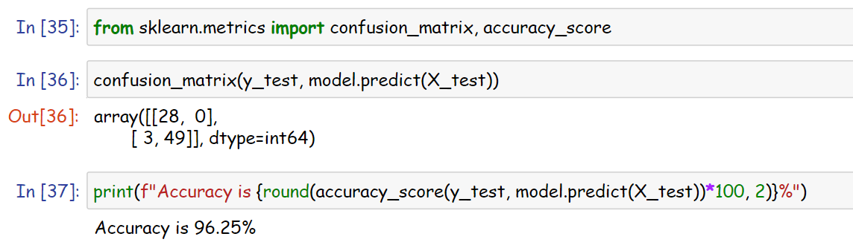
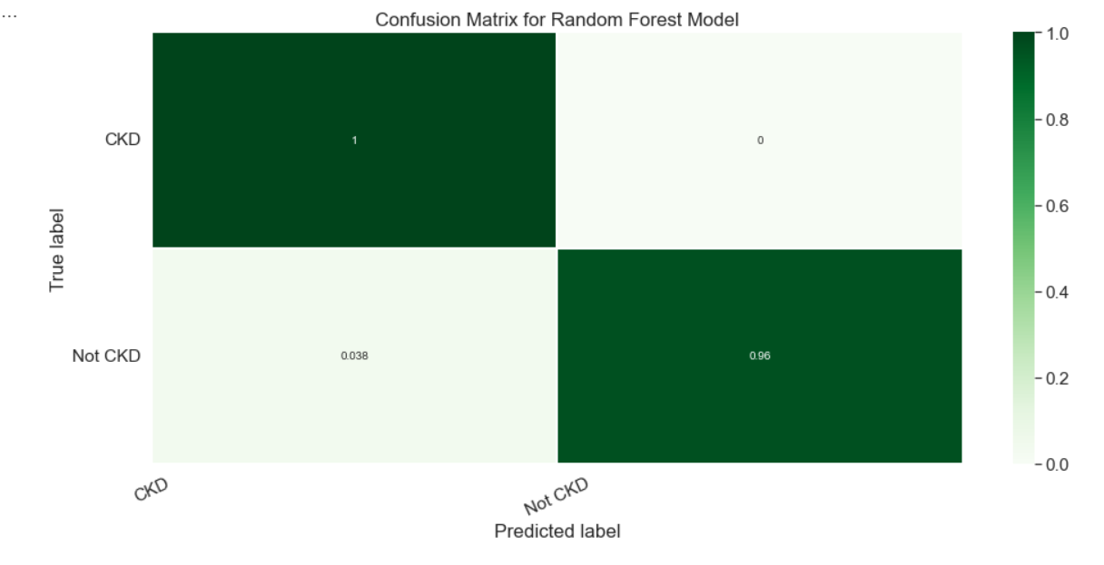
Model Testing
In this section we will test our prediction with testing data and calculate Confusion matrix and accuracy score to measure model accuracy.

Slide 14
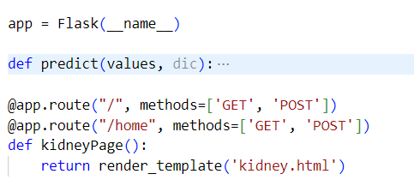
Deploying on Web
We will be using deploy our model on web with the help of Flask and Pickle.
Step 1: Saving the model using pickle library.
Step 2: Building a Flask Based Web App

Slide 15
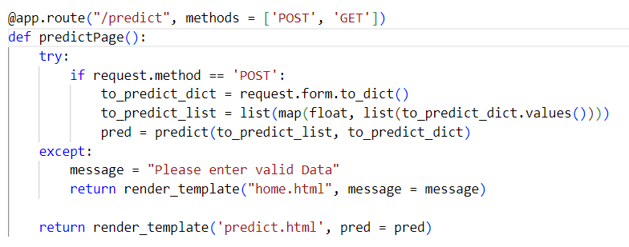
Deploying on Web
Step 3: Receiving the Form Data with POST request at Back-end

Slide 16
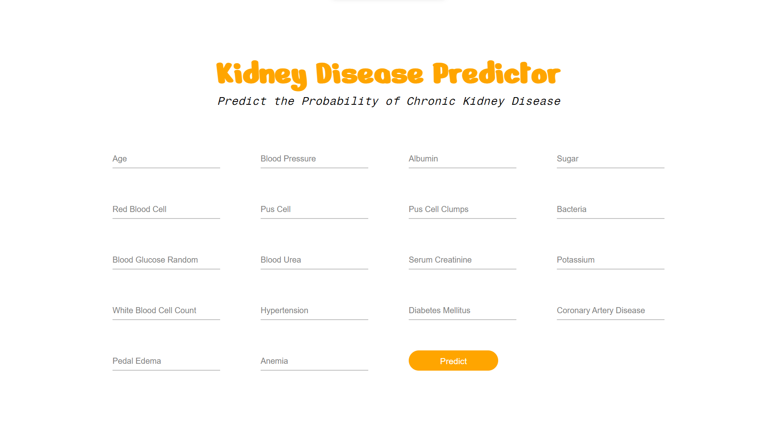
Web Interface : /home

Slide 17
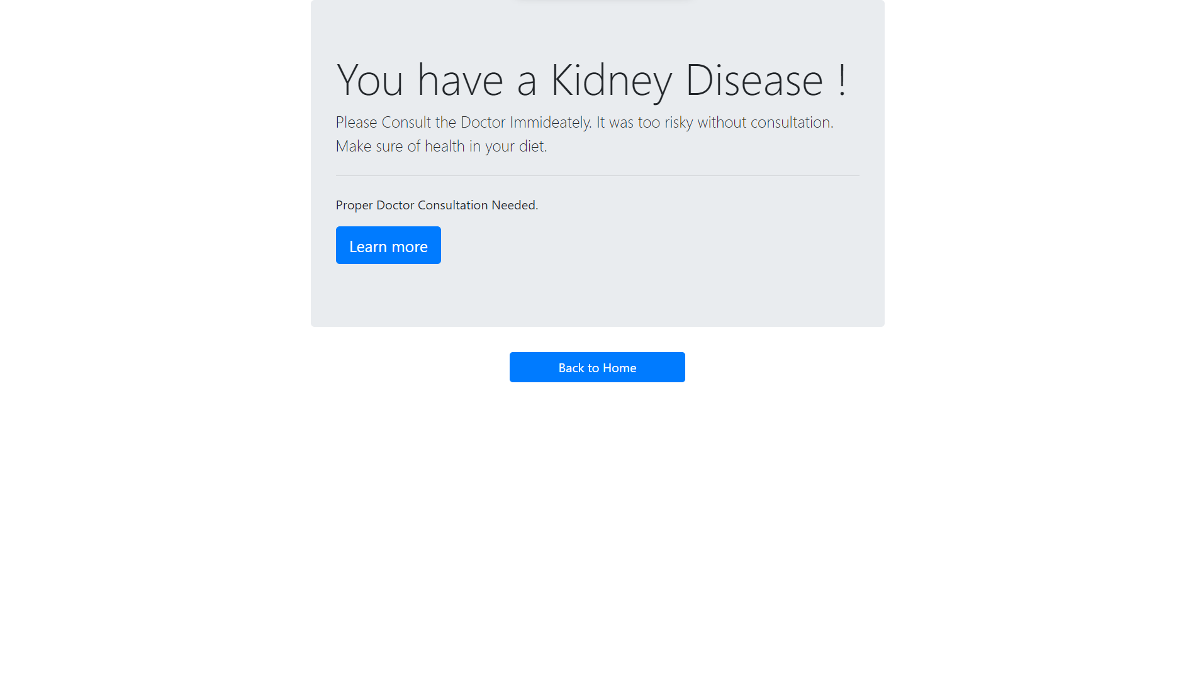
Web Interface : /predict

Slide 18



Meet our team
Rohit Tiwari
Samarth Gautam
Shivam Pandey

Slide 19




Thank you
Team Bit by Bit

