Slide 1




Crop and Fertilizer Recommendation System using ML

Slide 2

Learning Objectives
Understand the concept of a Crop-and-Fertilizer-Recommendation-System.
Learn how Machine Learning (ML) can be applied to recommend crops and fertilizers.
Familiarize yourself with the tools and technologies used in the project.
Analyze the methodology and approach used in the project.
Identify the problem statement and solution proposed by the project.
GOAL
Source :
www.freepik.com/

Slide 3
Tools and Technology used
Programming Language: Python
Machine Learning Library: Scikit-learn
Data Analysis Library: Pandas, NumPy
Data Visualization Library: Matplotlib, Seaborn
Database: MySQL, MongoDB (optional)
Front-end: HTML, CSS, JavaScript (optional)
Back-end: Flask, Django (optional)

Slide 4
Methodology
Data Collection: Collecting dataset on crop yields, fertilizer usage, soil type, climate, and other relevant factors.
Data Preprocessing: Cleaning, handling missing values, and normalizing the data.
Feature Engineering: Extracting relevant features from the data.
Model Training: Training ML models (e.g., decision trees, random forests, neural networks) on the dataset.
Model Evaluation: Evaluating the performance of the trained models.
Model Deployment: Deploying the best-performing model in a web application or API.

Slide 5
Problem Statement:
Farmers face difficulties in selecting the most suitable crop and fertilizer for their land, leading to reduced yields and increased costs.
Current methods of crop and fertilizer recommendation are often based on manual observations, leading to inaccuracies and inconsistencies.
There is a need for a data-driven approach to provide personalized crop and fertilizer recommendations to farmers.

Slide 6
Solution:
Develop a Crop-and-Fertilizer-Recommendation-System using ML that can provide personalized recommendations to farmers based on their soil type, climate, and other relevant factors.
The system will use a dataset of crop yields, fertilizer usage, and other relevant factors to train ML models.
The system will provide recommendations on the most suitable crop and fertilizer for a given piece of land, leading to increased yields and reduced costs for farmers.

Slide 7
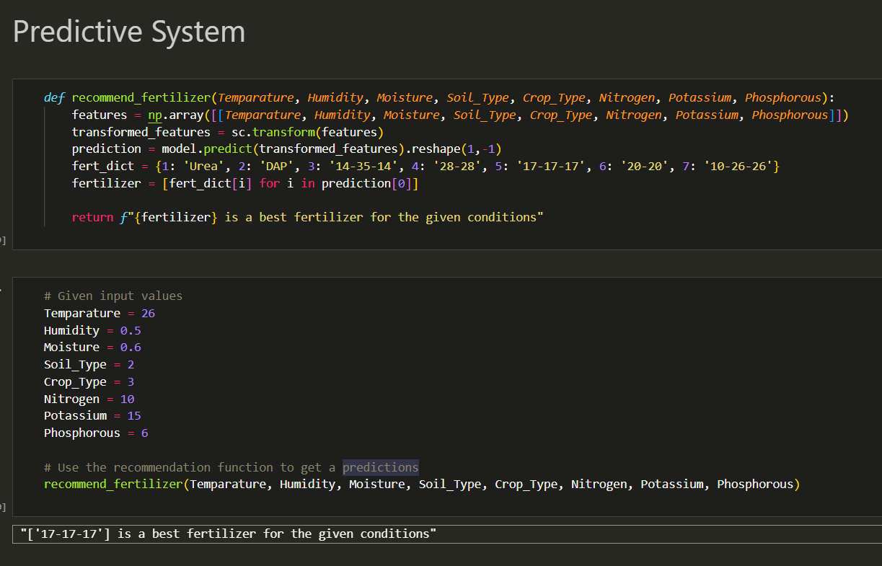
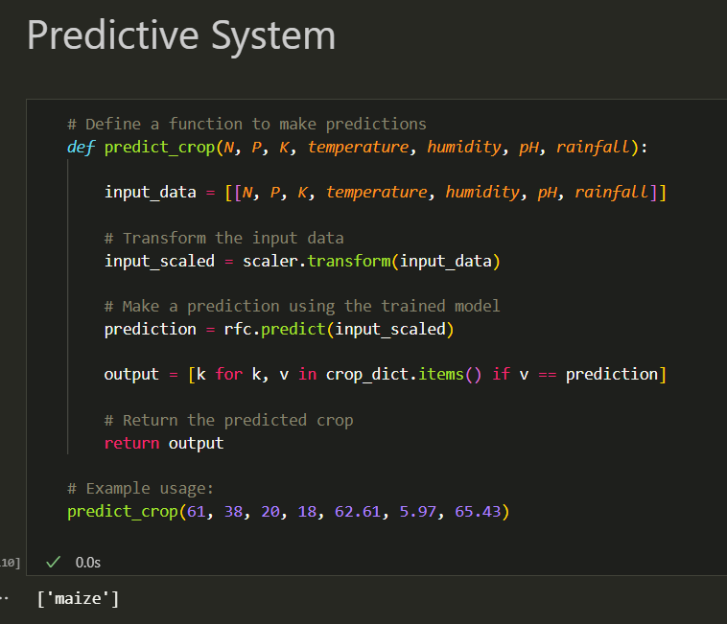
Screenshot of Output:
Fertilizers Recommendation
Crop Recommendation

Slide 8
Conclusion:
The Crop-and-Fertilizer-Recommendation-System using ML has the potential to revolutionize the agricultural industry by providing personalized recommendations to farmers.
The system can lead to increased yields, reduced costs, and improved efficiency for farmers.
Further research and development are needed to refine the system and make it more accessible to farmers.

