Slide 1
CS308 Final Presentation : Automators
Automation for Home Electric Appliances
Team 4 : Nitin, Suman, Rakesh, Rohit

Slide 2
Our mission is to provide improved convenience, comfort and energy efficiency in household activities through automation

Slide 3
Task Specification
Manual / Automatic fan control using temperature sensor.
Automatic lights control using motion sensor.
Theft protection using proximity sensor.
Controls sits on android phone, which controls all the appliances through bluetooth.

Slide 4
Project Plan
Plan followed, in order :
To make individual components and sensor works.
Design an android app and protocol, keeping the individual and overall requirements in mind.
Integrate everything together.
Work Division
Rohit : L293D and motor working
Suman : Putting up all the component and modules together.
Rakesh: bluetooth and android integration
Nitin: Motion and proximity sensors.

Slide 5
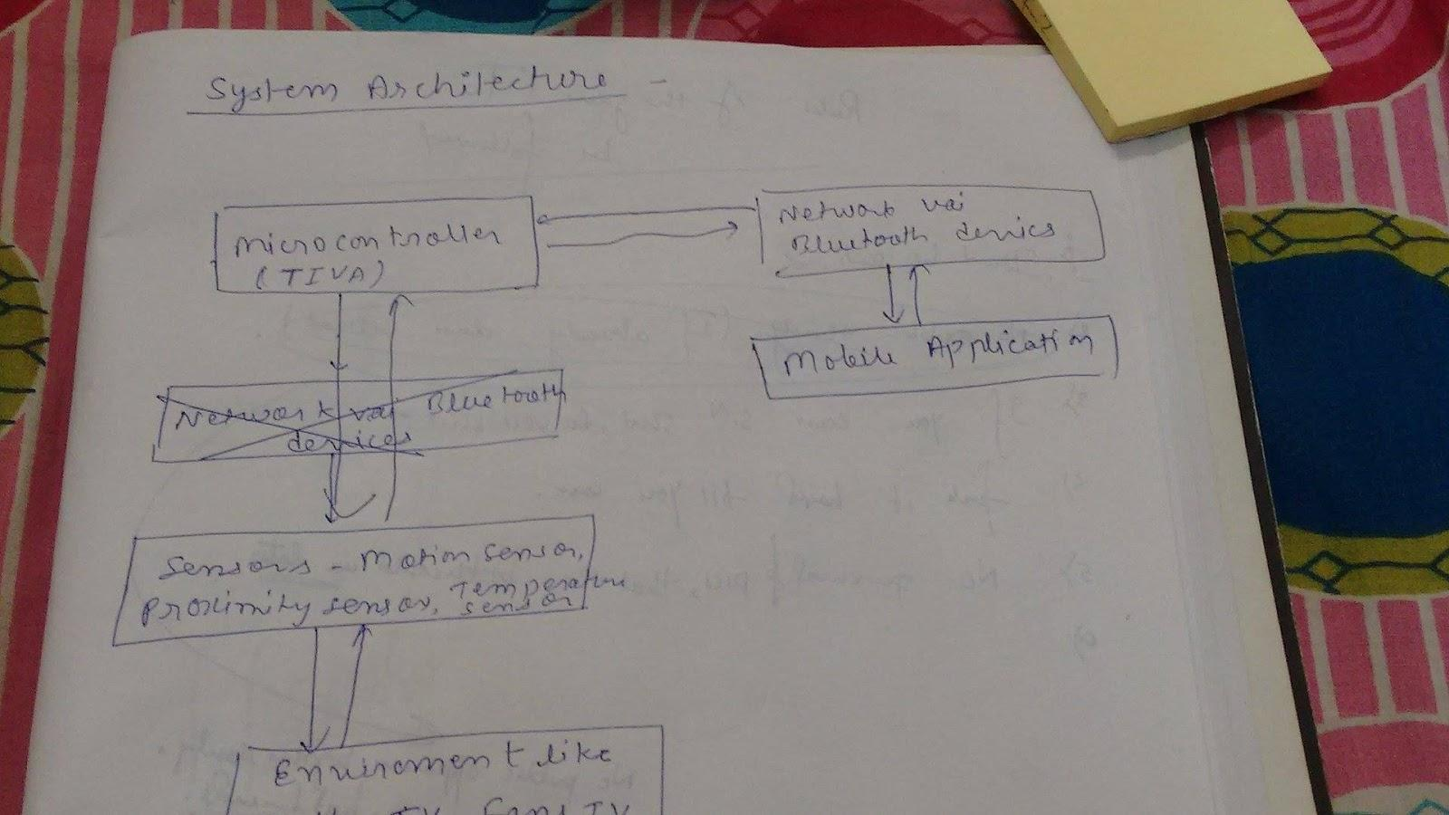
System Architecture

Slide 6
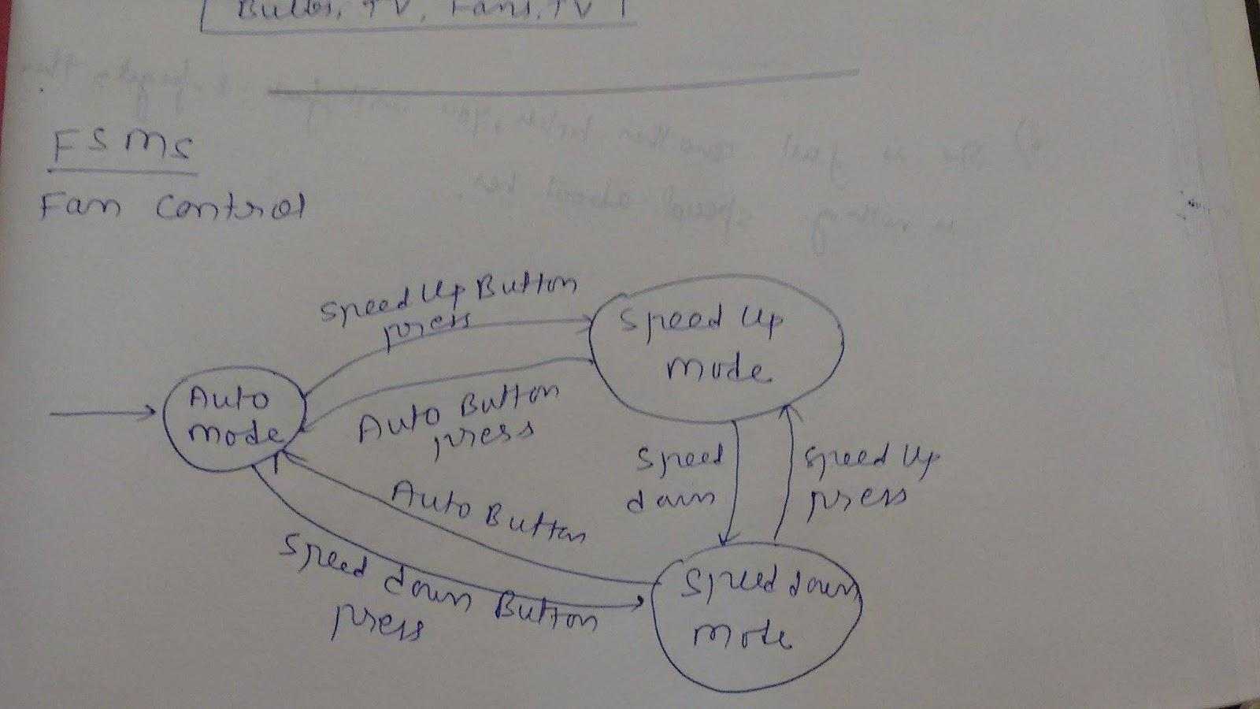
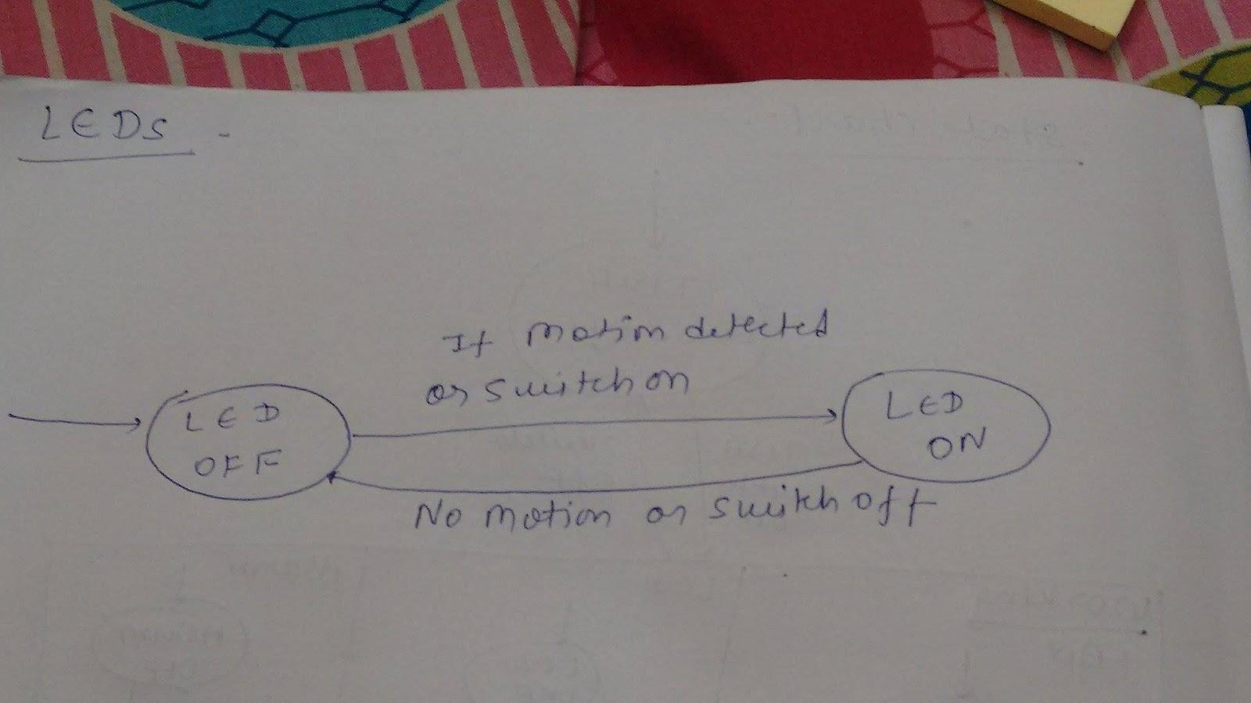
State machines
FAN:
LED

Slide 7
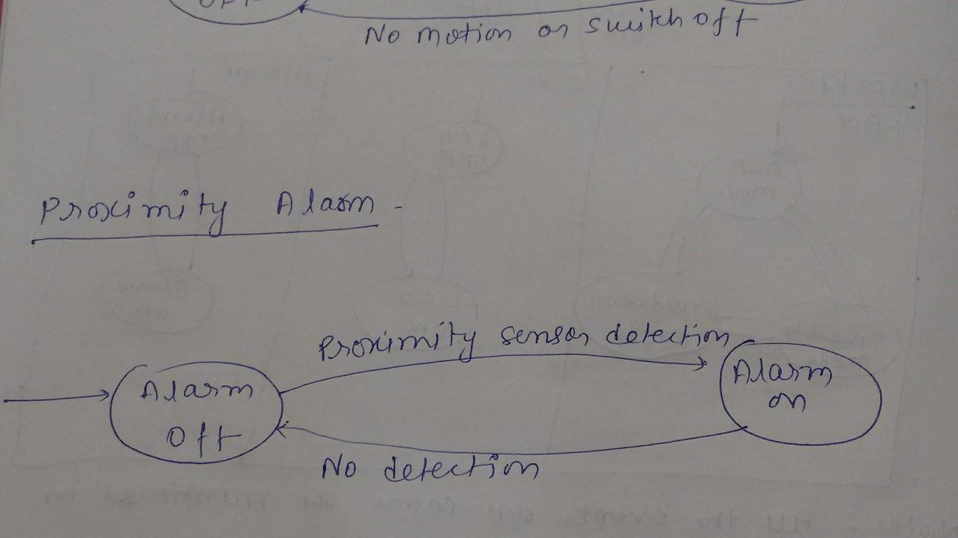
State machines Cont...
FAN:

Slide 8
Challenges and Innovation
Using the cheapest building blocks in the market, and still make a product that works seamlessly and reliably .
Integration of all the components on a single Tiva board.
Get numerous blocks with different specifications (eg. frequency) to work together.

Slide 9
Challenges in task completed
Fan control:
PMW board wasn't supporting many pins that we required.
We went through the whole documentation of PMW, and connected the pins accordingly.
Remote control:
The SDK for WiFi module wasn’t available for CCS, but for Energia. But all the code for other components was written in energia.
Even on Energia it was taking very long to connect.
We decided to use bluetooth connection instead.

Slide 10
Tests
Bluetooth:
When already connected to some bluetooth device, the bluetooth on the board shouldn’t
Fan:
Auto mode testing: Kept our kit in hot corridor and then air conditioned class back to back. The fan spun in full speed outside, but got slow in the air conditioned room.
Manual mode: Irrespective of the room temperature, the fan is fully controlled by app.
Lights:
When someone steps in front of the motion sensor the led glows.
Theft control :
A notification appears on the phone when the door opens ( cover of the box opens ).

Slide 11
Performance metrics
Cost:
Cost: approx rupee 2k.
Reliability :
The state of fan, bulbs and other appliances should be correctly depicted on the app.
If the operation fails, the app should act accordingly. Ex, if switching off of fan fails, the state of fan should remain on ( shouldn’t go to off ).
Response time:
The time between the stimulus event and the response. In our case these are:
Time between door opening and notification on phone.
Time between temperature change and the speed change of the fan.
The time is takes to connect the bluetooth.
The between the movement in front of motion sensor and the glowing of LED.

Slide 12
Re-usability features
TIVA -Board : Microcontroller can be used for further extension of project

Slide 13
Future Enhancements
Integration with real life home circuit.
Collect data of device uses and apply analytics to conclude power consumption patterns
Use Pulse detection sensor to detect drowsiness and control light switches based on that

