Slide 1
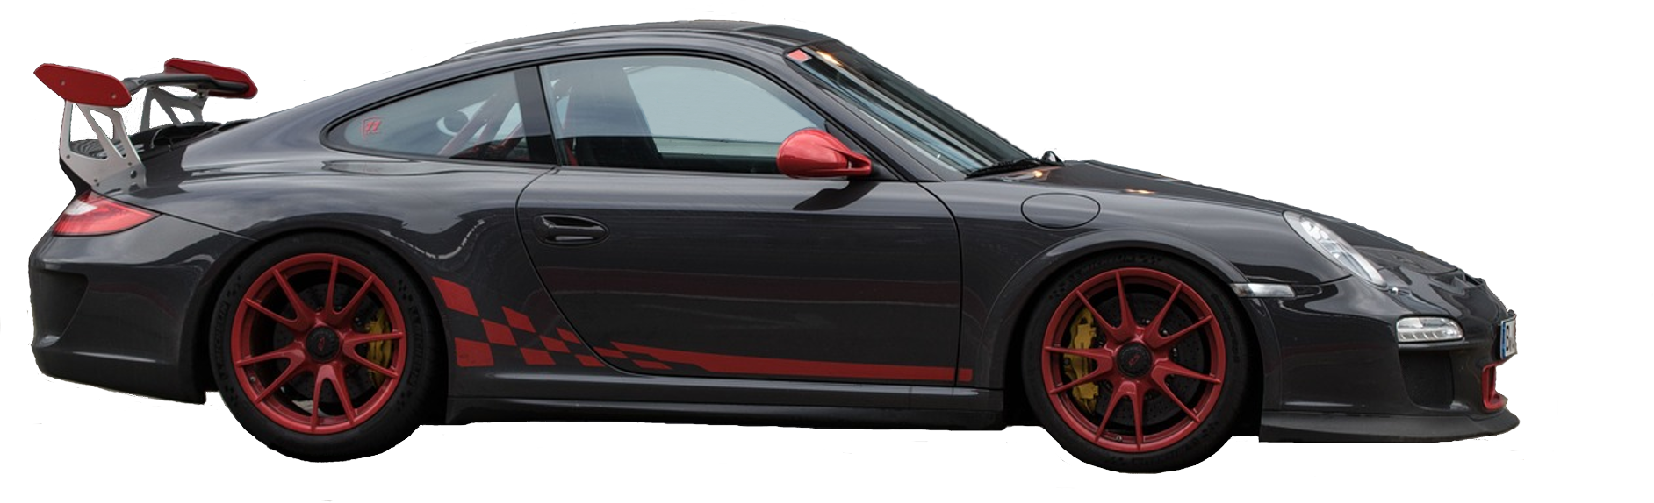
CarPriceIQ
Car Price Prediction
Predicting Car Prices with Intelligent Machine Learning Models
Presented by: Rohit Kumar Prajapati, MCA 2nd Year
Internship Coordinator: Prof Bibhudendu Panda
GitHub: github.com/rohitkumarprajapati472- lab/CarpriceIQ

Slide 2
Problem Statement -
Determining the correct price of a used car is difficult because many factors affect it, such as brand, model, age, kilometres driven, fuel type, transmission, owner type, engine and seats. Sellers often misjudge the value, and buyers cannot easily tell whether a price is fair. This leads to overpricing, underpricing and poor decisions.
Solution -
"A machine learning system that predicts a fair used-car price from 10 key features, with a live web app for instant estimates."

Slide 3
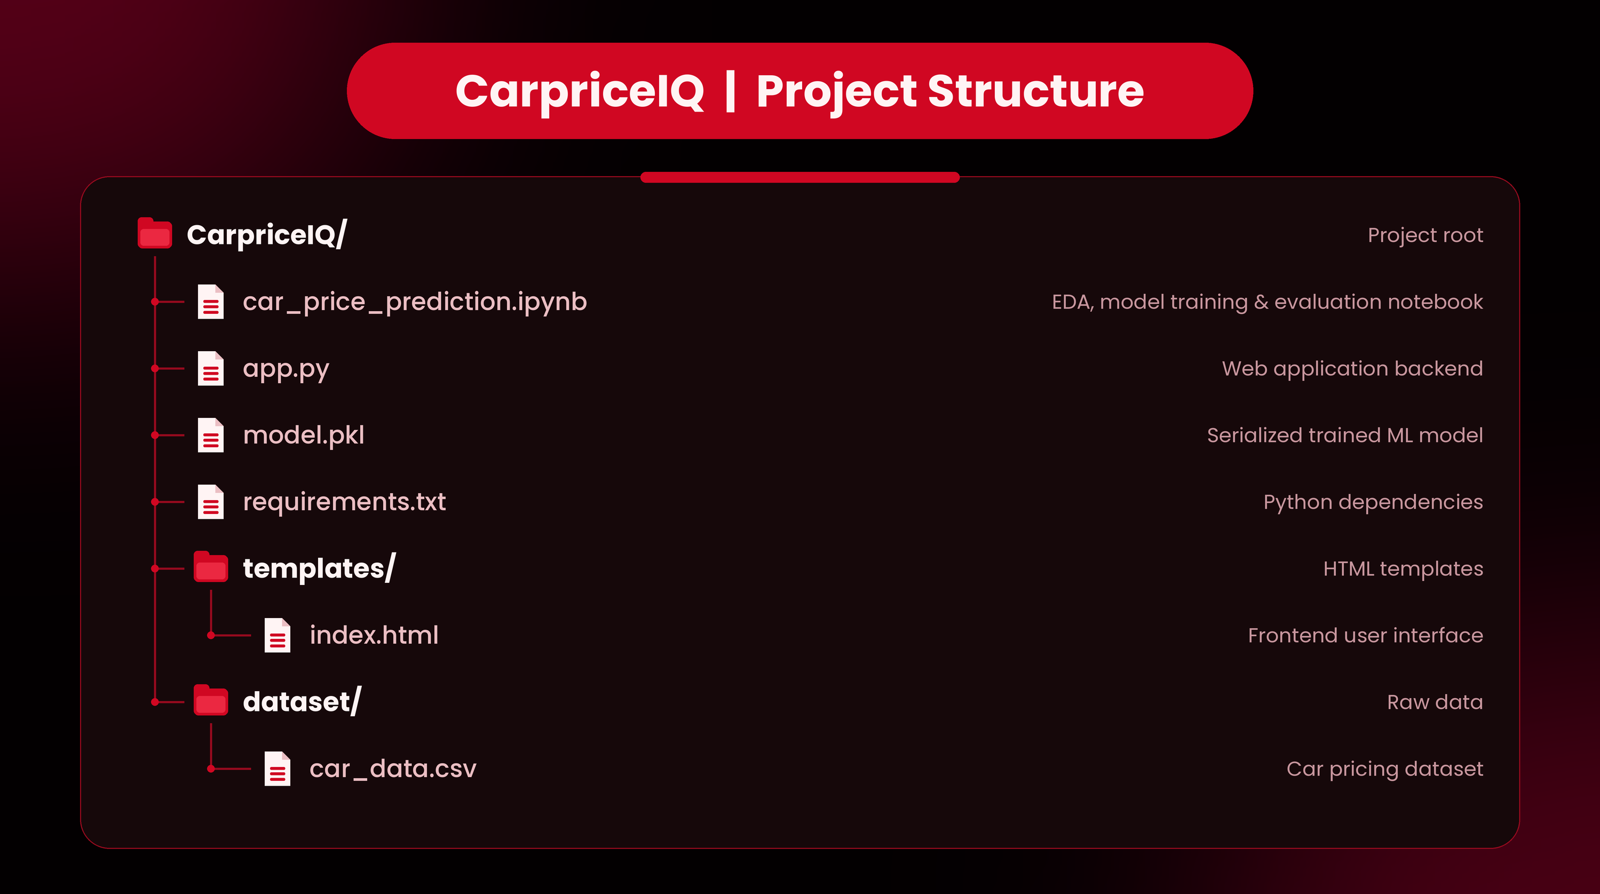

Slide 4
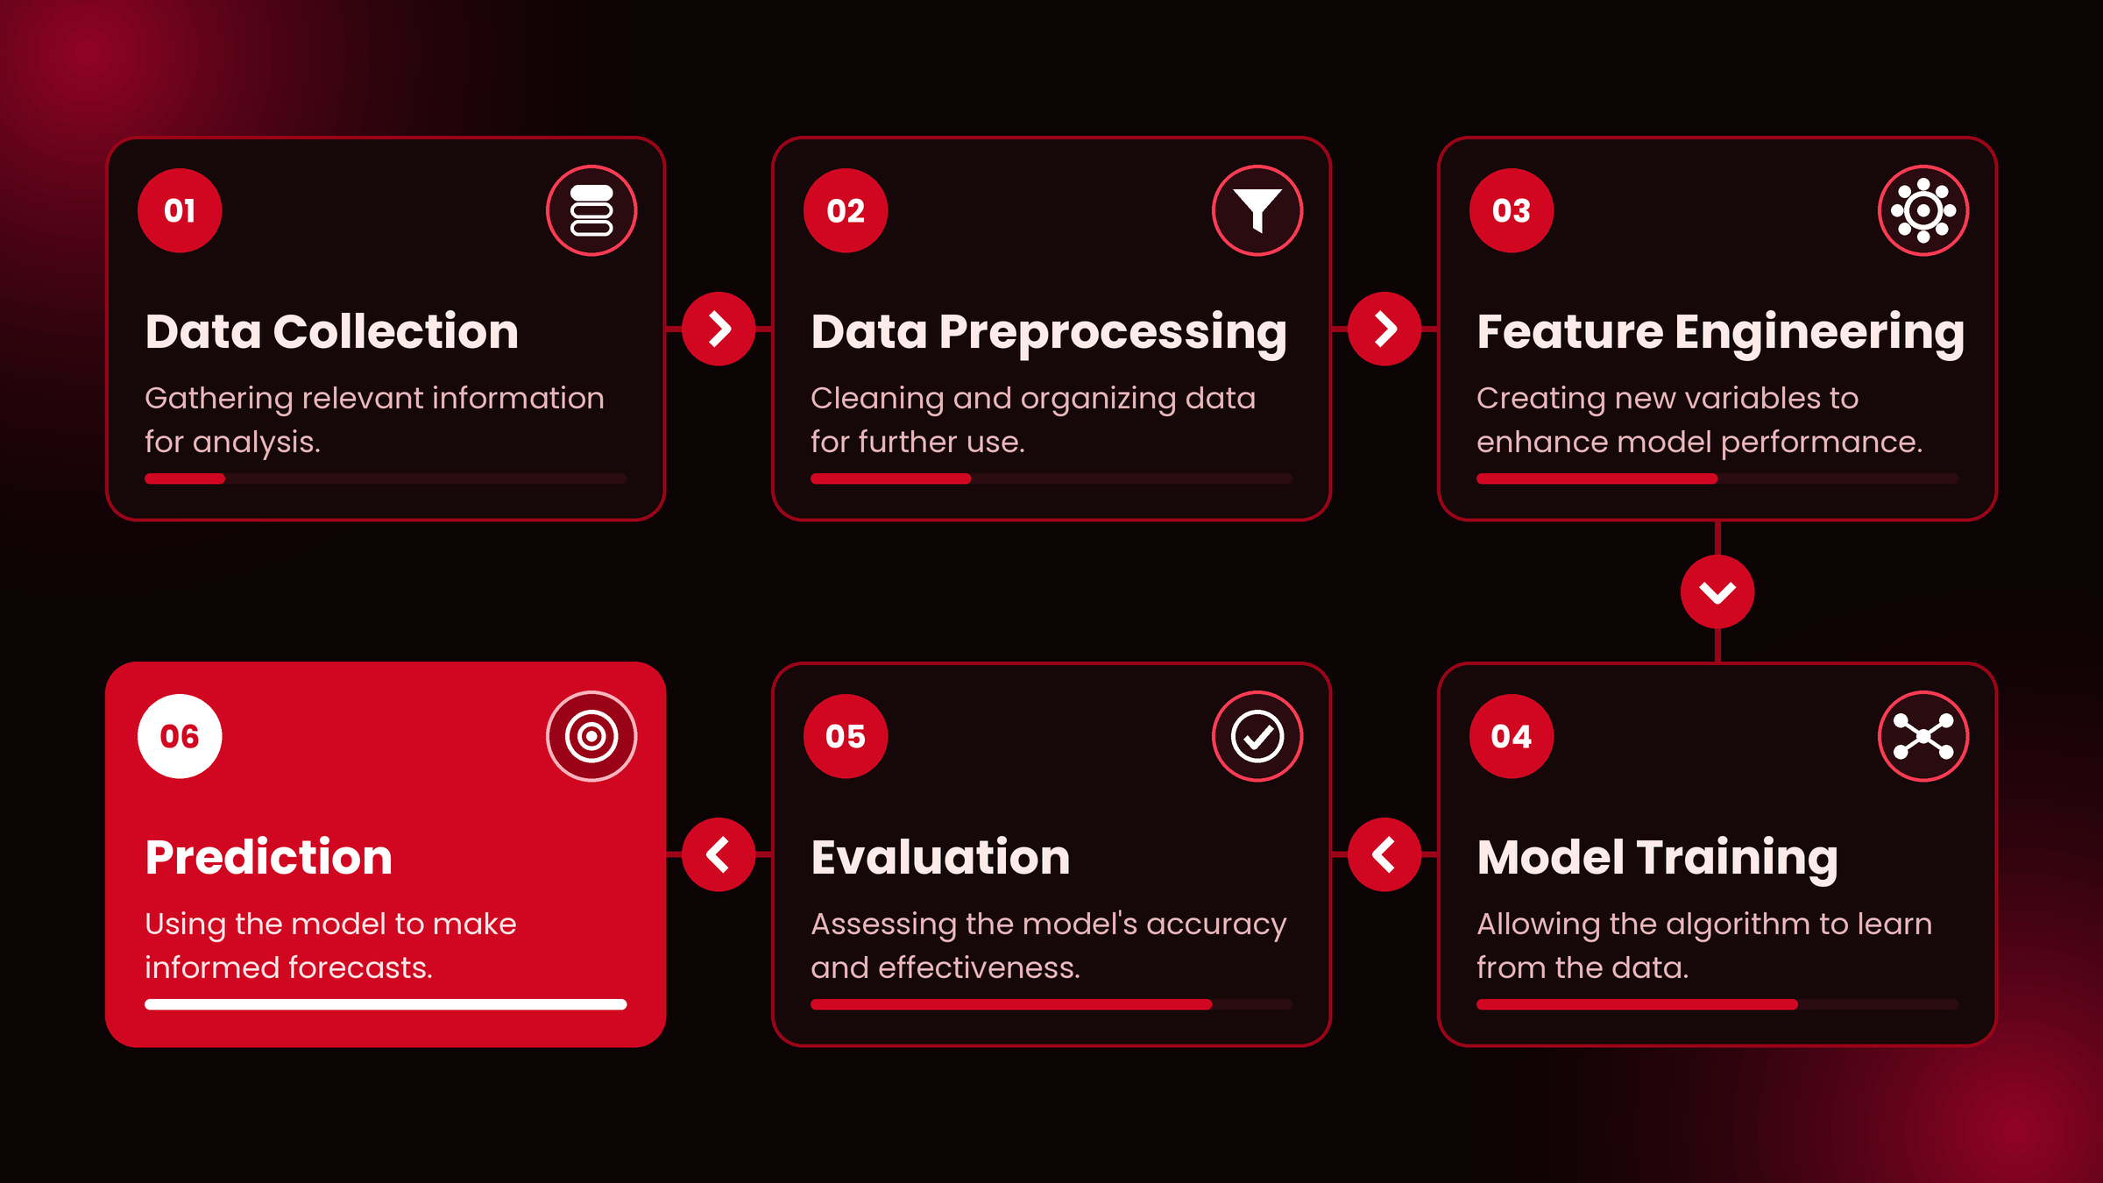
Data Analysis Process

Slide 5
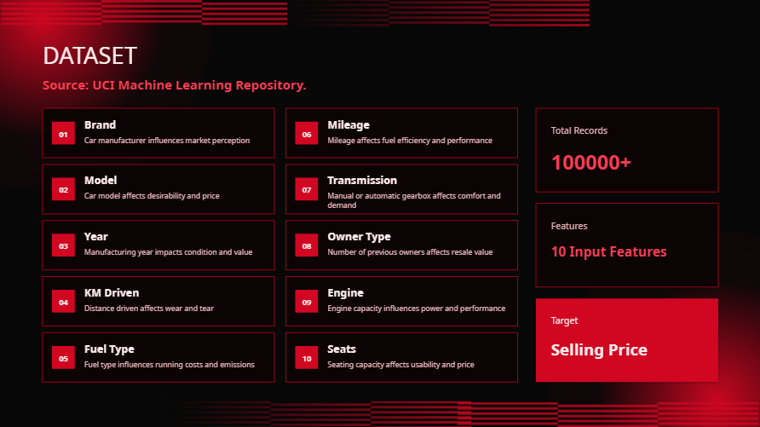
Dataset Source:

Slide 6
Implementation :
Import Library
import numpy as np ----# used for mathematical opertion
import pandas as pd ----# used for data cleaning and data manipulation
import matplotlib.pyplot as plt ----# used for understanding the data with the help of graph
import seaborn as sns ----# used for data visulation through heatmap and boxplot
from sklearn.model_selection import train_test_split ----# used for training and testing the da
from sklearn.preprocessing import LabelEncoder ----# this library is generaly use for converting text into numbers
from sklearn.linear_model import LinearRegression ----# linear regression is use analyze the relation between the variables by fitting a straight line to the data
from sklearn.ensemble import RandomForestRegressor ----# it improve the accuracy by combining the predictions of multiple decision tree
# loding the dataset
df = pd.read_csv("car_ML_model.csv")
df.head() # it will show the first 5 row
df.shape # number of column and row
df.columns # it will show all features name

Slide 7
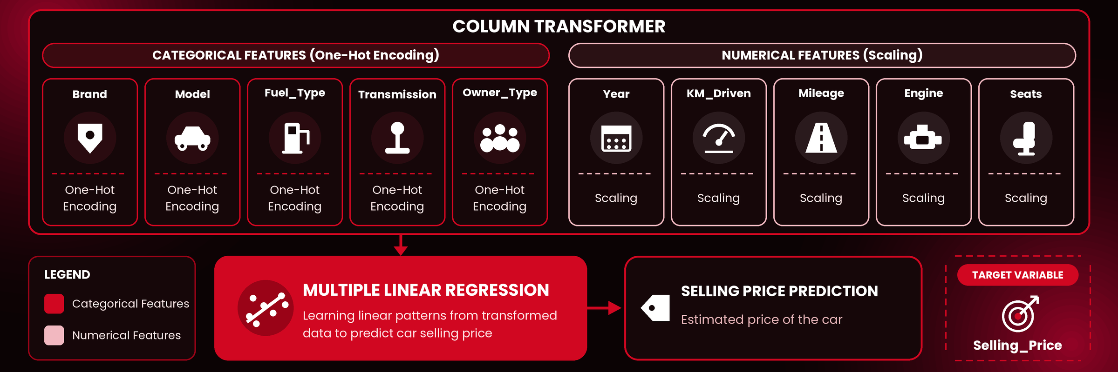
Data Cleaning
checking missing values
df.isnull().sum()
# for replacing null values with mean values
num_cols = df.select_dtypes(include=np.number).columns
for col in num_cols:
df[col].fillna(df[col].mean(), inplace=True)

Slide 8
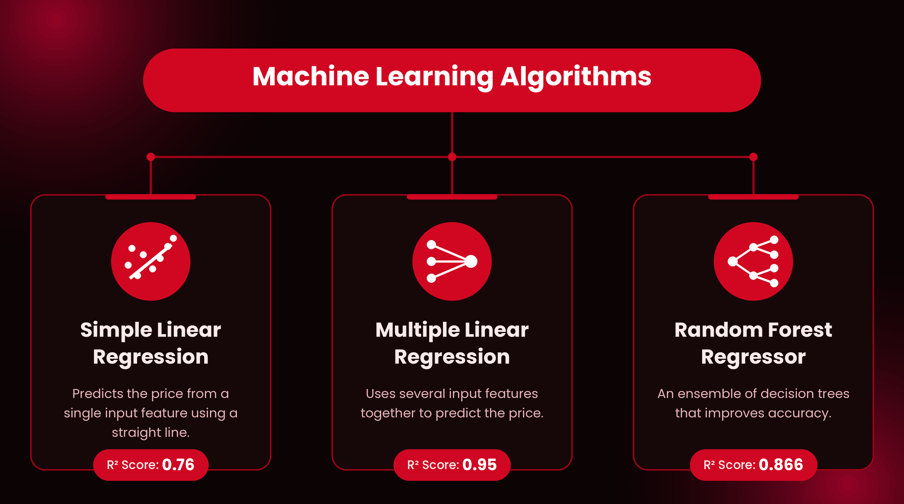
Machine Learning Algorithms Used-

Slide 9
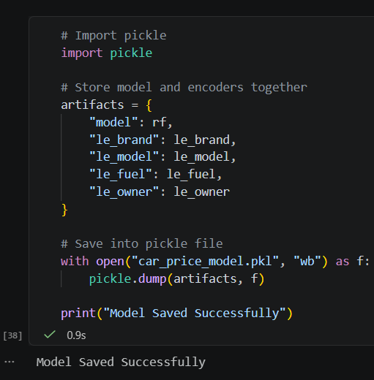
Saving the Trained Model
Result
Saved as car_price_model.pkl (binary write mode, "web").
It help when we deploy the model in render. The pkl file help to run the model
Loaded once by app.py, with no retraining needed

Slide 10


Future Scope :
03
Integrate real-time market data.
Use advanced ensemble models.
Create a mobile application.
Improve prediction accuracy using larger datasets.
02
01

Slide 11
THANK YOU

