Slide 1
Final Project: STAt 517 Climate analysis and prediction
Rohit k Yadav
Masters (computer Sc.)
University of idaho

Slide 2
Models Used
4. Classification
Nearest Neighbor
Decision Tree
Random Forest
Neural Net
Naive Bayes
Categorical Classification without PCA
Categorical Classification with PCA
Binary Classification without PCA
Binary Classification with PCA
Association Analysis
Regression
Linear Regression
Ridge Regression
Decision Tree Regression
Gradient Boosted Regression
K-Nearest Neighbors Regressor.
3. Clustering
KMeans
GMM (Gaussian mixture)
Agglomerative Clustering
Spectral Clustering
5. ROC Visualization of Binary Classification
Nearest Neighbor
Decision Tree
Random Forest
Neural Net
Naive Bayes

Slide 3

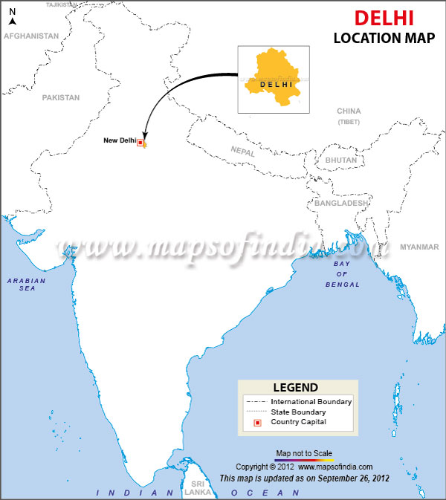
Introduction
Global climate change and its impact on human life has become one of our era's greatest challenges.
Despite the urgency, data science has had little impact on furthering our understanding of our planet in spite of the abundance of climate data.
A lot remains to be understood about our planet and the physical processes that govern it to effectively answer questions about global climate change and its societal impacts.
It has been proposed that given the abundance of climate data from different regression models observations and
different analysis, we may close some of these knowledge gaps by directly learning
from these large climate datasets and can predict the temperatures to save the environment
from unpredictable climate changes.
The dataset contains weather data for New Delhi, India.
This data was taken out from Kaggle which is owned by wunderground. It contains various features such as temperature, pressure, humidity, rain, precipitation,etc.
The target is to develop a prediction model for predicting the weather. We can try something like predicting the temperature, visibility, conditions etc.

Slide 4
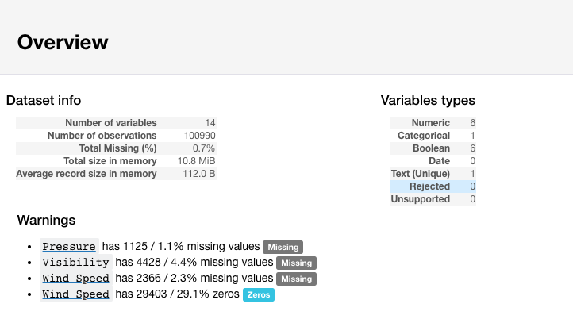
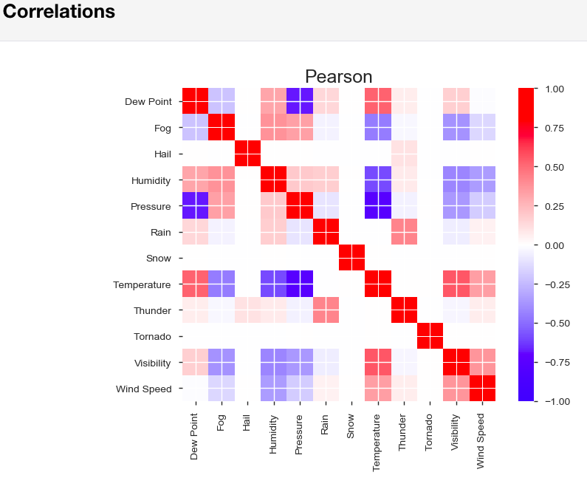
Firstly in preliminary EDA I have dropped the columns that was not complete or not useful.
Some of the temperature observations were in Fahrenheit also some of Pressure, wind speed, visibility were in strange
numbers so I converted them and then got the overview of each and every variables

Slide 5
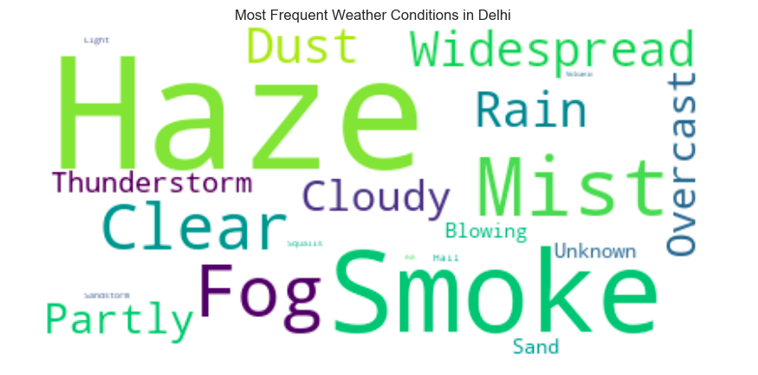
Modelling Process
Imputation has been done for getting rid of null values with most frequent weather condition Haze.

Slide 6
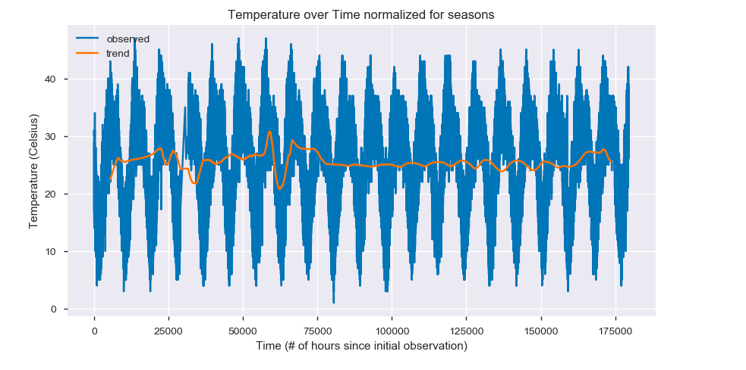
Visualizing trends
There will be trends in the data but it is periodic so we must normalize for seasons
This chart shows the original data in blue, and the trend after normalizing for seasons (i.e getting rid of useless data) in orange. From this we can see that there was an abnormally cold Winter in Delhi in 2003-2004.
This does not show the deadly heat wave of 2015 because it is smooth and ignores spikes.

Slide 7
Association Analysis
I tried using all weather conditions but apriori is 2^n and all variables took too long so I decreased this number
Before converting weather condition to boolean we must combine similar conditions like light haze and haze, Light rain,
Heavy rain etc.
Then I converted the condition to boolean using get dummies one hot encoding and dropped the unknown condition
which was not useful.
Calculated the frequencies of item sets ; Frequencies with single items is not useful for rule generation therefore
the most frequent pairs of item sets which occured together matters for rule generation.
To use the apriori algorithm; I find the most frequent pairs of features that occured together, then
calculate the confidence P(A&&B)/P(A).
High confidence means A -> B is a Good rule.

Slide 8
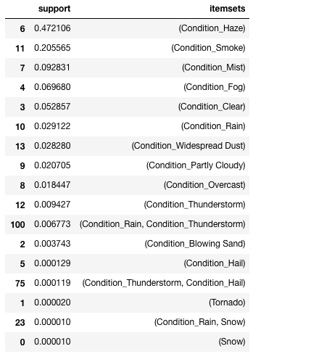
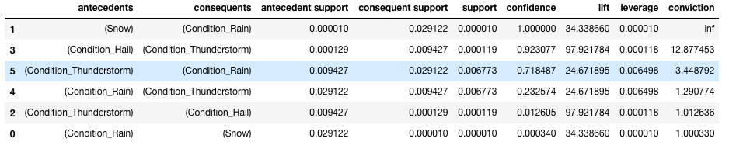
After using Apriori to get item set frequencies and association rules
generation to get rules, there are six rules and some are more confidence
than others.
We can say with 92.3% confidence that if we observe hail then we will
also observe thunder.
We can say with 71.8% confidence that if we observe thunder then we
will also observe rain.

Slide 9


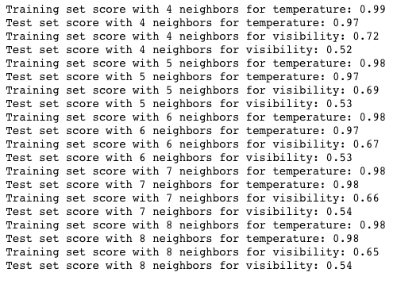


Regression
4. Gradient Boosted Regression
I have predicted Temperature and visibility both separately.
1. Linear Regression
5. K- Nearest Neighbors Regressor
2. Decision Tree Regression
3. Ridge Regression
At 7 neighbors the model predicted visibility the best, but still much worse than
temperature.
All models could not predict visibility as well as temperature which suggests that
visibility is a hard feature to predict

Slide 10
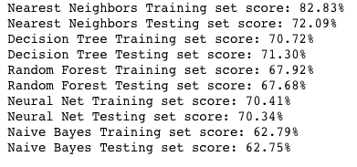
Classification
Categorical Classification without PCA
Tried to classify the observations into weather conditions.

Slide 11
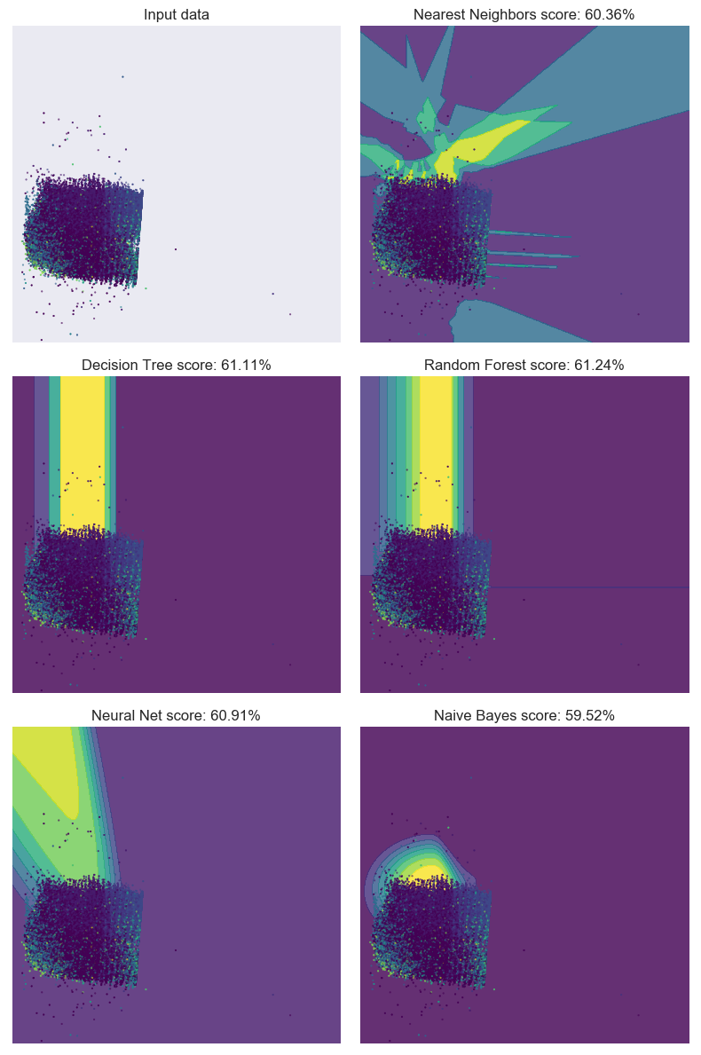
Categorical Classification with PCA
This classification problem is very hard for these algorithms.
KNN finds interesting patterns in the data but none of the scores are good. The different weather conditions are mixed together and separating them is almost impossible for these algorithms.
It is interesting that without PCA reduction these algorithms performed more accurately, but are harder to visualize.

Slide 12
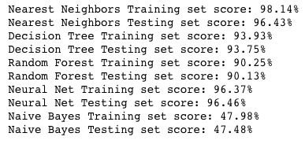
Binary Classification
I tried to classify the observations into hot or cold (above average or below average)
I convert temperature to binary hot or cold by calculating the average temperature
and dividing the dataset into hotter than average and colder than average.
Binary Classification without PCA

Slide 13
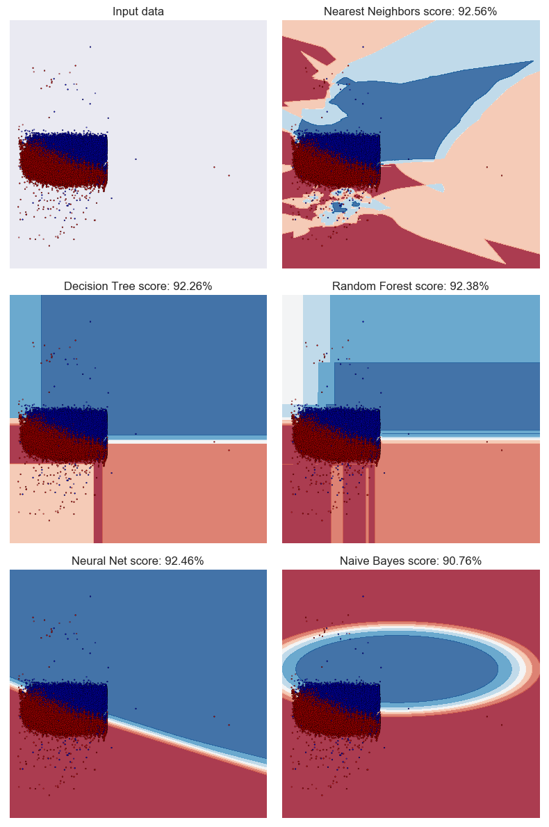
Binary Classification with PCA
The number of principle components with the highest ratio of variance to components is 2
Using 2 components will preserve 98.44% of the data, so I have used 2 components
The regions underneath the data points are showing where the model would classify points if they existed. These models can classify points in the entire space even though these points are mostly on the left side.
I have shown that these models can classify the dataset into hot and cold.
The hot/cold classification problem is much more interesting and it's more easy for these algorithms. They all found good solutions and KNN even found some of the hot points on the bottom.
ROC will tell if these are accurate classifiers or not.

Slide 14
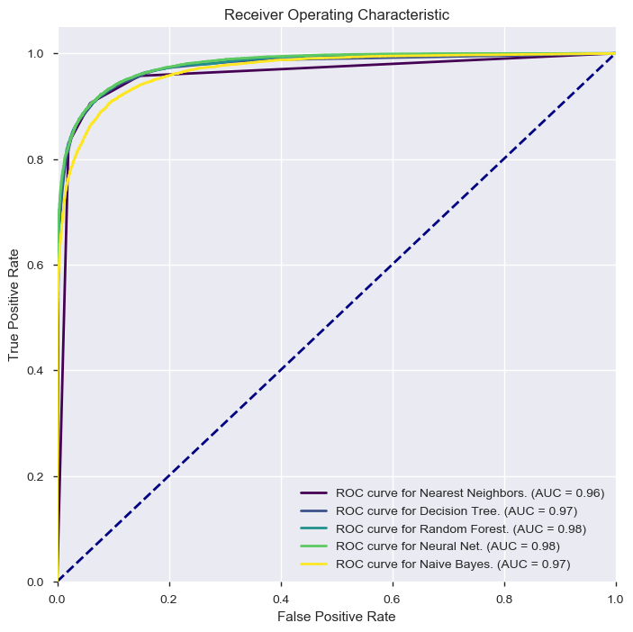
ROC Visualization of Binary Classification
The area under the curve (lower right legend) is equal to the probability that the classifier will rank a randomly chosen positive instance higher than a randomly chosen negative one.
We want the AUC to be as high as possible because that means the curve is as far to the top left as possible and at the elbow there is a low false positive rate and a high true positive rate.

Slide 15
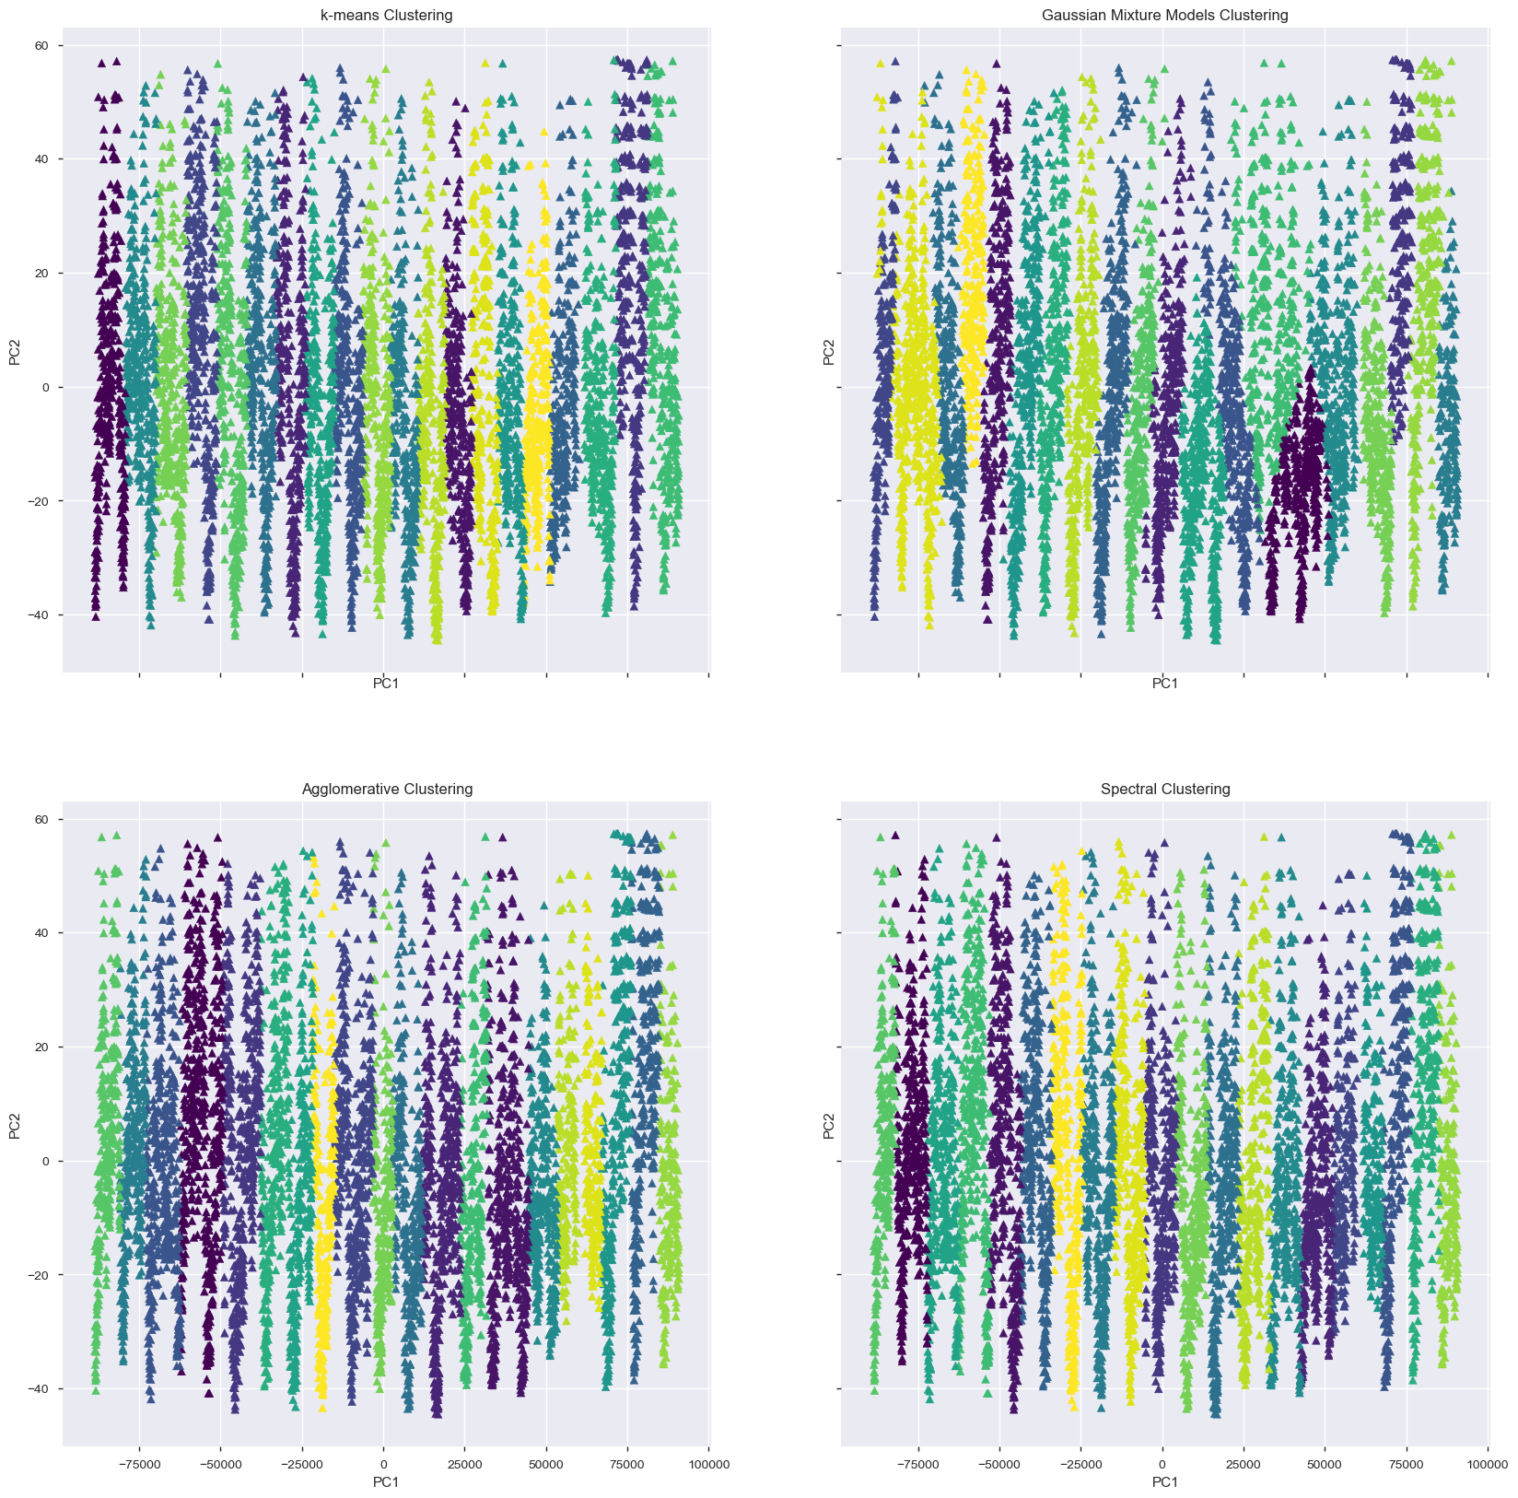
Clustering
Clustering did not seemed good enough to
visualize some valuable insights.
The first problem I had with clustering was the system crashed because the dataset was too big, so I have only taken one observation per day instead of hourly.
Even after PCA dimensionality reduction, the data is clustered into 20 stripes probably the 20 years.
This means that PCA found the most important component to be time, and reduced all other features into PC2.

Slide 16

THANK YOU

