Slide 1
Final Project: STAt 517 Climate analysis and prediction
Rohit k Yadav
Masters (computer Sc.)
University of idaho

Slide 2
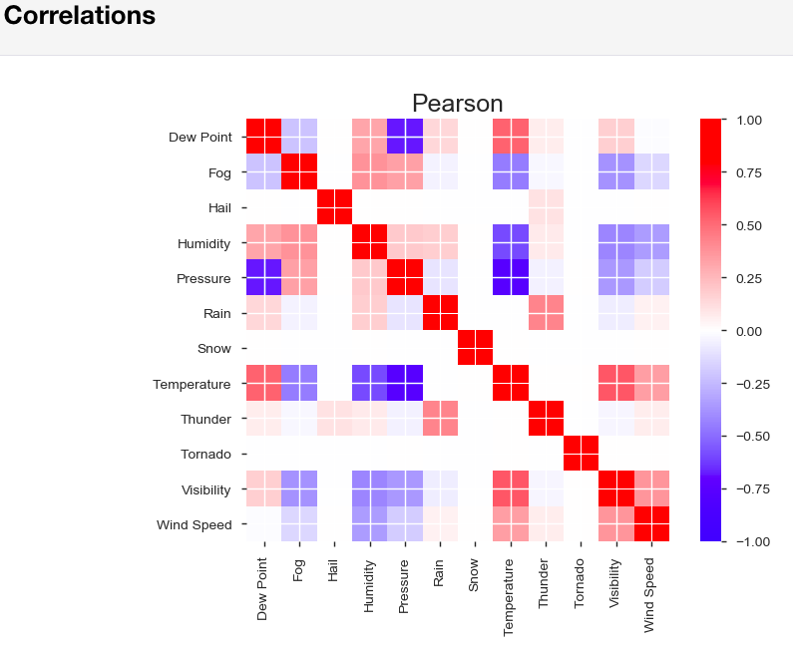
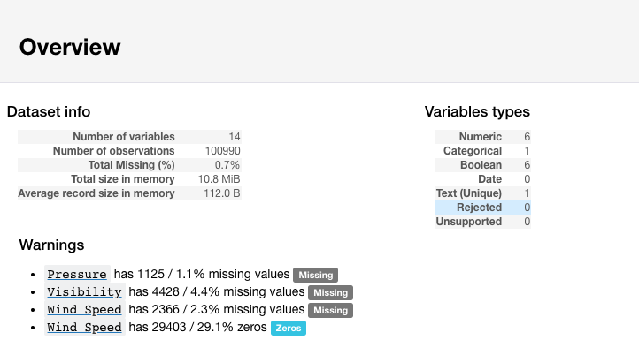
In preliminary EDA I have first dropped the columns that was not complete or not useful.
Some of the temperature observations were in Fahrenheit also some of Pressure, wind speed, visibility were in strange
numbers so I converted them and then got the overview of each and every variables

Slide 3
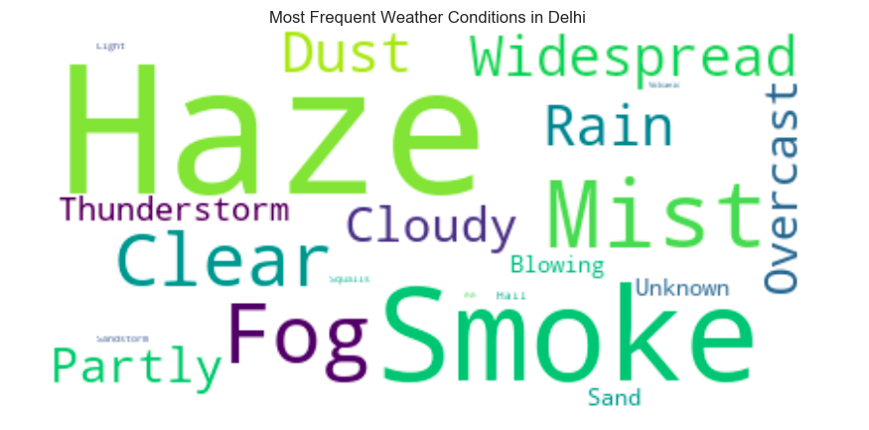
Modelling Process
Imputation has been done for getting rid of null values with most frequent weather condition Haze.

Slide 4
Models Used
Association Analysis
Regression
Linear Regression
Ridge Regression
Decision Tree Regression
Gradient Boosted Regression
K-Nearest Neighbors Regressor.
5. ROC Visualization of Binary Classification
3. Clustering
KMeans
GMM (Gaussian mixture)
Agglomerative Clustering
Spectral Clustering
4. Classification
Categorical Classification without PCA
Categorical Classification with PCA
Binary Classification without PCA
Binary Classification with PCA

Slide 5
Clustering
Clustering doesn’t seemed good enough to visualize some valuable insights

