Slide 1
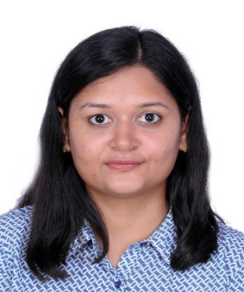
Aakanksha Sahu| Consultant | AWS Data Engineer
aaksahu@deloitte.com| Deloitte Touche Tohmatsu India LLP
Mobile: +91 7415693142
Location: Pune
Profile
Aakanksha has 4 years of experience in IT which includes 3 years of experience in big data development working on distributed computing such as Hadoop, Hive, Spark, AWS with a strong track record of successfully designing and implementing digital solutions as well as hands on creating KPIs & defining metrics to generate meaningful insights for business users.
Proficiency in writing SQL queries and developing Python, PY Spark code.
Experience in Agile Methodology of software development lifecycle(SDLC).
Selected Engagement Experience
Qualifications
1. Truck Training Portal Analysis For One Of The Germany Based Automobile Manufacturer :
The goal of this project was to gain a deeper understanding of user behavior, course effectiveness, revenue generation, portal analysis, overall performance and how it can be improved further.
Involved in writing spark programs using python API for applying transformations in spark using spark core, data frames and spark SQL as per the requirement. The extracted data from data source is processed in spark and targeted in data warehouse
Performed data processing and various transformations such as aggregations, joins, filter as per business rule.
Used AWS Glue catalog with crawler to get data from S3 and perform SQL query operations using AWS Athena.
Tech Stack: AWS EC2, AWS S3, AWS Glue, SQL, PySpark
2. Inventory Management System and Analysis For One Of The Canada Based Retail Group :
The aim of this project is to analyze demands, optimize inventory levels and minimize stockouts.
Worked on hive queries for creating and querying hive tables to retrieve useful analytical information as per requirement
Created partitions, buckets in hive to handle structured data.
Worked on performance tuning of hive queries to improve data processing and faster retrieving.
Writing hive scripts for data loading and generating reports for client.
Tech stack : Cloudera, Hive, Sqoop, HDFS
Bachelor of Engineering in Electronics & Instrumentation Engineering (2019) from Samrat Ashok Technological Institute – Vidisha, M. P.
Certifications
Functional Experience
PySpark, Python, SQL
Hadoop, Hive, Sqoop
Aws(EMR, EC2,S3, Glue, Redshift, Lambda)
Cloudera ,Databricks
Industry Experience
Automobile
Retail

