Slide 1
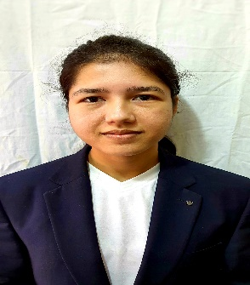

,
Ashwini Diwakar Raut , Senior Consultant
Ashwini is a Senior Consultant with Deloitte Touché Tohmatsu India LLP and is based out of Pune, India. She has experience in Data engineering, Data Analysis and ETL using Pyspark , SQL, AWS cloud services - S3, Redshift, glue, lambda. She has demonstrated global client management skills and worked with clients from US, Australia, India seamlessly, to fulfil their business requirements. She is adept in linking various data sources by designing ETL pipelines, processing huge amount of data files to empower business decisions
Experience Summary
US Based Client : Data Engineer:
Created and implemented config driven end-to-end pipeline to send and process the real-time data into Datawarehouse.
Used Kafka connection with Aws Glue streaming for data ingestion and processing.
Optimize the Data warehouse to improve the performance.
Technology: Pyspark, AWS Glue Streaming, MSK, S3, Redshift, CloudWatch, Athena
Deloitte India – Senior Consultant
Australian Human Resource Consulting Client(Bigdata/Pyspark)- Data Engineer
Created and Implemented end-to-end Pipeline to fetch data from different sources like workday, salesforce and internal data lakes to feed Power-BI.
Used Pyspark for performing ETL on Aws S3 data (source) and Airflow for orchestration.
Improved existing code, implement incremental load , identified the data issues, issues in Modelling sheet and resolved it.
Interacted with clients to resolved the defects.
Performed code review, unit test, data validation(using Athena) and schema correction.
Technology: Pyspark, SQL, Redshift, S3, Athena, AWS Batch, Airflow, CloudWatch
US Based Bank- Cloud Developer:
Created and implemented end-to-end pipeline to load the cleaned data of customer to Datawarehouse to derive data insights from that data for senior managements and clients use
Used SQL and Aws Glue (Pyspark) as an ETL tool
Optimize the Data warehouse to improve the performance.
Perform code review and data validation
Technology: Pyspark, AWS Glue, S3, Redshift, CloudWatch, Lambda, Athena, SQL
Functional Skills
Technical skills
AWS certified Solution Architect- Associate
Database : SQL Server, Redshift
ETL tool : Informatica, AWS Glue
Cloud: AWS
Cloud Services : S3, lambda, Redshift, EC2, CloudWatch, EMR, Glue, Athena, Batch
Language : Python/Pyspark, SQL
Data Processing Frameworks : Spark, Databricks

