Slide 1
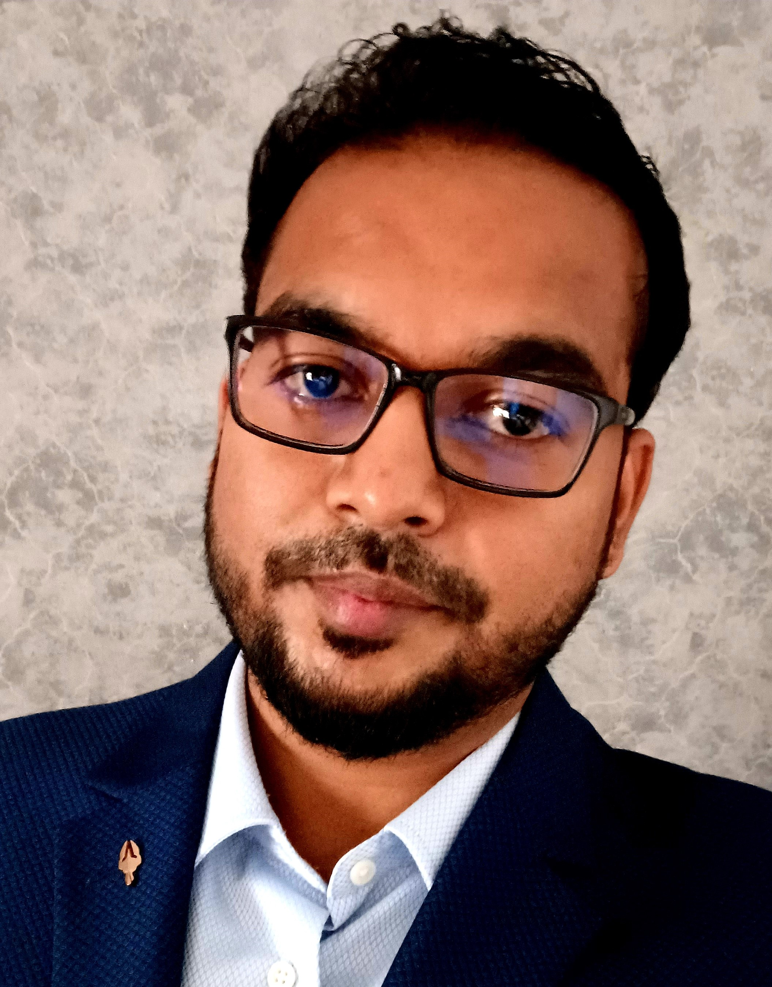
Professional Background
Chandan has 8.8 years of experience in working on different analytical problem. He has expertise in Python, machine learning, data cleaning , data exploration, Natural language processing, deep learning , Azure , AWS and PySpark, SQL, OpenAI tool( ChatGPT4), MLOps/CI/CDPipeline. Prior to joining Deloitte, he has worked on various Analytics and Data Science projects.
Education
MTech in Data Science and Engineering, BITS, Pilani
PG DIPLOMA in Data Science from IIIT Bangalore.
BE from Sant Longowal Institute Of Engineering and Technology, Sangrur.
Certification
Upgrad Certification: Data Scientist.
MTech in Data Science and Engineering, BITS, Pilani
GCP Gen AI Learning Path
GCP Gen AI For Developers
Key Areas of Expertise
Machine Learning
Marketing Research
Predictive Modeling
Generative AI,
Open AI
Industry Experience
Marketing Research
Retail
Automotive
Key Clients
GFK Market Research Company, IRI World, Continental, Panasonic, Ellucian.
Tools and Technology
Machine Learning Tools: Python, scikit-learn, pandas, NumPy, seaborn ,Matplotlib, TensorFlow)
Cloud : Azure DataLake, BLOB Data Storage, AWS instances.
Big Data tool: Apache Spark, Databricks, PySpark
Reporting :Tableau, MS Excel.
Deployment Tools: Jenkins, Docker.
Algorithms: Multiple Linear Regression, Logistics Regression, Clustering, Decision Tree ,Random Forest, Xgboost , Time Series (ARIMA, ARIMAX, SARIMAX, LSTM), etc.
Selected Experience
NSDC Advanced Data Analytics:
Designed and Developed the ML pipeline for the recommendation of Jobs and Skills.
Recommendation System and NLP was used for context and sequence aware recommendation system.
Integrated Resume Builder with generative AI tool (ChatGPT4).
Marketing Research and Recommendation(GFK, USA).
GFK needed to create an application which was going to recommend the brands and products to the consumer based on their behavioral and demographic features.
Implemented Ensembled algorithm to identify the most significant features of the brands for GFK marketing research. These features were used to figure out the brands relationships to further develop the recommendation system based on demographic and behavioral features. Deployed the model successfully with retraining.
Model accuracy was .92 and we were able to recommend the most relatable products and brands to the consumer.
Retail and Demand Forecasting(IRI World, USA).
Inter-Category Affinity Analysis:
This project was based on affinity analysis of the products to identify and recommend the complimentary products which can be sold together.
Worked on retail project for IRI World to analyze the inter-category relationship and to find out the affinity significance based on Chi-Square values.
Outcome was the analysis report where we were able to present the inter-category products.
Ellucian Data Monitoring
To find a solution for Ellucian application performance monitoring incident recording using Datadog monitor records for all the resources and applications.
Gathered data (combination of structed and unstructured format) from Datadog API. Processing the requirement and then created the development design by doing R&D. We created Model to classify the performance of all the running application resources.
Panasonic:
Integration of Alexa application in Honda Automobile.
Used NLP for pattern matching and semantic analysis in Alexa and for processing speech recognition.
Chandan Kumar
Senior Consultant
Analytics and Cognitive
Total experience
8.6 Years

