Slide 1
The Blueprint: Decoding Project Documentation
A visual guide to BRD, FRD, FRS, SRS, and SAD for Stakeholders.
FRON TNE BOAROROtIB TO THE 8ERVER ROON

Slide 2
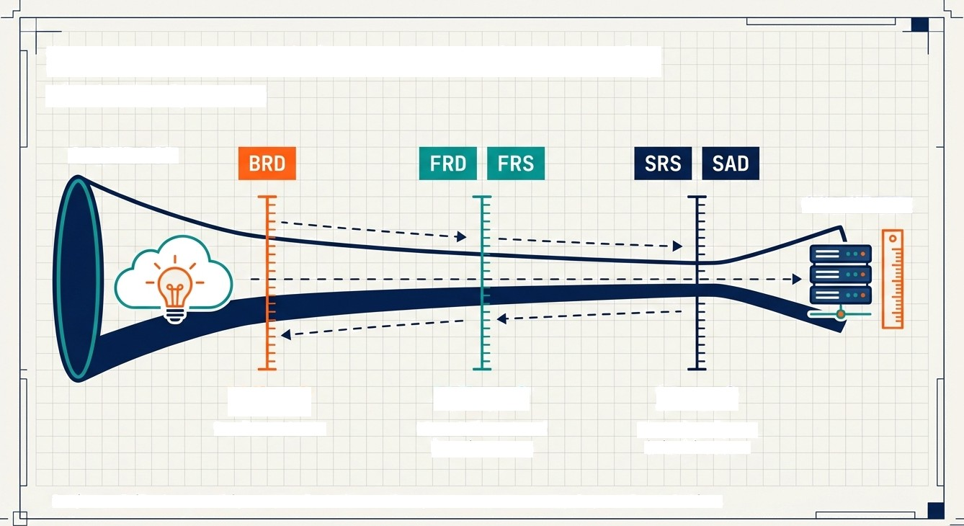
From Abstract Vision to Technical Reality
The Clarity Spectrum
ABSTRACT
CONCRETE
Why?
Business Goals
What?
User & Functional Requirements
!°/OWg
Technical Specs & Architecture
Projects fail when we skip steps. Each document represents a necessary layer of resolution.
G NotebookLM

Slide 3
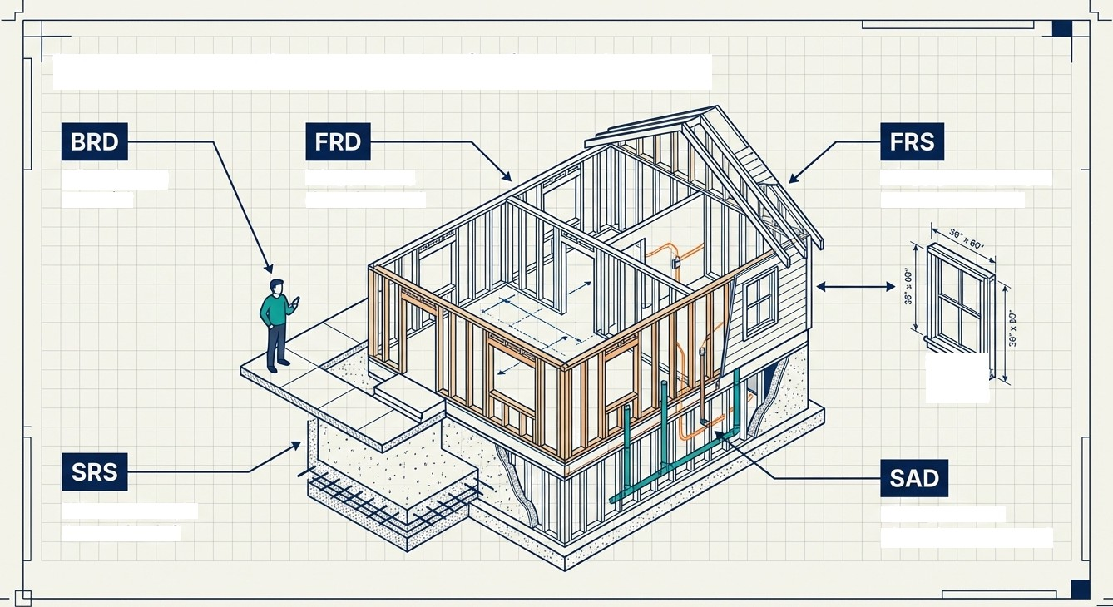
The Master Analogy: Building a House
Why do you
want it?
What rooms does it have?
What are the exact
measurements?
What materials
& standards?
How does the plumbing connect?
G NotebookLM

Slide 4
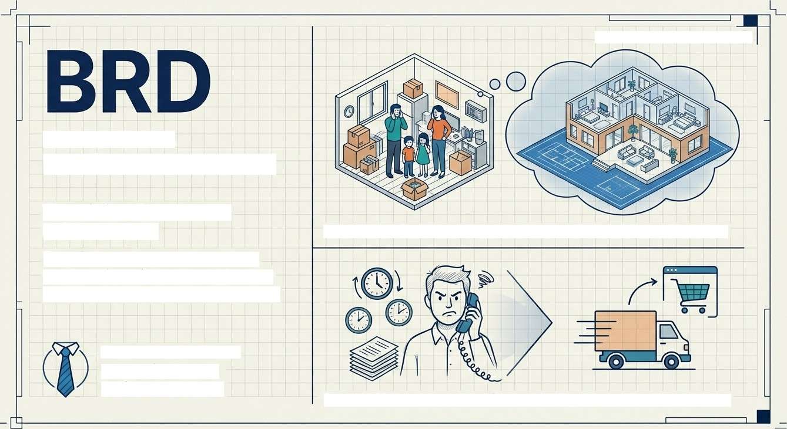
The Business Requirement Document
Z00rI LEVEL : 1/5 [¥/I0E
ANGLE]
The Vision (’Why are we
building this?’)
Explains the business problem, goals, pain points, and high-level expectations. No technical jargon.
Analogy: My family has grown; renting is too expensive. I need a home.
Audience: Business Users, Sponsors, Project Managers
Real World: Customers need faster delivery; phone ordering is too slow.
G NotebookLM

Slide 5
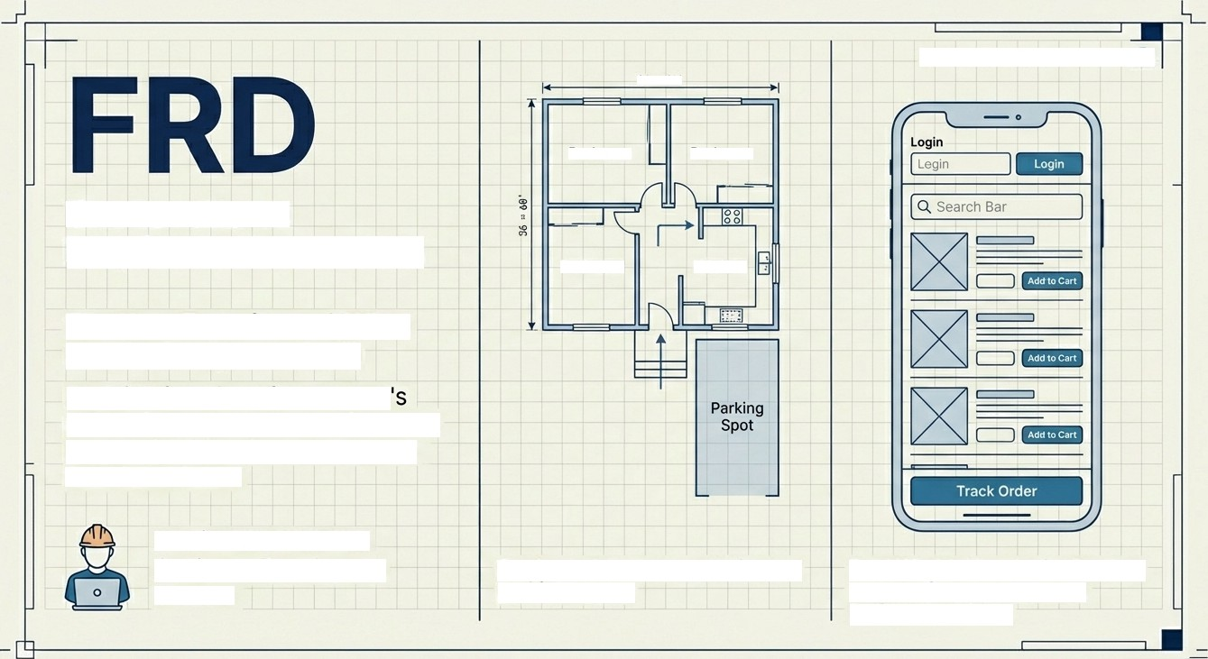
Z00 I LEVEL :
2/5 [STANDARD}
9G x 6O ’
Bedroom
Bedroom
The Functional Requirement Document
Bedroom
Kitchen
The User Experience (”What should the system do?”)
Explains functions from a user point of view. Focuses on features, user actions, business rules, and functional flows.
Audience: Business Analysts, Developers, Testers
Analogy: 2 bedrooms, 1 kitchen,
parking space.
Real World: User login, Product search, Order placement, Delivery tracking.
G NotebookLM

Slide 6

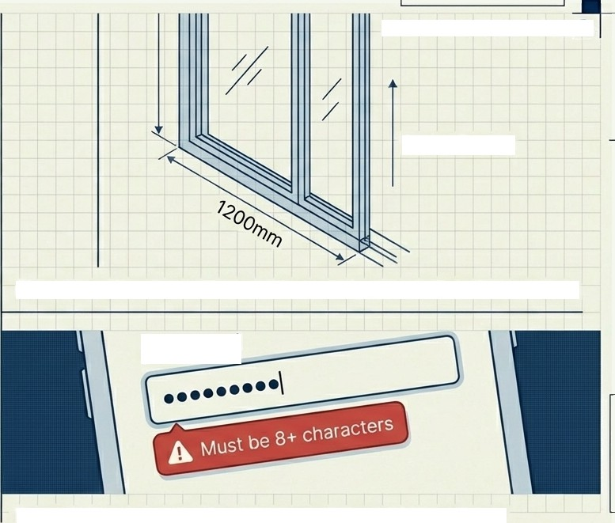


The Functional Requirement Specification
ZOOI1 LEVEL' 3/ 5 MACRO LENS}
South Facing
The Specifics (“Exactly how does it behave?”)
A detailed, structured version of the FRD. Focuses on input/output rules, validations, error messages, and edge cases.
Analogy: Master bedroom must be 120 sq ft, two south-facing windows.
Passw
ord
Audience: QA Teams & Developers (Critical for logic)
Real World: Password > 8 chars; Account locks after 3 failures.
G Nc•tebookLM

Slide 7

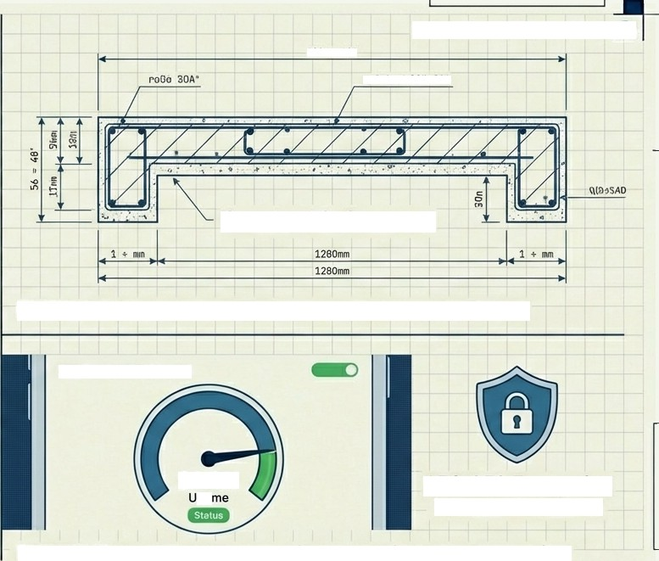


Z00I4 LEVEL: 4/5 [TECHNICAL]
C Reboy ZB” SQA
The Software
Requirement Specification
Grade 40 Cement
The Rules (“The technical blueprint.")
Explains how the software is built. Focuses on Non-Functional Requirements (NFRs): Performance, Security, Scalability, and Availability.
Analogy: Wiring standards, cement grade, foundation depth.
Application Dashboard
99.9%
pti
AES-256 Encryption
in JetBrains Mono
Audience: Developers &
Architects
Real World: Support 10k users, <3 sec load time, data encryption.
G Nc•tebookLM

Slide 8


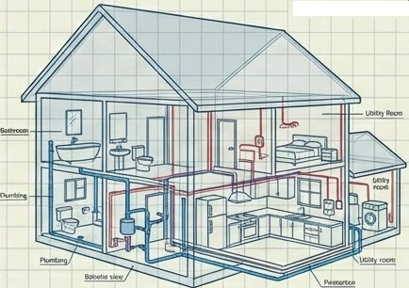



The System Architecture Document
Z008 LEVEL : 5/ 5 [X—RAY VIE¥/]
The Structure (“How it all fits together.“)
Shows overall system design and component interaction. Focuses on architecture diagrams, tech stack, data flow, and integrations.
Analogy: Electrical wiring diagrams, plumbing layout, HVAC integration.
Database
Mobile App |  | API Gateway |  | Backend
Payment
Gateway
Audience: Architects & Senior Devs
Real World: App -› API —› Backend -› Database + 3rd Party Integrations.
G Nc•tebookLM

Slide 9

Clearing the Confusion:
FRD vs. FRS
The difference between a Feature and Logic.
60mph
FORCE
¥ECT0R
30< STOPPING 0FSTAPCE
FRD
The Feature:”The car must have brakes.“
Focus: Existence of function.
FRS
The Logic:"The brakes must stop the car within 30 meters at 60mph.”
Focus: Specific behavior &
constraints.
FRD tells the developer what to build. FRS tells them
exactly how it must behave to pass testing.
G Nc•tebookLM

Slide 10



At a Glance: The Documentation Matrix
Acronym | Simple Meaning | The Question | Audience
BRD | Business Need | Why? | Business / PM
FRD | System Features | What? | BA / Dev / QA
FRS | Detailed Functions | What Exactly? | Dev / QA
SRS | Software Rules | How (Technical)? | Dev / Architect
SAD | System Design | How (Connects)? | Architect
G hJotebookLM

Slide 11
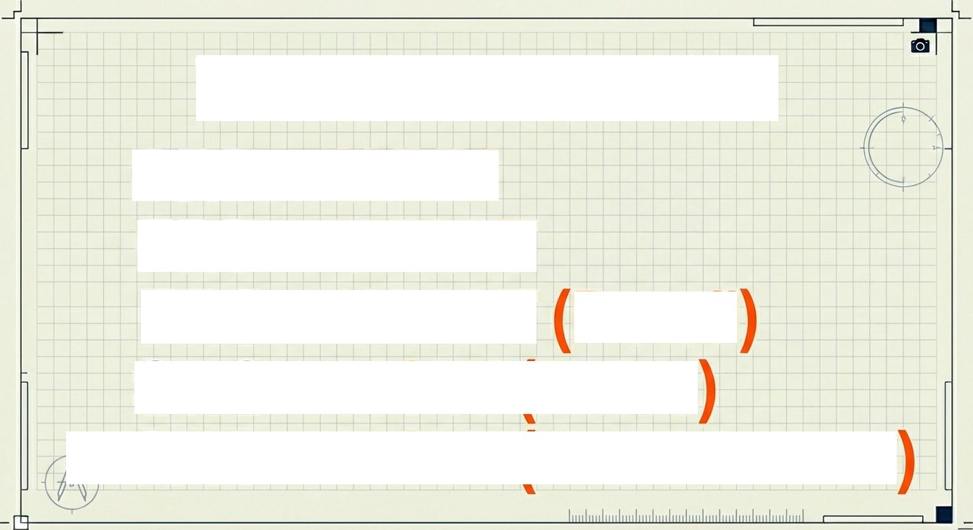
BRD = WHY
FRD = WHAT
The Memory Trick
FRS = WHAT Detail
SRS = HOW(Ruies
SAD = HOW(Architecture
G Nc•tebookLM

Slide 12
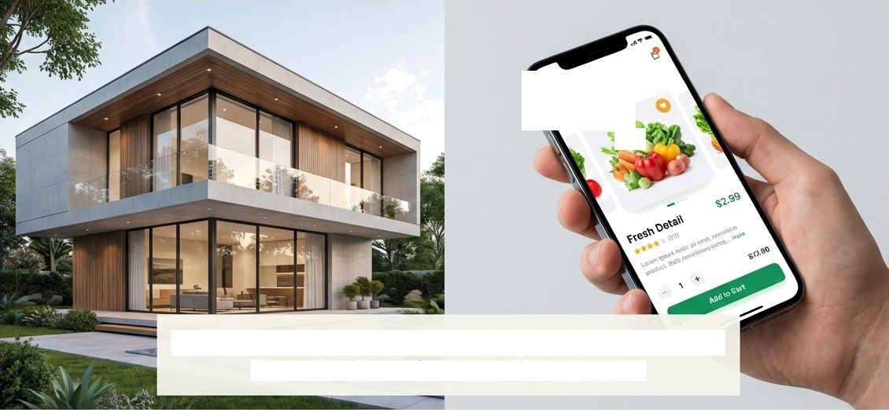


Great Documentation Builds Great Products
›*?'
You wouldn't build a home without a blueprint.
Don't build software without one.
Use the right blueprint for the right stage of construction.

