Slide 1
The Blueprint: Decoding Project Documentation
A visual guide to BRD, FRD, FRS, SRS, and SAD for Stakeholders, Developers, and Analysts.
FRON TNE BOARDROOMTO THE SERVER ROOM

Slide 2
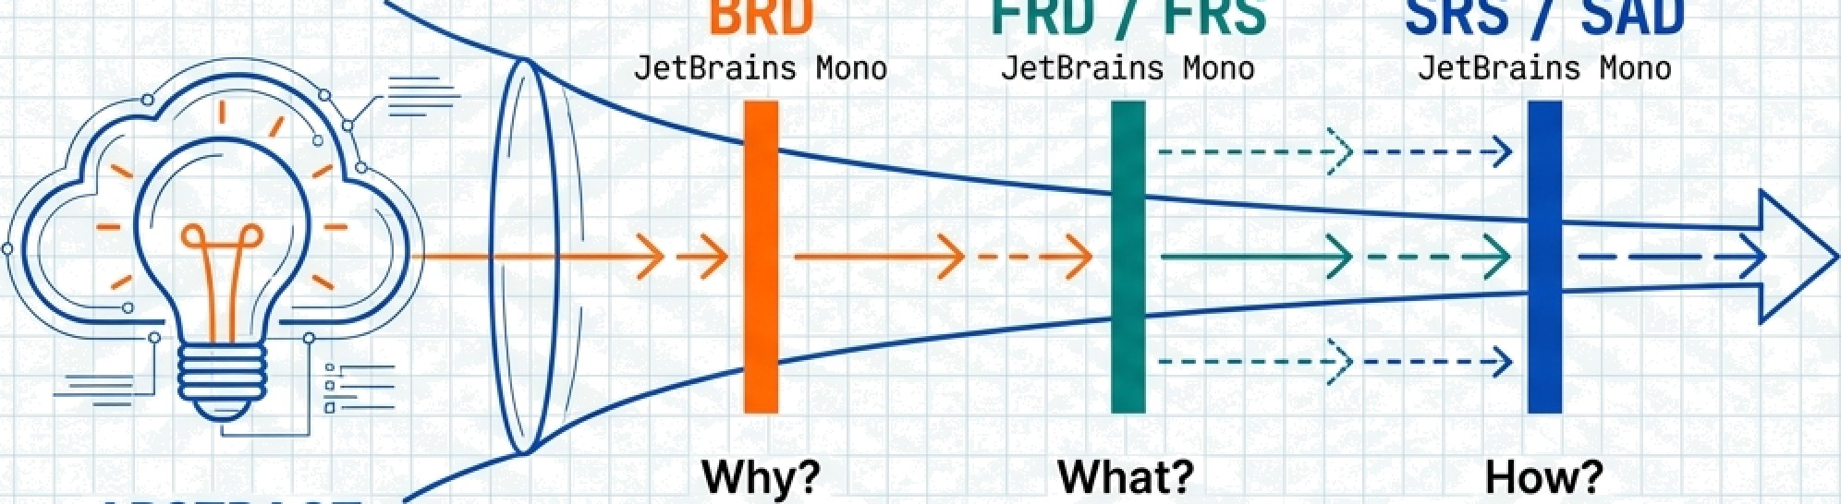











From Abstract Vision to Technical Reality
The Clarity Spectrum
BRD
JetBrains Nono
FRD / FRS
JetBra1ns I’lDno
SRS / SAD
3etBra1ns fJano
Why? (Business Ooals)
What? “““
(User & Functional Requirements)
"” How? (Technical Specs & Architecture)
ABSTRACT
CONCRETE
Projects fail when we skip steps. Each document represents a necessary layer of resolution.

Slide 3
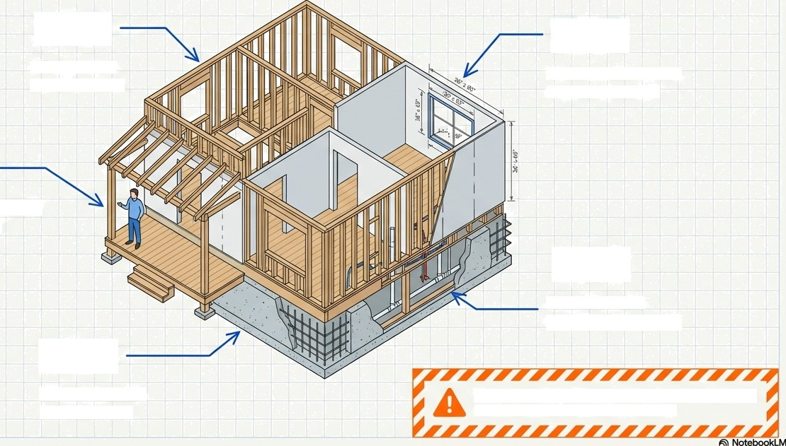
FRO
TheMaster Analogy: Building a House
FRS
What are the exact measurements7
What rooms
does it have?
BRD
Why do you wañt it7 (Family needs)
SAD
How does the plumbing con'nect†
SRS
What materials & standards†
You wouldn't build a home without a blueprlnh Don1build software without one.

Slide 4



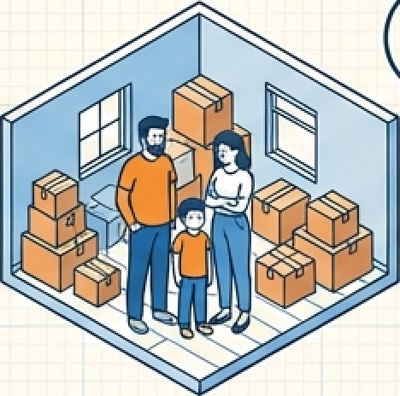







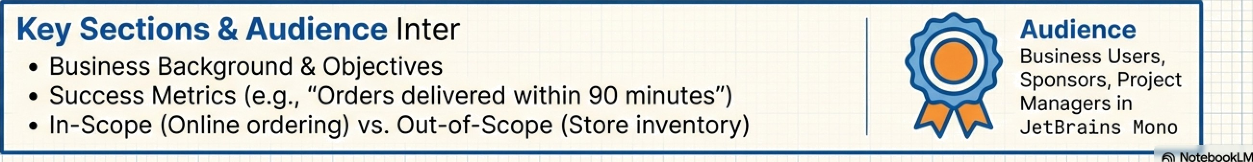


BRD: The Business Requirement Document
The Vision (“Why are we building this?”)
The Analogy The Reality (Grocery App)
My family has grown; renting is too expensive. I need a home.
Customers need faster delivery; current phone ordering is too slow and error-prone.
Key Sections & Audience Inter
Business Background & Objectives
Success Metrics (e.g., “Orders delivered within 90 minutes”)
In-Scope (Online ordering) vs. Out-of-Scope (Store inventory)
Audience Business Users, Sponsors, Project Managers in JetBra1ns mono

Slide 5
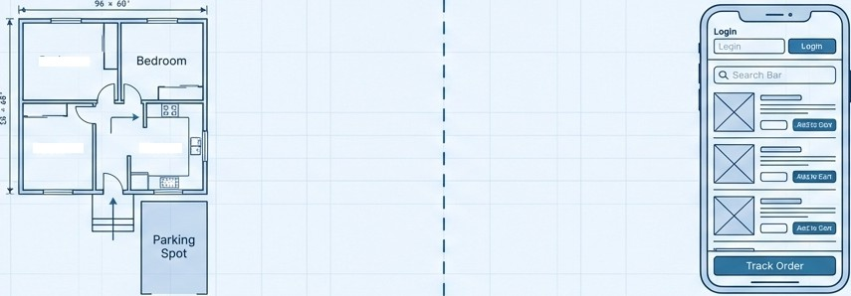

FRD: The Functional Requirement Document
The User Experience ("What should the system do?")
The Analogy The Reality (Grocery App)
Be droo m
Bedroom
Kitchen
The house needs 2 bedrooms, 1 kitchen, 2 bathrooms, and a parking spot.
User Login, Product Search, Order
Placement, Delivery Tracking.
I
,
Key Sections & Audience
User Roles
Functional Modules
Process Flows
Business Rules (e.g., "System calculates final amount")
I
Audience Business Analysts, Developers, Testers
I
i
1
G NotebookLM

Slide 6
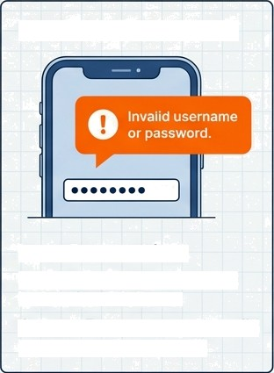



FRS: The Functional Requirement Specification
The Specifics ("Exactly how does it behave?")
FRD
The Feature: "The car must have brakes." (Focus: Existence)
FRS
The Logic:
"The brakes must stop the car within 30 meters at 60mph." (Focus: Behavior
& Constraints)
Real World Application
30m
brake callper
brake disc
i0mph
E ••••••••0• — —
Input: Password field.
Logic: Min 8 chars; Account
locks after 3 failures.
Output: Error message "Invalid
username or password".
brake dsc
QA Teama
(Critical for test cases) & Developers

Slide 7
SRS: The Software Requirement Specification
The Rules ("The technical blueprint”)
The Analogy
The Reality (Non-Functional Requirements)
‹o0eZoA
_{j}I
Performance
Response time < 3 seconds
30 mm
RE2lDAr 28" 20A
Security
AES-256 encryption
Grade 40 Cement
I I
Availability 99.9% uptime
1280mm
Wiring standards, Grade 40 cement, foundation depth.
Status: Active
Key Sections & Audience
Functional + Non-Functional Requirements
Scalability & Compliance
Audience:
Developers & Architects

Slide 8
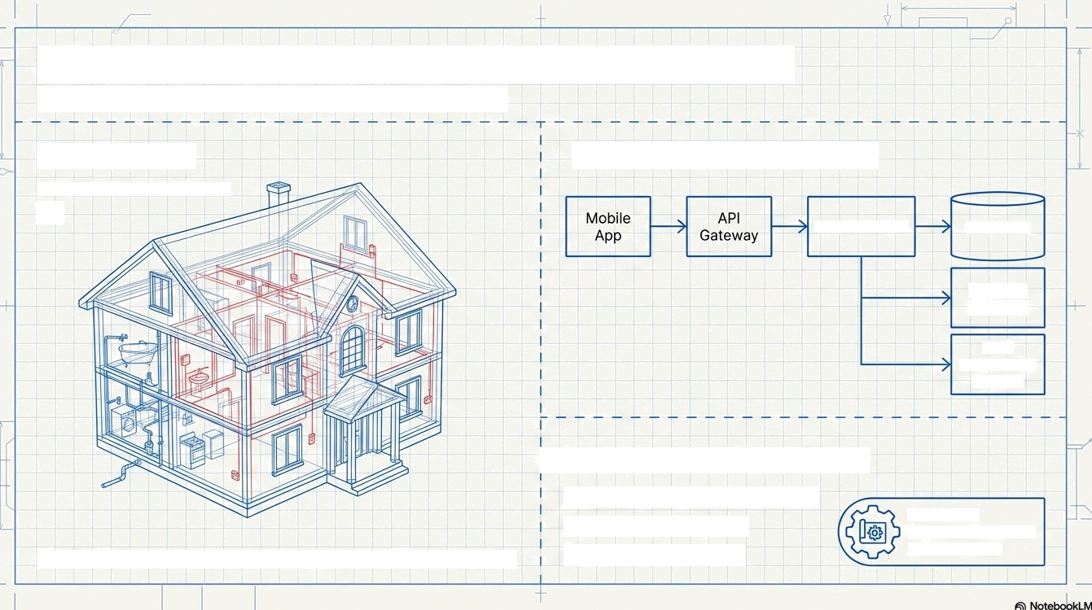

SAD: The System Architecture Document
The Structure (’How it all fits together’)
The Analogy The Reality (Tech Stack)
ZOOM LEVEL: 5/5 {X RAY VIEW]
Microservices
Database
Payment Gateway
SMS
Notification Service
i Key Sections & Audience
(tZ2 Logical/Physical Architecture Data Flow Diagrams Deployment Design
Audience: Solution Architects 8 Senior Devs
Electrical wiring diagrams, plumbing layout, HVAC integration.

Slide 9
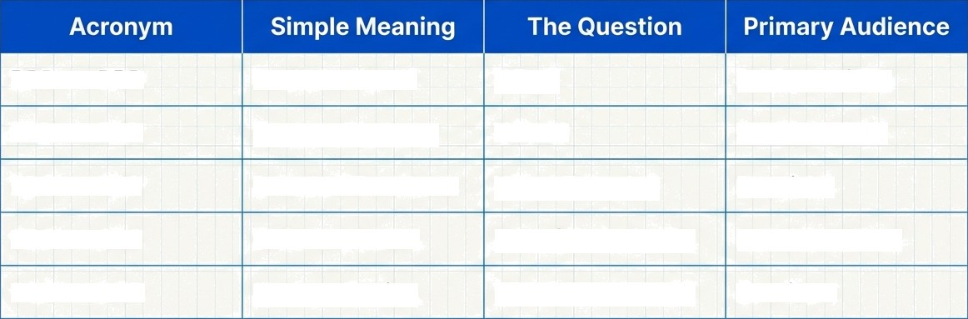
At a Glance: The Documentation Matrix
BRD | BRD | Business Need | Why? | Business / PM
FRD | FRD | System Features | What? | BA / Dev / QA
FRS | FRS | Detailed Functions | What Exactly? | Dev / QA
SRS | SRS | Software Rules | How (Technical)? | Dev / Architect
SAD | SAD | System Design | How (Connects)? | Architect
G NotebookLM

Slide 10






Anatomy of a Document: Essential Sections
The Business (BRD)
Business Background
Problem Statement
W Scope (In/Out)
Success Metrics
Stakeholders
The Function (FRD/FRS) Pocess Fows
Use Cases
Input/output Logic
Validations Error Messages Edge Cases
The Tech (SRS/SAD)
NFRs (Speed/Security) Tech Stack
Data Flow Diagrams API Integrations
Deployment
Architecture
!
G NotebookLM

Slide 11
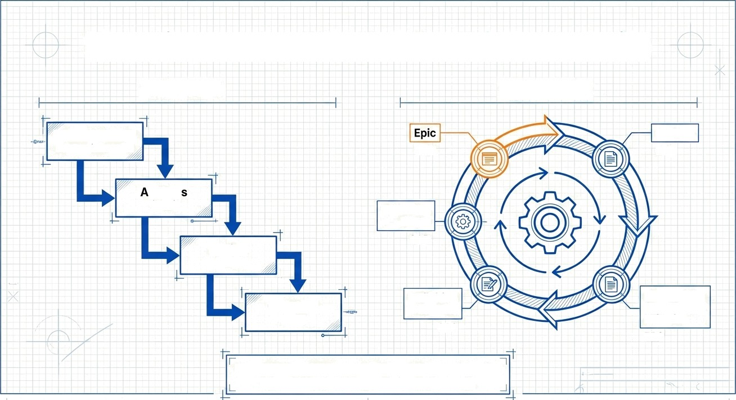
Mapping to the SDLC: Waterfall vs. Agile
Waterfall Agile/ Jira
Initiation (BRD)
JetBrains None
Feature
FRD
BRD
nalysi
(FRD)
Technical
Tasks
Design
(FRS)
SAD
Definition of Done
SRS
User Story/ Acceptance Criteria
FRS
Dev Prep
(SRS)
Agile doesn't kill documentation; it breaks it into
smaller, iterative chunks (User Stories).

Slide 12



The QA Perspective: Deriving Test Cases
How documentation drives quality assurance.
B FRD
Functional Testing
FRS
Validation & Edge Cases
B SRS
Performance &
Security Testing
B sAD
Concrète Example:
Source (FRS): 'Password must be min 8 characters.'
Test | Case | A: | Enter | 7 | chars | —> | Exçect | Error.
Test | Case | B: | Enter | 8 | chars | —> | Expect | Success.
G NotebookLM

Slide 13








Specialized Contexts: BFSI
When 'Good Enough' isn't enough.
Government
Key Characteristics
@ Heavy documentation &
Audit trails (Mandatory)
@ Regulatory Compliance
(RBI, SEBI, UIDAI)
@ Role-Based Access Control (RBAC) & Approval Matrices
Real World Example: Banking App requires data encryption and logged role approval workflows for every action.

Slide 14
The Interview Cheat Sheet
Ace the “Explain BRD vs. FRS vs. SRS” question.
WHY0 WHAT0
WHAT (Detail)4
HOW (Architecture)
HOW (Rules)0
BRD: Vision & Need.
FRD: Functional Scope.
FRS: Functional Clarity (Logic). SRS: Technical Rules.
SAD: System Blueprint.
G NotebookLM

Slide 15
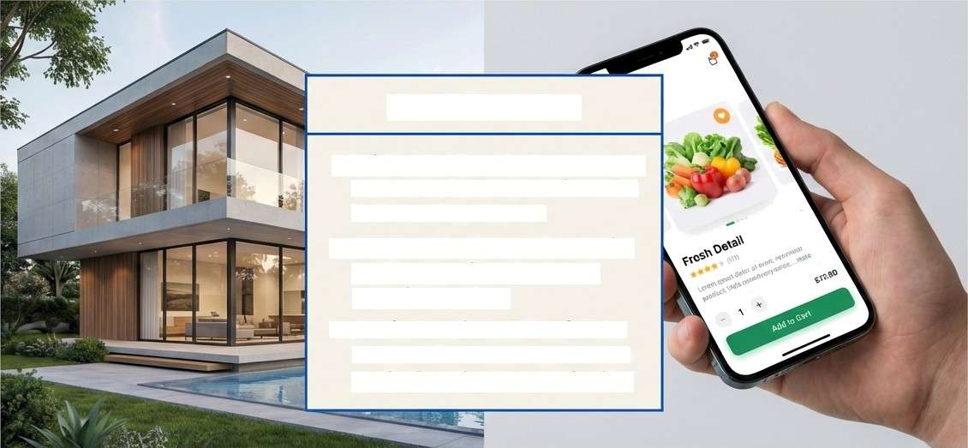

Clarity is King
Key Takeaways
°°°
Bridge the Gap: Documentation connects Business vision with Technical execution.
Respect the Layer: Start with the Why, define the What, specify the How.
Audience First: Write for the reader—Business users need goals; Developers need rules.
Use the right blueprint for the right stage of construction.

