Slide 1
Introduction
Aspect-Based Sentiment Analysis (ABSA)
ABSA is a granular level of Sentiment Analysis that digs deeper to understand sentiment towards specific aspects in a certain context, instead of just the overall sentiment about a topic
For instance, a review might have positive sentiment about the taste of a restaurant's food, but negative sentiment about the service. ABSA allows us to capture these details and analyze them separately

Slide 2
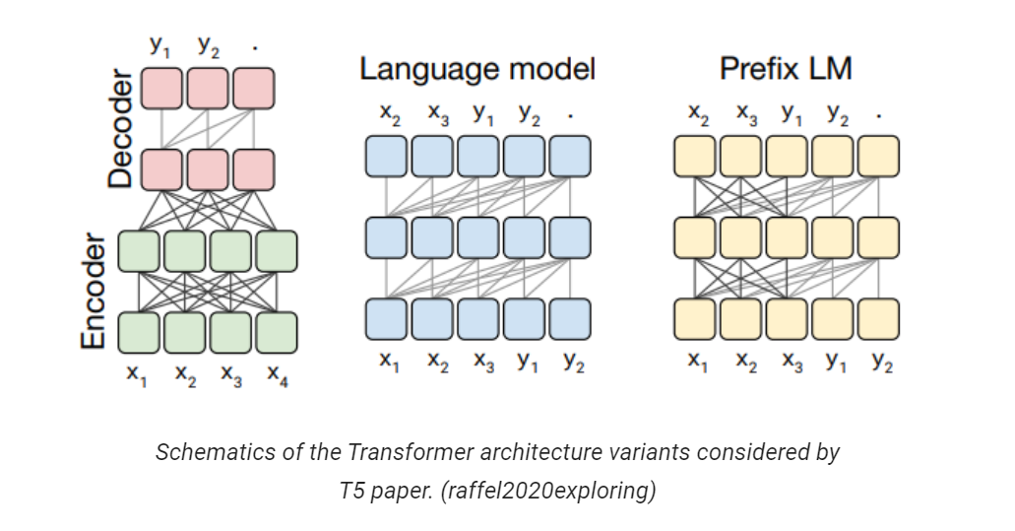
Role of Transformer Models in Sentiment Analysis
Power of Transformer Models
Transformer models, such as the T5 (Text-To-Text Transfer Transformer), have revolutionized Natural Language Processing tasks, including Sentiment Analysis.
These models excel due to their self-attention mechanism that allows them to understand the context of words and sentences.
T5 model is unique due to its "text-to-text" framework, where every language problem is cast as a text generation task.

Slide 3
Instruction Learning Approach
Instruction Learning in T5
We utilize Instruction Learning in this study to guide the T5 transformer in performing ABSA.
Instruction learning involves training models with explicit instructions in the data, offering a more controllable and interpretable model behavior.
This approach can efficiently combine various NLP tasks together (like aspect identification and sentiment analysis in ABSA) under a single model, improving performance and consistency.

Slide 4
Literature Review
Evolution of ABSA Techniques
Early work focused on rule-based and lexicon-based approaches for sentiment analysis.
Later, machine learning models such as SVM and Naive Bayes were employed for ABSA.
Deep learning models, such as CNN, LSTM, and GRU, have been explored extensively for ABSA in recent years.
Recent studies highlighted the use of Transformer-based models for ABSA, proving their effectiveness

Slide 5
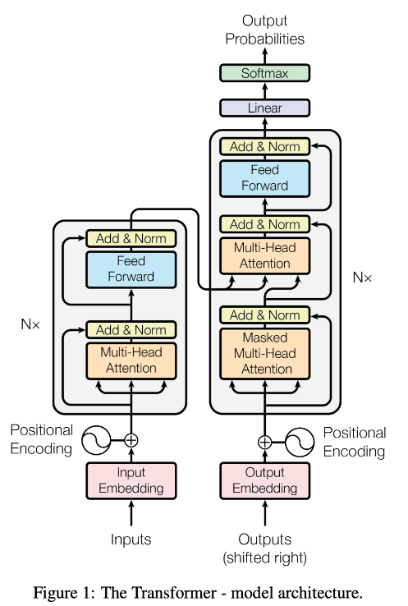
Transformer Models in Sentiment Analysis
Emergence of Transformer Models in NLP
"Attention is All You Need" (Vaswani et al., 2017) introduced Transformer models, revolutionizing NLP tasks, including sentiment analysis.
BERT (Devlin et al., 2019) demonstrated the power of transformer models in NLP tasks. Variants such as RoBERTa, ALBERT, and ELECTRA further pushed the performance.
T5 (Raffel et al., 2020) emerged as a versatile text-to-text transformer model capable of handling various NLP tasks effectively.

Slide 6
Instruction Learning and ABSA
Integration of Instruction Learning in ABSA
Recent studies started exploring the possibilities of using Instruction Learning for NLP tasks.
Brown et al. (2020) trained GPT-3 using Instruction Learning, demonstrating impressive results.
The application of Instruction Learning in ABSA is still an emerging field, with our study being one of the first to apply it with a T5 transformer model.

Slide 7
The Need for Aspect-Based Sentiment Analysis
Limitations of Traditional Sentiment Analysis
Traditional sentiment analysis provides a generalized sentiment, failing to capture the nuances in user opinions.
This generalization often leads to misinterpretation, as individual aspects within the context could carry differing sentiments.
Current challenge is to perform granular-level sentiment analysis - to understand sentiment towards specific aspects in a certain context.

Slide 8
Shortcomings in Existing ABSA Models
Limitations in Current ABSA Approaches
Traditional machine learning models for ABSA struggle with scalability and need extensive feature engineering.
While deep learning models improved performance, they often suffer from lack of interpretability.
Current ABSA models struggle to effectively capture context and aspect-specific sentiments consistently.

Slide 9
Harnessing Instruction Learning with Transformer Models
The Problem Statement
How can we employ the capabilities of transformer models, specifically T5, for ABSA?
How can we incorporate instruction learning to improve the interpretability and control over the model's behavior in ABSA tasks?
Our research aims to address these challenges by applying T5 transformer models through instruction learning for ABSA.

Slide 10
Methodology Overview
Methodological Approach
Our methodology involves utilizing the T5 transformer model for the ABSA task with an instruction-based learning approach.
The dataset will be preprocessed and formatted according to the requirements of the T5 model.
Explicit instructions will be included in the input data to guide the model's predictions.

Slide 11
Data Preprocessing and Model Training
Preprocessing and Training Process
Data Preprocessing: We'll prepare the text data by cleaning and tokenizing. We'll also include explicit instructions for the task.
Model Training: The T5 model will be trained on the prepared dataset. During training, the model learns to follow the instructions and perform ABSA.

Slide 12
Model Evaluation and Analysis
Model Evaluation: The model's performance will be evaluated using appropriate metrics such as Accuracy, Precision, Recall, and F1 Score. We'll also consider aspect-level evaluation metrics.
Result Analysis: We'll perform a detailed analysis of the results, focusing on cases where the model performed exceptionally well and areas where it struggled. This will include analysis of the model's performance on different aspects and its adherence to the provided instructions.

Slide 13
Results & Discussion
Comparison between GPTmed, GRACE, BARTABSA, IT-MTL V/S Inst ABSA
Model | Lapt14 | Rest14 | Rest15 | Rest16
GPT2med | 82.04 | 75.94 | NA | NA
GRACE | 87.93 | 85.45 | NA | NA
BARTABSA | 83.52 | 87.07 | 75.54 | NA
IT-MTL | 76.93 | NA | 74.03 | 79.41
Inst ABSA | 91.4 | 92.76 | 75.23 | 81.48

Slide 14
Model | Lapt14 | Rest14 | Rest15 | Rest16 | SEntFiN
GPT2med | 82.04 | 75.94 | NA | NA | NA
GRACE | 87.93 | 85.45 | NA | NA | NA
BARTABSA | 83.52 | 87.07 | 75.54 | NA | NA
IT-MTL | 76.93 | NA | 74.03 | 79.41 | NA
Inst ABSA | 91.4 | 92.76 | 75.23 | 81.48 | 74.16

Slide 15
