Slide 1
BANKLENS · CREDIT RISK POLICY
BankLens turns credit risk into an actionable policy
Predictive default triage and expected-loss routing across 30,000 retail credit accounts.
30,000
22.12%
0.28
Retail credit accounts
Portfolio default rate
PD cutoff for routing
Review above 0.28 PD
Approve below cutoff
Python: Pandas, Scikit-Learn, XGBoost, SHAP · MySQL: relational schema, CTEs, window functions · Power BI: DAX decision support

Slide 2
01 · PORTFOLIO BASELINE
METRIC | VALUE
Accounts analysed | 30,000
Observed defaults | 6,636
Baseline default rate | 22.12%
Active bad rate below 0.28 PD | 12.83%
Expected loss routed | NT$134.5M / NT$241.2M
The portfolio starts with a 22.12% default problem
30,000 complete client records contain 6,636 observed defaults. The policy objective is to isolate high-loss accounts for review without restricting performing borrowers.
22.12%
55.7%
BASELINE DEFAULT RATE
EXPECTED LOSS ROUTED
02

Slide 3
02 · GOVERNANCE
01
02
03
04
A governed pipeline turns raw histories into decision-ready data
Normalize
Engineer
Publish
Validate
Raw credit histories become MySQL tables using the BankLens SQL repository.
Risk features are built in the Python analytics notebook.
Explainability, cutoff, decile, and Power BI-ready outputs are released.
Metrics are checked through the verified metrics file before executive use.
SHAP ATTRIBUTIONS
POLICY CUTOFF CURVE
RISK DECILE SUMMARY
POWER BI-READY DATASET
03

Slide 4
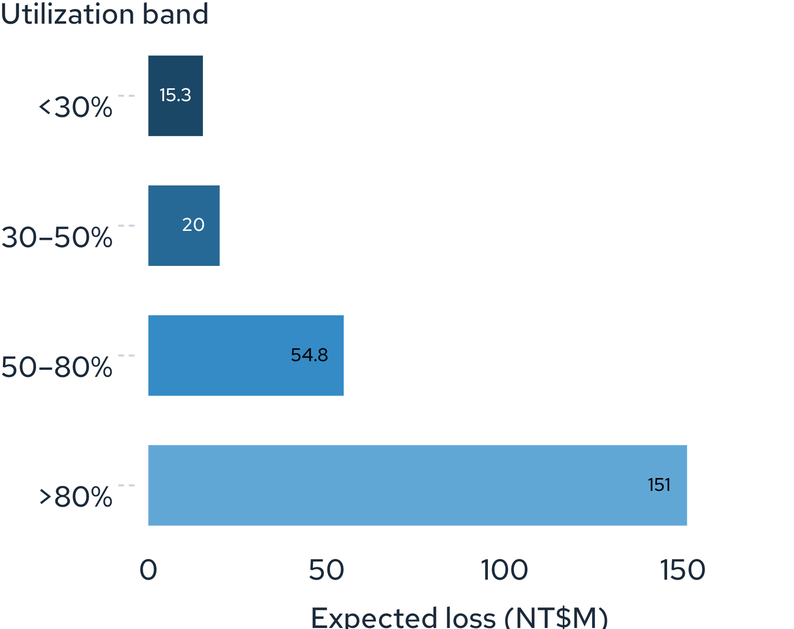
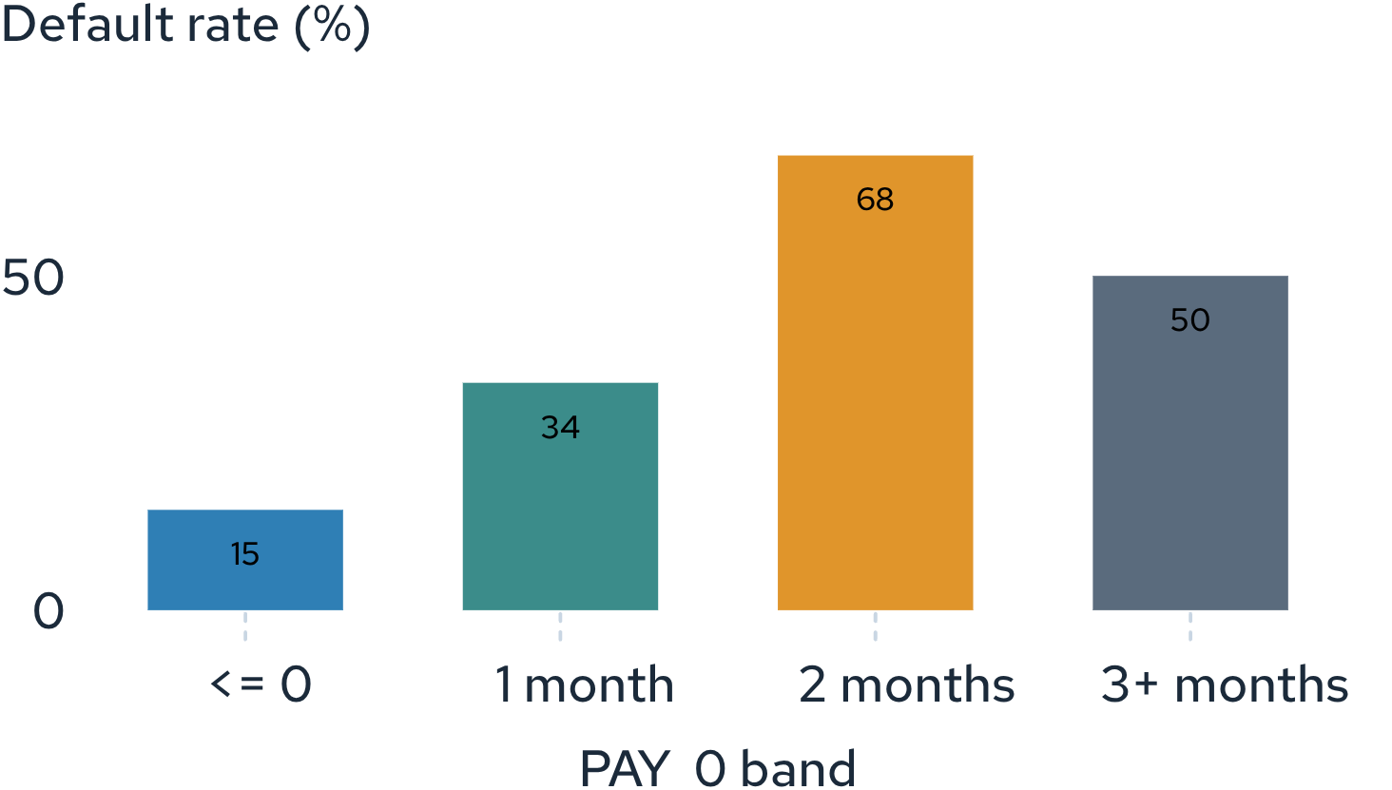
Expected loss by utilization
03 · ANALYTICAL CORE
Risk accelerates sharply after the first missed payment
1-month delay roughly doubles the current band; 2-month delay is the critical roll-rate inflection point.
The highest-utilization tier concentrates most expected loss.
Current / revolving: 13%–17%; 3+ months delayed: 50%–78% default rate.
04

Slide 5
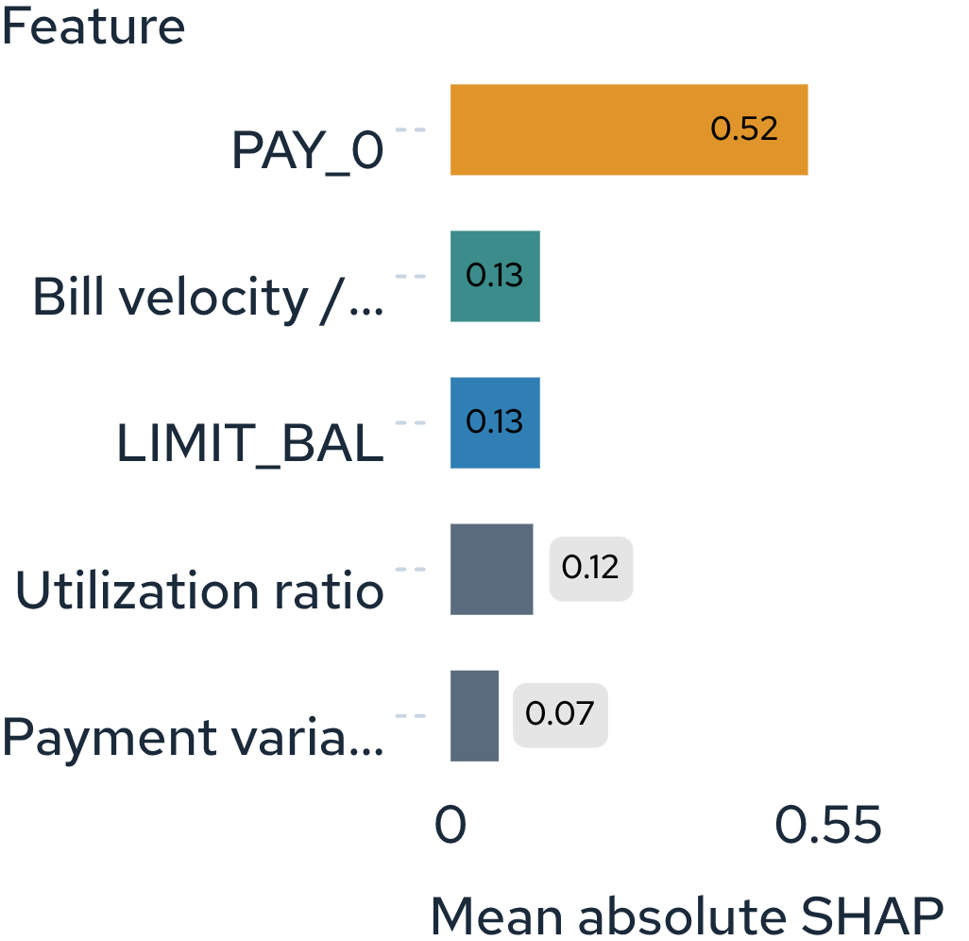
Mean absolute SHAP impact
04 · EXPLAINABILITY
Transparent scoring gives leadership a usable risk story
The XGBoost benchmark reaches 0.783 ROC-AUC. The Logistic scorecard reaches 0.730 ROC-AUC and is selected for transparent log-odds regulatory scoring.
0.783
0.730
XGBOOST BENCHMARK ROC-AUC
LOGISTIC SCORECARD ROC-AUC
05

Slide 6
05 · POLICY ANCHOR
The 0.28 PD cutoff captures loss without over-freezing the book
0.28
POLICY METRIC | VALUE
OOF simulation tested PD cutoffs | 0.05 to 0.65
Accounts routed | 6,698
Portfolio share routed | 22.3%
Expected loss captured | 55.7% / NT$134.5M
Residual active bad rate | 12.83%
SELECTED PD CUTOFF
Route accounts with PD ≥ 0.28 to manual review or line freeze.
Selected policy balances review capacity with expected-loss capture.
06

Slide 7
06 · DECISION COCKPIT
Power BI turns the scorecard into a decision cockpit
HEADLINE KPI
Delinquency roll-rate
SHAP drivers
55.7%
See the movement from current accounts to 1-month, 2-month, and 3+ months delayed.
Explain why the score moves, led by PAY_0.
EXPECTED LOSS CAPTURED
Utilization loss
Cutoff sensitivity
Drill into the >80% utilization concentration.
Use DAX measures for dynamic cutoff slicing and utilization-cohort drill-downs.
Leadership moves from portfolio signal to account-routing action in one view.
07

Slide 8
07 · OPERATING CADENCE
01
Enforce the cutoff
Three policy moves convert analysis into loss prevention
Route 6,698 accounts at PD ≥ 0.28. Capture NT$134.5M of expected loss and reduce the active bad rate to 12.83%.
02
Intervene early
Trigger automated payment plans at PAY_0 = 1, before risk reaches 68% at two months.
03
Cap exposure
Restrict credit-limit increases above 80% utilization, where NT$151.1M of expected loss is concentrated.
Monitor, intervene, and recalibrate the cutoff as portfolio conditions change.
Monitor. Intervene. Recalibrate.

