Slide 1
CAREPULSE · READMISSION ANALYTICS
CarePulse: Readmission risk is concentrated, not evenly distributed
Clinical encounter and 30-day patient readmission analytics across 101,766 inpatient stays and 130 US hospitals.

Slide 2
THE BASELINE
11.2% of encounters return within 30 days
11.2%
101,766
71,518
30-day readmission rate
inpatient stays
unique patients
11,357 encounters readmitted within 30 days; overall readmission rate is 46.1%.
Average length of stay: 4.4 days; median: 4.0 days.
02

Slide 3
VALIDATION DESIGN
Patient-grouped validation protects the signal
01
02
03
Clean and normalize
Standardize diagnoses
Group by patient
Clean and normalize encounter, patient, and admission dimensions in MySQL.
Standardize ICD-9 primary diagnosis groupings.
Use 5-fold cross-validation grouped by patient_nbr so repeat encounters never cross train and test splits.
The validation unit is the patient, not the encounter.
03

Slide 4
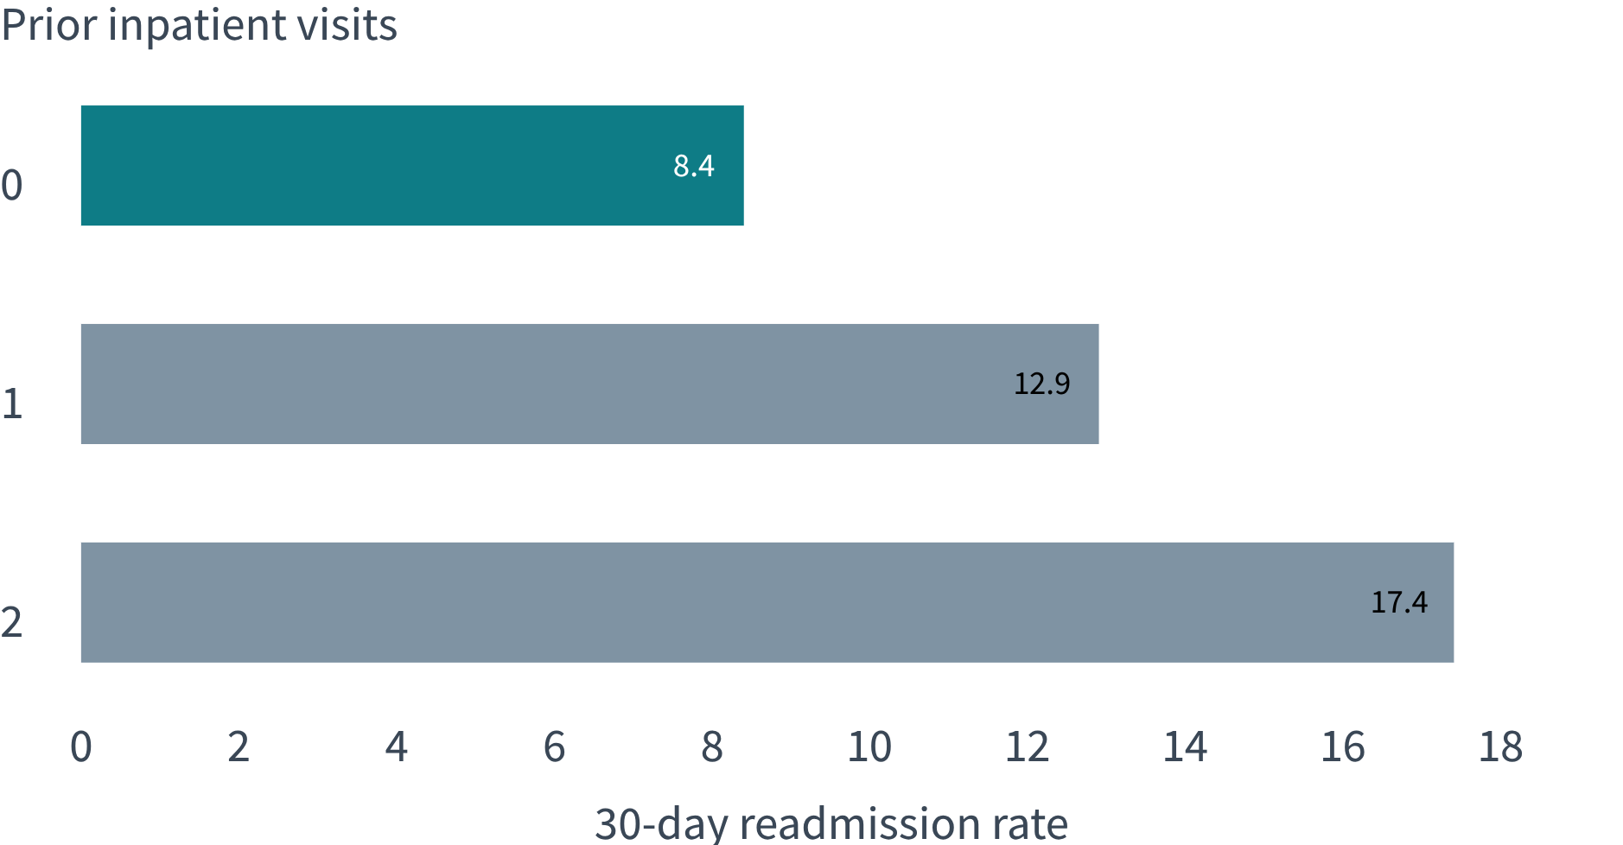
UTILIZATION SIGNAL
Prior utilization is the clearest readmission gradient
FREQUENT-UTILIZER SIGNAL
25.7%
3+ prior visits, more than 3× the no-prior-stay rate.
High-risk glycemic cohort: 20.3% among patients with 2+ prior visits and HbA1c >8% across 915 encounters.
Readmission risk rises monotonically with prior inpatient utilization.
04

Slide 5
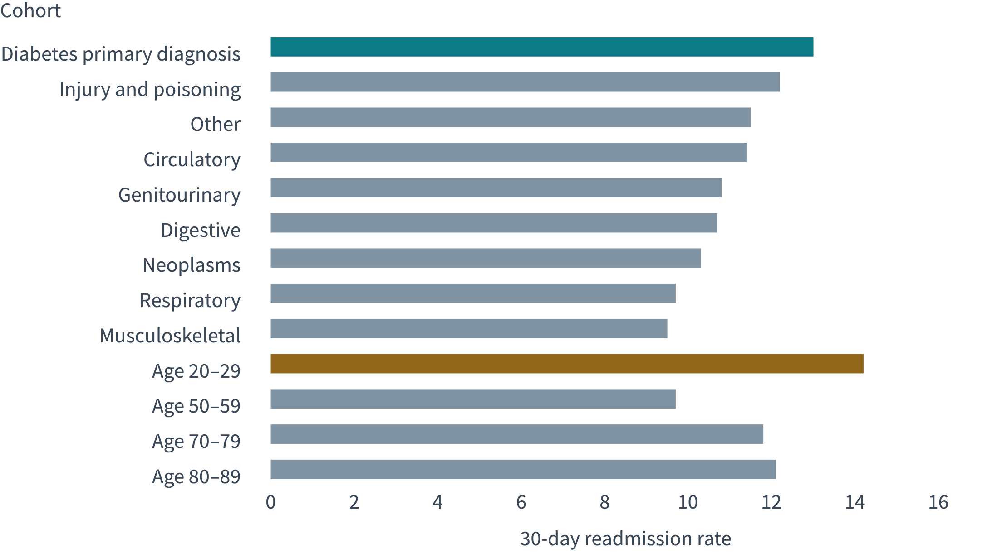
COHORT DIFFERENTIATION
Diagnosis and age reveal distinct intervention cohorts
Diabetes is the highest-risk primary diagnosis group at 13.0%; injury and poisoning follows at 12.2%.
Respiratory and musculoskeletal cohorts are lower at 9.7% and 9.5%.
Young adults aged 20–29 peak at 14.2%; seniors aged 70–79 and 80–89 are 11.8% and 12.1%.
05

Slide 6
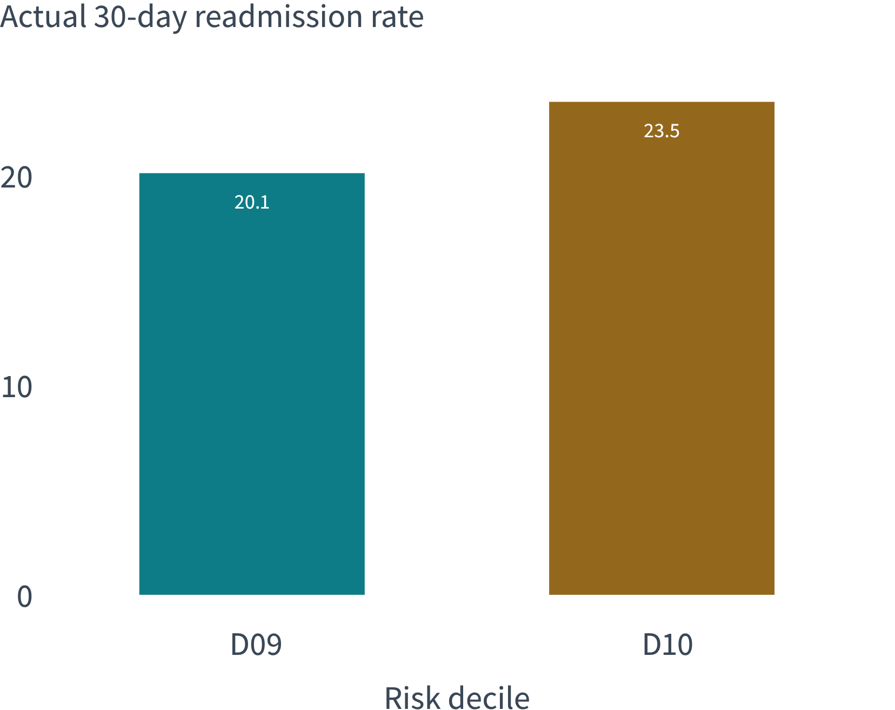
MODEL LIFT
The top 20% risk cohort captures 36% of readmissions
TOP-COHORT LIFT
20.1%
D09–D10 average readmission versus 11.2% overall.
Patient-grouped class-balanced logistic regression: 0.65 ROC-AUC and 56% recall. Actual readmission rates climb monotonically across deciles, peaking at 23.5% in D10.
06

Slide 7

OPERATIONALIZATION
Power BI turns the model into a clinical command center
Track the gradient
Track readmission rates across prior inpatient visits, diagnosis group, age band, and risk decile.
Pair signal with lift
Pair model validation metrics with the top-20% cohort lift.
Surface the intervention cohort
Surface the high-risk inpatient-utilization plus HbA1c subgroup for intervention.
07

Slide 8
CARE TRANSITIONS
Route the highest-risk patients into care transitions
1
2
3
D09–D10
3+ prior visits
Glycemic intervention
Mandatory 72-hour post-discharge nurse follow-up; targets a 20.1% cohort and 36% of all 30-day readmissions.
Dedicated transitional case managers for a 25.7% risk cohort.
Endocrine consultation and diabetes education for 2+ prior stays with HbA1c >8%, plus young adults aged 20–29.
08

