Slide 1
GridPulse – Household Electricity Load & Peak-Demand Analytics
High-Frequency Smart-Meter Telemetry & Demand-Response Optimization Across 2.08M Readings
Tech stack: Python (Pandas, NumPy, Matplotlib) · MySQL (Star Schema, CTEs, Window Functions) · Power BI (DAX)

Slide 2





Evening peaks and winter surges are straining the residential grid
Residential power distribution suffers from sharp evening demand peaks and winter heating surges, reducing daily system load factors and straining transformer capacity.
Source readings: 2.08M (2,075,259 minute-level rows; 25,979 / 1.25% missing values interpolated into 34,588 hourly and 1,442 daily rows)
Evening peak, 19:00–22:00: 1.83 kW (67.6% above average)
Daily load factor: 39.7% (Average / Peak)
Average active load: 1.09 kW
Winter vs. summer: +95% (1.42 kW vs. 0.73 kW)
GridPulse – Household Electricity Load &amp; Peak-Demand Analytics
2

Slide 3

A high-volume ETL pipeline turns raw telemetry into an analytics-ready star schema
01
02
03
Parse
Resolve
Resample
Parse 2,075,259 minute-level sensor records.
Resolve 25,979 missing readings (1.25%) via time-series interpolation.
Resample into 34,588 hourly and 1,442 daily aggregations.
MySQL schema:
joined to
fact_hourly_load
dim_calendar
dim_tariff_tiers
SQL window functions support rolling demand baselines and peak ranking.
GridPulse – Household Electricity Load &amp; Peak-Demand Analytics
3

Slide 4
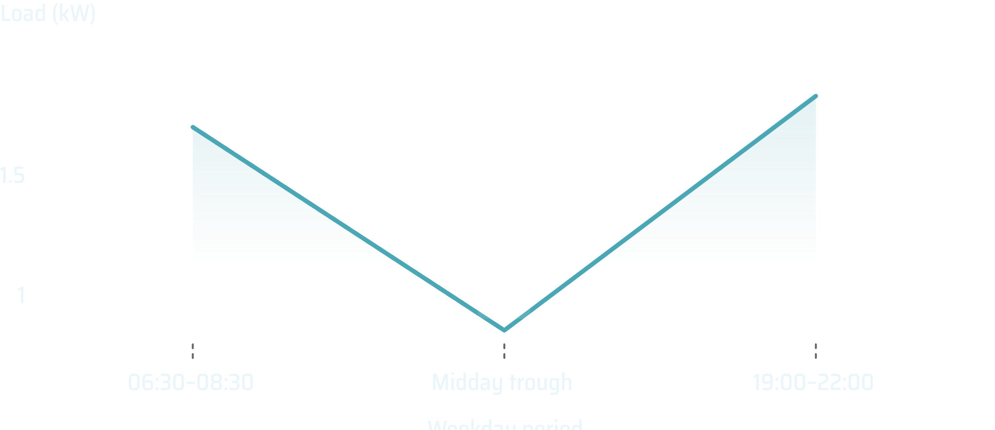
The 19:00–22:00 window is the clearest peak-shaving opportunity
Evening peak: 1.83 kW, 67.6% above the 1.09 kW daily average.
Weekdays: dual peaks, with a sharp morning ramp at 06:30–08:30 (~1.70 kW), a midday trough (~0.85 kW), and the evening spike.
Weekends: sustained daytime load (~1.35–1.50 kW) culminating in a >2.0 kW evening peak.
Show weekday and weekend intraday curves with the 19:00–22:00 peak band highlighted.
GridPulse – Household Electricity Load &amp; Peak-Demand Analytics
4

Slide 5
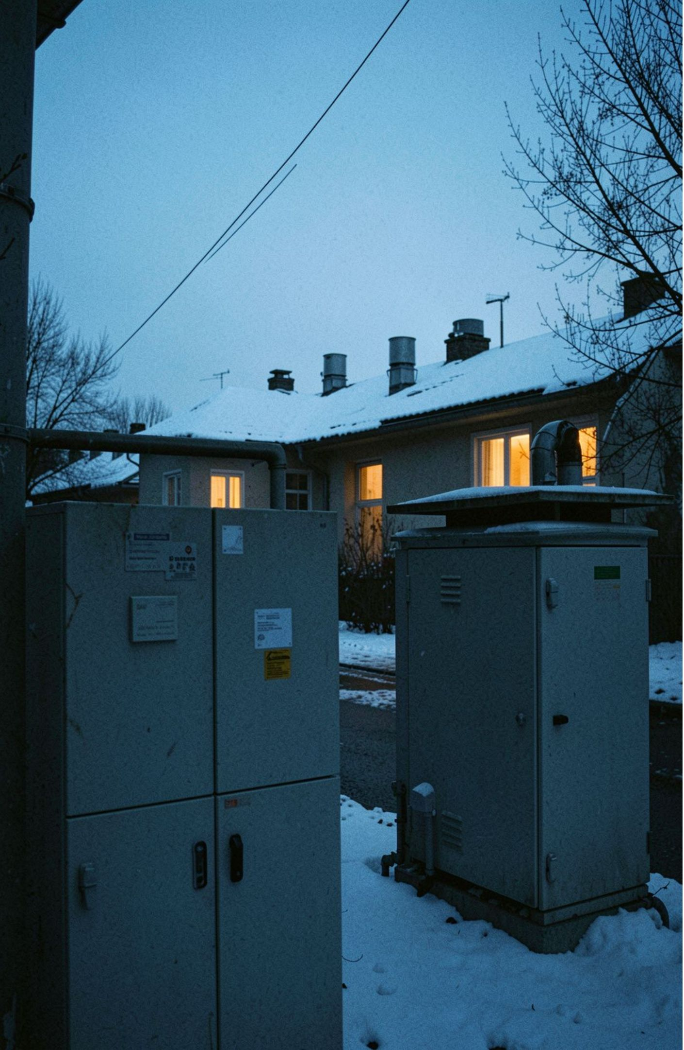
Winter demand runs at nearly twice summer load, but the four-year baseline is stable
Winter: 1.42 kW (+95% above summer)
Autumn: 1.14 kW
Spring: 1.10 kW
Summer: 0.73 kW; annual August troughs dip to ~0.30 kW during summer vacations
Monthly average load oscillates consistently around the 1.09 kW horizontal baseline across all four annual cycles from Dec 2006 to Nov 2010.
GridPulse – Household Electricity Load &amp; Peak-Demand Analytics
5

Slide 6
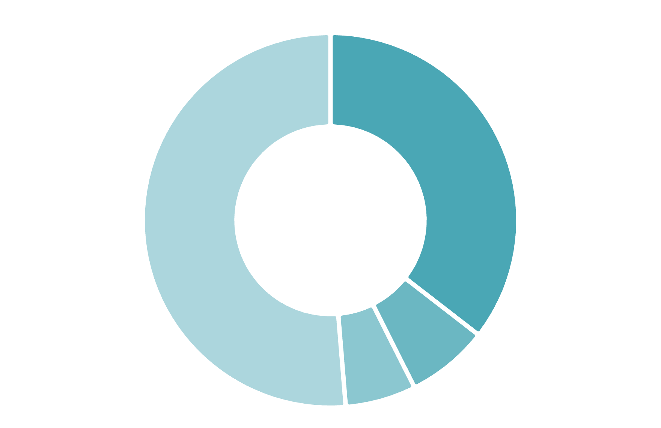
Water heating and AC are the largest controllable load group
Water Heater & AC (Sub_metering_3): 35.5% of total energy, representing 73% of all metered sub-circuit load
Laundry Room (Sub_metering_2): 7.1%
Kitchen (Sub_metering_1): 6.1%
Unmetered base & lighting load: 51.3%
Use a breakdown visual that separates controllable sub-metered demand from the unmetered base.
GridPulse – Household Electricity Load &amp; Peak-Demand Analytics
6

Slide 7

Shifting 60% of deferrable evening load cuts the peak by 19%
Scenario: shift 60% of deferrable evening laundry (Sub_metering_2) and water-heater (Sub_metering_3) consumption from 19:00–22:00 to off-peak night hours, 01:00–05:00.
 | Before | After
Evening peak | 1.83 kW | 1.49 kW, a 19% reduction
Daily system load factor | 40% | 42%
19:00–22:00
01:00–05:00
Deferrable evening laundry and water-heater consumption
Off-peak night hours
Show the before/after peak-shaving impact in a compact comparison table with a load-shift flow from peak to off-peak.
GridPulse – Household Electricity Load &amp; Peak-Demand Analytics
7

Slide 8



Automate water-heating schedules and price the peak window
Automated water-heater timer controls:
Time-of-use peak pricing:
Customer outcome:
implement a 19:00–22:00 peak tariff tier during winter months, when average load reaches 1.42 kW.
incentivize automated delay cycles for laundry and dishwashing while protecting transformer headroom.
program water heaters (35.5% of total energy, 73% of metered load) to pre-heat during the 01:00–05:00 trough (~0.45 kW baseline).
GridPulse – Household Electricity Load &amp; Peak-Demand Analytics
8

