Slide 1
Chennai Flood- and Congestion-Aware Dynamic Traffic Routing
Project Vision & Scope
• Core Goal: Build an intelligent urban routing engine for Chennai under flooding and congestion.
• Multi-Source Data: Fuse OpenStreetMap, SRTM elevation, GPM rainfall, and flood hotspots.
• Transport Modelling: Translate waterlogging & volume into dynamic BPR travel-time edge costs.
• Stage 1 Achieved: Completed end-to-end proof of concept mapping OpenCity flood points to OSM edges.
• Validation: 6 unit tests passed; reproducible execution commands verified.
FULL PROJECT ARCHITECTURE & STAGE 1 POC
STUDENT PRESENTER
Rohit Michael Raj
Register No: 24BCE5108
Notes:
[KEY PRESENTATION TALKING POINTS]
• Welcome Ma'am. This presentation details the project vision for Flood- and Congestion-Aware Dynamic Traffic Routing in Chennai.
• My name is Rohit Michael Raj, Register No 24BCE5108.
• This master deck presents the end-to-end architecture, Stage 1 implementation & evidence, multi-factor disruption matrix, and the 10-stage roadmap.

Slide 2
1. Master System Architecture & Workflow
MASTER ARCHITECTURE
6-layer modular workflow from raw geospatial data to SUMO microsimulation
1
L1. Data Ingestion
2
L2. Spatial Engine
3
L3. Road State
4
L4. BPR Engine
5
L5. Dynamic Route
6
L6. Evaluation
• OpenStreetMap • OpenCity Flood • SRTM Elevation • GPM Rainfall
• Metric Projection • KDTree Mapping • HAND Hydrology • Susceptibility
• Normal • Degraded (50% C) • Severe (10% C) • Blocked (0% C)
• Flow Volume V • Capacity C_eff • Travel Time T • Congestion Index
• Dynamic Dijkstra • Threshold Rules • Hysteresis • Emergency Priority
• SUMO Simulator • Static Baseline • Delay Metrics • Stability Analysis
KEY SYSTEM HIGHLIGHTS & DECOUPLING PRINCIPLE
• Strict Layer Decoupling: The data collection layer, hydrological state engine, BPR capacity modeller, and dynamic routing algorithm operate as independent modular layers.
• Physical Capacity Basis: Flooding and congestion are converted into physical road capacity reduction (C_eff), avoiding ad-hoc heuristic penalties.
• Emergency Fleet Preemption: Emergency vehicles follow a priority override rule (zero congestion penalty) rather than competing with standard traffic queues.
Rohit Michael Raj | Reg No: 24BCE5108
Full Project | Slide 2
Notes:
[KEY PRESENTATION TALKING POINTS]
• Walk Ma'am through the 6-layer architecture workflow diagram.
• Emphasize strict layer decoupling: data, physical capacity, cost functions, and routing logic are cleanly separated.

Slide 3
2. Stage 1 Execution Pipeline & Sub-Modules
STAGE 1 PIPELINE
Complete pipeline executed in Stage 1 from geospatial ingestion to Dijkstra reroute
1
1. Data Ingestion
2
2. Flood Parsing
3
3. Spatial Mapping
4
4. Road State
5
5. BPR Engine
6
6. Dijkstra Route
Download OSM road network & OpenCity flood KML
Parse 327 KML flood point coordinates
Map points to nearest road edge within 150m
Assign state (BLOCKED / Degraded / Normal)
Calculate effective capacity & travel time cost
Execute dynamic dynamic route selection
IMPLEMENTED SUB-MODULES IN STAGE 1 CODEBASE
Geospatial & CRS Handler
• OSMnx extracts driving network. • GeoPandas converts WGS84 (EPSG:4326) to Metric UTM 44N (EPSG:32644) for safe metric distance calculation.
Capacity & BPR Modeller
• Normal capacity = 1200 veh/hr. • Disrupted edge capacity = 0 (BLOCKED). • BPR cost becomes infinite/unavailable for blocked road segment.
Dynamic Dijkstra Routing
• Runs Baseline Dijkstra on initial graph. • Refreshes edge weight matrix. • Runs Disrupted Dijkstra to pick optimal detour path.
Rohit Michael Raj | Reg No: 24BCE5108
Full Project | Slide 3
Notes:
[KEY PRESENTATION TALKING POINTS]
• Present the exact 6-step pipeline executed in Stage 1.
• Highlight spatial metric projection (EPSG:32644) to convert GPS lat/lon to exact meter distances.
• Show how the output of BPR feeds directly into Dijkstra.

Slide 4
3. Factors Considered: Data Sources & Spatial Fusion
DATA FACTORS
Rigorous integration of open road graphs and historical flood hotspots
FACTOR 1: Road Network Data (OpenStreetMap)
FACTOR 3: Spatial Nearest-Neighbor Road Mapping
• Downloaded via OSMnx Python library for target Chennai bounding box (North Chennai area). • Preserves edge attributes: length, geometry, highway class, and speed limits. • Graph structural integrity validated before routing.
• Metric Projection: Raw WGS84 geographic coordinates (latitude/longitude) cannot be accurately matched using Euclidean distance. Projected to EPSG:32644 (UTM Zone 44N) for metric accuracy.
• Spatial Buffer Threshold: A strict 150-meter metric threshold buffer is applied. Flood points farther than 150m from any road edge are ignored to prevent false matches.
• Affected Edge Identification: The mapping pipeline identified 15 affected road directions matching flood hotspots in the demonstration bounding box.
• Controlled Disruption Selection: Selected real mapped edge (9992430988, 9992430963) along Kannan Street for controlled Stage 1 routing experiment.
FACTOR 2: Historical Flood Hotspots (OpenCity)
• Dataset: OpenCity Chennai 2015 GCC Area Flood Hotspots (Public Domain KML). • Parsed 327 point features corresponding to verified historical waterlogging sites. • Strictly classified as HISTORICAL evidence, not live flood telemetry.
Rohit Michael Raj | Reg No: 24BCE5108
Full Project | Slide 4
Notes:
[KEY PRESENTATION TALKING POINTS]
• Detail the three data factors considered in Stage 1.
• OpenStreetMap gives real Chennai road geometry.
• OpenCity provides 327 real historical flood points from 2015.
• Coordinate projection to UTM Zone 44N guarantees exact metric meter distance calculations.

Slide 5
4. Capacity Degradation & Travel-Time Cost Modelling
MATHEMATICAL MODEL
Formulating road waterlogging into BPR dynamic edge costs
BUREAU OF PUBLIC ROADS (BPR) TRAVEL-TIME EQUATION
T = t_0 * [ 1 + alpha * ( V / C_eff )^beta ]
Where: t_0 = free-flow travel time (length / speed), V = traffic volume, C_eff = effective degraded capacity, alpha = 0.15, beta = 4.0
NORMAL STATE
DEGRADED STATE
SEVERE STATE
BLOCKED STATE
C_eff = 1.0 * C_0
100% Nominal Capacity
Travel time equals free-flow baseline with minimal congestion delay.
C_eff = 0.5 * C_0
50% Capacity Reduction
Minor waterlogging. BPR travel time inflates significantly due to volume ratio.
C_eff = 0.1 * C_0
90% Capacity Reduction
Deep standing water. BPR travel time skyrockets, discouraging route entry.
C_eff = 0.0
0% Capacity (Excluded)
Complete road submergence. Edge cost becomes infinite; Dijkstra excludes edge.
Rohit Michael Raj | Reg No: 24BCE5108
Full Project | Slide 5
Notes:
[KEY PRESENTATION TALKING POINTS]
• Explain the BPR formula parameters.
• Emphasize how effective capacity C_eff connects physical flood states to mathematical routing costs.
• Point out that in Stage 1, the affected test edge is set to BLOCKED state to demonstrate clean Dijkstra detour selection.

Slide 6
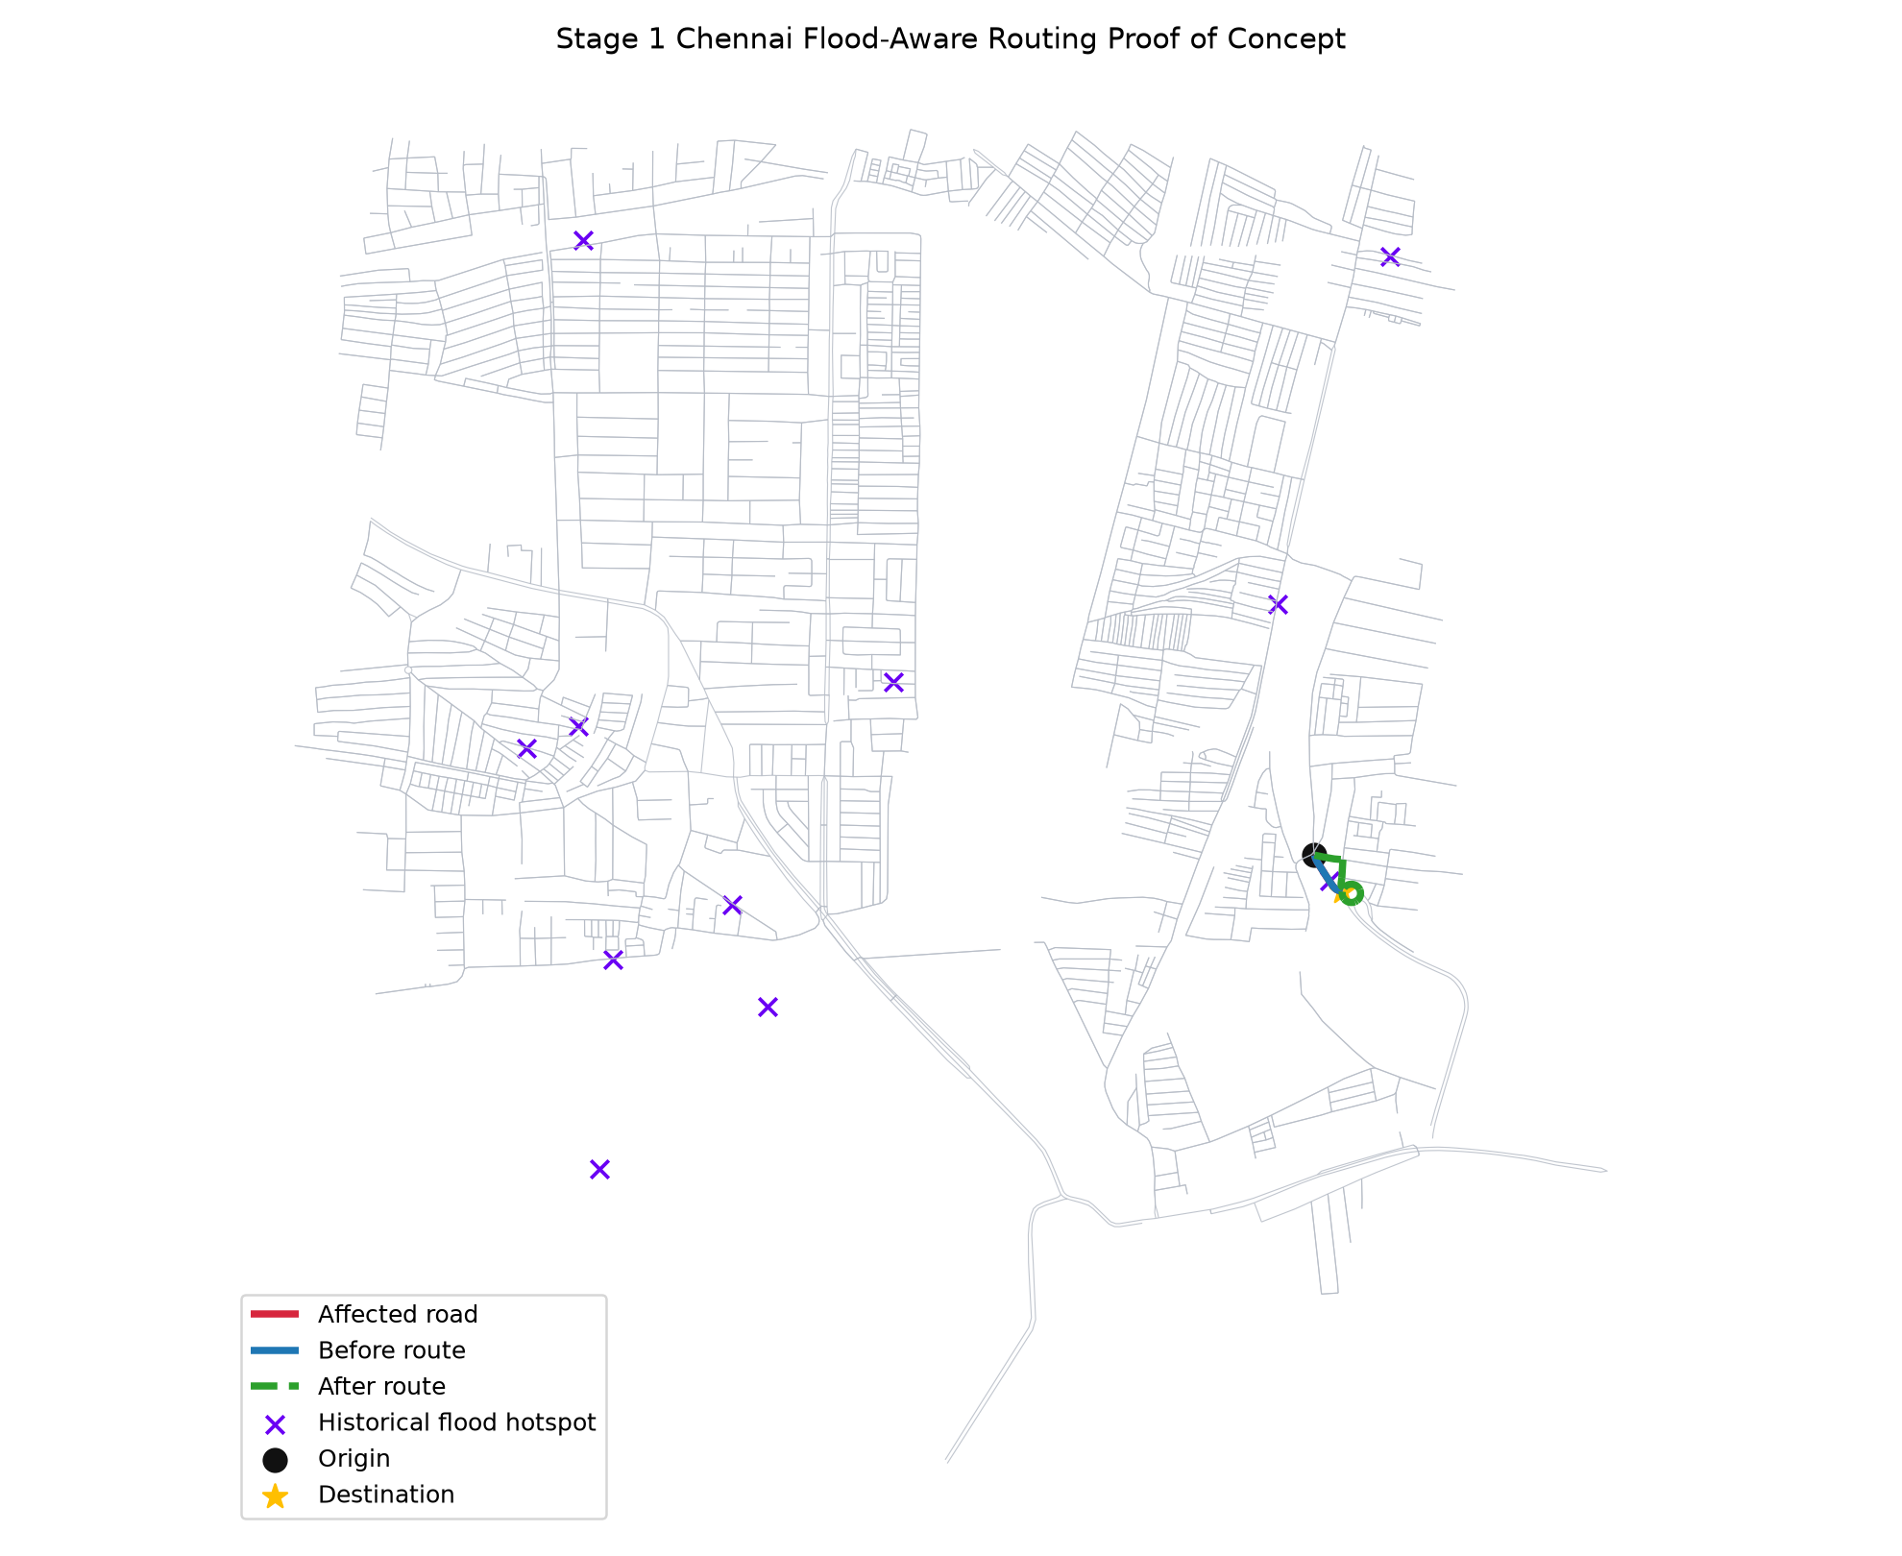
5. Stage 1 Demonstration Results & Map Evidence
EMPIRICAL RESULTS
Visual proof of Dijkstra route switching after road disruption
327
15
Flood Hotspot Points
Affected Road Edges
14.63s
34.61s
Before Route Cost
After Detour Cost
• Target Disrupted Edge: Kannan Street segment (9992430988, 9992430963).
• Before Route Path: Direct single-edge traversal (Nodes: 9992430988 -> 9992430963).
• After Route Detour: 9-node alternate path via surrounding unflooded local streets.
• Routing Outcome: Dijkstra successfully avoids blocked edge and finds minimal travel-time detour.
Rohit Michael Raj | Reg No: 24BCE5108
Full Project | Slide 6
Notes:
[KEY PRESENTATION TALKING POINTS]
• Point to the generated map image on the left.
• Highlight the numbers: 327 flood points loaded, 15 affected edges found.
• Before disruption: direct route takes 14.63 seconds.
• After disruption: Dijkstra detours around Kannan Street, taking 34.61 seconds across 9 nodes.

Slide 7
6. Code Architecture, Output Artifacts & Test Suite
VALIDATION
Clean modular repository design supported by automated unit tests
Modular Code Engine
Generated Output Artifacts
Automated Test Suite
• src/chennai_routing/data/ - flood.py: KML parser & downloader - osm.py: OSMnx road graph loader • src/chennai_routing/preprocessing/ - geospatial.py: CRS & KDTree mapper • src/chennai_routing/models/ - capacity.py: Road state multipliers - bpr.py: BPR cost function engine • src/chennai_routing/routing/ - dijkstra.py: Dynamic shortest path
• outputs/tables/stage1_affected_roads.csv Contains list of all 15 mapped affected edge IDs and coordinates. • outputs/tables/stage1_route_summary.csv Before vs after route node sequences & travel-time costs. • outputs/tables/stage1_summary.json Machine-readable execution metrics. • outputs/maps/stage1_before_after_route.png High-resolution route comparison map.
6 / 6 PASSED
Pytest suite verifies: 1. CRS Mismatch Protection 2. Spatial Nearest Edge Mapping 3. BPR Capacity Degradation 4. Blocked Edge Exclusion 5. Synthetic Graph Route Switching 6. Repository File Structure Integrity Verified command: pytest tests/test_stage1_poc.py
Rohit Michael Raj | Reg No: 24BCE5108
Full Project | Slide 7
Notes:
[KEY PRESENTATION TALKING POINTS]
• Explain that the codebase is modularly structured in src/chennai_routing.
• Highlight that all 6 pytest automated unit tests pass successfully.
• Emphasize that all output tables and map images are generated reproducibly via scripts/run_stage1_poc.py.

Slide 8
7. Multi-Factor Disruption Matrix: Factors Considered
MULTI-FACTOR ANALYSIS
Comprehensive categorization of road, flood, traffic, and emergency variables
ROAD FACTORS
FLOOD FACTORS
TRAFFIC FACTORS
INCIDENT FACTORS
Network Geometry
• Edge Length (meters)
• Functional Highway Class
• Speed Limit (km/h)
• Number of Lanes
• Node Intersections
Waterlogging Hazard
• Historical Hotspots KML
• SRTM Elevation & Slope
• HAND Hydrology Index
• GPM Rainfall Intensity
• Water Depth / State
Congestion & Flow
• Vehicle Volume (V)
• Nominal Capacity (C_0)
• Volume/Capacity Ratio
• BPR Travel Time Delay
• Corridor Bottlenecks
Emergency & Safety
• Unplanned Road Blockages
• Accident Obstructions
• Emergency Priority Level
• Reserved Lane Override
• Safety Exclusion Zones
Rohit Michael Raj | Reg No: 24BCE5108
Full Project | Slide 8
Notes:
[KEY PRESENTATION TALKING POINTS]
• Explain the 4 factor categories considered in our project scope.
• 1. Road Network factors (geometry, speeds, lanes).
• 2. Flood factors (hotspots, elevation, rainfall).
• 3. Traffic factors (volumes, capacities, BPR delays).
• 4. Incident & Emergency factors (accidents, emergency priority).

Slide 9
8. Master 10-Stage Project Implementation Roadmap
ROADMAP
Phased implementation plan from proof of concept to full SUMO evaluation
STAGE 1: Proof of Concept (DONE)
Historical flood hotspot mapping to nearest road edges with Dijkstra rerouting.
STAGE 2: Robust Chennai Road Graph (NEXT)
Reusable road network module with functional highway hierarchy and graph persistence.
STAGES 3-5: Flood Susceptibility & Rainfall (PLANNED)
SRTM elevation, HAND hydrological index, and GPM IMERG rainfall-triggered road states.
STAGES 6-7: Dynamic Routing & Stability (PLANNED)
BPR dynamic edge cost engine, threshold-based rerouting, and hysteresis stability control.
STAGES 8-10: SUMO Simulation & Evaluation (PLANNED)
SUMO traffic microsimulation, emergency fleet priority, and static vs dynamic evaluation.
Rohit Michael Raj | Reg No: 24BCE5108
Full Project | Slide 9
Notes:
[KEY PRESENTATION TALKING POINTS]
• Present the clear 10-stage roadmap.
• Stage 1 is complete.
• Stage 2 is the immediate next step (robust road graph).
• Stages 3-10 build up flood susceptibility, dynamic costs, SUMO microsimulation, and evaluation.

Slide 10
9. Core Novelty: Dynamic Routing vs Static Baseline
COMPARATIVE ANALYSIS
Why dynamic capacity-based routing outperforms standard static GPS engines
TRADITIONAL STATIC DIJKSTRA / GPS
OUR PROPOSED DYNAMIC FLOOD-AWARE ENGINE
• Fixed Edge Weights: Calculates route once using static physical distance and posted speed limit.
• Weather Blindness: Unaware of waterlogging, road submergence, or capacity collapse.
• Congestion Cascade: Directs multiple vehicles onto degraded corridors, causing severe traffic grids.
• No Rerouting: Vehicles become trapped in flooded segments without alternate guidance.
• Dynamic BPR Weights: Edge costs update continuously based on water state and volume/capacity ratio.
• Flood Susceptibility Integration: Combines rainfall & elevation data to predict effective capacity collapse.
• Adaptive Rerouting: Recalculates detours before vehicles reach flooded bottlenecks.
• Hysteresis Control: Prevents rapid route oscillations and stabilizes network traffic flow.
CORE NOVELTY OF THIS PROJECT
The innovation lies in fusing Chennai-specific geospatial hydrology into a transport capacity model (BPR) to enable adaptive dynamic Dijkstra routing with hysteresis stability.
Rohit Michael Raj | Reg No: 24BCE5108
Full Project | Slide 10
Notes:
[KEY PRESENTATION TALKING POINTS]
• Contrast traditional static Dijkstra with our proposed dynamic engine.
• Highlight that our system dynamically updates BPR edge weights and uses hysteresis to prevent traffic oscillation.

Slide 11
10. Special Routing Rules: Emergency Vehicle Priority
EMERGENCY ROUTING
Dedicated priority rules for ambulances and disaster response fleets
Standard Vehicles
Emergency Vehicles
Safety Exclusion Rules
• Subject to full BPR congestion delays as volume approaches capacity. • Rerouted around both flooded segments and high-density traffic bottlenecks. • Goal: Minimize overall network delay and prevent traffic congestion cascades.
• Ambulances, fire trucks, and disaster response vehicles. • Zero Congestion Discount: Emergency priority rules assume sirens / signal preemption override standard traffic queues. • Goal: Absolute shortest travel time while strictly avoiding impassable BLOCKED flooded roads.
• Severe flooded edges (water depth > critical threshold) are marked strictly impassable even for emergency fleets. • Prevents emergency vehicle submersion or stranding. • Dynamic rerouting calculates emergency detours with high priority.
Rohit Michael Raj | Reg No: 24BCE5108
Full Project | Slide 11
Notes:
[KEY PRESENTATION TALKING POINTS]
• Explain the dedicated emergency routing module.
• Standard traffic experiences congestion delays.
• Emergency vehicles get priority weight discounts but must strictly avoid submerged BLOCKED segments.

Slide 12
11. Academic Honesty & Scope Boundaries
RIGOR & BOUNDARIES
Explicit documentation of project scope, data nature, and model limits
Historical Data Evidence
Transport Model Parameters
• Flood hotspot data represents historical 2015 evidence from OpenCity. • It is NOT real-time live flood sensor telemetry. • Serves as spatial validation for algorithm behavior.
• BPR capacity parameters (C_0=1200, V=600) are transport engineering model parameters. • Future stages will calibrate parameters against empirical flow curves.
SUMO Simulation Labelling
Scope & Novelty Definition
• SUMO traffic flow simulations in later stages represent controlled synthetic scenario testing. • Accurately labeled as microsimulation experiments.
• We do not claim to invent Dijkstra. • The core project contribution is fusing Chennai geospatial hydrology into dynamic capacity-aware dynamic routing.
Rohit Michael Raj | Reg No: 24BCE5108
Full Project | Slide 12
Notes:
[KEY PRESENTATION TALKING POINTS]
• Reiterate academic boundaries and honesty.
• Ensures evaluators understand exact project limits and scientific rigor.

Slide 13
12. Comprehensive Evaluation Framework & Metrics
EVALUATION PLAN
Measuring performance improvements against static Dijkstra baseline
Average Travel Time (ATT)
Measures total trip duration reduction across network vehicle fleets.
Network Congestion Index (NCI)
Evaluates traffic volume distribution across alternate arterial corridors.
Blocked-Road Avoidance Rate
Verifies 100% prevention of vehicles entering submerged BLOCKED edges.
Route Stability Index (RSI)
Quantifies hysteresis performance to prevent unnecessary route switching.
Emergency Response Time (ERT)
Measures speedup in emergency fleet dispatch under flood conditions.
Rohit Michael Raj | Reg No: 24BCE5108
Full Project | Slide 13
Notes:
[KEY PRESENTATION TALKING POINTS]
• Detail the evaluation metrics that will be calculated in Stage 10.
• Emphasize that the dynamic system will be quantitatively benchmarked against static Dijkstra.

Slide 14
13. Master Summary & Key Presentation Points for Ma'am
SUMMARY
Core summary points and student presenter details
KEY TALKING POINTS FOR FACULTY EVALUATION
PROJECT CREDITS & DETAILS
Student Name:
Rohit Michael Raj
Register Number:
24BCE5108
Project Title:
Chennai Flood- & Congestion-Aware Dynamic Traffic Routing
• Stage 1 Fully Accomplished: Built and verified proof of concept combining OSM road graph with real OpenCity historical flood hotspots.
• Transport Modelling Grounding: Utilized capacity degradation (C_eff) and BPR travel-time equations rather than arbitrary penalty metrics.
• Verified Route Detour: Empirically demonstrated Dijkstra route switching from 14.63s to 34.61s with 6 passing pytest unit tests.
• Clear 10-Stage Vision: Structured roadmap leading to SRTM elevation, GPM rainfall, dynamic hysteresis control, and SUMO microsimulation.
Rohit Michael Raj | Reg No: 24BCE5108
Full Project | Slide 14
Notes:
[KEY PRESENTATION TALKING POINTS]
• Conclude the master presentation.
• Reiterate student presenter name: Rohit Michael Raj, Reg No 24BCE5108.
• Thank Ma'am and open for questions.

