Slide 1
Chennai Flood-Aware Dynamic Traffic Routing
Stage 1 Executive Summary
• Core Goal: Validate data pipeline from historical flood points to Dijkstra route change.
• Data Fusion: OpenStreetMap road graph fused with OpenCity 2015 Chennai flood hotspots.
• Disruption Model: Nearest-edge spatial mapping with BPR capacity degradation model.
• Key Result: Dijkstra rerouted travel time from 14.63s (direct) to 34.61s (detour).
• Validation: 6 unit tests passed; reproducible execution scripts verified.
STAGE 1 PROOF OF CONCEPT — COMPLETED
STUDENT PRESENTER
Rohit Michael Raj
Register No: 24BCE5108
Notes:
[KEY PRESENTATION TALKING POINTS]
• Welcome Ma'am. This presentation covers Stage 1 of my project on Flood-Aware Dynamic Traffic Routing for Chennai.
• My name is Rohit Michael Raj, Reg No 24BCE5108.
• Stage 1 establishes the core algorithmic proof of concept: mapping real flood points to OSM edges and observing Dijkstra rerouting.

Slide 2
1. Background & Motivation: Chennai Flood Challenge
PROBLEM
Monsoon waterlogging collapses effective urban road capacity
Static Routing Failure
Capacity Degradation Model
Dynamic Flood Routing
• Standard GPS engines (static Dijkstra/A*) assume nominal free-flow speeds regardless of weather. • During Chennai monsoons, severe waterlogging physically blocks or slows traffic on key corridors. • Drivers using static navigation are routed directly into submerged bottlenecks.
• Rather than adding arbitrary manual penalties, flooding is modeled as a reduction in effective road capacity (C_eff). • As effective capacity drops, the Bureau of Public Roads (BPR) function exponentially inflates travel time. • Provides a scientifically grounded transport engineering baseline.
• Dynamically updates edge weights in response to mapped flood disruption. • Dijkstra recalculates optimal routes before vehicles enter flooded segments. • Stage 1 proves this end-to-end chain on a real Chennai historical flood dataset.
Rohit Michael Raj | Reg No: 24BCE5108
Stage 1 POC | Slide 2
Notes:
[KEY PRESENTATION TALKING POINTS]
• Explain why static routing fails during Chennai floods.
• Emphasize that our project uses a capacity degradation model (BPR) rather than arbitrary penalty numbers.
• This keeps the routing engine grounded in transport engineering principles.

Slide 3
2. Stage 1 End-to-End Workflow Diagram
ARCHITECTURE
Complete pipeline from geospatial data ingestion to dynamic route selection
1
1. Data Ingestion
2
2. Flood Parsing
3
3. Spatial Mapping
4
4. Road State
5
5. BPR Engine
6
6. Dijkstra Route
Download OSM road network & OpenCity flood KML
Parse 327 KML flood point coordinates
Map points to nearest road edge within 150m
Assign state (BLOCKED / Degraded / Normal)
Calculate effective capacity & travel time cost
Execute dynamic dynamic route selection
DETAILED ALGORITHMIC SUB-MODULES IN STAGE 1
Geospatial & CRS Handler
• OSMnx extracts driving network. • GeoPandas converts WGS84 (EPSG:4326) to Metric UTM 44N (EPSG:32644) for safe metric distance calculation.
Capacity & BPR Modeller
• Normal capacity = 1200 veh/hr. • Disrupted edge capacity = 0 (BLOCKED). • BPR cost becomes infinite/unavailable for blocked road segment.
Dynamic Dijkstra Routing
• Runs Baseline Dijkstra on initial graph. • Refreshes edge weight matrix. • Runs Disrupted Dijkstra to pick optimal detour path.
Rohit Michael Raj | Reg No: 24BCE5108
Stage 1 POC | Slide 3
Notes:
[KEY PRESENTATION TALKING POINTS]
• This slide presents the exact 6-step workflow diagram implemented in Stage 1.
• Highlight that spatial coordinate projection (EPSG:32644) is applied so spatial distance matching is metric and accurate.
• Emphasize how the output of BPR feeds directly into Dijkstra.

Slide 4
3. Factors Considered: Data Sources & Spatial Fusion
DATA FACTORS
Rigorous integration of open road graphs and historical flood hotspots
FACTOR 1: Road Network Data (OpenStreetMap)
FACTOR 3: Spatial Nearest-Neighbor Road Mapping
• Downloaded via OSMnx Python library for a target Chennai bounding box (North Chennai hotspot area). • Preserves edge attributes: length, geometry, highway class, and speed limits. • Graph structural integrity validated before routing.
• Metric Projection: Raw WGS84 geographic coordinates (latitude/longitude) cannot be accurately matched using Euclidean distance. Projected to EPSG:32644 (UTM Zone 44N) for metric accuracy.
• Spatial Buffer Threshold: A strict 150-meter metric threshold buffer is applied. Flood points farther than 150m from any road edge are ignored to prevent false matches.
• Affected Edge Identification: The mapping pipeline identified 15 affected road directions matching flood hotspots in the demonstration bounding box.
• Controlled Disruption Selection: Selected real mapped edge (9992430988, 9992430963) along Kannan Street for controlled Stage 1 routing experiment.
FACTOR 2: Historical Flood Hotspots (OpenCity)
• Dataset: OpenCity Chennai 2015 GCC Area Flood Hotspots (Public Domain KML). • Parsed 327 point features corresponding to verified historical waterlogging sites. • Strictly classified as HISTORICAL evidence, not live flood telemetry.
Rohit Michael Raj | Reg No: 24BCE5108
Stage 1 POC | Slide 4
Notes:
[KEY PRESENTATION TALKING POINTS]
• Detail the three data factors considered in Stage 1.
• Note that OpenStreetMap gives us real Chennai road geometry.
• Note that OpenCity provides 327 real flood points from 2015.
• Highlight the CRS projection step to UTM Zone 44N, which guarantees exact metric meter calculations.

Slide 5
4. Capacity Degradation & Travel-Time Cost Modelling
MATHEMATICAL MODEL
Formulating road waterlogging into BPR dynamic edge costs
BUREAU OF PUBLIC ROADS (BPR) TRAVEL-TIME EQUATION
T = t_0 * [ 1 + alpha * ( V / C_eff )^beta ]
Where: t_0 = free-flow travel time (length / speed), V = traffic volume, C_eff = effective degraded capacity, alpha = 0.15, beta = 4.0
NORMAL STATE
DEGRADED STATE
SEVERE STATE
BLOCKED STATE
C_eff = 1.0 * C_0
100% Nominal Capacity
Travel time equals free-flow baseline with minimal congestion delay.
C_eff = 0.5 * C_0
50% Capacity Reduction
Minor waterlogging. BPR travel time inflates significantly due to volume ratio.
C_eff = 0.1 * C_0
90% Capacity Reduction
Deep standing water. BPR travel time skyrockets, discouraging route entry.
C_eff = 0.0
0% Capacity (Excluded)
Complete road submergence. Edge cost becomes infinite; Dijkstra excludes edge.
Rohit Michael Raj | Reg No: 24BCE5108
Stage 1 POC | Slide 5
Notes:
[KEY PRESENTATION TALKING POINTS]
• Explain the BPR formula parameters.
• Emphasize how effective capacity C_eff connects physical flood states to mathematical routing costs.
• Point out that in Stage 1, the affected test edge is set to BLOCKED state to demonstrate clean Dijkstra detour selection.

Slide 6
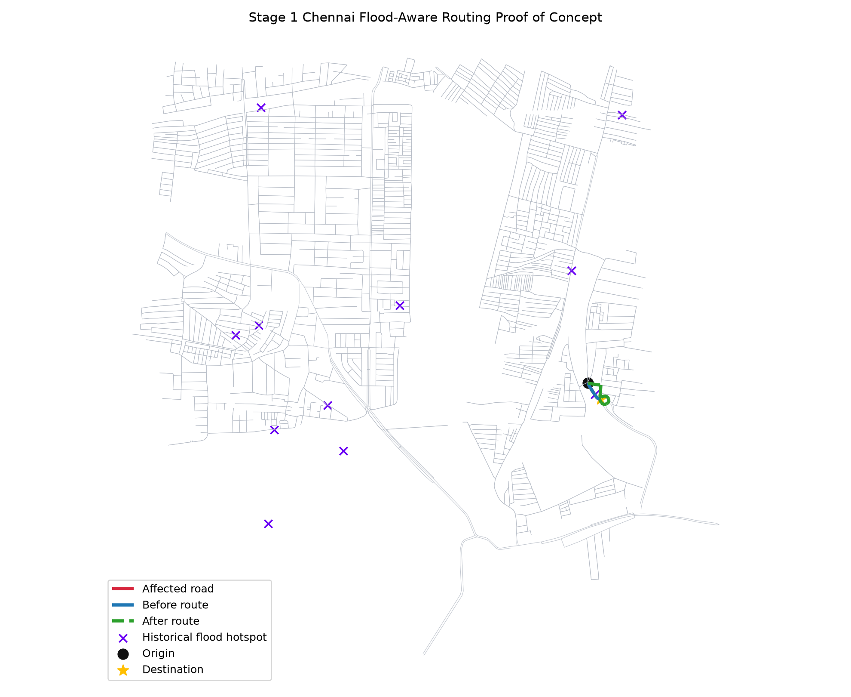
5. Stage 1 Demonstration Results & Map Evidence
EMPIRICAL RESULTS
Visual proof of Dijkstra route switching after road disruption
327
15
Flood Hotspot Points
Affected Road Edges
14.63s
34.61s
Before Route Cost
After Detour Cost
• Target Disrupted Edge: Kannan Street segment (9992430988, 9992430963).
• Before Route Path: Direct single-edge traversal (Nodes: 9992430988 -> 9992430963).
• After Route Detour: 9-node alternate path via surrounding unflooded local streets.
• Routing Outcome: Dijkstra successfully avoids blocked edge and finds minimal travel-time detour.
Rohit Michael Raj | Reg No: 24BCE5108
Stage 1 POC | Slide 6
Notes:
[KEY PRESENTATION TALKING POINTS]
• Point to the generated map image on the left.
• Highlight the numbers: 327 flood points loaded, 15 affected edges found.
• Before disruption: direct route takes 14.63 seconds.
• After disruption: Dijkstra detours around Kannan Street, taking 34.61 seconds across 9 nodes.
• This proves the algorithm works dynamically!

Slide 7
6. Code Architecture, Artifacts & Test Validation
VALIDATION
Clean modular repository design supported by automated unit tests
Modular Code Engine
Generated Output Artifacts
Automated Test Suite
• src/chennai_routing/data/ - flood.py: KML parser & downloader - osm.py: OSMnx road graph loader • src/chennai_routing/preprocessing/ - geospatial.py: CRS & KDTree mapper • src/chennai_routing/models/ - capacity.py: Road state multipliers - bpr.py: BPR cost function engine • src/chennai_routing/routing/ - dijkstra.py: Dynamic shortest path
• outputs/tables/stage1_affected_roads.csv Contains list of all 15 mapped affected edge IDs and coordinates. • outputs/tables/stage1_route_summary.csv Before vs after route node sequences & travel-time costs. • outputs/tables/stage1_summary.json Machine-readable execution metrics. • outputs/maps/stage1_before_after_route.png High-resolution route comparison map.
6 / 6 PASSED
Pytest suite verifies: 1. CRS Mismatch Protection 2. Spatial Nearest Edge Mapping 3. BPR Capacity Degradation 4. Blocked Edge Exclusion 5. Synthetic Graph Route Switching 6. Repository File Structure Integrity Verified command: pytest tests/test_stage1_poc.py
Rohit Michael Raj | Reg No: 24BCE5108
Stage 1 POC | Slide 7
Notes:
[KEY PRESENTATION TALKING POINTS]
• Explain that the codebase is modularly structured in src/chennai_routing.
• Highlight that all 6 pytest automated unit tests pass successfully.
• Emphasize that all output tables and map images are generated reproducibly via scripts/run_stage1_poc.py.

Slide 8
7. Model Assumptions & Honest Scope Boundaries
SCOPE BOUNDARIES
Maintaining academic honesty regarding proof-of-concept assumptions
1. Historical Evidence vs Live Telemetry
The flood dataset consists of 2015 historical hotspot points from OpenCity. It represents historical vulnerability evidence, not live real-time flood sensor feeds.
2. Controlled Stage 1 Disruption Demo
The selected mapped edge was marked BLOCKED strictly for a controlled proof-of-concept experiment to demonstrate Dijkstra route switching logic.
3. Model Parameters vs Calibrated Constants
Traffic volume (V=600) and capacity (C=1200) are initial transport model parameters, not physically calibrated sensor measurements.
4. Default Speed Fallback Handling
Road segments missing speed limit attributes in OpenStreetMap default to a visible 30 km/h baseline fallback.
Rohit Michael Raj | Reg No: 24BCE5108
Stage 1 POC | Slide 8
Notes:
[KEY PRESENTATION TALKING POINTS]
• Clearly explain model boundaries to Ma'am/evaluators.
• Emphasize academic honesty: we do not claim to have built a live flood predictor in Stage 1.
• Stage 1 is a controlled, reproducible proof of concept.

Slide 9
8. Stage 1 Summary & Transition to Stage 2
NEXT STEPS
Key deliverables achieved and immediate next roadmap milestone
STAGE 1 DELIVERABLES ACHIEVED (DONE)
IMMEDIATE NEXT MILESTONE: STAGE 2
✓ Downloaded real OpenStreetMap Chennai road graph via OSMnx.
✓ Ingested real OpenCity 2015 historical flood hotspots KML.
✓ Implemented CRS-safe metric projection & nearest-edge mapping.
✓ Built capacity degradation model & BPR travel-time engine.
✓ Verified dynamic Dijkstra route switching (14.6s -> 34.6s).
✓ Passed 6/6 automated pytest unit tests reproducibly.
• Robust Chennai Road Graph Module: Expand bounding box coverage to major Chennai arterial corridors with enhanced edge attribute parsing.
• Clean Functional Class Hierarchy: Categorize roads (Primary, Secondary, Residential) and parse explicit free-flow speeds.
• Graph Persistence Engine: Implement efficient GraphML saving/loading pipelines for fast graph retrieval.
• Preparation for Flood Susceptibility: Establish clean edge ID schemes ready for SRTM elevation & rainfall integration in Stage 3.
Rohit Michael Raj | Reg No: 24BCE5108
Stage 1 POC | Slide 9
Notes:
[KEY PRESENTATION TALKING POINTS]
• Summarize Stage 1 accomplishments: 100% complete and verified.
• Present the immediate next milestone: Stage 2 (Robust Chennai Road Graph).
• Conclude Stage 1 deck and open for questions!

