Slide 1
Employee Satisfaction Portal
Front-End — React js (version – 16+)
Clone the project from github, and then run “npm install”, once all the dependencies installed, run “npm start”
This command will start our frontend on port 3000, and when we load http://localhost:3000, it will open “Employee Satisfaction Index Portal”
This page presents multiple question to check if employee is satisfied/not satisfied/happy in the organization
Once employee enters answer for each questions in yes/no/sometime form and submit the response.
A call goes to backend service
Back-End — Spring Boot (version 3) with jdk 17 and gradle 7.6
Clone this project from github and import on any IDE as gradle project, once all the dependencies
installed then run main class as java application
At backend, the logic checks how many yes/no/sometime has entered and based on some calculation returns happy/satisfied/not satisfied as response back to the front-end.
Note :- both server must be running in order to see whole app working

Slide 2
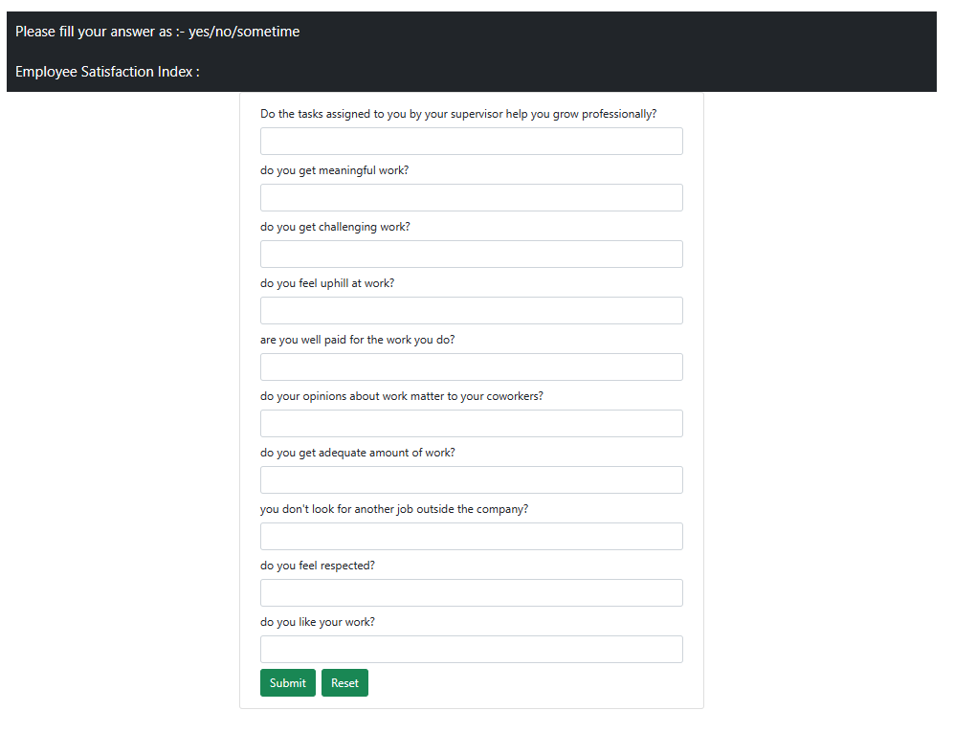
Front – End screen before submission

Slide 3
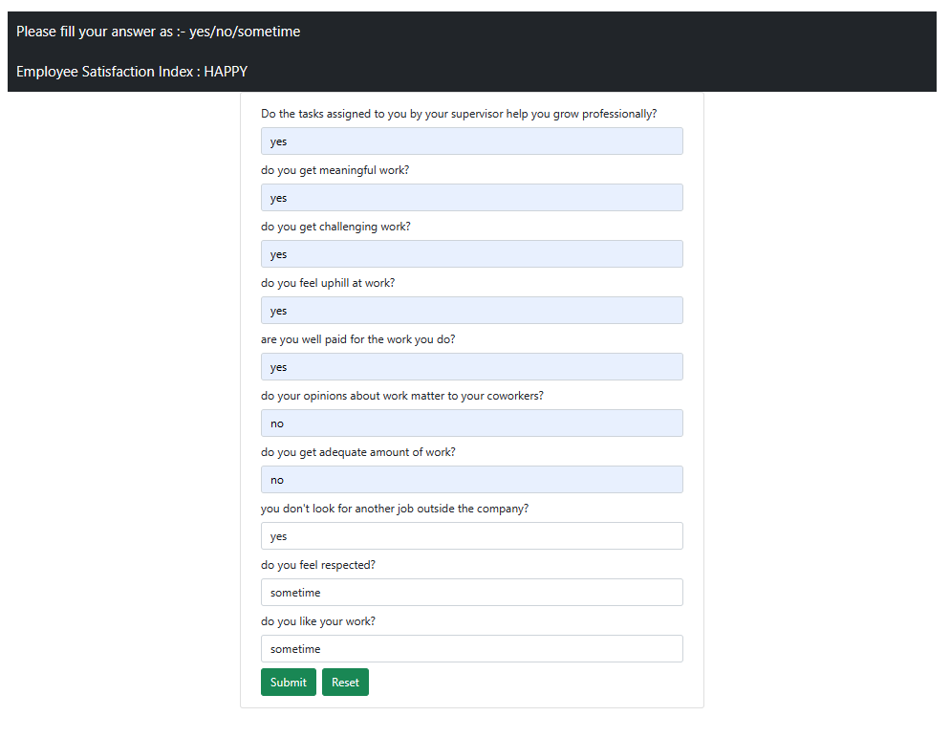
Front – End screen after submission

