Slide 1
How infective are ideas?

Slide 2
Motivation
Do ideas spread in academia based on merit, or on name recognition (individual or institution)? How do we filter shining ideas from the huge pool of papers?
People who should care:
Students applying to PhD programs
Professors who want to optimize career success
PhD students with FOMO

Slide 3
How do ideas spread?
Conversation/collaboration between researchers
Departmental seminars
Conferences
Browsing the internet
Questions:
Do “good” ideas spread faster?
Can we anticipate spread of future ideas based on current publication networks?

Slide 4
Measuring Idea Quality -- OpenReview
Conference: ICLR 2018
Paper quality = average review rating
Biased, since rejected papers aren’t published in proceedings

Slide 5
Institutional Prestige
Weighted sum of multiple metrics:
CSRankings (based average number of publications by faculty members in top venues)
US News & World Report rankings
Faculty placement rankings (Morgan et al, 2018)

Slide 6
Constructing a collaboration network
Data source: Microsoft Academic Graph (MAG)
Publications: Top AI/ML Conferences (2016-2020)
Computer Vision: ICCV, CVPR
ML: NeurIPS, ICML, ICLR, AAAI, IJCAI
NLP: COLING, EMNLP, ACL, EACL, NAACL
Data Mining: KDD, WWW
Edges placed between any pair coauthors in 2016-2020
Network has 66k nodes and 296k edges

Slide 7
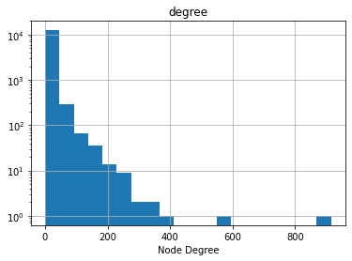
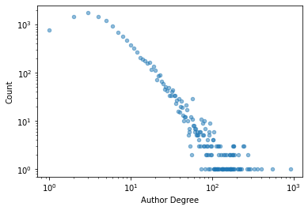
Collaboration Network Statistics

Slide 8
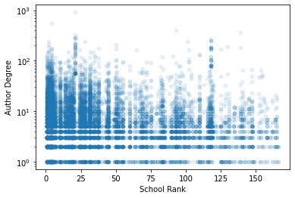
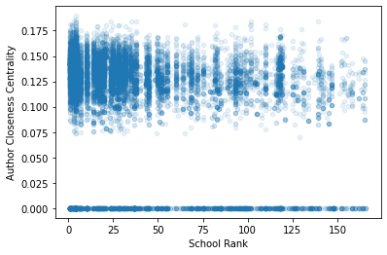
Collaboration Network Centralities

Slide 9
Actual idea spread
Consider papers A and B. An idea is transferred from A to B iff:
B cites A
10+ % of research key term overlap for A and B
10+ % of non-stopwords in abstracts for A and B
Yields 108k transferred ideas out of candidate 409k citations.

Slide 10
Simulating idea spread
Model: Discrete-time SIR
Network: Collaboration network
Starting infected: Authors of a single paper

Slide 11
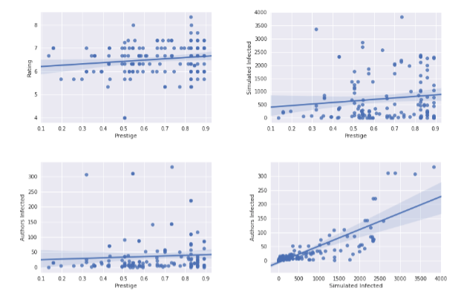
Results

Slide 12
Statistical Analysis -- OLS
Variable | Coefficient | P-Value
Rating | 1.132 | 0.777
Prestige | -13.924 | 0.392
Simulated epidemic size | 0.0587 | 0.000

Slide 13
What drives this?
Paper recommendations are egocentric
e.g. following someone on Google Scholar
Cognitive shortcuts
Easier to look at a name than read and evaluate a paper
Publication volume
Self-citing
Diminishing effort to additional publications

Slide 14
Questions?

