Slide 1
How infective are ideas?
Rohit Mujumdar and David Kartchner

Slide 2
Motivation
Lots of evidence of systemic bias towards highly ranked institutions in academia
Bias hurts everyone by excluding some groups and their ieas
Do ideas spread in academia based on merit, or on name recognition (individual or institution)?
How do we filter shining ideas from the huge pool of papers?
People who should care:
Students applying to PhD programs
Professors who want to optimize career success
PhD students with FOMO

Slide 3

Who should care?
Students applying to PhD programs
Professors who want to optimize career success
PhD students with FOMO
You!

Slide 4


How do ideas spread?
Conversation/collaboration between researchers
Departmental seminars
Conferences
Browsing the internet

Slide 5
Research Questions
Do “good” ideas spread faster than average ones?
Can we anticipate spread of future ideas based on current publication networks?
Do more prestigious institutions get more citations for papers of the same calibre?

Slide 6
Previous work
Use faculty hiring networks to model idea spread via researchers
More prestigious universities place many more faculty candidates
Simulated epidemics have higher reach from nodes at prestigious institutions
Unclear whether this is driven by name recognition or better students and research environment

Slide 7
Method
Create
Create metrics of paper quality and institutional prestige
Create
Create author collaboration network for idea spread
Simulate
Simulate epidemics on collaboration network to approximate spreadability
Compare
Compare simulations to empirical data

Slide 8

Measuring Idea Quality -- OpenReview
Venue: ICLR 2018
Double-blind review
Multiple years of follow-up data
Open to all types of deep learning
Paper quality = average review rating
Biased, since rejected papers aren’t published in proceedings

Slide 9
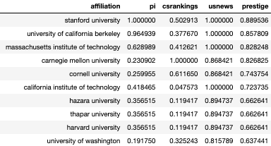
Institutional Prestige
Weighted sum of multiple metrics:
CSRankings (based average number of publications by faculty members in top venues)
US News & World Report rankings
Faculty placement rankings (Morgan et al, 2018)

Slide 10
Actual idea spread
Citation ML papers from top venues, 2018-present
Consider papers A and B. An idea is transferred from A to B iff:
B cites A
10+ % of research key term overlap for A and B
10+ % of non-stopwords in abstracts for A and B
Yields 108k transferred ideas out of candidate 409k citations.
Total influence of paper is count of authors in its descendants

Slide 11
Constructing a collaboration network
Data source: Microsoft Academic Graph (MAG)
Publications: Top AI/ML Conferences (2016-2020)
Computer Vision: ICCV, CVPR
ML: NeurIPS, ICML, ICLR, AAAI, IJCAI
NLP: COLING, EMNLP, ACL, EACL, NAACL
Data Mining: KDD, WWW
Edges placed between any pair coauthors in 2016-2020
Network has 66k nodes and 296k edges

Slide 12
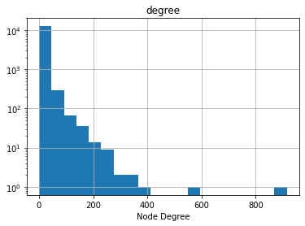
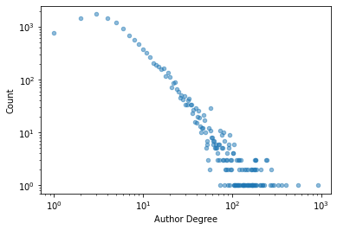
Collaboration Network Statistics

Slide 13
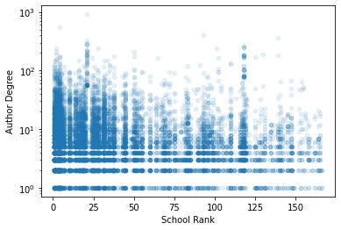
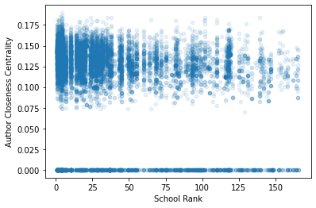
Collaboration Network Centralities

Slide 14

Simulating idea spread
Model: Discrete-time SIR
Network: Collaboration network
Patient Zero: Authors of a single paper
Analysis: OLS of empirical spread on prestige, rating, simulated spread

Slide 15
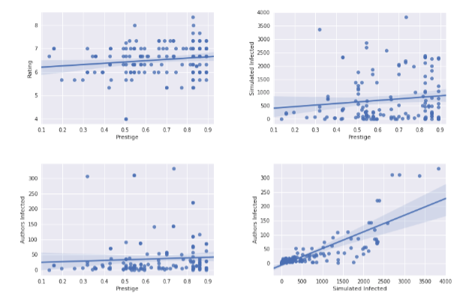
Data Trends

Slide 16
Statistical Analysis -- OLS
Variable | Coefficient | P-Value
Rating | 1.132 | 0.777
Prestige | -13.924 | 0.392
Simulated epidemic size | 0.0587 | 0.000

Slide 17
What does this mean?
Paper quality and prestige have little affect on idea uptake after accounting for the connections of its authors
Academic collaboration networks provide some proxy for idea reach in first few years after publication
When you look for papers, author is more important than institution

Slide 18
Potential Drivers
Paper recommendations are egocentric
e.g. following someone on Google Scholar
Cognitive shortcuts
Easier to look at a name than read and evaluate a paper
Publication volume
Self-citing
Diminishing effort to additional publications

Slide 19

Future work
More diverse data (additional CS venues, biomedicine, CORD-19)
Investigation of egocentric idea propagation
Wider scope of epidemiological models

Slide 20
Questions?

