Slide 1
Requirements
Requirements: Features of system or system functions used to fulfill system purpose.
Focus on customer’s needs and problem, not on the solutions.
Requirements Definition Document .
(written for customer).
Requirements Specification Document.
(written for programmer; technical staff).

Slide 2
Types of Requirements
Functional requirements:
input/output
processing.
error handling.
Non-functional requirements:
Physical environment (equipment locations, multiple sites, etc.).
Interfaces (data medium etc.).
User & human factors (who are the users, their skill level etc.).
Performance (how well is the system functioning).
Documentation.
Data (qualitative stuff).
Resources (finding, physical space).
Security (backup, firewall).
Quality assurance (max. down time, MTBF, etc.).

Slide 3
SRS must delineate
Inputs.
Outputs.
Functional Requirements.
Non-functional Requirements.
SRS should be/have
Consistent Internally and with existing documents.
Correct & complete w.r.t. satisfying customer needs.
Understandable to the users, customers, designers, & testers.
Capable of serving as a base for design & test.

Slide 4
Requirements Engineering
The process of eliciting, analyzing, documenting, and validating the services required of a system and the constraints under which it will be developed and operated.
Descriptions of these services and constraints are the requirements for the system.
Requirements may be high-level and abstract, or detailed and mathematical. (or somewhere in between)

Slide 5
Requirements Engineering
The hardest single part of building a software system is deciding precisely what to build. No other part of the conceptual work is as difficult… No other part of the work so cripples the resulting system if done wrong. No other part is more difficult to rectify later.
– Fred Brooks, “No Silver Bullet…”

Slide 6
RE Includes
Discovery/Identification/Elicitation.
Refinement/Analysis: Identify inconsistencies, omissions, defects etc.
Modeling: Functional (DFD), Behavioral (STD), Informational (DD), Other.
Specifications: Writing requirements formally (SRS Document).
Without well documented SRS
Developers do not know what to build.
Customers do not know what to expect.
No way to validate whether build system satisfies the requirements.

Slide 7
Software Requirements Analysis Phases
Problem recognition.
Evaluation and synthesis: focus is on what not how.
Modeling.
Specification.
Review.

Slide 8
Requirements Engineering Process

Slide 9
Feasibility Study
Economic Feasibility
Cost Benefit Analysis.
Technical Feasibility
Hardware/Software/People etc.
Legal Feasibility
Alternatives
there are always more than one way to do it.

Slide 10
Requirements Analysis
Software engineering task that bridges the gap between system requirements engineering and software design.
Provides software designer with a model of
system information
function
behavior
Model can be translated to data, architectural, and component-level designs.
Expect to do a little bit of design during analysis and a little bit of analysis during design.

Slide 11
Requirement Validation
Correct?
Consistent?
Complete?
Each requirement describes something actually needed by the customer.
Requirements are verifiable (testable) ?
Requirements are traceable.

Slide 12
Requirements Definition Document
General purpose of document.
System background and objectives.
Description of approach.
Detailed characteristics of proposed system (data & functionality).
Description of operating environment.

Slide 13
Software Requirement Elicitation
Most difficult, critical, error-prone, and communication intensive aspect of s/w development.
Requirements actually reside in the minds of the users.
Developers and users have different mind set, expertise, and vocabularies.
Communication gap between customers and developers may lead to inconsistencies, misunderstanding and omissions of requirements.
Customers have solid background in their domain but have a little knowledge of s/w development process.
Developers have experience of developing s/w but have little knowledge of everyday environment of the customer.

Slide 14
Software Requirements Elicitation Techniques
Customer Meetings/Interview: Most commonly used technique.
Brainstorming.
Facilitated Application Specification Technique (FAST).
Quality Function Deployment (QFD).
Use Case Diagrams.

Slide 15
Software Requirements Elicitation Techniques
Customer meetings are the most commonly used technique.
Meetings/Interviews may be open ended or structured.
Use context free questions to find out
Customer's goals and benefits.
Identify stakeholders.
Gain understanding of problem.
Determine customer reactions to proposed solutions.
Assess meeting effectiveness.
Interview cross section of users when many users are anticipated.

Slide 16
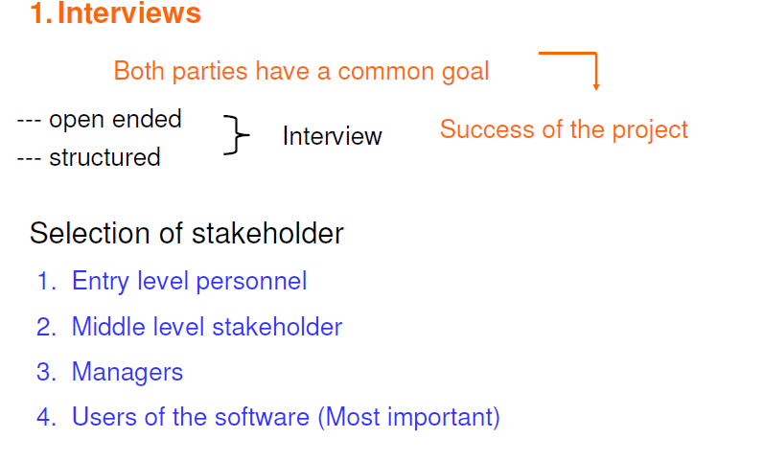
Interviews

Slide 17
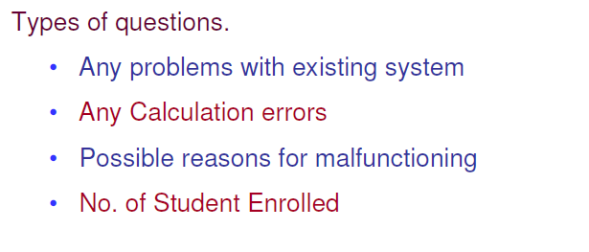
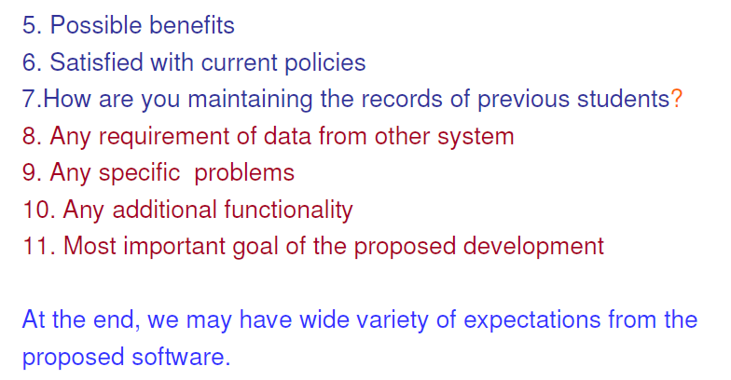

Slide 18
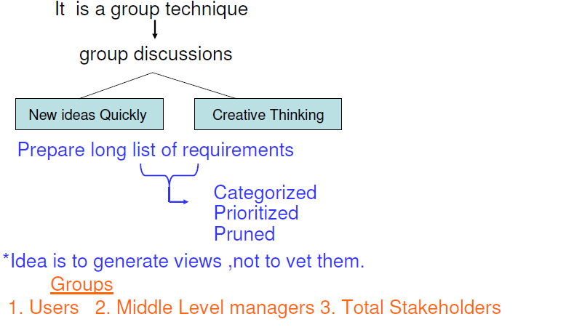
Brainstorming

Slide 19
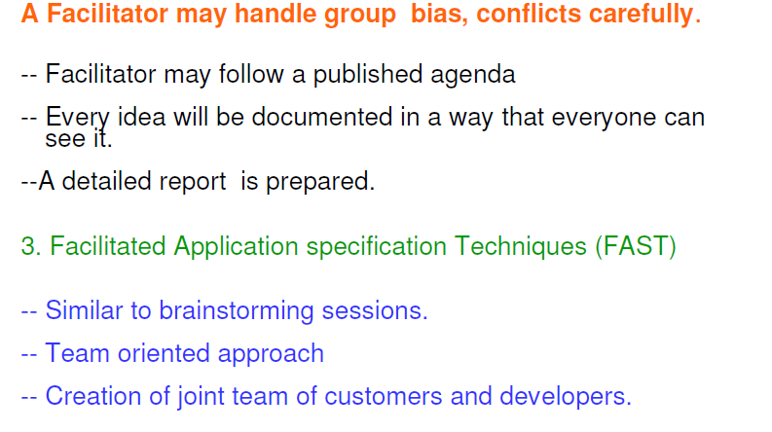

Slide 20
F.A.S.T. - 1
Facilitated Application Specification Technique
Meeting between customers and developers at a neutral site (no home advantage).
Goals
Identify the problem.
Propose elements of solution.
Negotiate different approaches.
Specify preliminary set of requirements.

Slide 21
F.A.S.T. - 2
Rules for participation and preparation are established ahead of time.
Agenda suggested
brainstorming encouraged
Facilitator appointed.
Definition mechanism
sheets, flipcharts, wallboards, stickers, etc.

Slide 22
F.A.S.T.-3
Each FAST attendee is asked to prepare a list of objects that are part of environment that surround the system, produced by the system, used by the system.
Every attendee is asked to make a list of services (processes or functions that manipulate or interact with the objects).
List of constraints (cost, size) & performance criteria (speed, accuracy, response etc.)

Slide 23
F.A.S.T.- 4
Each attendee presents the list of objects, services, constraints & performance.
Prepare a common list of objects, services, constraints and performance.
Discuss the list & prepare a consensus list.
Divide the whole team into sub-teams to prepare mini specs for one or more entries of the list.
Present the mini specs. Addition/deletion is permitted.
Create a list of validation criteria.
Designate a team to write complete draft specs.

Slide 24
Quality Function Deployment (QFD)
Is a quality management technique that translates the needs of the customer into technical requirements.
Concentrates on maximizing customer satisfaction.
Emphasizes on what is valuable to the customers and then deploys these values during SE process.
QFD generally identifies three types of requirements.

Slide 25
QFD
Customer’s needs imply technical requirements:
Normal requirements: If these requirements are present the customer is satisfied (minimal functional & performance).
Expected requirements: These are implicit and so fundamental in nature that customer does not explicitly states them (important implicit requirements, i.e. ease of use, learn, and operate).
Exciting requirements: Beyond the customers expectation (may become normal requirements in the future, highly prized & valued).

Slide 26
Q.F.D.
Function Deployment:
Determines value of required function.
Information Deployment:
Focuses on data objects and events produced or consumed by the system.
Task Deployment:
Product behavior and implied operating environment.

Slide 27
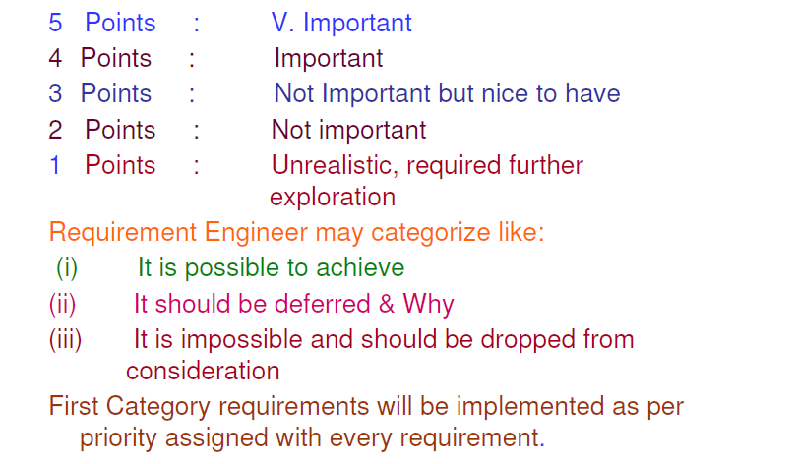
QFD

Slide 28
Q.F.D.
Value Analysis makes use of
Customer interviews.
Observations.
Surveys.
Historical data.
to create
Customer Voice Table (Table of requirements).
extract expected requirements.
derive exciting requirements.

Slide 29
Use Case Diagrams
Scenarios that describe how the product will be used in specific situations.
Written narratives that describe the role of an actor (user or device) as it interacts with the system.
Use-cases designed from the actor's (End user) point of view.
Not all actors can be identified during the first iteration of requirements elicitation.
But it is important to identify the primary actors before developing the use-cases.

Slide 30
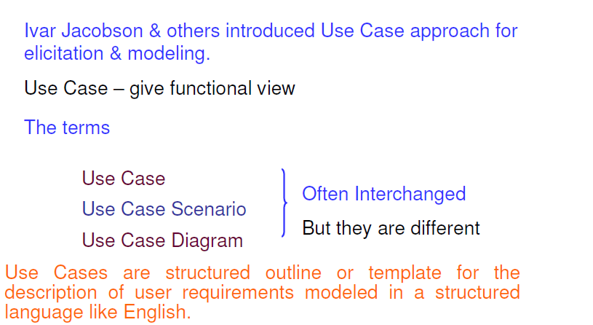
Use Case Diagrams

Slide 31
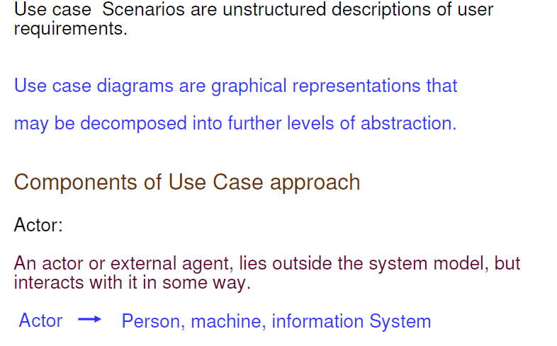
Use Case Diagrams

Slide 32
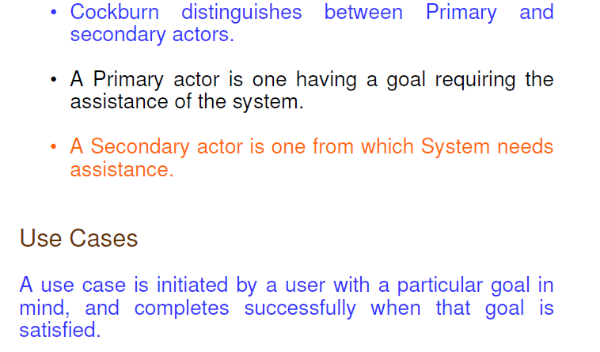
Use Case Diagrams

Slide 33
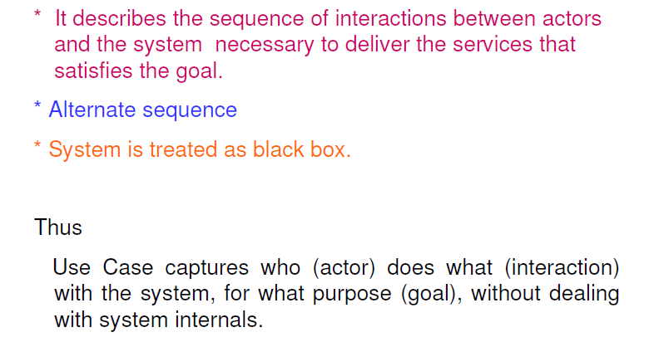
Use Case Diagrams

Slide 34
Use Case Template
Brief Description: Background
Actors that interact with the use case
Flow of events
Basic: Primary events that occur when use case is executed.
Alternative: Any subsidiary events that occur in use case.
Preconditions
Post conditions
Special Requirements
Extension Points

Slide 35
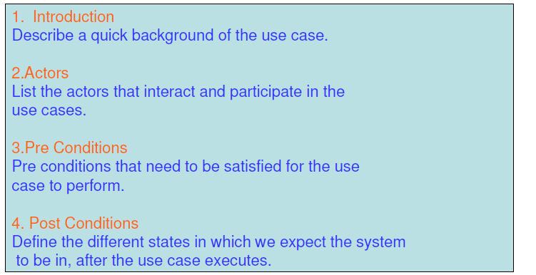
Use Case Template

Slide 36
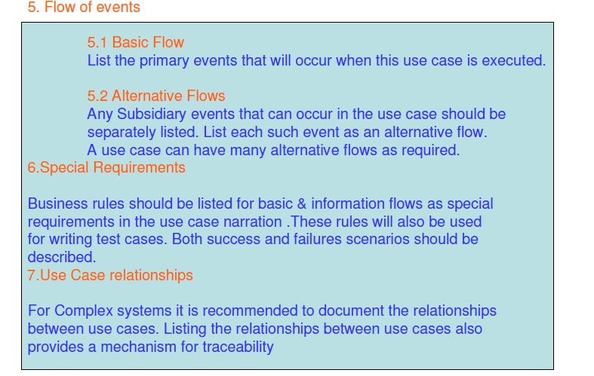
Use Case Template

Slide 37
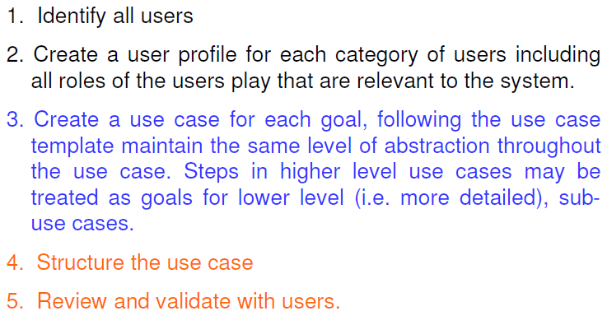
Use Case Guidelines

Slide 38
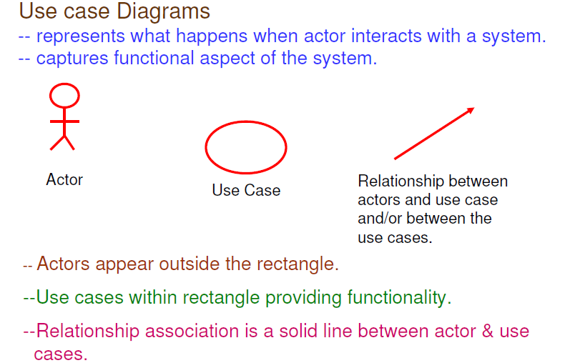
Use Case Conventions

Slide 39
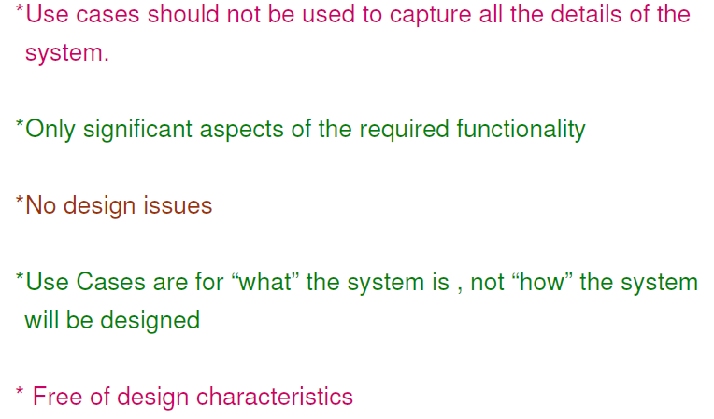
Use Case Conventions

Slide 40
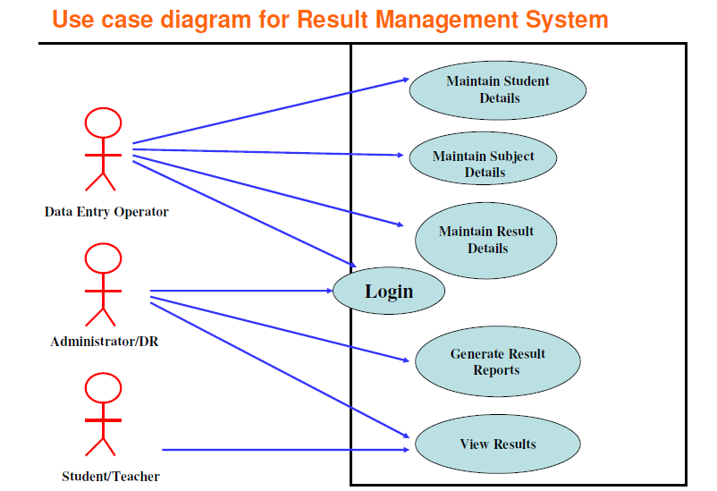

Slide 41
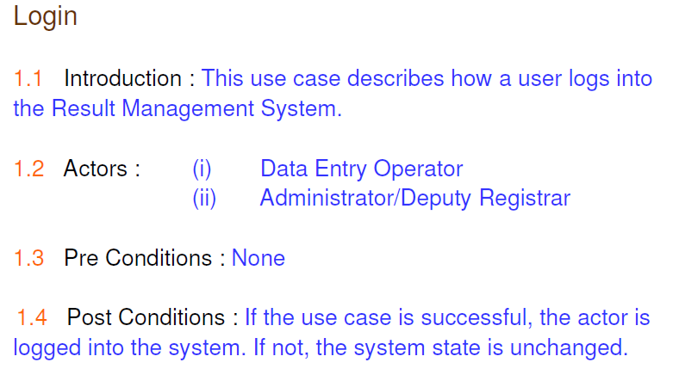
Use Case Description
------- User Name, Role, Password

Slide 42
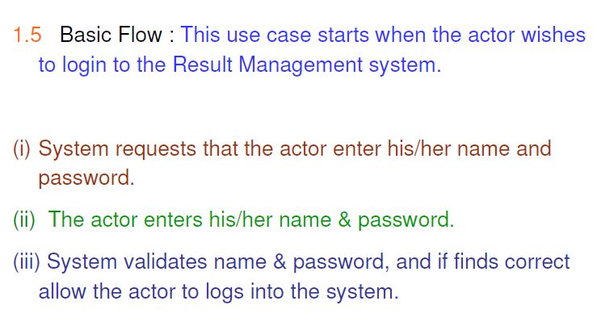
Use Case Description

Slide 43
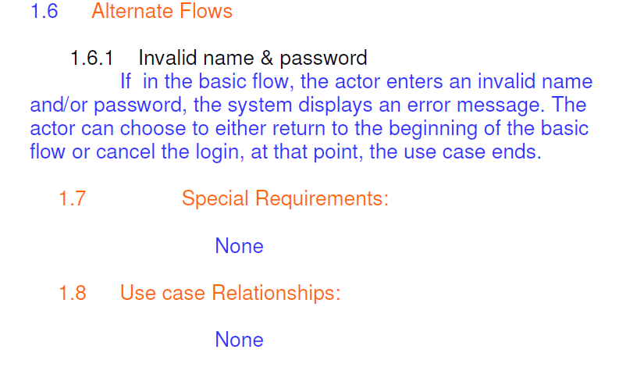
Use Case Description

Slide 44
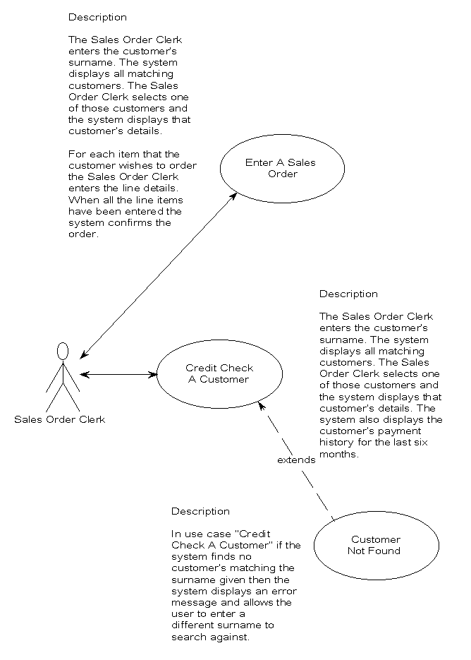

Slide 45
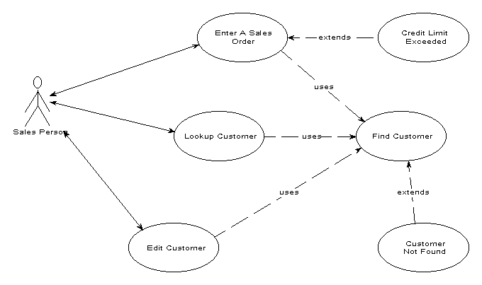

Slide 46
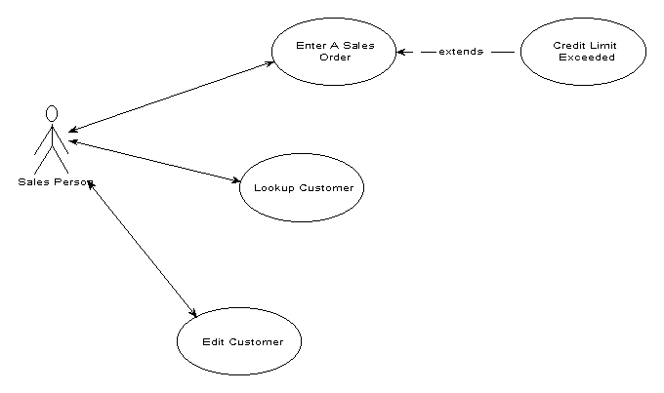

Slide 47
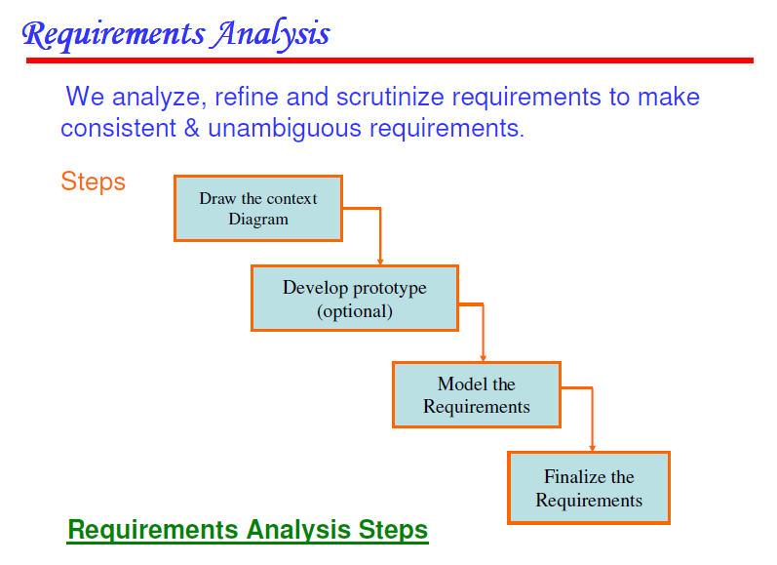

Slide 48
Analysis Principles
Information domain of problem must be presented & understood.
Models depicting system information, functions, and behavior should be developed.
Models and problems must be partitioned in a manner that uncovers detail in layers.
Analysis proceeds from essential information toward implementation details.
Must be traceable.

Slide 49
Information Domain
Encompasses all data objects that contain numbers, text, images, audio, or video.
Information Content or Data Model (ERD)
Shows the relationships among the data and control objects that make up the system.
Information Flow (DFD)
Represents manner in which data and control objects change as each moves through system.
Information Structure
Representations of the internal organizations of various data and control items (DD).

Slide 50
Requirements Analysis Modeling
Data Model (ERD)
Shows relationships among system objects.
Functional Model (DFD)
Description of the functions that enable the transformations of system objects.
Behavioral Model (STD)
Manner in which software responds to events from the outside world.

Slide 51
Analysis Model Objectives
Describe what the customer requires.
Establish a basis for the creation of a software design.
Devise a set of requirements that can be validated once the software is built.

Slide 52
Analysis Model Elements
Data Dictionary: Contains the descriptions of all data objects consumed or produced by the software.
Entity Relationship Diagram (ERD): Depicts relationships between data objects.
Data Flow Diagram (DFD): Provides an indication of how data are transformed as they move through the system; also depicts functions that transform the data flow. A function is represented in a DFD using a process specification or PSPEC.

Slide 53
Analysis Model Elements
State Transition Diagram (STD)
indicates how the system behaves as a consequence of external events.
states are used to represent behavior modes.
arcs are labeled with the events triggering the transitions from one state to another.
control information is contained in control specification or CSPEC.

Slide 54
Data Dictionary
DD are repositories to store information about all data items defined in DFD. Entities are
Name: Primary name for each data or control item, data store, or external entity
Alias: Alternate names for each data object
Where/How used: Listing of processes that use the data or control item and how it is used.
input to process
output from process
as a store
as an external entity
Content Description: Notations to represent content.
Supplementary Information: Other data type information, preset values, restrictions, limitations, etc.

Slide 55
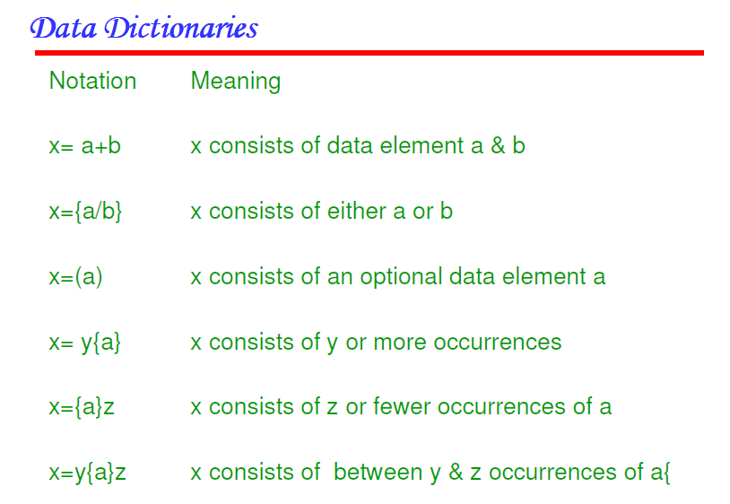

Slide 56
Example
name: telephone number
aliases: none
where used/how used: dial phone (input)
assess against set−up (output)
description:
telephone number = [local number | long distance number]
local number = prefix + access number
long distance number = 1 + area code + local number
area code = [800 | 888 | 561]
prefix = *a three digit number that never starts with 0 or 1*
access number = *any four digit string*

Slide 57
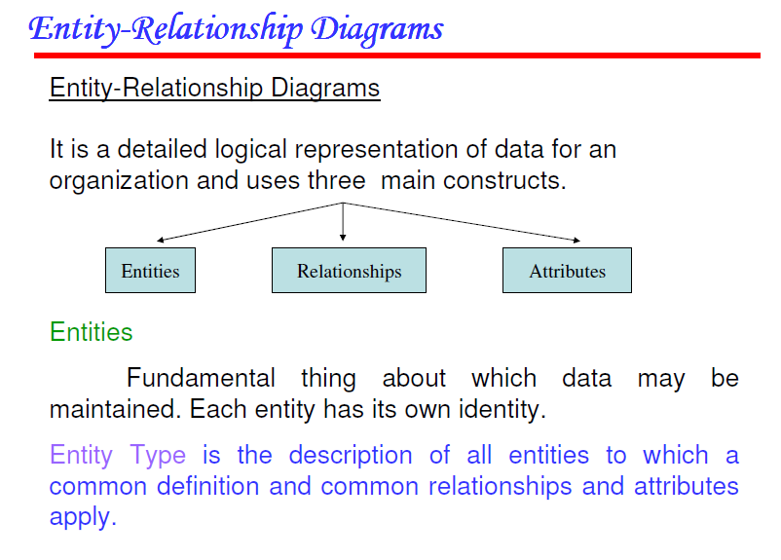

Slide 58
ERD Elements
Data Object/Entity: Any person, organization, device, or software product that produces or consumes information.
Attributes: Name a data object instance, describe its characteristics, or make reference to another data object.
Relationships: Indicate the manner in which data objects are connected to one another.

Slide 59
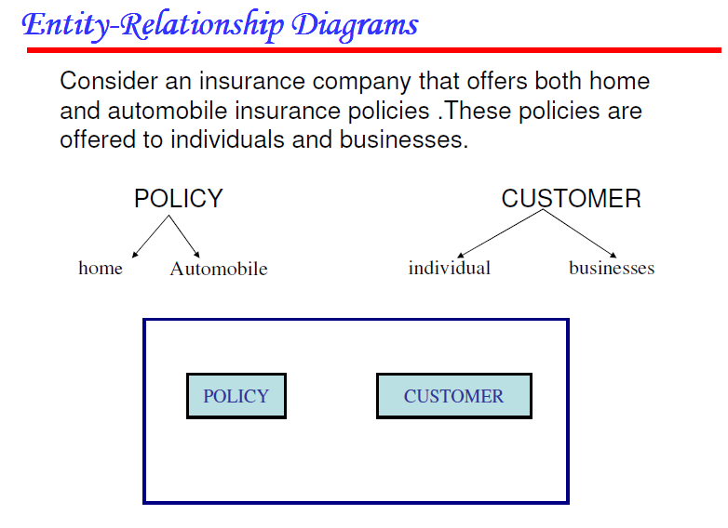

Slide 60
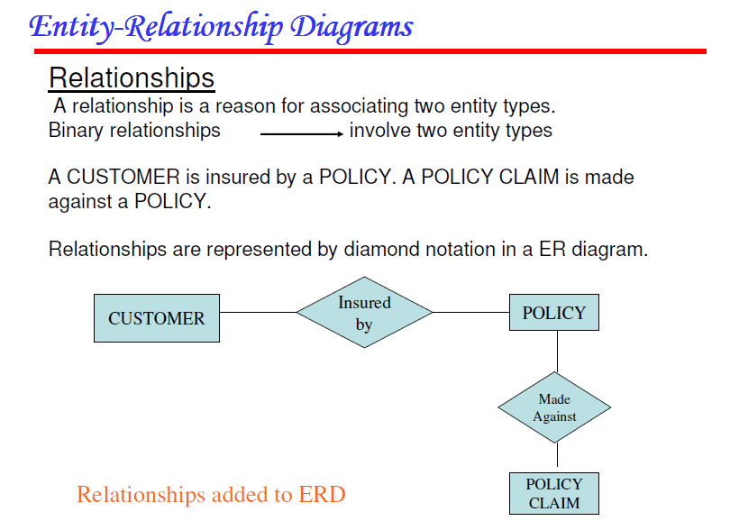

Slide 61
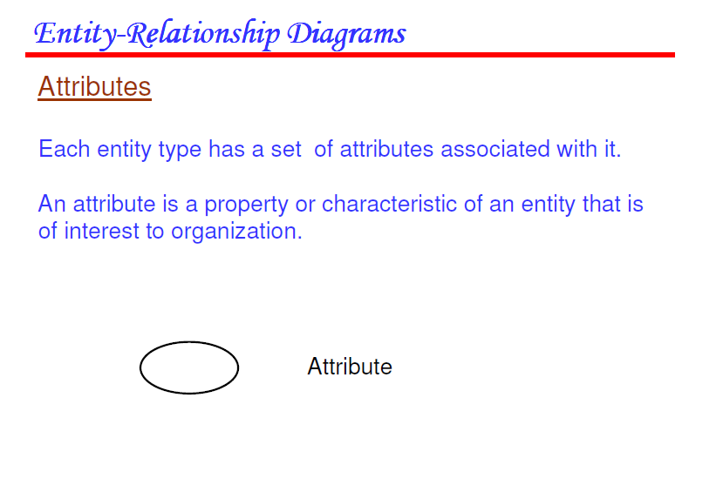

Slide 62
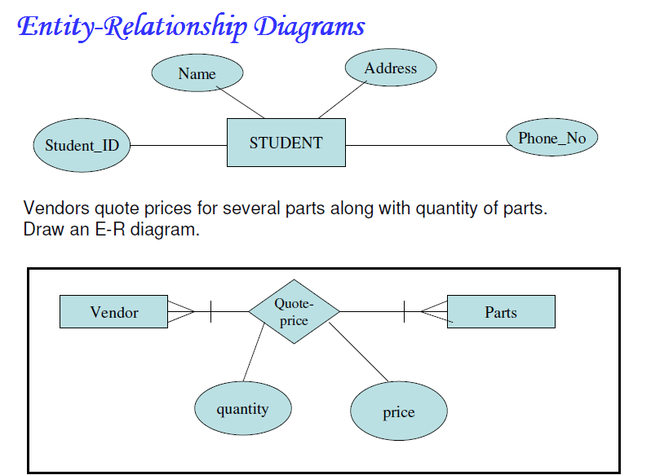

Slide 63
Cardinality and Modality
Degree: Refers to the number of entities participating in the relationship.
Cardinality: Specifies how the number of occurrences of one object are related to the number of occurrences of another object (1:1, 1:N, M:N)
Modality: Represents the nature of relationship.
zero (0) for an optional object relationship
one (1) for a mandatory relationship

Slide 64
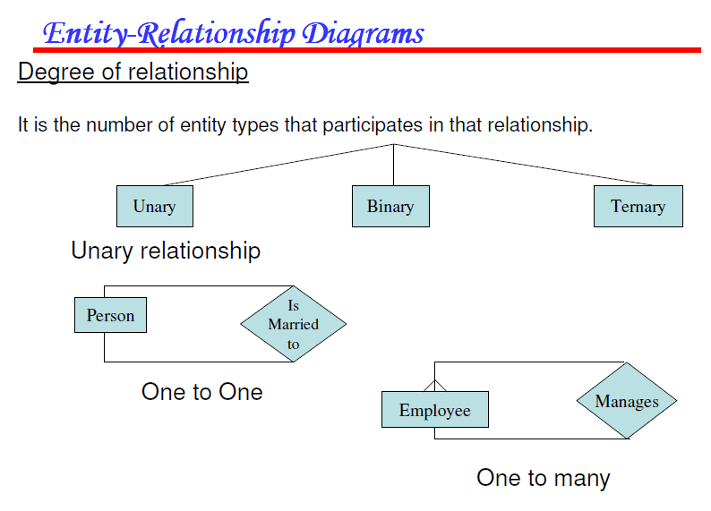

Slide 65
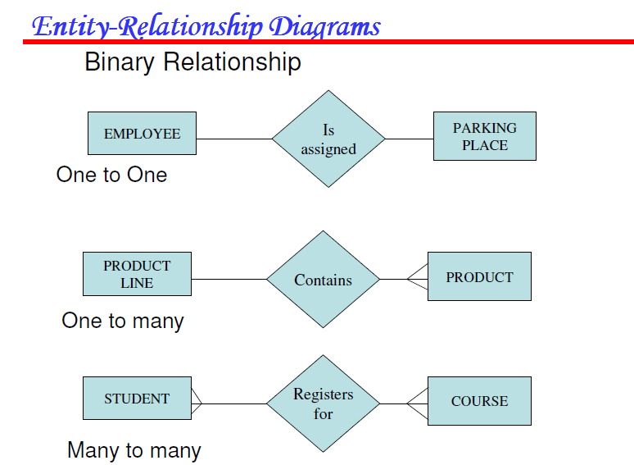

Slide 66
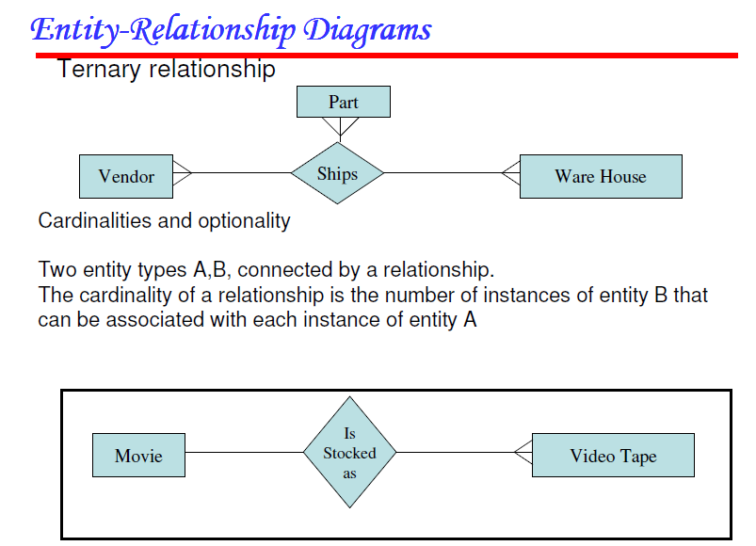

Slide 67
Creating ER Diagrams
Customer is asked to list "things" that application addresses.
These things evolve into input objects, output objects, and external entities.
Analyst and customer define connections among the objects.
One or more object-relationship pairs is created for each connection.
Cardinality and modality are determined for an object-relationship pair.
Attributes of each entity are defined.
ERD is reviewed and refined.

Slide 68
Functional Modeling DFD
Shows the relationships among external entities, process or transforms, data items and data stores.
DFD’s only show the flow of data through the software system and can’t show procedural details like conditionals or loops.
Refinement from one DFD level to the next should follow approx. 1:5 ratio.
This ratio will reduce as the refinement proceeds.
To model real-time systems, structured analysis notation must be available for time continuous data and event processing.

Slide 69
Creating DFD
Level 0 DFD should depict the system as a single bubble with Primary input and output.
Refinement should begin by consolidating candidate processes, data objects and data stores to be represented at the next level.
Label all arrows with meaningful names.
Information flow must be maintained from one level to the other.
Refine/explore one bubble at a time.
Write PSPEC for each bubble in the final DFD.

Slide 70
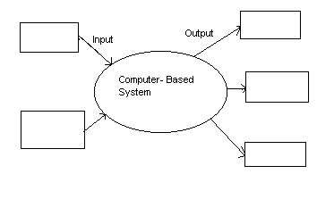
Dataflow Diagram
Rectangle = information producer or consumer
Oval = software element that transforms information
Arrow = direction of data item flow
information repository (not shown)

Slide 71
Graphical Notation
Bubbles represent functions.
Arcs represent data flows.
Open boxes represent persistent store.
Closed boxes represent I/O interaction.

Slide 72
Example
specifies evaluation of
(a + b) * (c + a * d)

Slide 73
A Construction “Method”
1. Start from the “context” diagram

Slide 74
A Construction “Method”
2. Proceed by refinements until you reach “elementary” functions (preserve balancing)

Slide 75
A Library Example

Slide 76
Refinement of “Get a book”

Slide 77
Patient monitoring systems
The purpose is to monitor the patients’ vital factors--blood,
pressure, temperature, …--reading them at specified frequencies
from analog devices and storing readings in a DB. If readings fall
outside the range specified for patient or device fails an alarm
must be sent to a nurse. The system also provides reports.

Slide 78
A refinement

Slide 79
More Refinement

Slide 80
Behavioral Modeling (STD)
State transition diagrams represent the system states and events that trigger state transitions.
STD's indicate actions taken as consequence of a particular event.
A state is any observable mode of behavior.
Control Flow Diagrams (CFD) can also be used for behavioral modeling.

Slide 81
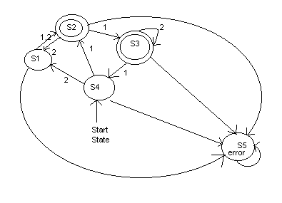
State Transition Diagram

Slide 82
STD Elements
STD = { S, I, F, S0, δ }
S is the set of machine states.
S₀ ∈ S S₀ is the Start state.
F ⊆ S set of final state(s).
I: Set of input symbols.
Transition function δ is defined as:
δ (S_{i} , I_{j}) → S_{j}

Slide 83
Example: A Lamp

Slide 84
FSMs as Recognizers

Slide 85
STD of Washing Machine
Idle
Stop/Enable Filling
Stop/Disable Filling
Filling
Stop/Disable Washing
Spin-dry done/Disable Spin-dry
Washer Filled/Enable Wash
Washing
Washing Over/Enable Spin-dry
Spin-dry

Slide 86
Elements of Analysis Model
Data-object Description
Data/Information Model
ERD
Data Dictionary
Process Specifications
DFD
Functional Model
STD
Control Specifications
Behavioral Model

Slide 87
SRS Document Format
INTRODUCTION
System Reference
Overall Description
Software Project Constraints
INFORMATION DESCRIPTION
Information Flow Representation
Data Flow
Control Flow
Information Content Representation (DD)
System Interface Description
FUNCTIONAL DESCRIPTION
Functional Partitioning
Functional Description
Process Narrative
Restrictions/Limitations
Performance Requirements
Design Constraints
Supporting Diagrams

Slide 88
SRS Document Format
CONTROL DESCRIPTION
Control Specifications
Design Constraints
BEHAVIORAL DESCRIPTION
System States
Events and Actions
VALIDATION CRITERIA
Performance Bounds
Classes of Tests
Expected Software Response
Special Considerations
BIBLIOGRAPHY and APPENDIX

Slide 89
Decision Table
Notation that translates complex combination of conditions and corresponding actions into tabular form.
It consists of condition stubs and condition rules as well as action stubs and action rules.
Rules
Condition Stubs
1
2
Action Stubs
1
2

Slide 90
What is Estimation?
The project manager must set expectations about the time required to complete the software among the stakeholders, the team, and the organization’s management.
If those expectations are not realistic from the beginning of the project, the stakeholders will not trust the team or the project manager.

Slide 91
Software Project Estimation
Both before and during a project we need to be able to estimate the resources that the project will consume in the future.
These estimates are used to allocate resources and budget and to plan the schedule.
Estimates are typically based on historical data and on various rules and heuristics to determine the size and scope of a project from very incomplete information.
An organization must record accurate cost and time information about its projects if it is going to do serious estimation for future projects.

Slide 92
Estimation Methods
• Comparison with historical projects
• Delphi - iterative consensus of experts
• Weighed average
• Intuition and experience
• Estimation models

Slide 93
Estimation Options
Delay estimation until late in the project.
Base estimates on similar projects already completed.
Delphi - iterative consensus of experts
Weighed average
Use simple decomposition techniques to estimate project cost and effort.
Use empirical models for software cost and effort estimation.
Automated tools may assist with project decomposition and estimation.

Slide 94
Weighed Average (Expert Guessing)
A = The most pessimistic estimate.
B = The most likely estimate.
C = The most optimistic estimate.
Ê = (A + 4B + C)
6
(Weighted average; where Ê = estimate).
May be used in combination with the decomposition technique

Slide 95
Decomposition Technique
Divide the overall project into modules
Select an estimation variable (LOC,FP)
Calculate/estimate individual variable
Find the total value of estimated variable
Use baseline metric ($/LOC, LOC/PM) to estimate cost or effort.
Total value of variable (LOC,FP) is used with baseline data to determine cost/effort
Value of the FP, LOC for every module is used with the baseline data to determine cost/effort for every individual component which are finally added.

Slide 96
Decomposition Technique (Example)
Module | a | b | c | e | $/LOC | LOC/PM | $ | PM
M1 | n11 | n12 | n13 | n1 | c1 | L1 | R1 | P1
M2 | n21 | n22 | n23 | n2 | c2 | L2 | R2 | P2
M3 | n31 | n32 | n33 | n3 | cΣ3 | L3 | R3 | P3
Mk | nk1 | nk2 | nk3 | nk | ck | Lk | Rk | Pk
Total |  |  |  | Σni |  |  | ΣRi | ΣPi

Slide 97
Double Decomposition
Cost and efforts can also be estimated directly without estimating LOC and FP
For every component estimate efforts required for every phase of development for the component.
Find the prevailing market rates.
Calculate the cost of the product by multiplying labor rates with estimated efforts for each phase and finally add them all.

Slide 98
Double Decomposition (Example)
Module | RA | DE | CD | TS | Total
M1 | R1 | D1 | C1 | T1 | E1=R1+D1+C1+T1
M2 | R2 | D2 | C2 | T2 | E2=R2+D2+C2+T2
M3 | R3 | D3 | C3 | T3 | E3=R3+D3+C3+T3
Mk | Rk | Dk | Ck | Tk | Ek=Rk+Dk+Ck+Tk
Total | ΣRi | ΣDi | ΣCi | ΣTi | E= ΣEi (Estimated Efforts)
Rate $ | L1 | L2 | L3 | L4
Cost $ | P1 | P2 | P3 | P4 | ΣPi (Estimated Cost)

Slide 99
Empirical Estimation Models
Experiential Models
Typically derived from regression analysis of historical software project data with estimated person-months as the dependent variable.
Static Estimation Model
Does not include time as an independent variable.
Constructive Cost Model (COCOMO)
Dynamic Estimation Models
Usually takes time or development phase into account.
Software Equation Model.

Slide 100
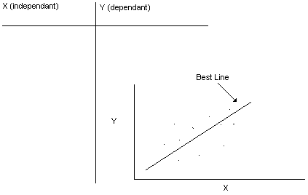
Regression

Slide 101
Correlation and Regression
Mean = Σ(x_{i})/n
Variance
σ_{x}² = Σ(x_{i}²)/n - (mean_{x})²
Covariance
μ_{xy} = Σ(x_{i} y_{i})/n – (mean_{x})(mean_{y})
Correlation
r = μ_{xy} / σ_{x} σ_{y}
Regression
y = mx + b
m = μ_{xy} / (σ_{x})²
b = mean_{y} – m * mean_{x}

Slide 102
Wideband Delphi
Wideband Delphi is a process that a team can use to generate an estimate
The project manager selects an estimation team, and gains consensus among that team on the results
Wideband Delphi is a repeatable estimation process because it consists of a straightforward set of steps that can be performed the same way each time

Slide 103
Delphi Technique (Summary)
Group of experts, make "secret" guesses.
"secret" guesses are used to compute group average.
Group average is presented to the group.
Group, once again makes "secret" guesses.
Individual guesses are again averaged.
If new average is different from previous, then go to step 4.
Otherwise Ê = new average.

Slide 104
The Wideband Delphi Process
Step 1: Select the team
The project manager selects the estimation team and a moderator. The team should consist of 3 to 7 project team members.
The moderator should be familiar with the Delphi process, but should not have a stake in the outcome of the session if possible.
If possible, the project manager should not be the moderator because he should ideally be part of the estimation team.

Slide 105
The Wideband Delphi Process
Step 2: Kickoff Meeting
The project manager must make sure that each team member understands the Delphi process, has read the vision and scope document and any other documentation, and is familiar with the project background and needs.
The team brainstorms and writes down assumptions.
The team generates a WBS with 10-20 tasks.
The team agrees on a unit of estimation.

Slide 106
The Wideband Delphi Process
Step 3: Individual Preparation
Each team member independently generates a set of preparation results.
For each task, the team member writes down an estimate for the effort required to complete the task, and any additional assumptions he needed to make in order to generate the estimate.

Slide 107
The Wideband Delphi Process
Step 4: Estimation Session
During the estimation session, the team comes to a consensus on the effort required for each task in the WBS.
Each team member fills out an estimation form which contains his estimates.
The rest of the estimation session is divided into rounds during which each estimation team member revises his estimates based on a group discussion. Individual numbers are not discussed.

Slide 108
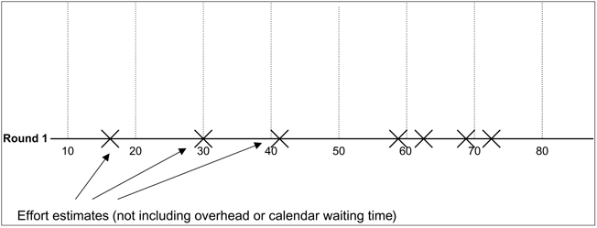
The Wideband Delphi Process
Step 4: Estimation Session (continued)
The moderator collects the estimation forms and plots the sum of the effort from each form on a line:

Slide 109
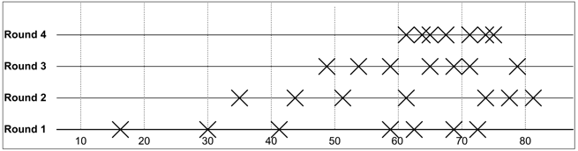
The Wideband Delphi Process
Step 4: Estimation Session (continued)
The team resolves any issues or disagreements that are brought up.
Individual estimate times are not discussed. These disagreements are usually about the tasks themselves. Disagreements are often resolved by adding assumptions.
The estimators revise their individual estimates. The moderator updates the plot with the new total.

Slide 110
The Wideband Delphi Process
Step 4: Estimation Session (continued)
The moderator leads the team through several rounds of estimates to gain consensus on the estimates. The estimation session continues until the estimates converge or the team is unwilling to revise estimates.
Step 5: Assemble Tasks
The project manager works with the team to collect the estimates from the team members at the end of the meeting and compiles the final task list, estimates and assumptions.
Step 6: Review Results
The project manager reviews the final task list with the estimation team.

Slide 111
Estimation Models

Slide 112
SEL Model
Static Single Value Model
E = 1.4* S ^{0.93}
D = 4.6* S ^{0.26}
E is estimated in Person Months, Duration in Months and Size in KLOC

Slide 113
Walston and Felix Model
Static Multi Variable Model
E = 5.25 * S ^{0.91}
D = 4.1* S ^{0.36}
Estimation of S is itself based on composite productivity index
I = Σ w_{i *} x_{i}

Slide 114
COCOMO - I
E = a S^{b} * m(x) PM, S: KLOC
D = c E^{d} * m(x) Months
BASIC
MODE
a
b
c
d
Organic
2.4
1.05
2.5
0.38
Semidetached
3.0
1.12
2.5
0.35
Embedded
3.6
1.20
2.5
0.32

Slide 115
Types of projects
Organic: Small team of experienced developers, familiar & in house environment, small project size (2-50 KLOC), little innovation, deadline not tight.
Semidetached: Medium project size (50-300 KLOC), medium size team, average team experience on similar projects, innovation, deadline and familiarity with similar projects as medium.
Embedded: Large projects (above 300 KLOC), Real time systems, complex interfaces, Little previous experience, significant innovation, tight deadline, complex h/w and customer interface required.

Slide 116
Basic COCOMO
Computes software development effort (and cost) as a function of program size, expressed in estimated lines of code.
m(x) = 1

Slide 117
Intermediate COCOMO
Computes software development effort as a function of program size and a set of "cost drivers" that include subjective assessments of product, hardware, personnel, and project attributes.
m(x) = π m(x_{i}) The range of EAF or m(x) is from 0.9 to 1.4

Slide 118
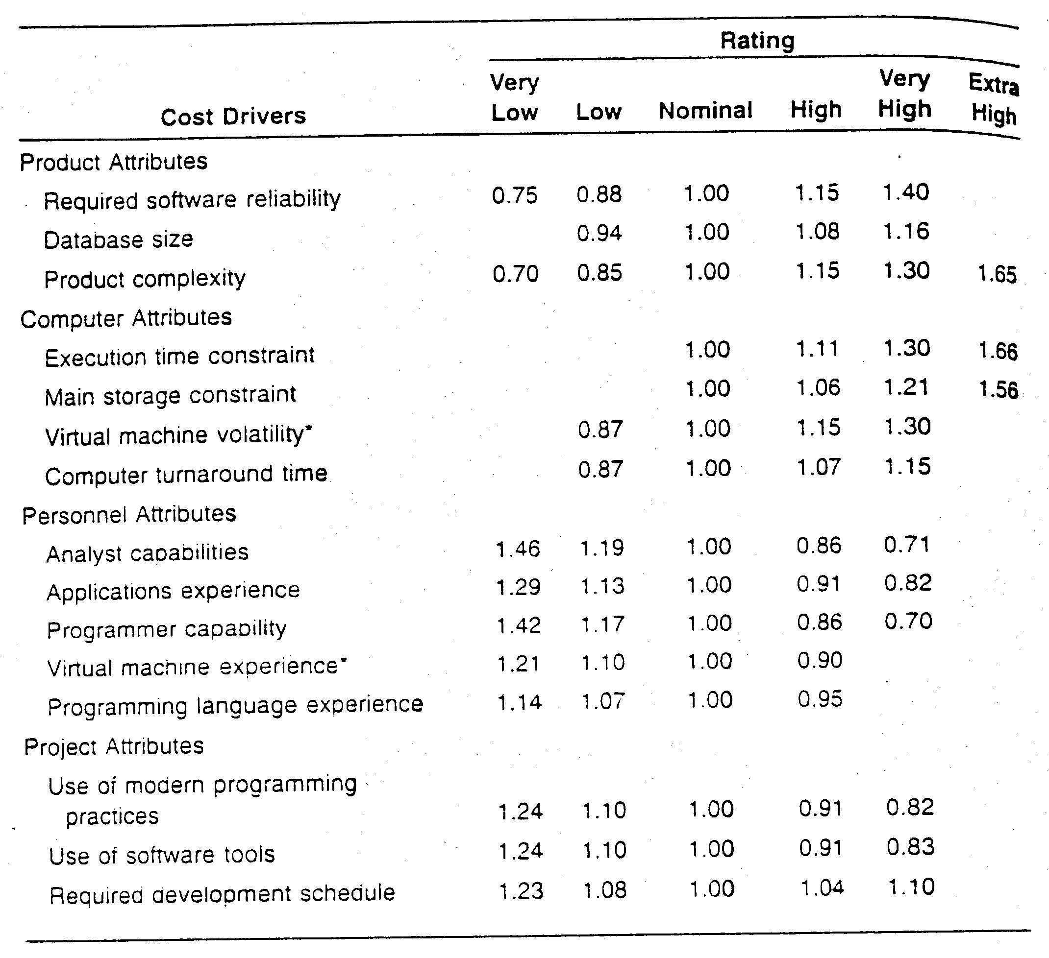

Slide 119
Detailed COCOMO
Includes all characteristics of the intermediate version with an assessment of the cost driver’s impact on each step (analysis, design, etc.) of the software engineering process.
Phase sensitive effort multiplier values.
m(x) based on similar questionnaire.
Effort and duration proportioned in phases as
Ep = µp*E
Dp = βp*D

Slide 120
Dynamic Models
It is helpful to know when effort will be required on a project as well as how much total effort is required.
Most models are time or phase sensitive in their effort computations.

Slide 121
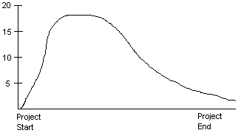
Putnam Model
Based on Rayleigh curve - > skewed, median & mean offset from one another

Slide 122
Putnam Model Details
Rayleigh Curve represents manpower measured in person per unit time as a function of time
M(t) = dy/dt = 2Kate^{-at2} Equation represents manpower utilization rate per unit time.
Integrating the equation on interval [0,t] we obtain Y(t) = K(1- e^{-at2}) which is cumulative manpower used up to time t
Y(0) = 0 and Y(infinity) = K
The relationship between the peak time td and a can be found by double differentiating Y(t) and equating to 0 which gives td² = 1/2a

Slide 123
Putnam Equations
Substituting t = td in Y(t) we get
Y(t) = 0.3945 * K
K = area under curve measured in programmer year.
D = K / td² Difficulty

Slide 124
Risk Management

Slide 125
What is Risk?
Risks are potential problems that may affect successful completion of a software project.
Risks involve uncertainty and potential losses.
A risk is a probability that some adverse circumstance will occur
Project risks affect schedule or resources;
Product risks affect the quality or performance of the software being developed;
Business risks affect the organisation developing or procuring the software.

Slide 126
Software Risks

Slide 127
Risks and Risk Types

Slide 128
Other ways of classifying Risks
Software Project Management risk are as
Project risks affect schedule or resources
Product risks affect the quality or performance of the software being developed
Business risks affect the organisation developing or procuring the software
Also
Internal (can be controlled by the PM)
External (outside the scope of the PM)

Slide 129
Risk Breakdown Structure (RBS)
Risk
Engineering
Risk
Analysis
Risk
Management
Risk
Identification
Risk
Estimation
Risk
Evaluation
Risk
Planning
Risk
Control
Risk
Monitoring
Risk
Directing
Risk
Staffing

Slide 130
Risk Management
Risk management is concerned with identifying risks and drawing up plans to minimise their effect on a project.
Risk analysis and management are intended to help a software team understand and manage uncertainty during the development process.

Slide 131
The Risk Management Process
Composed of four steps:
Risk Management Planning
Risk Identification
Risk Assessment
Qualitative Risk Assessment
Quantitative Risk Assessment
Risk Response Planning
Risk Monitoring and Control

Slide 132
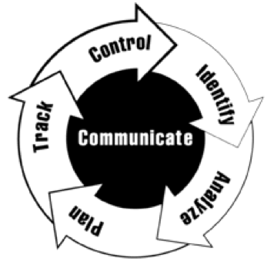
Risk Management Process

Slide 133
The Risk Management Process
Risk identification
Identify project, product and business risks;
Risk analysis
Assess the likelihood and consequences of these risks;
Risk planning
Draw up plans to avoid or minimise the effects of the risk;
Risk monitoring
Monitor the risks throughout the project;

Slide 134
The Risk Management Process

Slide 135
Risk Identification
Identify risks and for each risk :
Describe the risk
Describe the potential responses (counter measures)
Risk category
Other characteristics
Probability
When it can occur
Frequency
Consequences

Slide 136
Risk analysis
Assess probability and seriousness of each risk.
Probability may be very low, low, moderate, high or very high.
Risk effects might be catastrophic (disastrous), serious, tolerable or insignificant.

Slide 137
Risk Analysis (i)

Slide 138
Risk Analysis (ii)

Slide 139
Quantitative Risk Analysis
Similar as qualitative:
Define probability and impact (in a sense which depends on the techniques; how depends on the domain)
Use techniques to numerically assess risks and to visualize data
Highlight significant risks

Slide 140
Risk Assessment
Goal:
being able to prioritize risks according to their impact and likeness on the project
Making explicit the information necessary to define the risk management strategies (risk management planning)

Slide 141
Techniques
Two techniques:
Qualitative risk analysis
Simpler
Can be used when no precise information about probabilities of risk is available
Quantitative risk analysis
More systematic
Suitable for mathematical analysis
Provide figures on the (economical) impact of risks

Slide 142
Quantitative Risk Assessment
Approach: Expected monetary value (EMV) analysis. It computes the expected monetary outcome (according to different statistical criteria) of a decision/risk
Technique: Decision tree analysis. Technique that helps solving the EMV analysis.
Approach: Modeling. Provide a model of the project.
Technique: Sensitivity analysis. Helps determining which risks have the most impact by examining one variable at a time. (Tornado diagrams)
Technique: simulation, monte-carlo technique.

Slide 143
EMV
Decision D has probability pj of generating gain gj (j = 1..N, SUM(pj) = 1)
Expected Monetary Value associated to D is
EMV(D) = SUMj(pj*gj)
Take decision with maximum EMV

Slide 144
Decision Trees
A way of computing EMV
It graphically represents all the possible outcomes in a tree
Costs are associated to leaves (and propagate to nodes)
Probability are associated to labels

Slide 145
Modeling
Define a model for the decision/project (some formula describing how inputs are transformed into outputs).
“Play” with the formula to understand the main factors (sensitivity analysis) or to get a global value.

Slide 146
Qualitative Risk Analysis
A three-step process
Define probability, impact, and score
Organize risk
Highlight significant risks

Slide 147
Qualitative Risk Assessment
Define classes of probabilities and classes of impact
Example
Probability: Very low, low, moderate, high, very high
Impact: negligible, low, moderate, severe, catastrophic
Risk Score: low, medium, high

Slide 148
Qualitative Risk Assessment
… or numeric:
Risk Score = P x I
Very Low | 0.1 | 1
Low | 0.3 | 2
Moderata | 0.5 | 3
High | 0.7 | 4
Very High | 0.9 | 5
Negligible | 0.1 | 1
Low | 0.3 | 2
Moderate | 0.5 | 3
Severe | 0.7 | 4
Catastrophic | 0.9 | 5

Slide 149
Risk Matrix
 | Negligible | Low | Moderate | Severe | Catastrophic
Very High | R1 |  |  |  | R5
High |  |  | R2 | R6, R7, R8
Moderate |  | R3
Low |  |  |  | R4
Very Low |  | R9, R10

Slide 150
Risk Matrix
 | Negligible | Low | Moderate | Severe | Catastrophic
Very High | R1 |  |  |  | R5
High |  |  | R2 | R6, R7, R8
Moderate |  | R3
Low |  |  |  | R4
Very Low |  | R9, R10

Slide 151
Risk Matrix
 | Negligible | Low | Moderate | Severe | Catastrophic
Very High | R1 |  |  |  | R5
High |  |  | R2 | R6, R7, R8
Moderate |  | R3
Low |  |  |  | R4
Very Low |  | R9, R10

Slide 152
Risk Planning
Consider each risk and develop a strategy to manage that risk.
Avoidance strategies
The probability that the risk will arise is reduced;
Minimisation strategies
The impact of the risk on the project or product will be reduced;
Contingency plans
If the risk arises, contingency plans are plans to deal with that risk;

Slide 153
Risk Management Strategies (i)

Slide 154
Risk Management Strategies (ii)

Slide 155
Strategies: Menaces
Avoid.
Change the plan to eliminate the threat (increase time, relax objectives, take corrective actions - increase time to do requirements)
Transfer.
Shift the negative outcome to a third party. It transfers responsibility, it does not eliminate the risk (insurance, contracts to transfer liability… they require to pay you a price)
Mitigate
Reduce probability or impact (often better than trying and repair the damage; prototyping)

Slide 156
Strategies: Opportunities
Exploit
Eliminate uncertainty related to the occurrence of the opportunity (e.g. assign more talented people, provide better quality)
Share
Allocate responsibility of exploitation to a third party (joint-ventures, partnerships, …)
Enhance
Modify the size of an opportunity by increasing probability and/or positive impact

Slide 157
Risk Monitoring
Assess each identified risks regularly to decide whether or not it is becoming less or more probable.
Also assess whether the effects of the risk have changed.
Each key risk should be discussed at management progress meetings.

Slide 158
Risk Monitoring and Control
Process
Analyse deviations
Identify causes
Evaluate corrective actions
Modify current plan
Mind:
Planned risks dealt with as above
Unplanned risks require the full process!

Slide 159
Make Buy Decision
It may be more cost effective to acquire a piece of software rather than develop it.
Decision tree analysis provides a systematic way to sort through the make-buy decision.
As a rule outsourcing software development requires more skillful management than does in-house development of the same product.

Slide 160
Decision Process
Develop specifications.
Estimate internal cost & delivery.
Select 3 or 4 candidate packages.
Select reasonable components.
Build a cost-benefit comparison matrix (key function performance) or use conduct benchmark tests of candidate software
Evaluate each software package or component based on history with the product or vendor.
Contact other users.

Slide 161
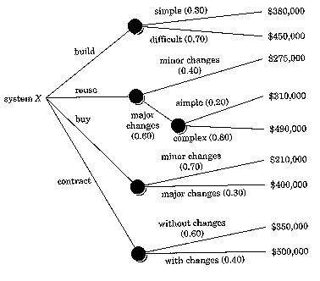
Decision Tree

Slide 162
Example
Condition Stubs | Condition Rules
N not numeric | T | F | F | F
N <= 1 | - | T | F | F
N legal | - | - | T | F
N prime | - | - | T | F
Action Stubs | Action Rules
Print “N prime” |  |  | X
Print “N not prime” |  |  |  | X
Print error message | X | X
Print “Good bye” |  |  | X | X
Input new value for N | X | X
Stop |  |  | X | X

