Slide 1
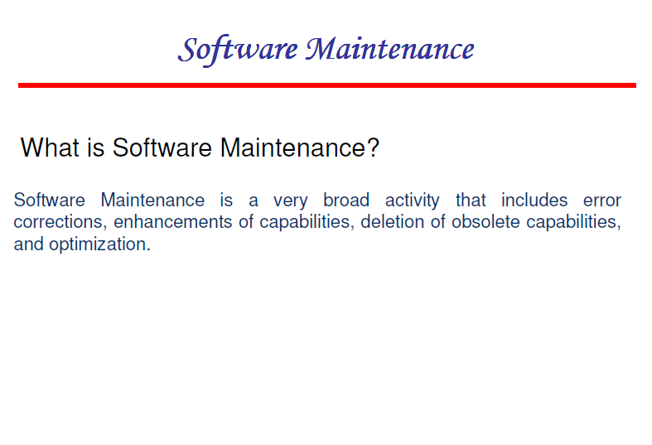

Slide 2
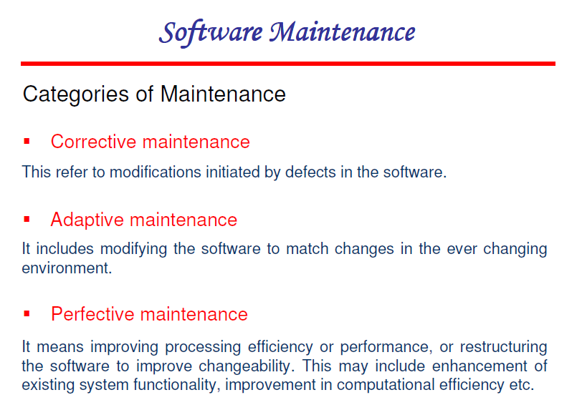

Slide 3
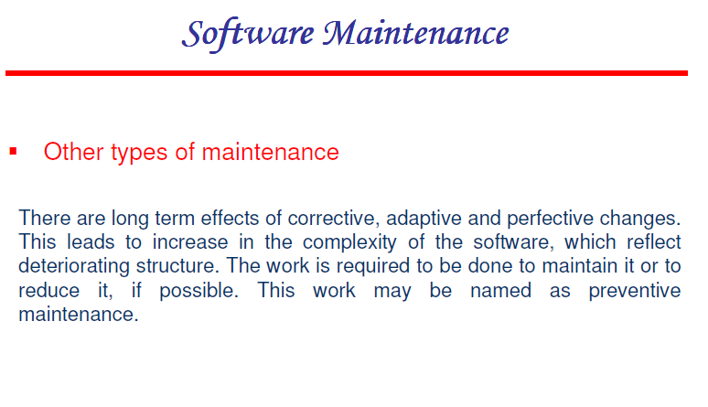

Slide 4
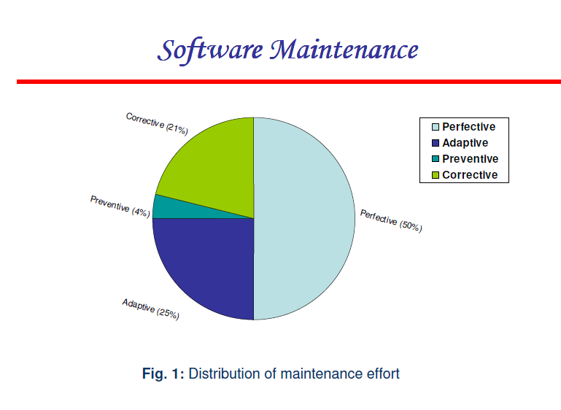

Slide 5
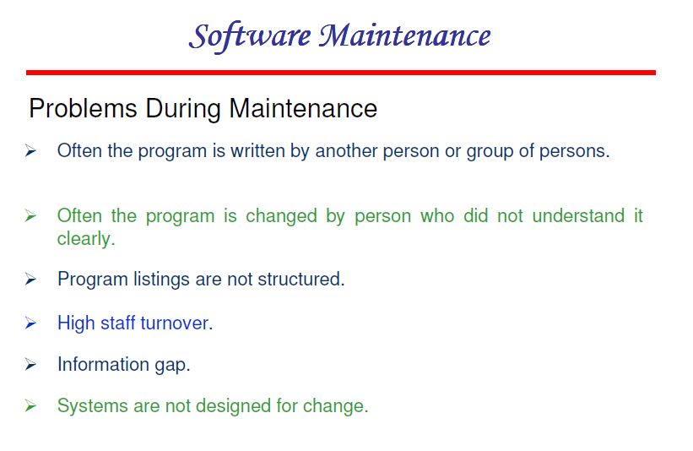

Slide 6
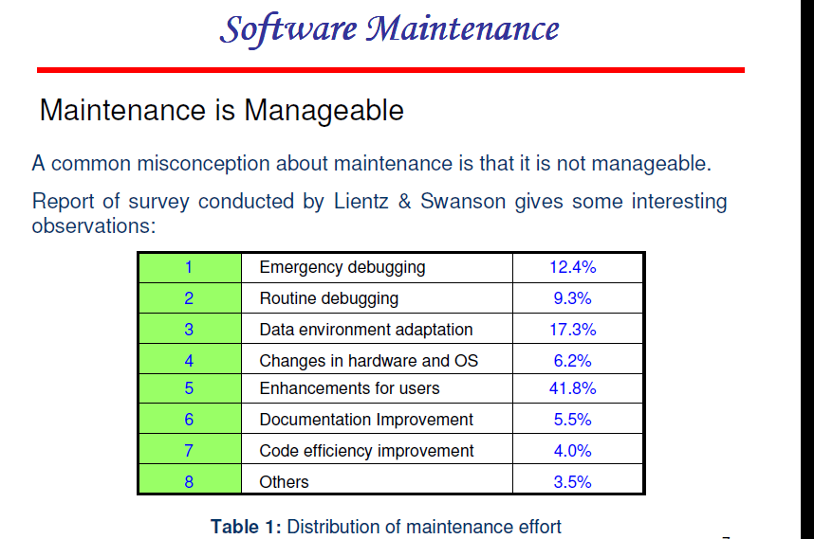

Slide 7
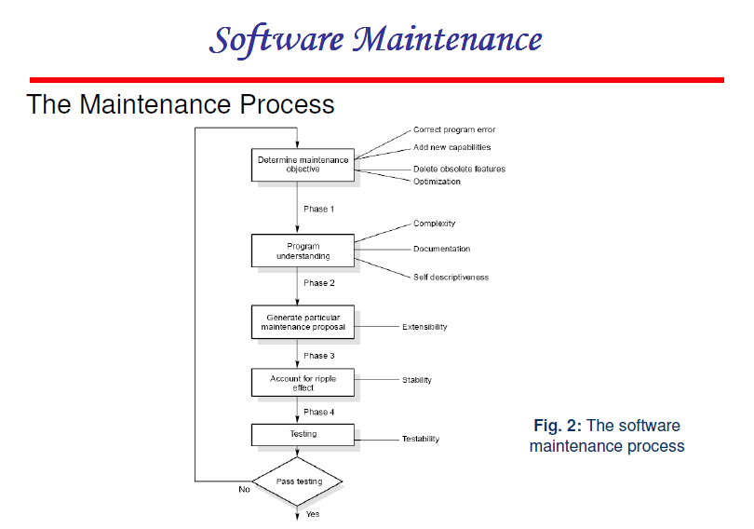

Slide 8
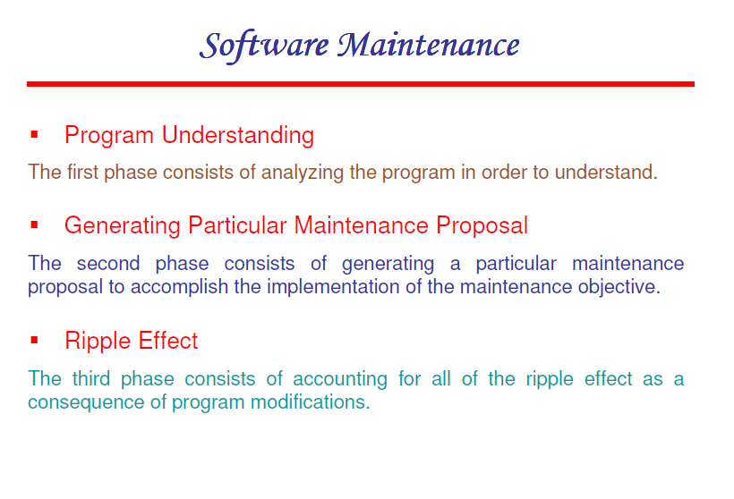

Slide 9
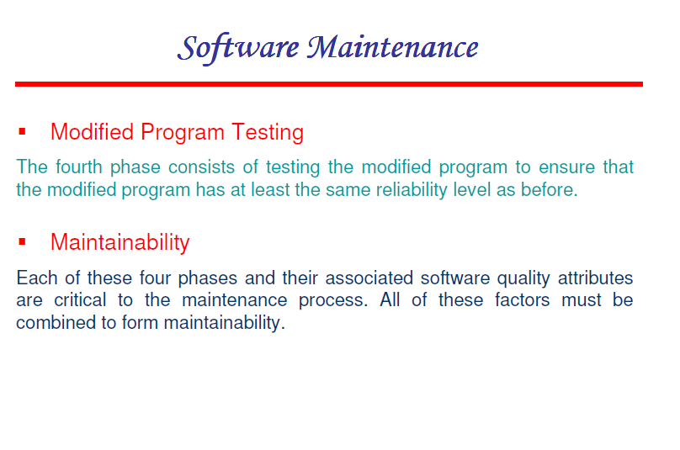

Slide 10
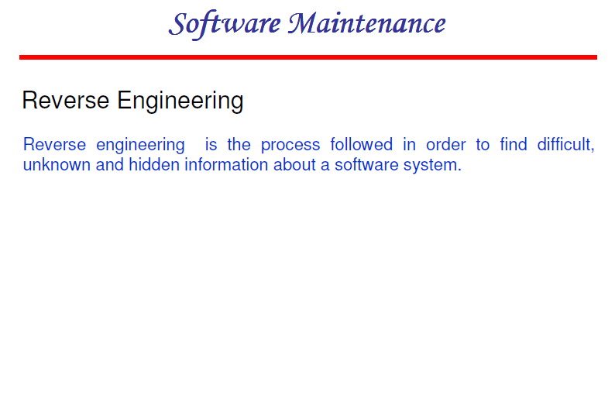

Slide 11
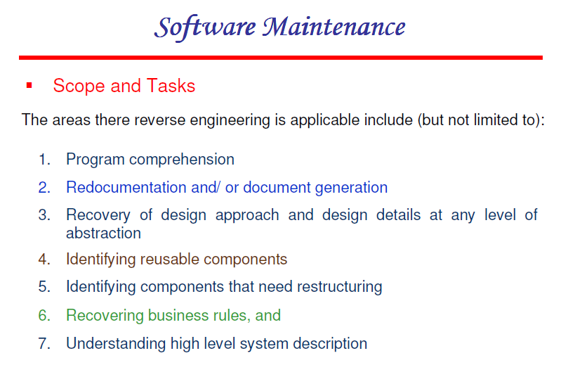

Slide 12
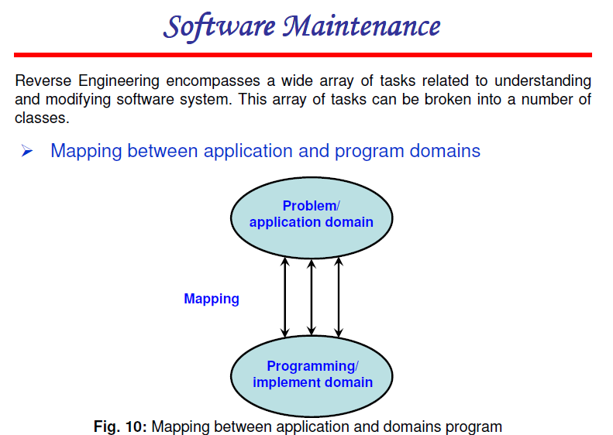

Slide 13
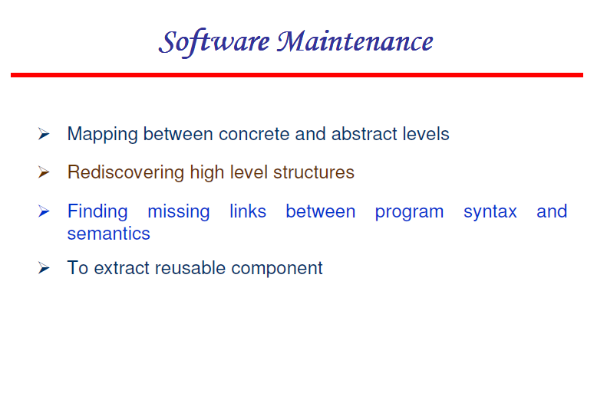

Slide 14
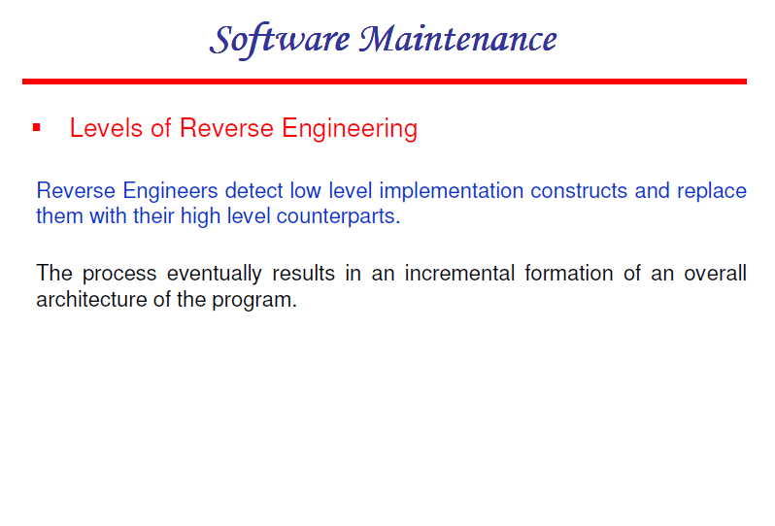

Slide 15
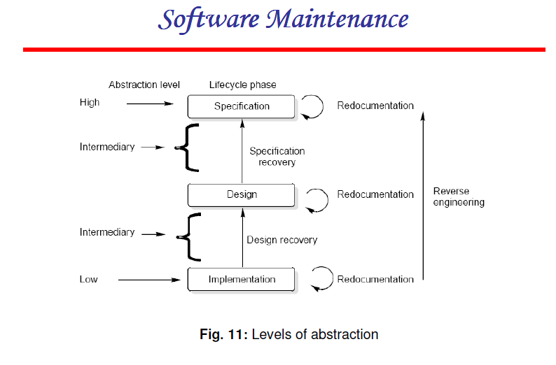

Slide 16
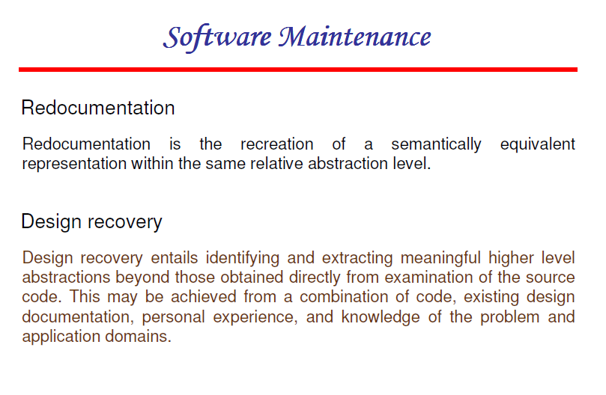

Slide 17
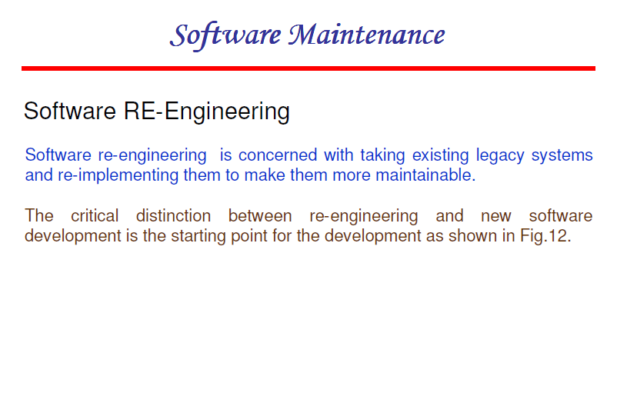

Slide 18
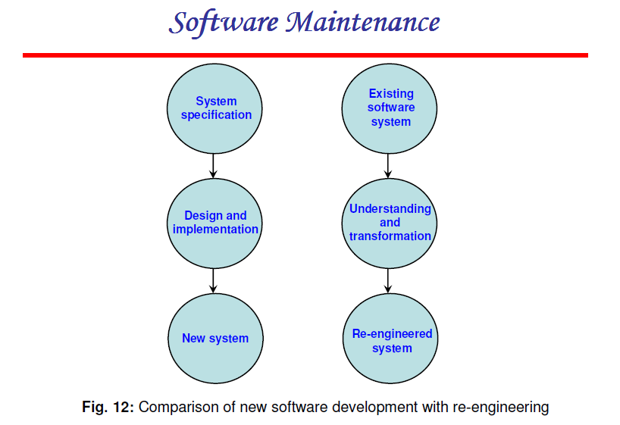

Slide 19
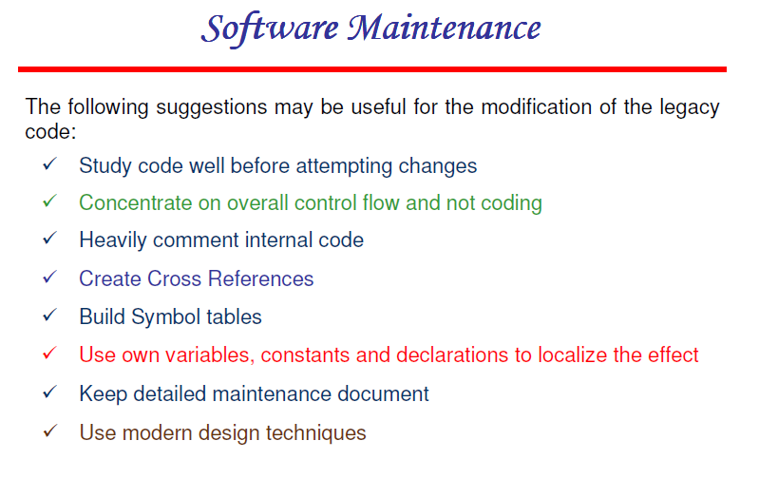

Slide 20
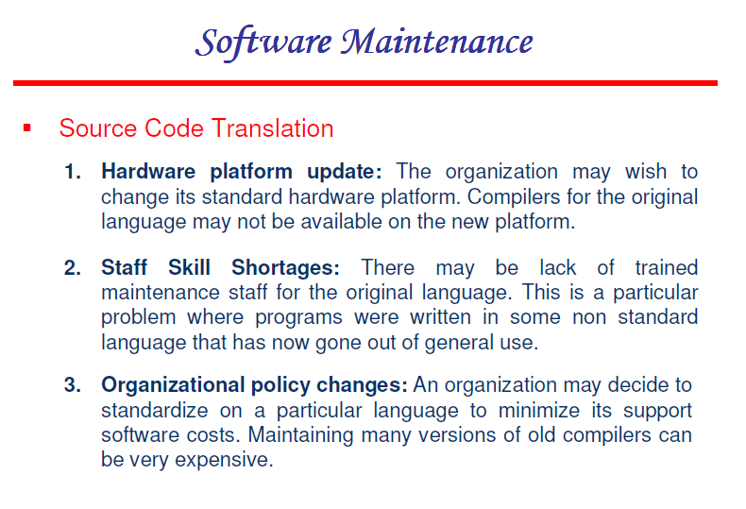

Slide 21
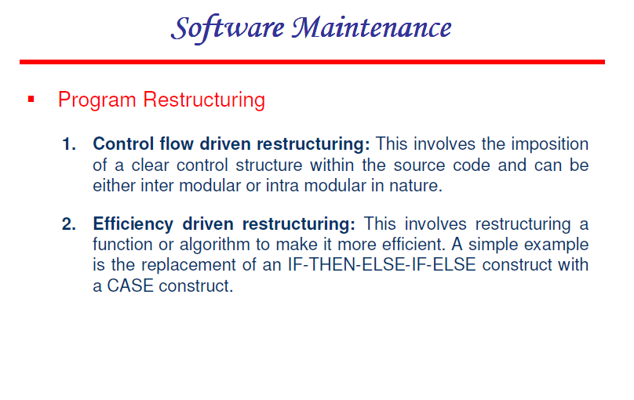

Slide 22
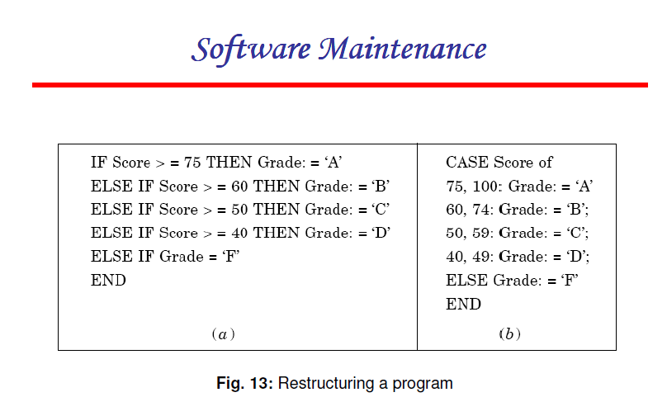

Slide 23
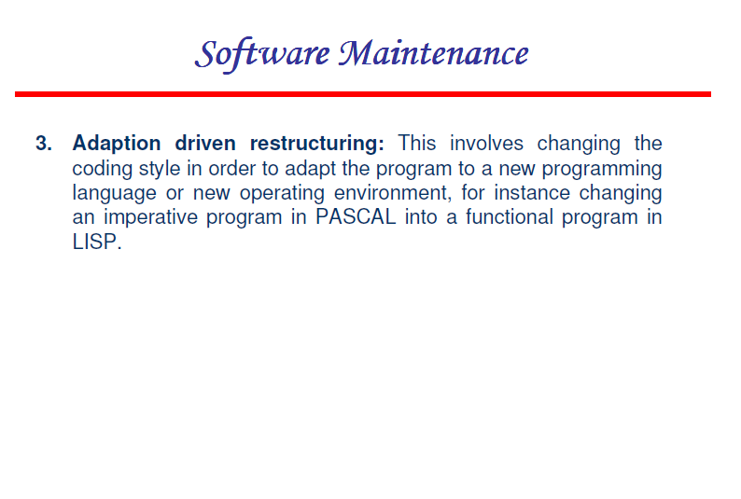

Slide 24
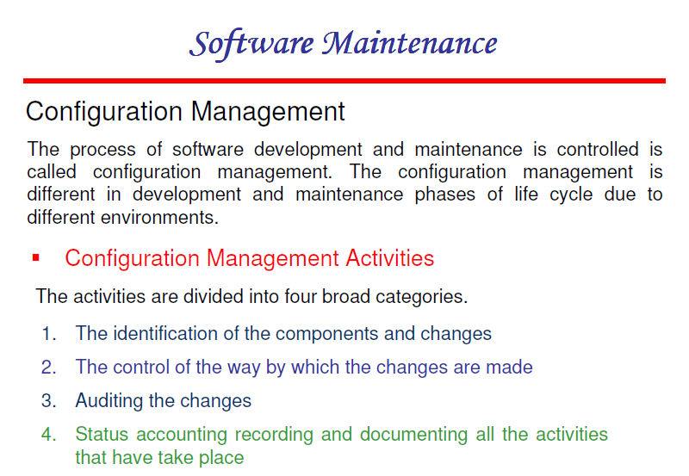

Slide 25
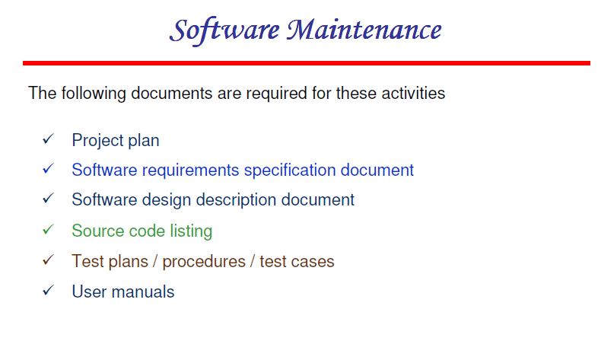

Slide 26
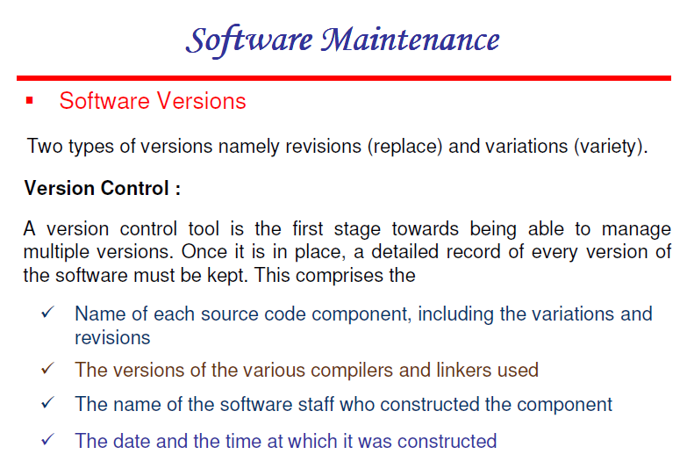

Slide 27
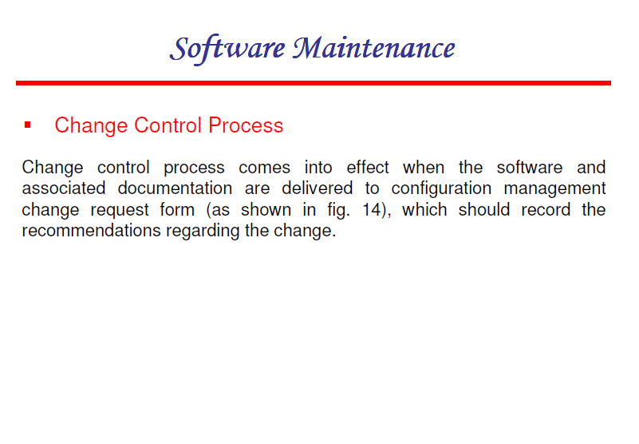

Slide 28
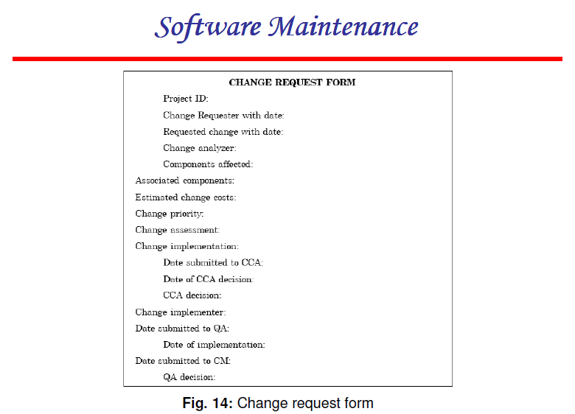

Slide 29
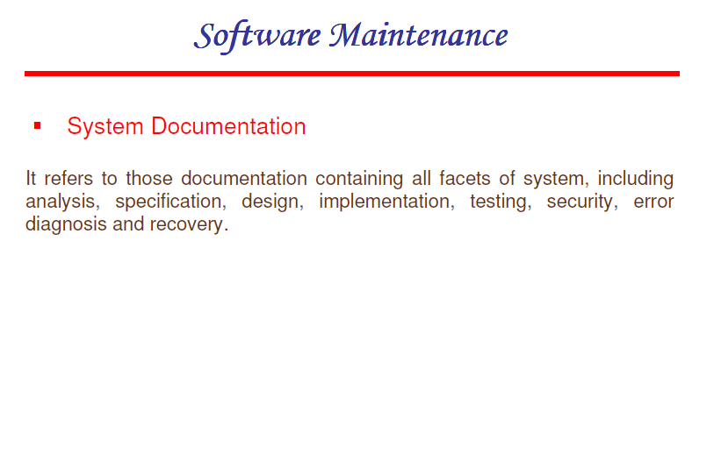

Slide 30
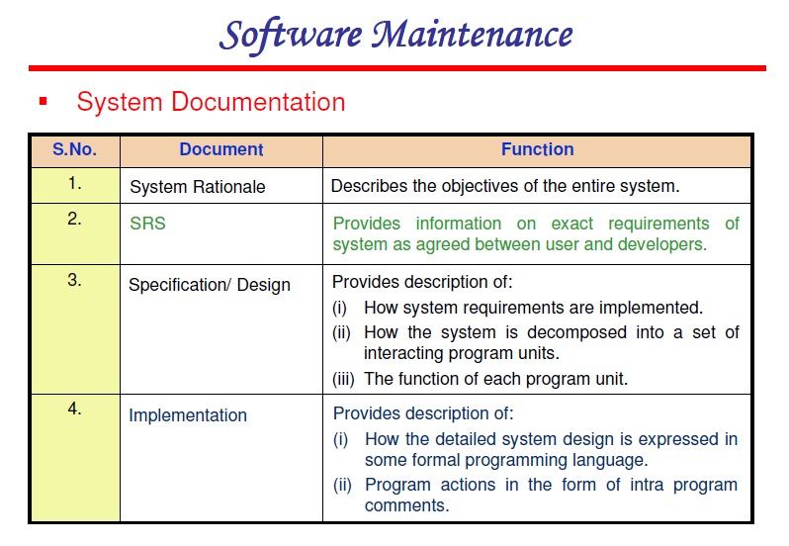

Slide 31
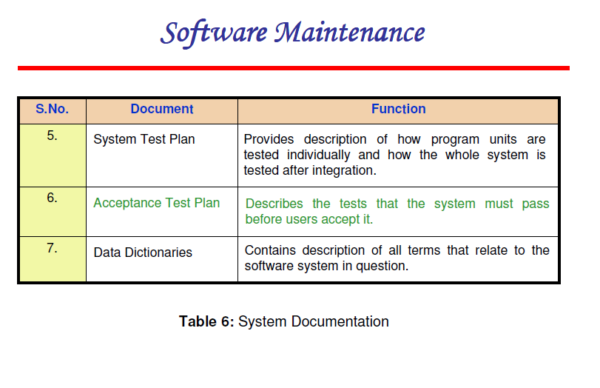

Slide 32
CASE Tools
Upper CASE
requirements
specification
planning
design
Lower CASE
implementation
integration
maintenance

Slide 33
CASE Building Blocks - 1
CASE tools Integration framework
specialized programs allowing CASE tools to communicate with one another
Portability services
Ability of CASE tools to migrate across different operating systems and hardware platforms without significant adaptive maintenance
Operating system
database and object management services
Hardware platform
Environmental architecture
hardware and system support

Slide 34
CASE Tool Taxonomy - 1
Business process engineering tools
represent business data objects, their relationships, and flow of the data objects between company business areas
Process modeling and management tools
represent key elements of processes and provide links to other tools that provide support to defined process activities
Project planning tools
used for cost and effort estimation, and project scheduling

Slide 35
CASE Tool Taxonomy - 2
Risk analysis tools
help project managers build risk tables by providing detailed guidance in the identification and analysis of risks
Requirements tracing tools
provide systematic database-like approach to tracking requirement status beginning with specification

Slide 36
CASE Tool Taxonomy - 3
Metrics and management tools
management oriented tools capture project specific metrics that provide an overall indication of productivity or quality. Determine metrics that provide greater insight into the quality of design or code
Documentation tools
provide opportunities for improved productivity by reducing the amount of time needed to produce work products

Slide 37
CASE Tool Taxonomy - 4
System software tools
network system software, object management services, distributed component support, and communications software
Quality assurance tools
metrics tools that audit source code to determine compliance with language standards
tools that extract metrics to project the quality of software being built

Slide 38
CASE Tool Taxonomy - 5
Database management tools
RDMS and OODMS serve as the foundation for the establishment of the CASE repository
Software configuration management tools
uses the CASE repository to assist with all SCM tasks (identification, version control, change control, auditing, status accounting)
Analysis and design tools
enable the software engineer to create analyze and design models of the system to be built, perform consistency checking between models

Slide 39
CASE Tool Taxonomy - 6
Prototyping/Simulation (PRO/SIM) tools
prototyping and simulation tools provide software engineers with ability to predict the behavior of real-time systems before they are built and the creation of interface mockups for customer review
Interface design and development tools
toolkits of interface components, often part environment with a GUI to allow rapid prototyping of user interface designs

Slide 40
CASE Tool Taxonomy - 7
Prototyping tools
enable rapid definition of screen layouts, data design, and report generation
Programming tools
compilers, editors, debuggers, OO programming environments, fourth generation languages, graphical programming environments, applications generators, and database query generators
Web development tools
assist with the generation of web page text, graphics, forms, scripts, applets, etc.

Slide 41
CASE Tool Taxonomy - 8
Integration and testing tools
Data acquisition: Get data for testing
Static measurement: Analyze source code without using test cases
Dynamic measurement: Analyze source code during execution
Simulation: Simulate function of hardware and external devices
test management
cross-functional tools

Slide 42
CASE Tool Taxonomy - 9
Static analysis tools
code-based testing tools, specialized testing languages, requirements-based testing tools
Dynamic analysis tools
intrusive tools modify source code by inserting probes to check path coverage, assertions, or execution flow
non-intrusive tools use a separate hardware processor running in parallel with processor containing the program being tested

Slide 43
CASE Tool Taxonomy - 10
Test management tools
coordinate regression testing, compare actual and expected output, conduct batch testing, and serve as generic test drivers
Client/server testing tools
exercise the GUI and network communications requirements for the client and server

Slide 44
CASE Tool Taxonomy - 11
Reengineering tools
reverse engineering to specification tools
generate analysis and design models from source code, where used lists, and other design information
code restructuring and analysis tools
analyze program syntax, generate control flow graph, and automatically generates a structured program
on-line system reengineering tools
used to modify on-line DBMS

Slide 45
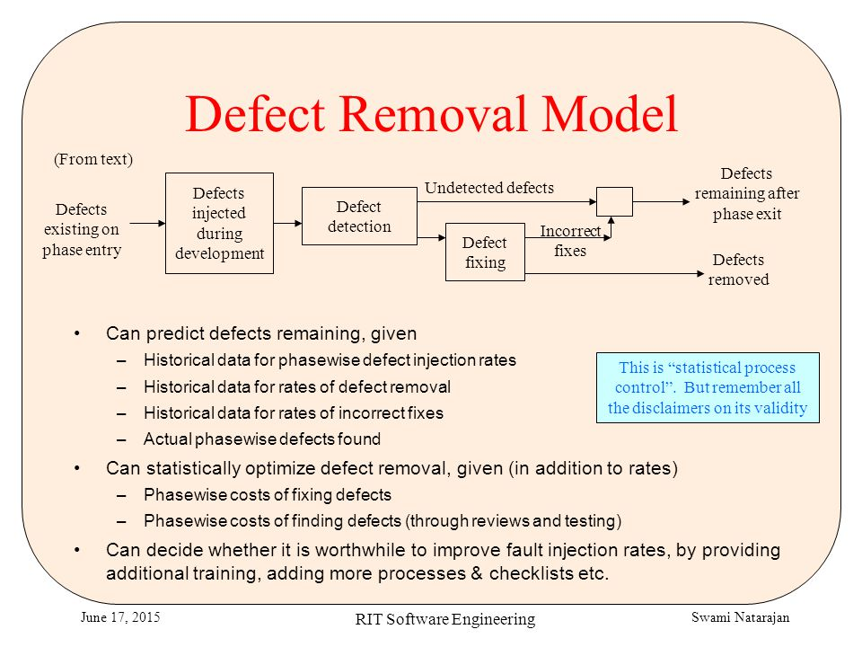

Slide 46
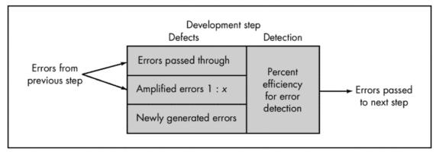
Defect Amplification Model

Slide 47
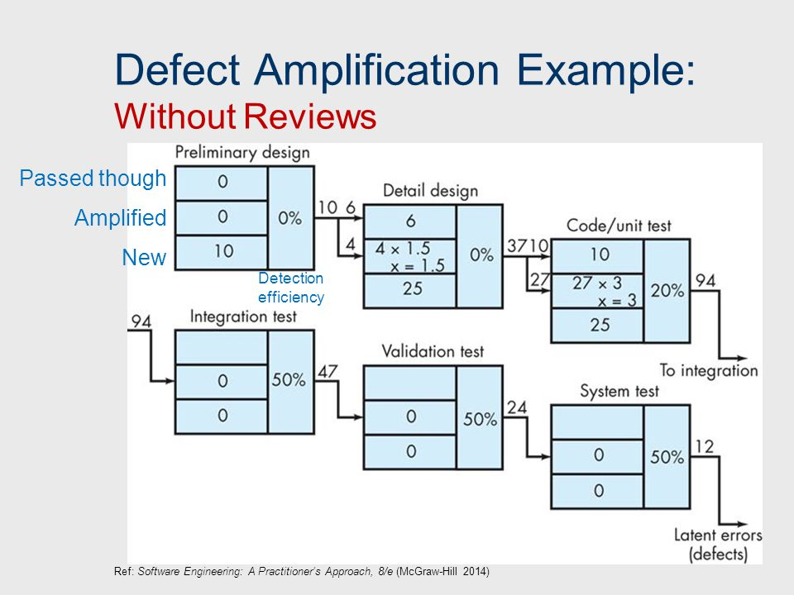

Slide 48
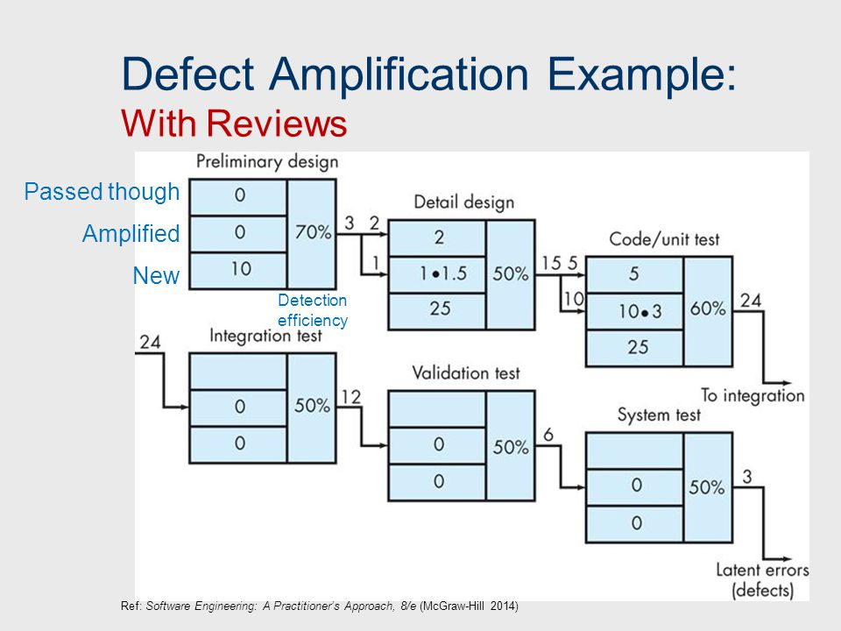

Slide 49
Defect Prevention/ Removal
S/w contains 200K lines
Inspection time = 7053 Hrs.
Defects prevented = 3112
Programmer cost = 40.00 per hr.
Total cost of defect prevention = 7053 x 40.00 = 282120.00
Cost per defect prevention = 282120/3112
= 91.00

Slide 50
Defect Removal
Defect escaped into product = 1 per 1K
Total defects escaped = 200K/1000
= 200
Cost of removal of single defect = 25000
Total defect removal cost = 25000 x 200
= 5000000
Ratio of defect removal to prevention = 18

Slide 51
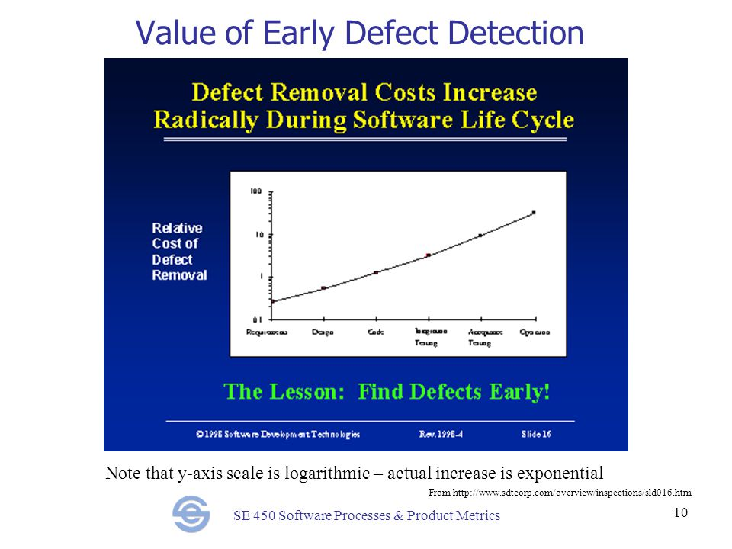

Slide 52
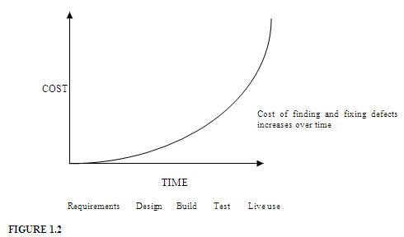
Relative Cost of Defect Removal

Slide 53
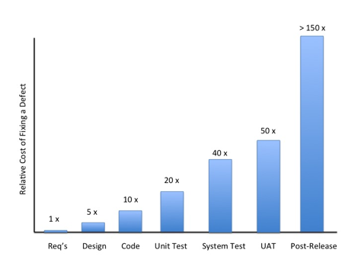
Relative Cost of Defect Removal

Slide 54
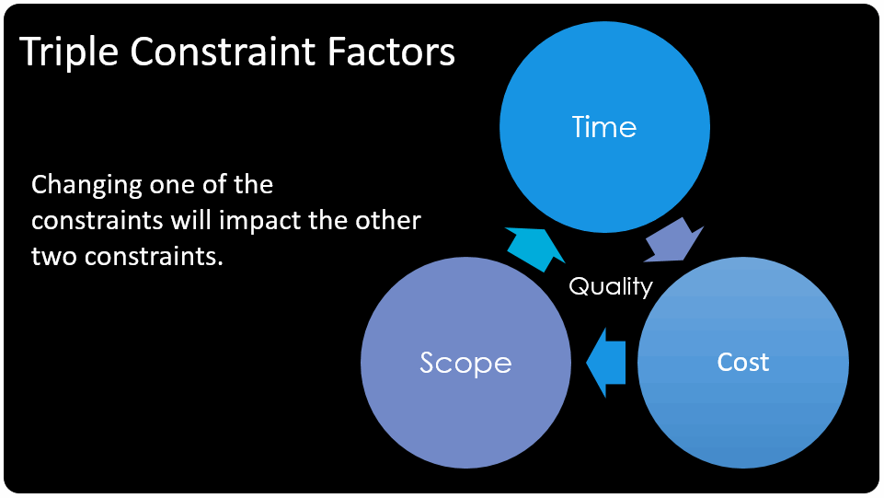

Slide 55
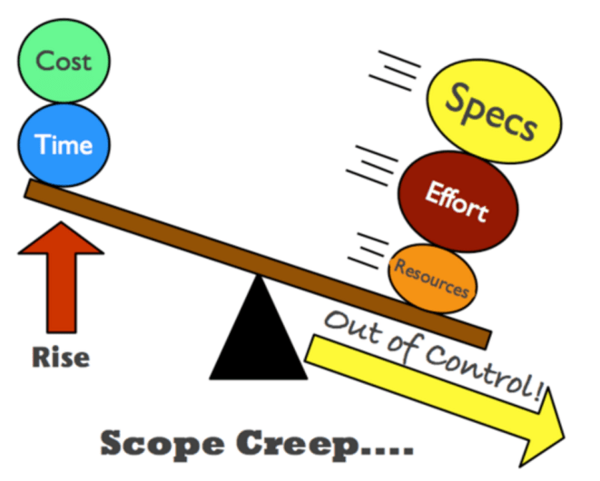
Scope Creep Effect

Slide 56
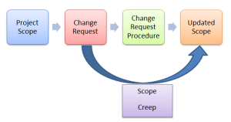
Scope Creep

Slide 57
Scope Creep
After the implementation/programming has started, users and stakeholders make changes.
Each change is easy to describe, so it sounds “small” and the programmers agree to it.
But, later it is found to be very difficult to incorporate the change.
Eventually, the project slows to a crawl.
It’s 90% done – with 90% left to go.
Programmers know that if they had been told from the beginning what to build, they could have built it quickly from the start.

